Slide 1
Civil Rights Movement
Test #9
VUS.14

Slide 2
After Reconstruction – “Jim Crow” laws – Segregation laws
De Jure Segregation – separation of the races by law
De Facto Segregation – separation by custom ex. – housing patterns in cities
1950s: Movement to end De Jure segregation

Slide 3
NAACP
NAACP—National Association for the Advancement of Colored People – 1st major civil rights organization
1896 - Plessy v. Ferguson – Supreme Court established “Separate but equal”

Slide 4
Brown v . Board of Education of Topeka Kansas
1954: Brown v. Board of Education challenged segregation in public schools
NAACP attorney – Thurgood Marshall
Separate educational facilities were NOT equal
School segregation - unconstitutional

Slide 5
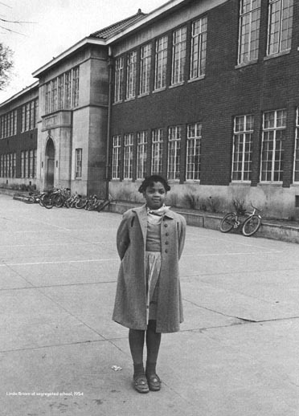
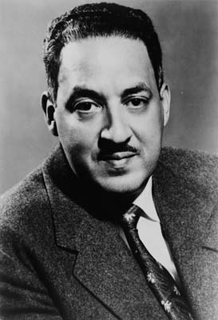
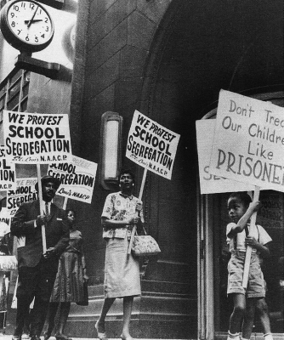
Linda Brown
Thurgood Marshall

Slide 6
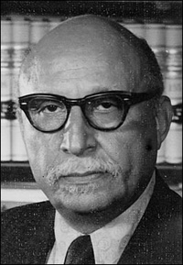
In Virginia, Prince Edward county
Virginia NAACP – Oliver Hill
Massive Resistance – States refusing to integrate public schools
Oliver Hill

Slide 7
Crisis at Central High
1957 – Little Rock, Arkansas – 9 African Americans students attend Central High School with 2000 white students
1st test of Brown decision
Eisenhower has to send Federal troops
1958 – Little Rock schools closed –
Showed desegregation of schools would be difficult.

Slide 8
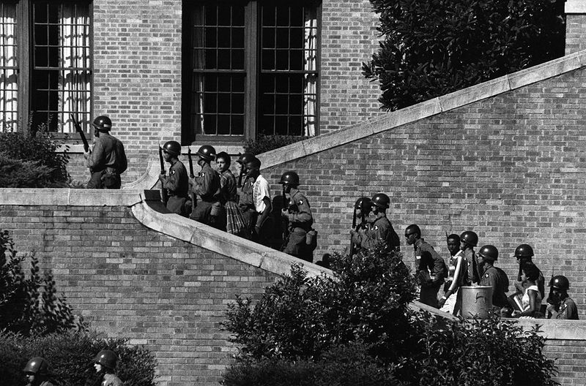
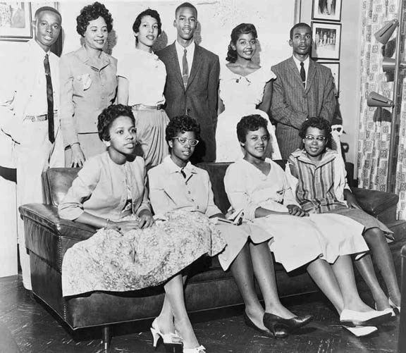
Federal troops escorting the Little Rock 9
The Little Rock Nine

Slide 9
Federal troops escorting the Little Rock 9

Slide 10
Virginia’s Response
Massive resistance
Private schools and academies - created for white students (Prince Edward Academy, now Fuqua)
“White Flight”: whites left cities , move to the suburbs

Slide 11
Montgomery Bus Boycotts
Rosa Parks—violated city law - refused to give up her seat on the bus
Results –
Creation of the Southern Christian Leadership Conference – SCLC – headed by Martin Luther King, Jr. a young Baptist minister.
Organization of a Bus Boycott
Boycott ended - Supreme Court ruled segregation on buses was unconstitutional

Slide 12
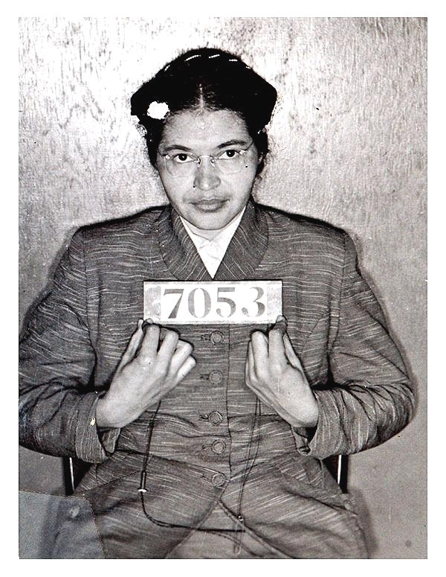
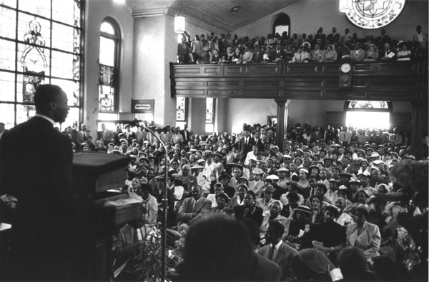
Dr. King speaking to his congregation about the bus boycott
Rosa Parks

Slide 13
Dr. Martin Luther King, Jr.
“Nonviolent resistance” – ideas of Mohandas Gandhi of India
Used marches and boycotts
SCLC: Southern Christian Leadership Conference
coordinated nonviolent resistance to segregation in schools, stores, busses, and hotels

Slide 14
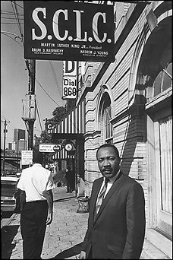
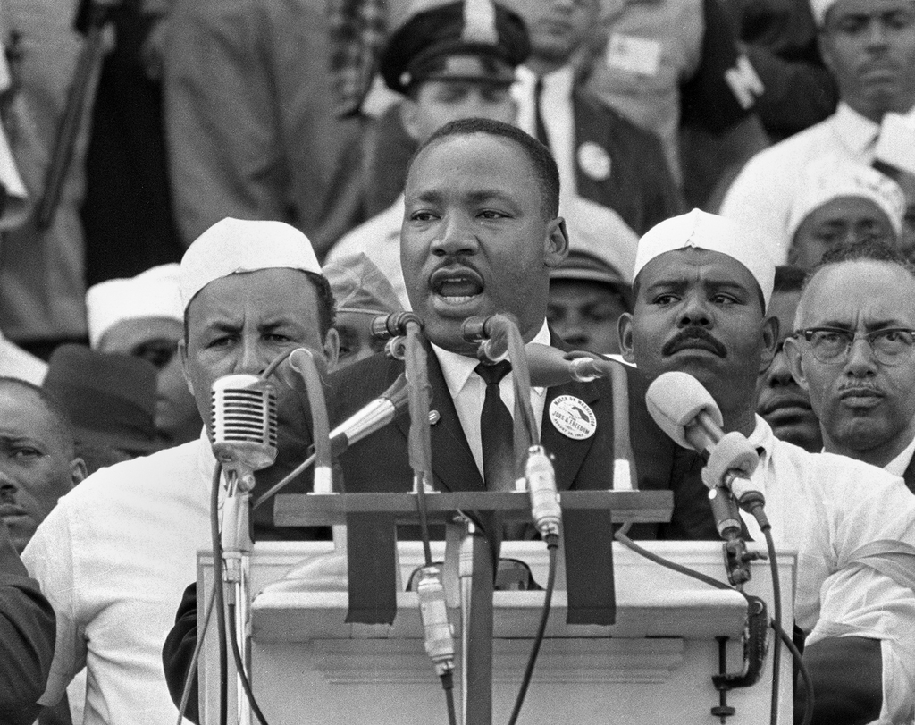
Dr. Martin Luther King, Jr.

Slide 15
SNCC
Student Nonviolent Coordinating Committee
used sit-ins – protest segregated lunch counters
Began voter registration drive in Mississippi

Slide 16
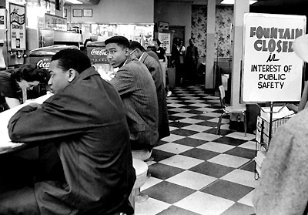
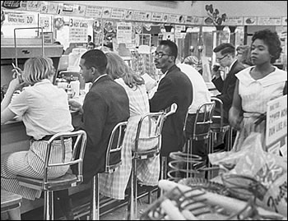
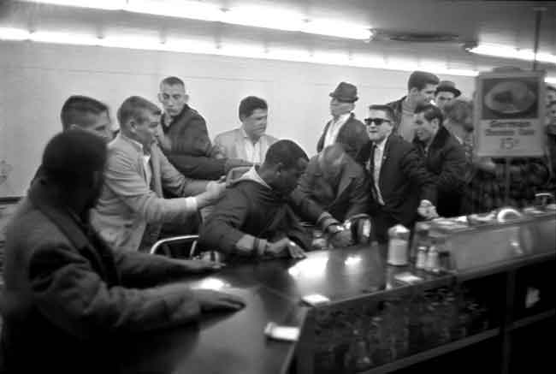
Greensboro Sit-ins

Slide 17
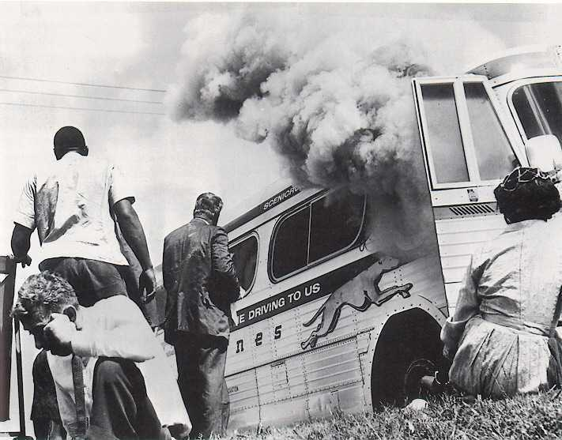
Freedom Rides
Organized by CORE (Congress of Racial Equality)
Tested Federal government power - desegregate bus lines -interstate travel.
Met with violence a bus terminals in the south
Freedom Rides

Slide 18
Letter from Birmingham Jail
attempt to desegregate public facilities
police dogs and fire hoses to break up demonstrations - children involved
Dr. King – arrested, wrote Letter from jail – answered critics - explained his reasons for civil disobedience
Made it known he would continue
Letter Video

Slide 19
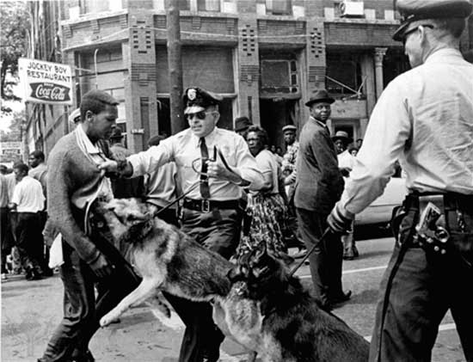
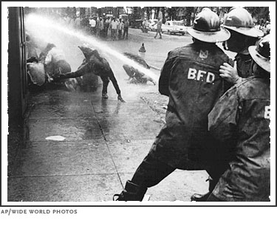

Slide 20
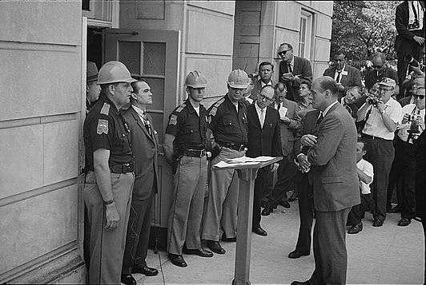
Governor Wallace attempting to block the entrance to the University of Alabama

Slide 21
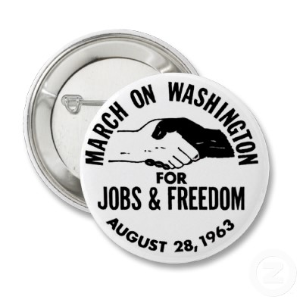
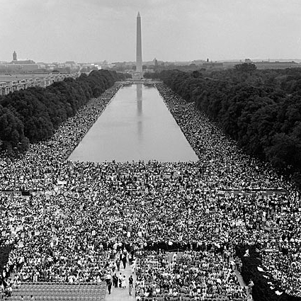
March on Washington
August 28, 1963: massive protest
Dr. King – “I have a dream” speech - Lincoln Memorial
Dr. King's "I have a dream" speech

Slide 22
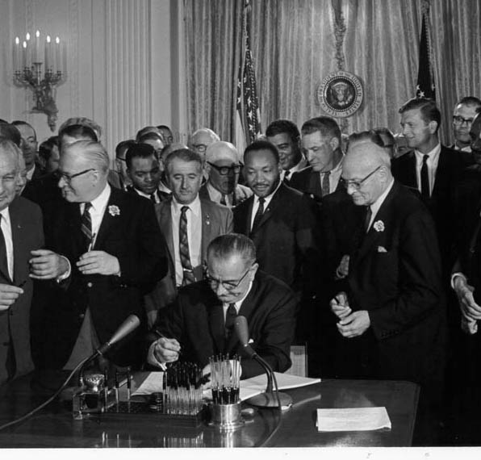
Civil Rights Act of 1964
The act forbade segregation in hotels, motels, restaurants, lunch counters, theaters, and sporting arenas
Increased power of Federal Government
Pres. Johnson signing the Civil Rights Act of 1964

Slide 23
Selma to Montgomery
After Civil Rights Act of 1964
Few African Americans registered to vote
John Lewis—SNCC – marchers met with tear gas
2nd march – protected by troops
Voting Rights Act of 1965 – Law eliminated literacy tests

Slide 24
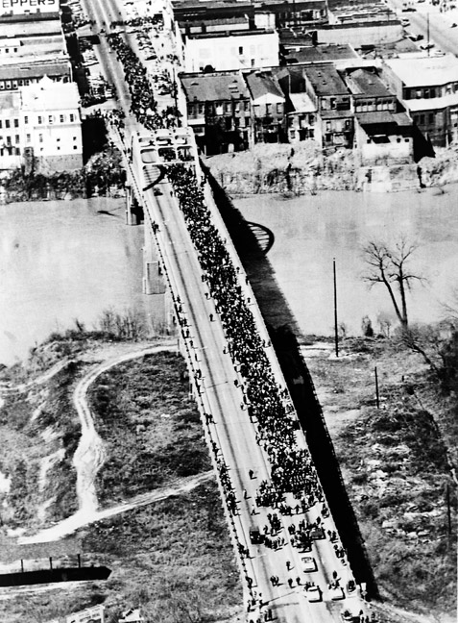
Marchers on the Edmund Pettus Bridge

Slide 25
New Directions
SNCC – Stokely Carmichael “use violence if necessary”
Black Pride –pride in ethnicity
“Black power” – African Americans concentrate on political power
Black Panthers -protect African American communities from police harassment – support use of weapons for self defense and retaliation

Slide 26
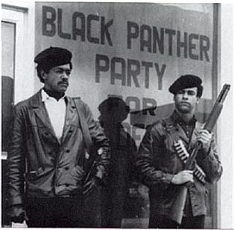
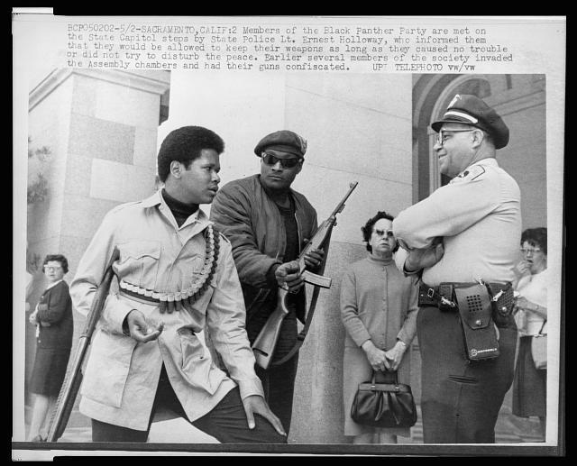
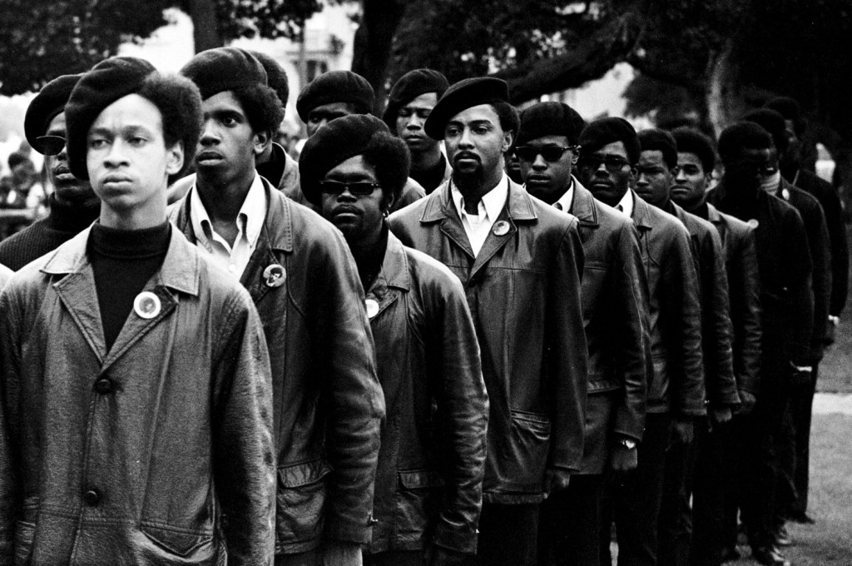

Slide 27
Malcolm X
Follower of Elijah Mohammed – Nation of Islam
separatism – belief that US should be physically divided into white and black Americas.
Critical of MLK,Jr. and JFK, initially
More moderate after visiting Mecca, starts own Mosque
Feb 21, 1965: assassinated

Slide 28
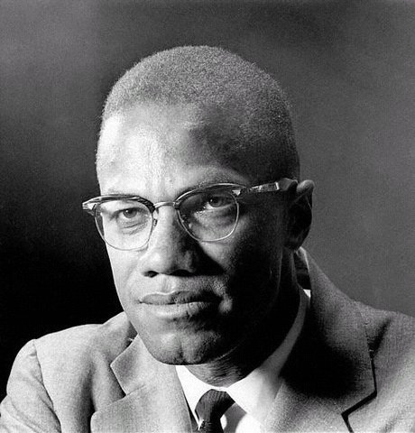
Malcolm X

Slide 29
Watts Riots
1965: Race riot - Watts area of Los Angeles
34 people will be killed,1072 people were injured and 4000 people were arrested
National Guard sent
In 1967, 60 cities report racial riots, many in the North.

Slide 30
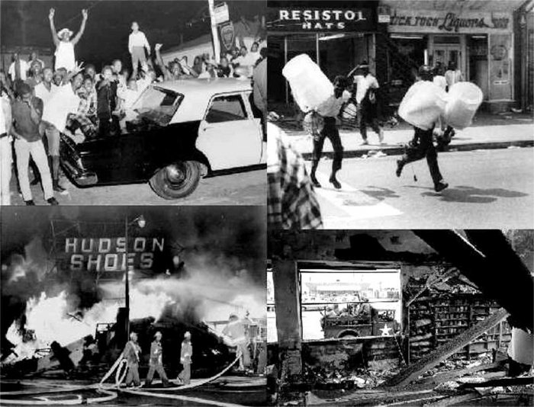

Slide 31
Assassination of Dr. King
Dr. King addressed a rally and delivered his "I've Been to the Mountaintop“ speech
April 4, 1968: assassinated by James Earl Ray

Slide 32
Gerrymandering: drawing voting districts in a manner that favors a particular group
Westberry v. Sanders – must divide voting districts with similar populations – helps limit gerrymandering
24th Amendment - eliminates the poll tax

Slide 33
Affirmative Action
giving preference to minorities and women for past discriminatory practices
Regents of the University of California v. Bakke
1978-Supreme Court – “reverse discrimination”
Alan Bakke – turned down for admission, due to quota system - academic scores higher than some minority qualifiers
Court rules for Bakke
Decision outlawed the quota system but did not find affirmative action unconstitutional.

Slide 34
