Slide 1
World War II
Test #7 Lecture Notes
VUS.11-12

Slide 2
Axis Powers
1.) Italy
Mussolini - Fascist Party
2.) Germany
Hitler - Nazi Party
3.) Japan
Emperor Hirohito and General Tojo

Slide 3
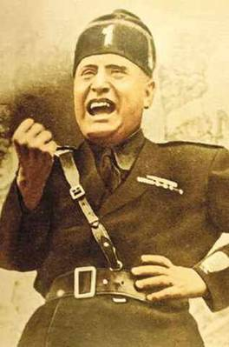
1.) Fascism in Italy
1919: Benito Mussolini created a new political party in Italy—Fascist Party
Glorified the state, a strong single ruler, and totalitarian government
Recreate the glory of ancient Rome
“Il Duce”—The Leader
1935- Invades Ethiopia

Slide 4
2.) Germany
The Versailles Treaty put heavy restrictions on Germany
Limiting Germany’s military
Rhineland - demilitarized – occupied by France
Reparations: war payments to Britain and France
Inflation: To pay off the war debt, the German government began printing more money—lost value
1923: 1 trillion Marks=$1 (US)

Slide 5
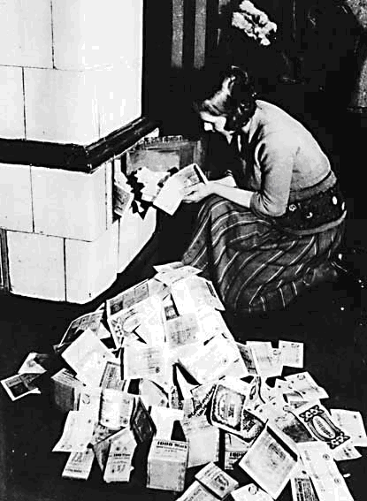

Slide 6
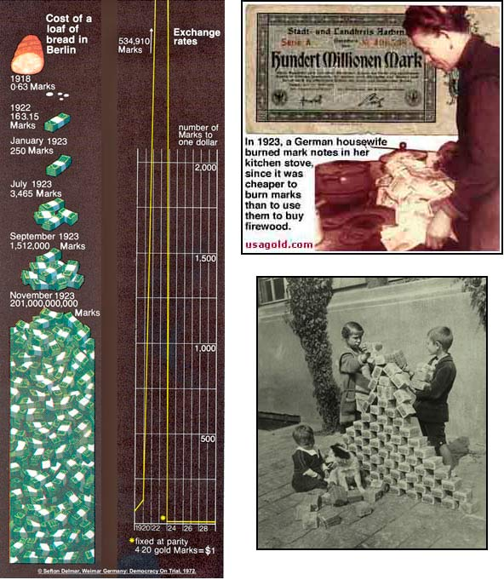

Slide 7
Nazism & Hitler:
National Socialist Workers’ Party—Nazi Party
Adolf Hitler became a member of the Nazi Party
Had applied to Austrian art school but failed the entrance exams
Served in the military during WWI— wounded in the war
Formed private army—Brownshirts
1923: Hitler was arrested in an attempt to overthrow government
Wrote Mein Kampf—”My Struggle” - outlined Hitler’s views on Germany and its future
Blamed Jews and Communists for Germany’s defeat in WWI

Slide 8
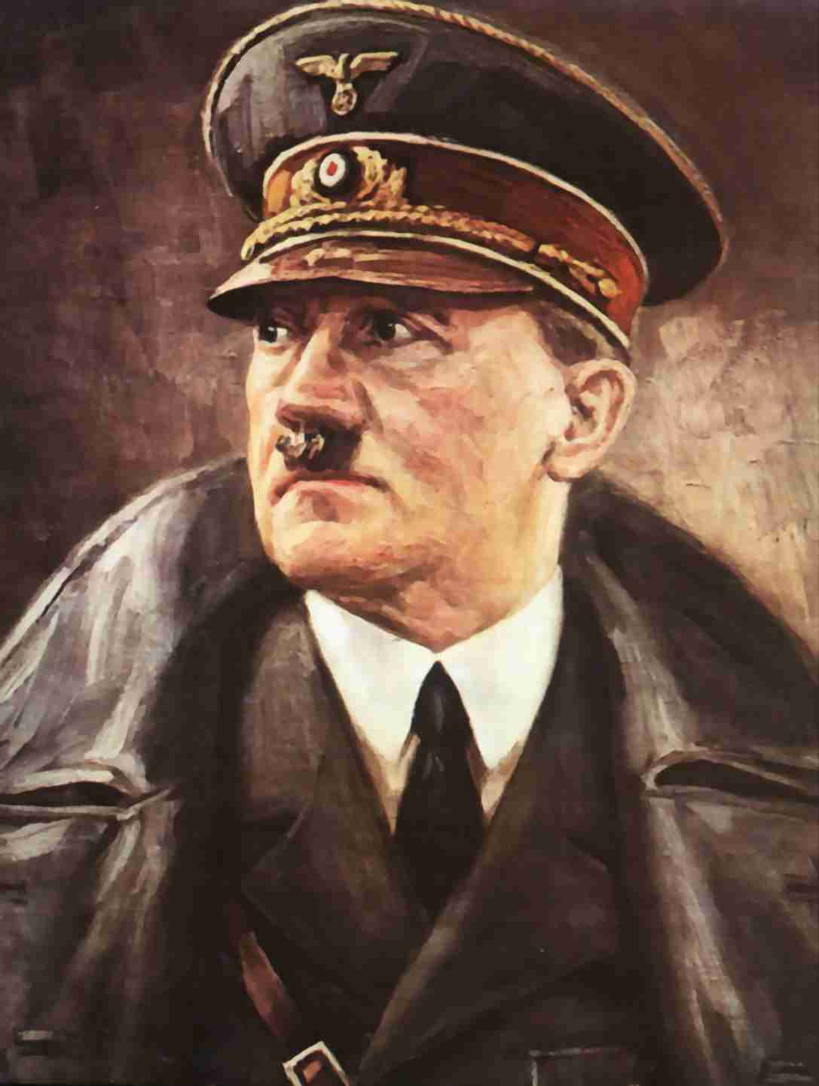
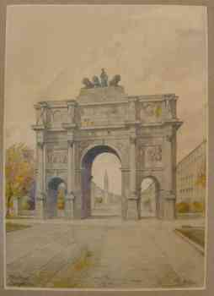
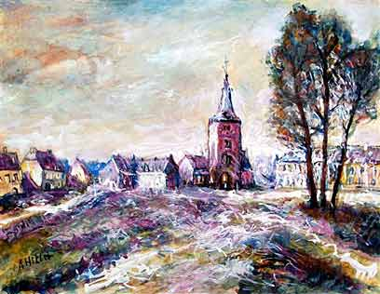
Hitler’s Art
Adolf Hitler

Slide 9
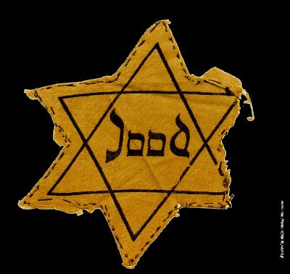
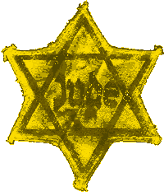
Hitler’s rise to power
1) hatred of the Versailles Treaty
2) hatred of the Jews (anti-semitism)
Hitler Speech Video
Hitler and the Jews:
1935: Nuremberg Laws
Restricted Jews’ freedoms
No citizenship Jews were forbidden to hold public office
Forced to wear yellow badges signifying their being Jewish
Kristallnacht: “the night of broken glass”
Jewish business were vandalized

Slide 10
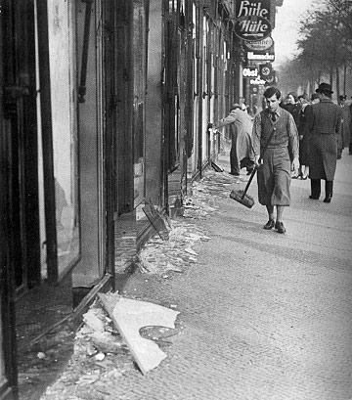
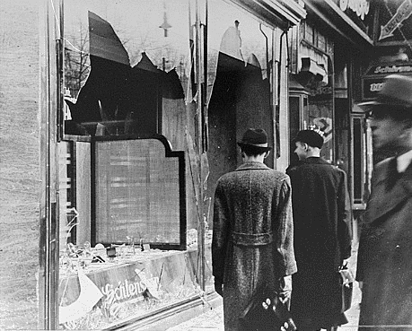
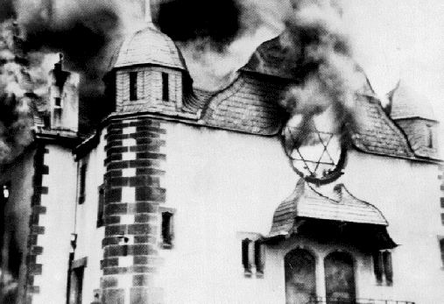
Kristallnact

Slide 11
Hitler -Der Fuhrer (the leader)
The Third Reich – last 1000 years
Ignores Versailles Treaty
Began building a massive army and weapons
“Today Germany; tomorrow, the World.”—A. Hitler
1936: Reoccupies Rhineland - no opposition from the French
1938: Annexs Austria – no opposition in Europe
6 months later, demands the Sudetenland region of Czechoslovakia
Munich Conference
British PM Neville Chamberlain and French PM Edouard Daladier
Appeasement – to give in to an aggressive nation to keep peace
Munich Pact— Hitler is given the Sudetenland, he promises to stop aggression
Chamberlain -- “We have secured peace in our time.”

Slide 12
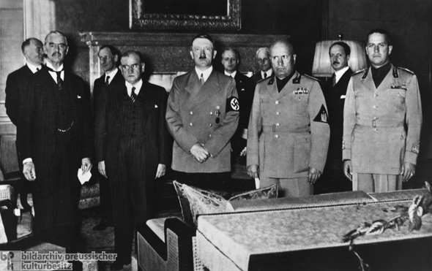

Slide 13
3.) Japan—Prime Minister Hideki Tojo
Government is controlled by military
Japan needed resources —especially land and raw materials
1931: Japan invaded Manchuria to get its iron and coal
US began an embargo on Japan
1937: Japan moved its forces into Northern China
Japan executed over 200,000 Chinese citizens - “China Incident” or “Rape of Nanking”
1940: Japan signed the Tripartite Pact with Italy and Germany—creating the Axis Powers

Slide 14
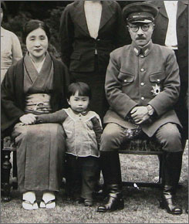
Hideki Tojo

Slide 15
Axis Strategy for WWII
Germany wants to invade eventually the Soviet Union to gain access to oil fields
Germany wants to avoid a 2-front war—having enemies on both sides – failure in World War I

Slide 16
Allied Powers
1.) Soviet Union
Joseph Stalin
2.) Great Britain
Neville Chamberlain and Winston Churchill
3.) United States
Franklin Roosevelt and Harry Truman

Slide 17
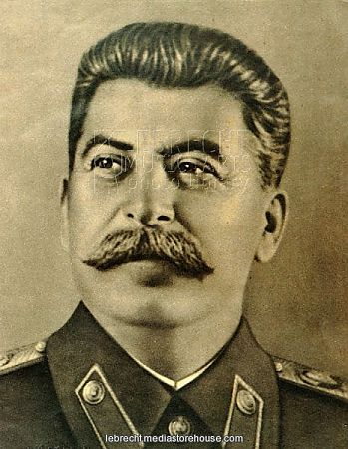
Joseph Stalin

Slide 18
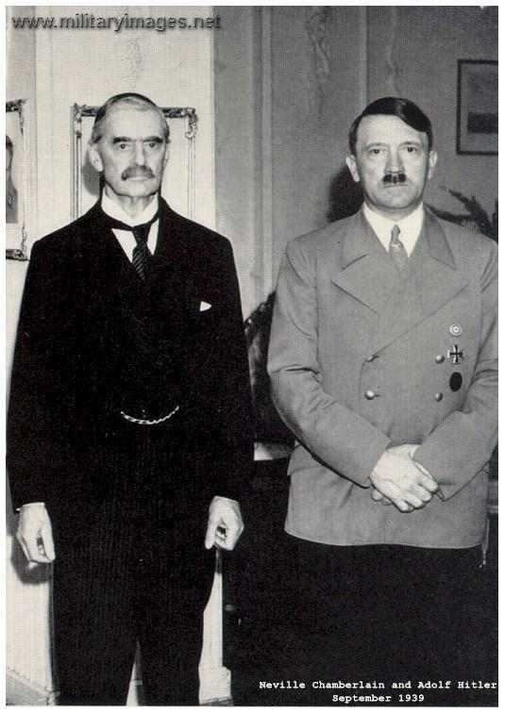
Hitler with Neville Chamberlain

Slide 19
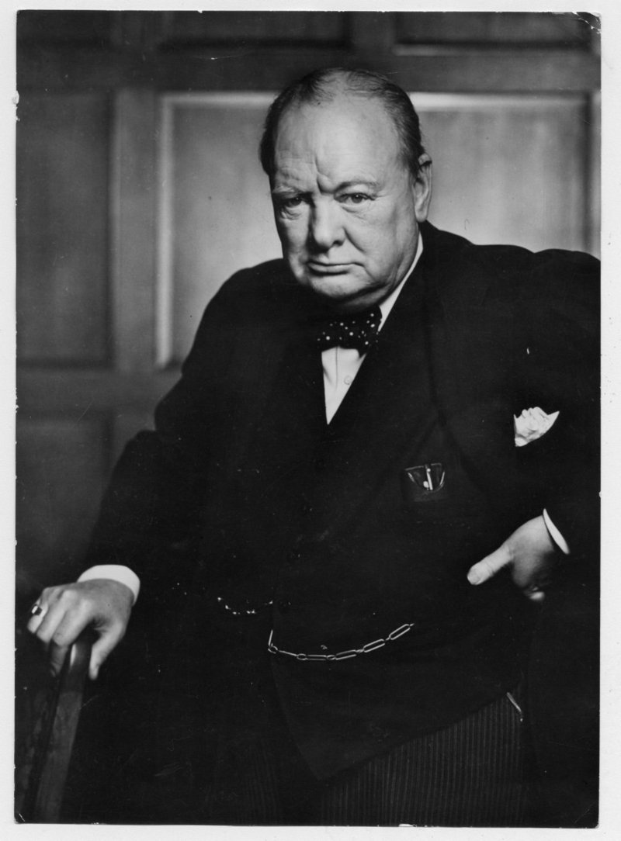
Winston Churchill

Slide 20
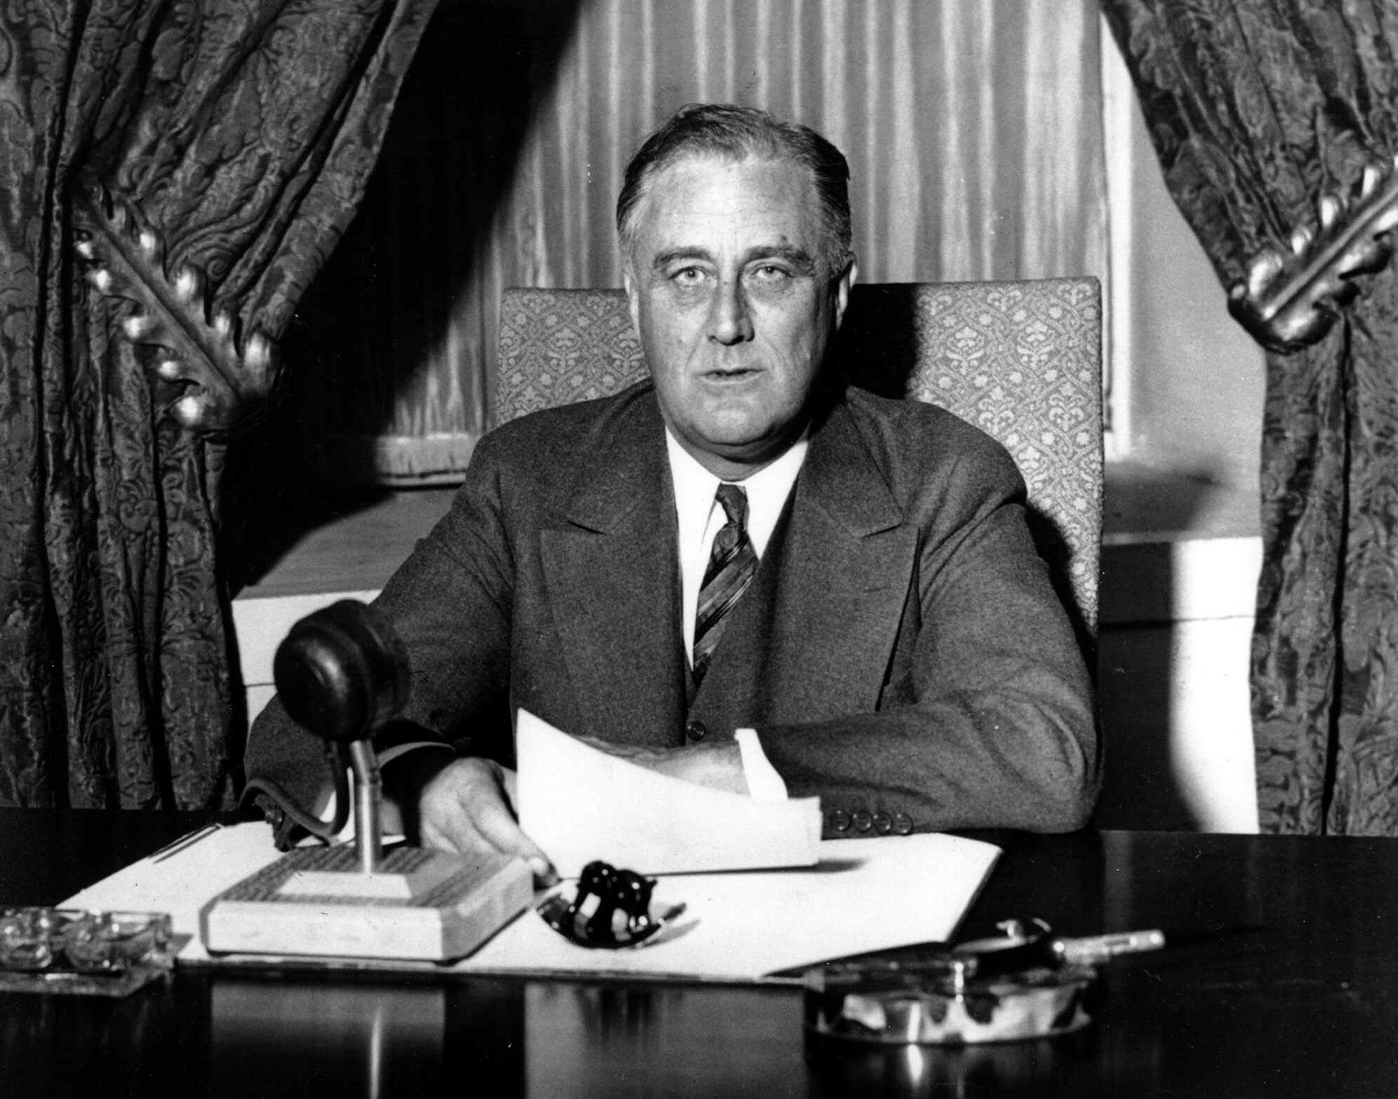
Franklin Roosevelt

Slide 21
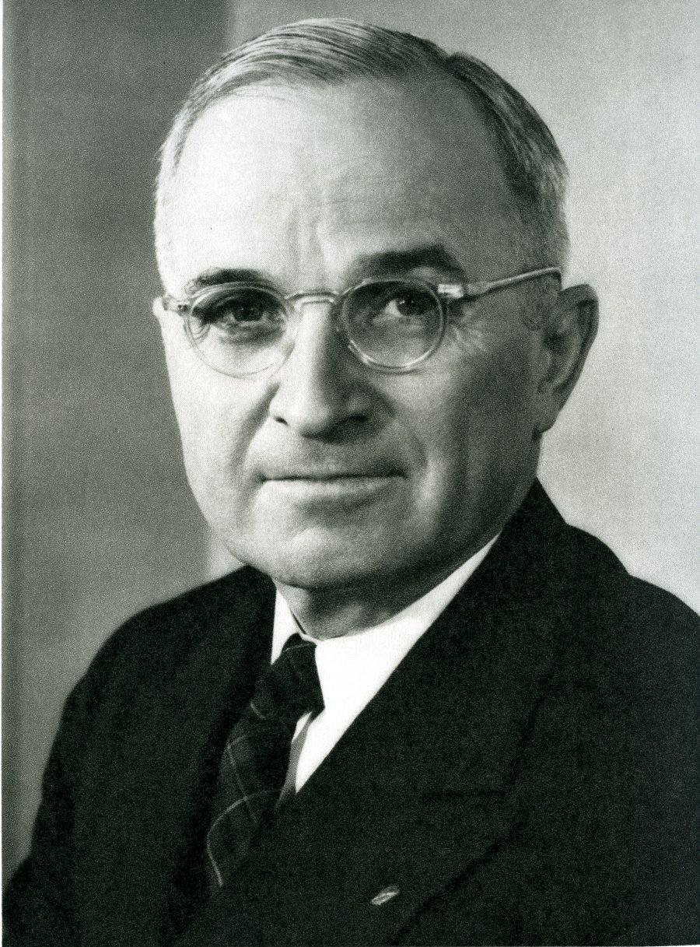
Harry S. Truman

Slide 22
Allied Strategy for WWII
First order was to defeat Hitler
Fear of Germany’s completion of an A-bomb
Germany - more powerful - could cut us off from our other allies
Pacific
Island Hopping—seizing islands closer and closer to Japan

Slide 23
The War In Europe

Slide 24
Non-Aggression Pact and the Soviet Union
August 29, 1939: Hitler signed the Non-Aggression Pact with Stalin and the USSR
Neither nation would attack the other – “shocked” the world
Hitler avoid 2-front war
Stalin could rebuild his army - “Great Purges” - 1930’s

Slide 25
Invasion of Poland
After pact with Soviet Union, Hitler invades Poland on September 1, 1939 – World War II Begins
Used Blitzkrieg (lightening warfare) – use of mechanized forces combining airplanes and tanks in the attack – No Trench Warfare

Slide 26
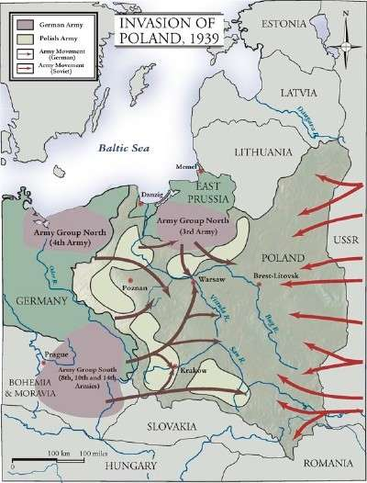

Slide 27
Invasion and Fall of France
May 1940: German tanks attacks France through Belgium
The fortified guns of the Maginot Line were never fired
The massive tank attacks and constant bombardment -French and British to retreat
Dunkirk—the British were saved by boarding private ships that took them back to England
France surrenders

Slide 29
Battle of Britain
Great Britain - Winston Churchill
Hitler uses Luftwaffe - constant bombardment nearly destroys London
British counters with the Royal Air Force
RAF had better planes, pilots and radar
Hitler also started using his V-2 rockets t

Slide 30
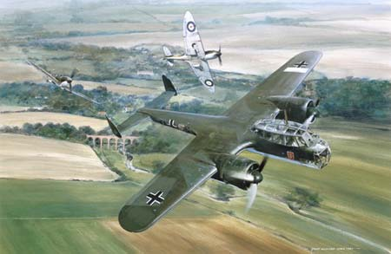
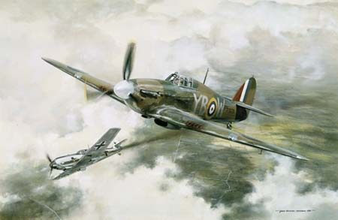

Slide 31
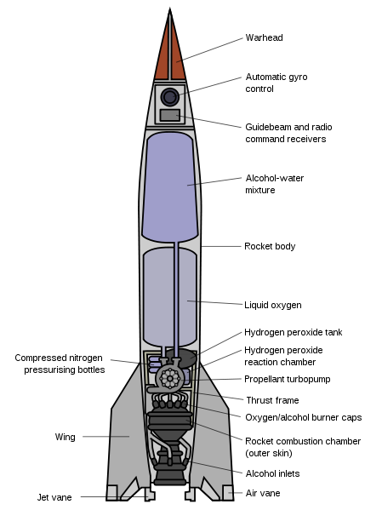
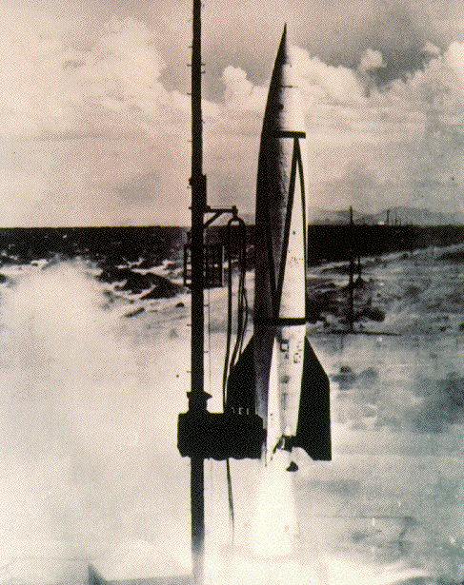

Slide 32
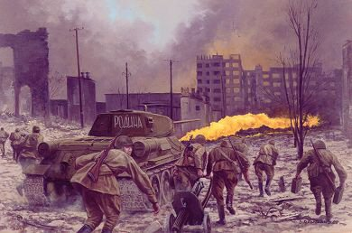
German Invasion of the Soviet Union
June 22, 1941: Germany invaded the Soviet Union –breaking the 1939 Non-aggression Pact
Harsh Soviet winter hurt the unprepared Germany Army
Battle of Stalingrad – Turning Point on the Eastern Front
Surrender stopped the German’s advance eastward

Slide 33
Allied Offenses:
North Africa -
Battle of El Alamein
British forces under Gen. Montgomery defeated German Gen. Rommel – turning point
Kept Hitler from gaining access to Middle Eastern oil fields
Allies landed in Sicily and preceded to invade Italy
Mussolini captured and executed
September 8, 1943: Italy surrendered to the Allies

Slide 34
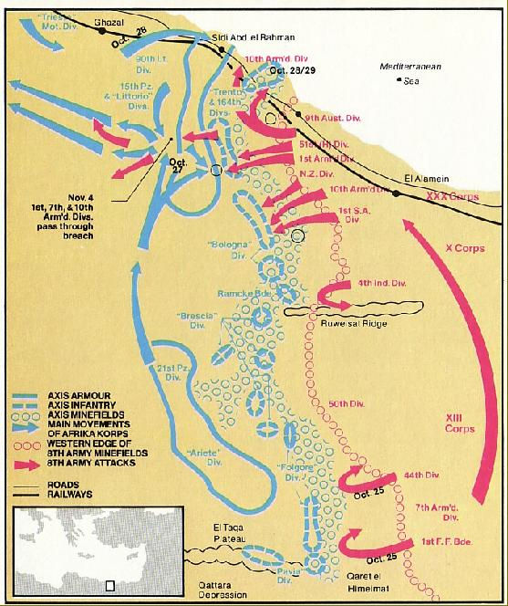

Slide 35
D-DAY: Invasion of Normandy, France
June 6, 1944: General Dwight D. Eisenhower -largest land-sea-air attack in history—Operation Overlord
Opens second front against the Germans

Slide 37
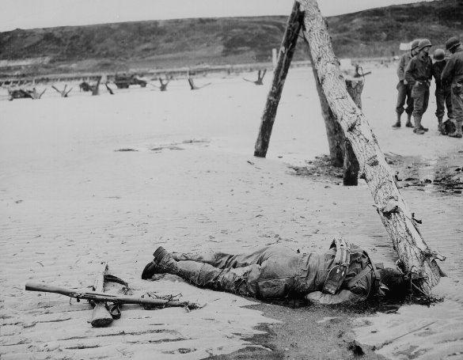

Slide 38
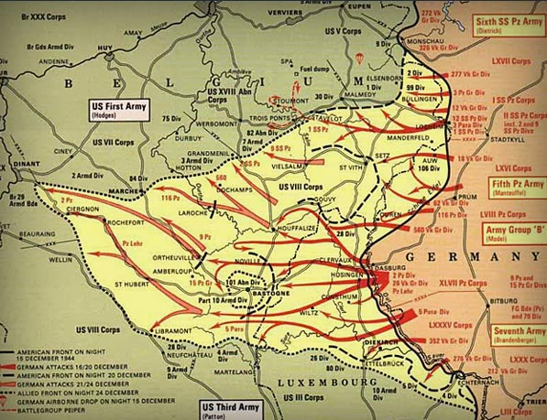
Battle of the Bulge:
Last German counter-offensive
German troops drove a bulge 80 miles long and 50 miles deep into the Allied lines
Delays allied advance into Germany

Slide 39
Yalta Conference :
Last meeting of the “Big Three”
Great Britain—Winston Churchill
United States—FDR
Soviet Union—Joseph Stalin
FDR wanted the Soviets to help him defeat Japan
Germany and Berlin would be divided into zones of occupation

Slide 40
Holocaust:
Hitler - attempt at exterminating all European Jews his “final solution”
Concentration camps - slave labor or medical experiments
About 6 million Jews were killed
Non – Jews killed - Polish, Slavs, Gypsies, “untouchables” (homosexuals, mentally ill, political dissidents)
genocide—systemic and purposeful destruction of a racial, political, religious, or cultural group

Slide 41
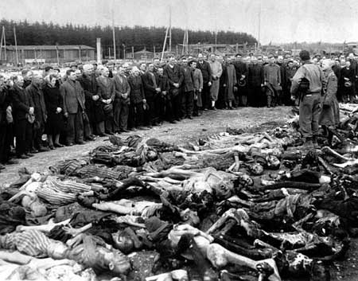
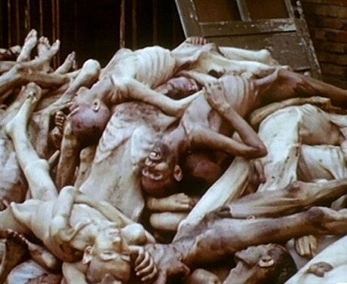

Slide 42
Victory in Europe:
April 30, 1945: Hitler committed suicide
May 8, 1945: V-E day

Slide 43
US ENTRANCE INTO WWII
December 7, 1941: the Japanese bomb Pearl Harbor destroying many American ships and killing thousands of American sailors
19 ships were destroyed
188 planes were destroyed
2400 men were killed
US declares war
A few days later, Germany and Italy declared war on US

Slide 44
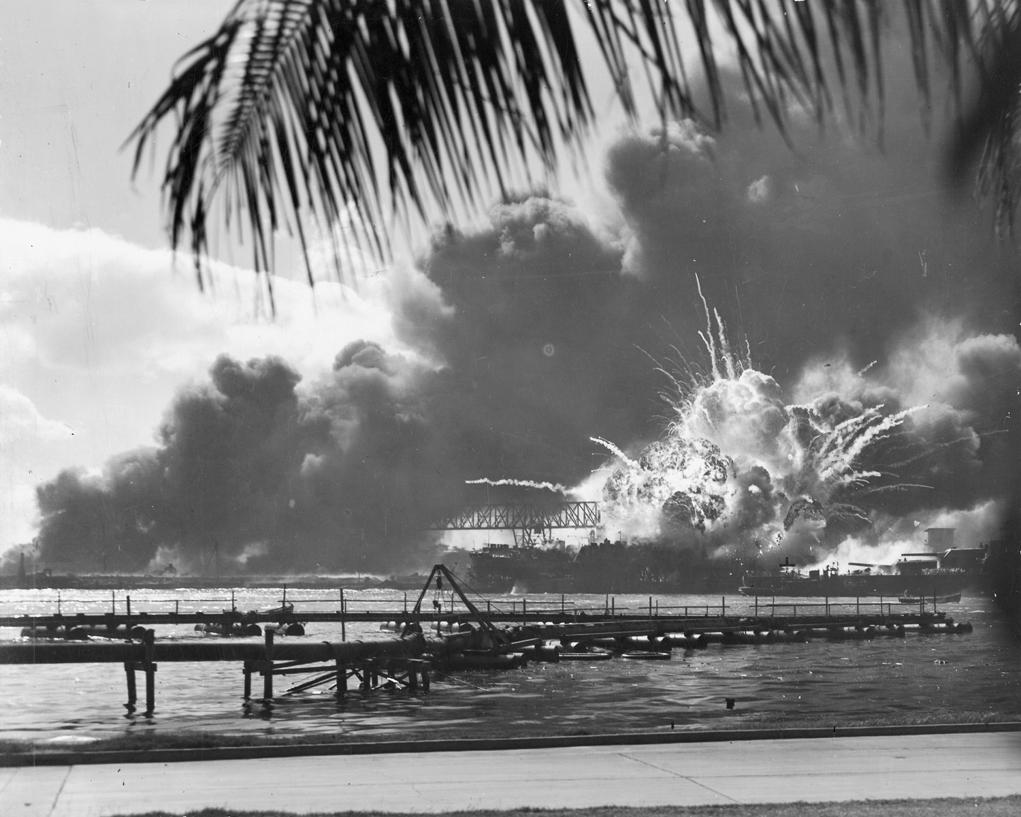

Slide 45
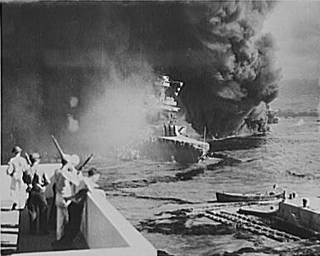

Slide 46
War in the Pacific
War against Japan
June 1942: Battle Midway Island
US naval forces defeated a much larger Japanese force
Midway -Turning Point of the Pacific
US strategy called “island hopping”
Capturing key islands, bypass others

Slide 47
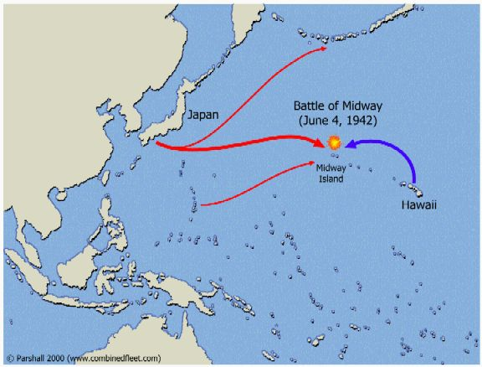

Slide 48
Early 1945: Battles of Iwo Jima and Okinawa
Proved that an all out assault on Japan would cost millions of American lives
Japanese were willing to commit suicide than surrender
Convinced Truman to use the Atomic bomb

Slide 49
Marines at Iwo Jima

Slide 50
Atomic Bomb:
Code named Manhattan Project
led by J. Robert Oppenheimer
July 16, 1945: 1st atomic bomb test in New Mexico
Truman - use the Atomic bomb to save American and Japanese lives if an amphibious landing was used

Slide 51
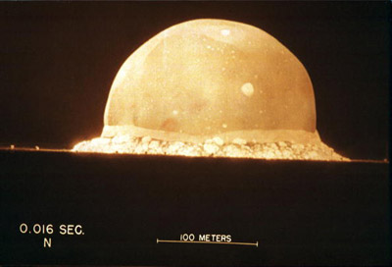
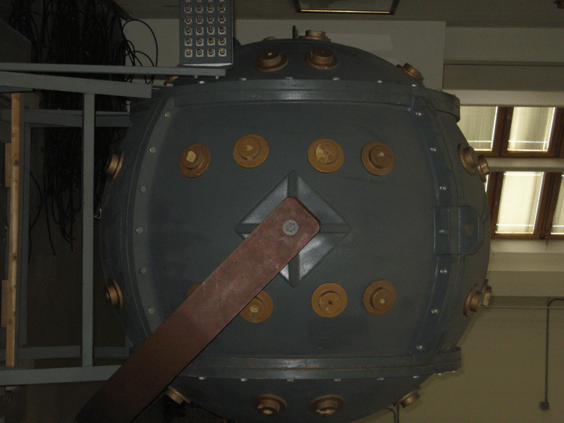
First Atomic Bomb Test Video

Slide 52
August 6, 1945: “Little Boy” dropped on Hiroshima
Atomic Bomb:
100,000 people were killed on impact
100,000 more died from burns, radiation, or wounds
The bomb was dropped by the Enola Gay

Slide 53
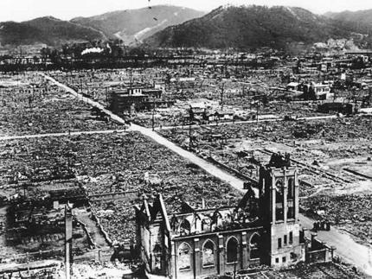
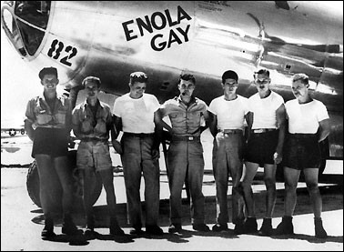
Hiroshima Atomic Bomb Video

Slide 54
August 9, 1945: Japan had still not surrendered
US drops atomic bomb on Nagasaki—40,000 killed instantly
August 14, 1945: Japan surrenders—V-J Day
WWII was now over

Slide 55
America at Home
Neutrality Acts – legislation designed to keep us neutral
Cash-Carry – nations could buy weapons from US but had to pay cash and had to carry them on their ships
Conscription - Selective Training and Service Act—1st peacetime draft in US history
Men 21 and 35 were eligible
FDR was trying to build an American military in case the U.S. got involved in the war

Slide 56
Lend-Lease
US sent 50 destroyers to Britain in return for the right to establish U. S. naval bases on British held lands
Britain could no longer “Cash and Carry”
FDR compared Lend-Lease to “lending a garden hose to a next-door neighbor whose house is on fire”

Slide 57
African-Americans Soldiers
Segregated commanded by white officers
Most were non-combat, labor intensive jobs
Tuskegee Airmen—African American air force – “Red tails”

Slide 58
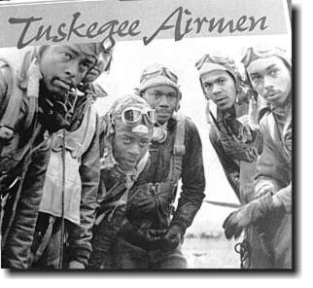
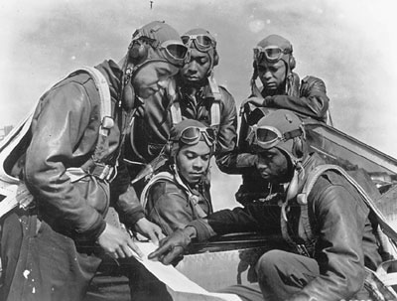
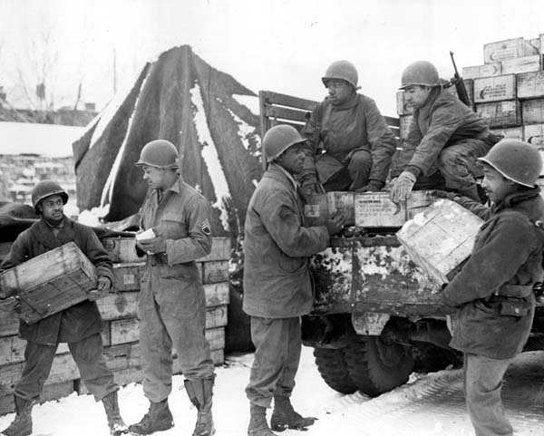
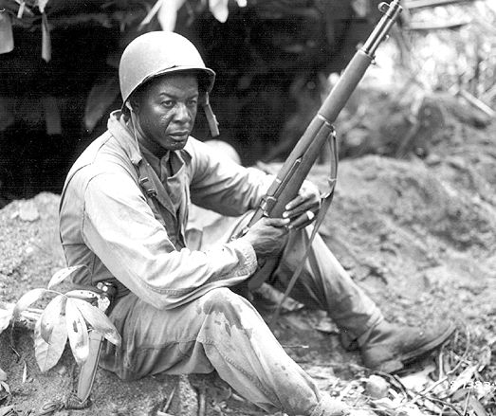
Video on the Tuskegee Airmen

Slide 59
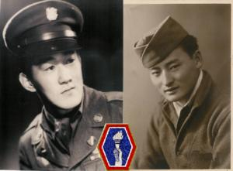
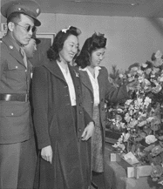
Japanese-Americans - most decorated war heroes in World War II—Nisei Regiments

Slide 60
Hispanic-Americans fought in non-segregated units
Navajo Indians – used to send codes in the Pacific
Navajo -oral language

Slide 61
The War @ Home in the United States:
Racial tensions high especially in cities during the war
1.) African Americans:
Migrated to the cities to find work in the war plants
A. Philip Randolph
Argued that minorities were excluded from the high paying industrial jobs in many wartime plants
Organized the March on Washington Movement (MOWM)

Slide 62
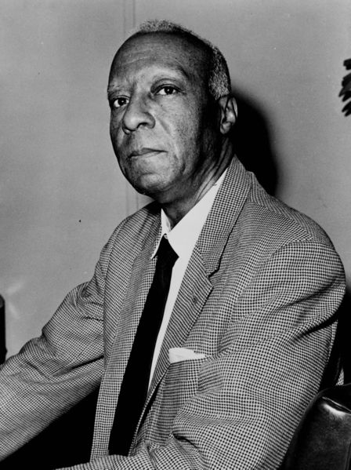
A. Philip Randolph

Slide 63
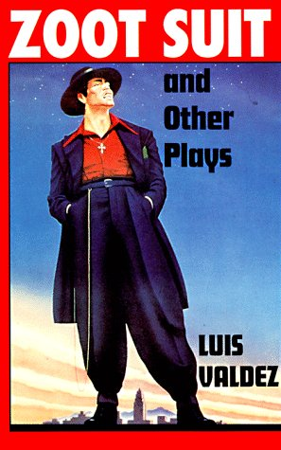
2.) Mexican-Americans:
Many Hispanic teenagers wore “Zoot Suits”—a long jacket with padded shoulders and pleated pants
Zoot Suit riots occurred in Los Angeles due to prejudice

Slide 64
3.) Japanese Americans:
1942: Japanese Americans placed in internment camps
Occurred due to fear and prejudice
Ironically, Japanese American soldiers - most decorated of all American soldiers in WWII

Slide 65
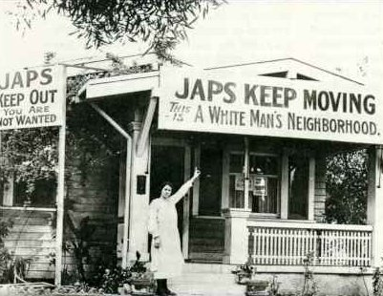
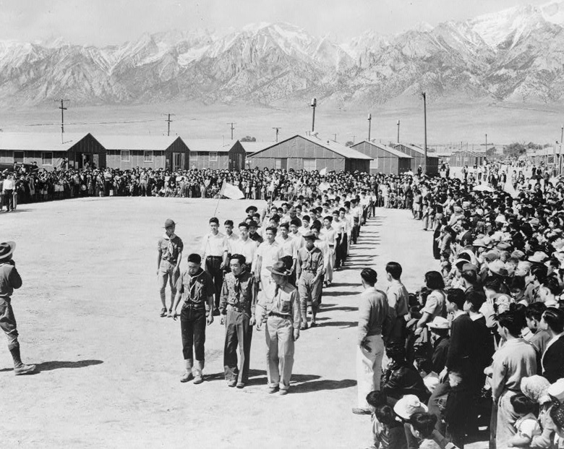
Video on Japanese Internment Camps

Slide 66
Media and Communications in America during the War:
Public morale and ad helped war effort
Entertainment industry produced movies, plays, and shows increased morale and patriotic support for the war effort
Portrayed the enemy in stereotypical ways
Dr. Seuss

Slide 67
How the War Changed Home Life:
Mobilization – to prepare for war
Factories were converted over to produce materials for war
Planes
Tanks
Weapons
Uniforms
American economy grew
GNP (Gross National Product) rose from $90 billion to $211 billion in 1945

Slide 68
1942: Rationing—limiting how much of something the people could buy
Each family had a quota on their rationing coupons
Women - worked in the factories (“Rosie the Riveter”)
Built tanks, airplanes
Made other gear such as uniforms and parachutes

Slide 69
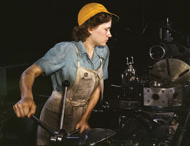
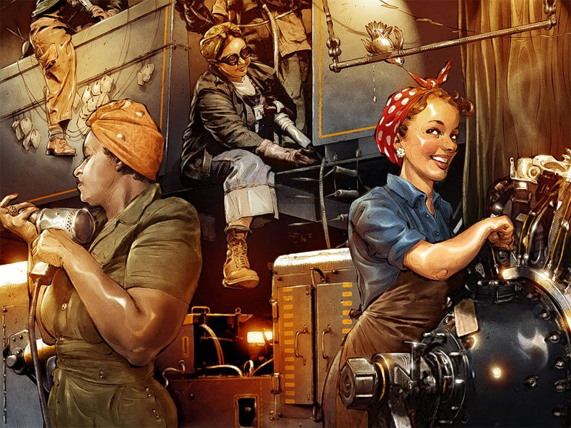
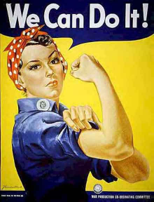

Slide 70
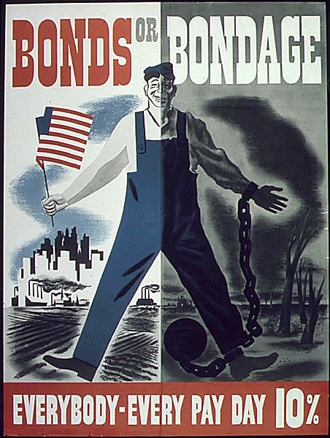
To pay for the war, the government increased taxes and sold war bonds
Bonds also helped to control inflation

Slide 71
Geneva Convention:
Created in 1949
Ensure the humane treatment of prisoners of war (POWs) by establishing rules to be followed by all nations
Example of mistreatment of POWs
Bataan Death March—American and Filipino POWs were brutally treated by the Japanese military after Philippines surrendered

Slide 72
Dead soldiers during the Bataan Death March

Slide 73
Nuremburg Trials:
Nazi leaders and others were placed on trial and convicted of war crimes
The Nuremburg Trials increased demand for a Jewish homeland
Creation of Israel
Nation of Israel - British mandate of Palestine
Palestine divided among Jews and Palestinian Arabs (Muslims)
Confrontations broke out between the Muslims and Jews which continue today

