Slide 1
TEST #6 Lecture Notes
The United States from 1890-1941
VUS.9-10

Slide 2
Imperialism: Nations have colonies
Duty of US to instill American way of life around the world – linked to Industrialization
Need for refueling stations
Searched for overseas markets
Desire for raw materials
Concentrated on Latin America & Asia

Slide 3
Spanish American War
Cuban war for independence from Spain
US Army troops attacked Cuba in June
Results
US received Puerto Rico. Also, Guam & the Philippines in the Pacific.
US had the right to intervene in Cuban affairs

Slide 4
Hawaii
U. S. deposed the monarchy (Queen) in Hawaii
1887: built and fortified a naval base on Hawaii at Pearl Harbor
1898: The U. S. annexed Hawaii
Other US acquisition – Midway Island

Slide 5
The Panama Canal
Waterway crossing Central America—linking Atlantic with Pacific – eliminate need to go around South America
1903: Plans to construct canal – Colombian region of Panama
Colombia backs out
U. S. encourages revolution in Panama – Independent Panama signs treaty for canal
Example of TR’s “Big Stick” Policy

Slide 6
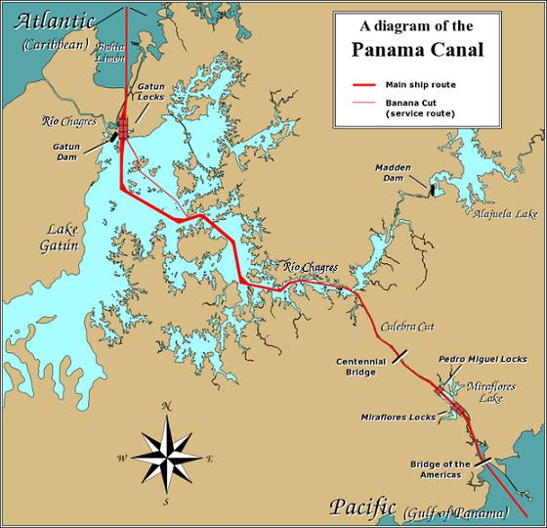

Slide 7
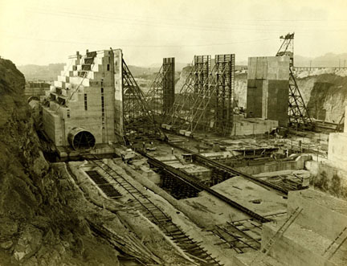
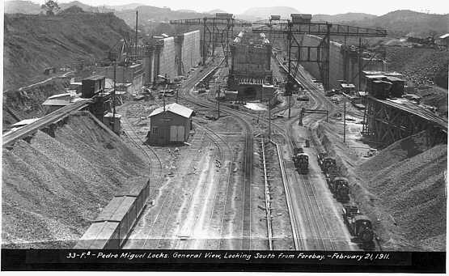

Slide 8
“Big Stick” Diplomacy
Theodore Roosevelt
Use of Negotiations first but be prepared to use force to get what you want
“Speak softly & carry a big stick; you’ll go far.”
Pres. Roosevelt issued corollary to the Monroe Doctrine—the Roosevelt Corollary
Policeman of the W. Hemisphere

Slide 9
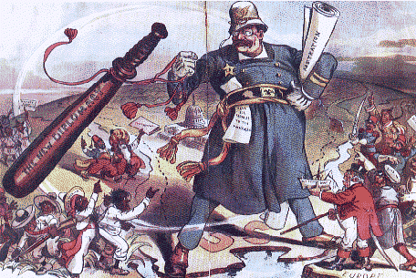

Slide 10
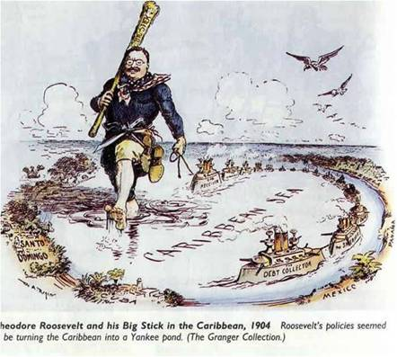

Slide 11
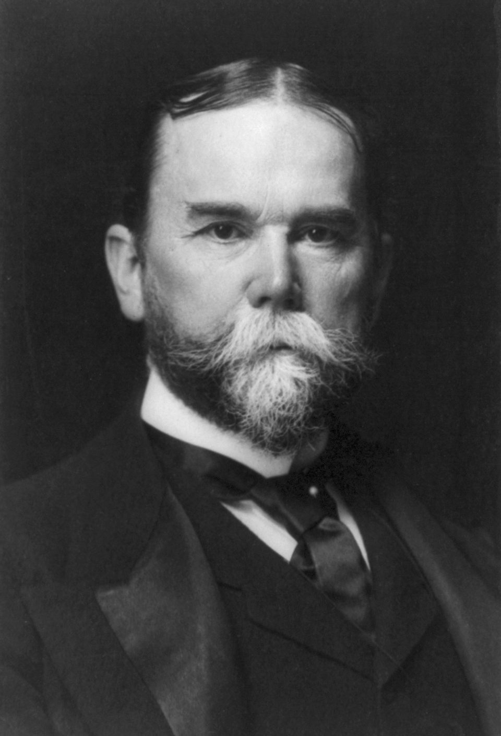
Open Door Policy
Secretary of State John Hay
Free trade for all nations in China

Slide 12
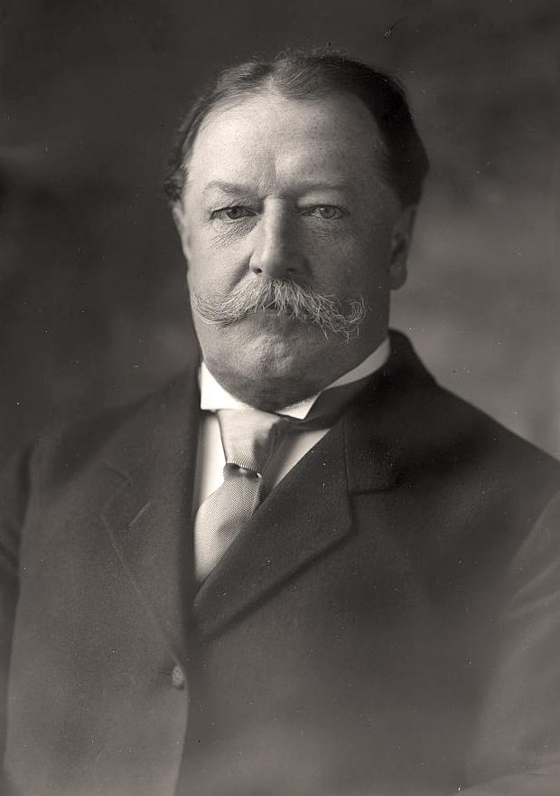
Dollar Diplomacy
Influence foreign governments by using American investment ($)
Howard Taft
US could intervene anytime in Latin America to protect investments

Slide 13
World War I
Causes (MAIN)
Militarism – build up of weapons and soldiers
Alliances – binding agreements with other nations
Imperialism – quest for colonies
Nationalism – love of country
June 28, 1914: The war will start in the Balkans with the Assassination of Francis Ferdinand
Austria-Hungary blamed Serbia for the attack
The alliances will be brought in bringing Europe into a major conflict

Slide 14
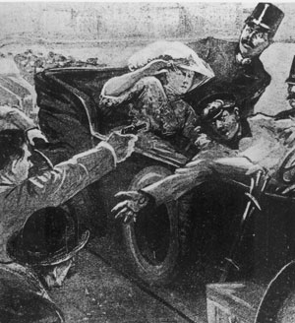
Assassination of Archduke Franz Ferdinand

Slide 15
Allied Powers in WWI
Great Britain
Russia – out 1918
France
U.S. - 1917
Central Powers in WWI at beginning of war
Germany
Austria-Hungry
Ottoman Empire

Slide 16
Trench warfare
Fighting resulted in a stalemate
New weapons of war
Airplanes
Poisonous gas
Machine guns
Tanks
Submarines – U-boats

Slide 17
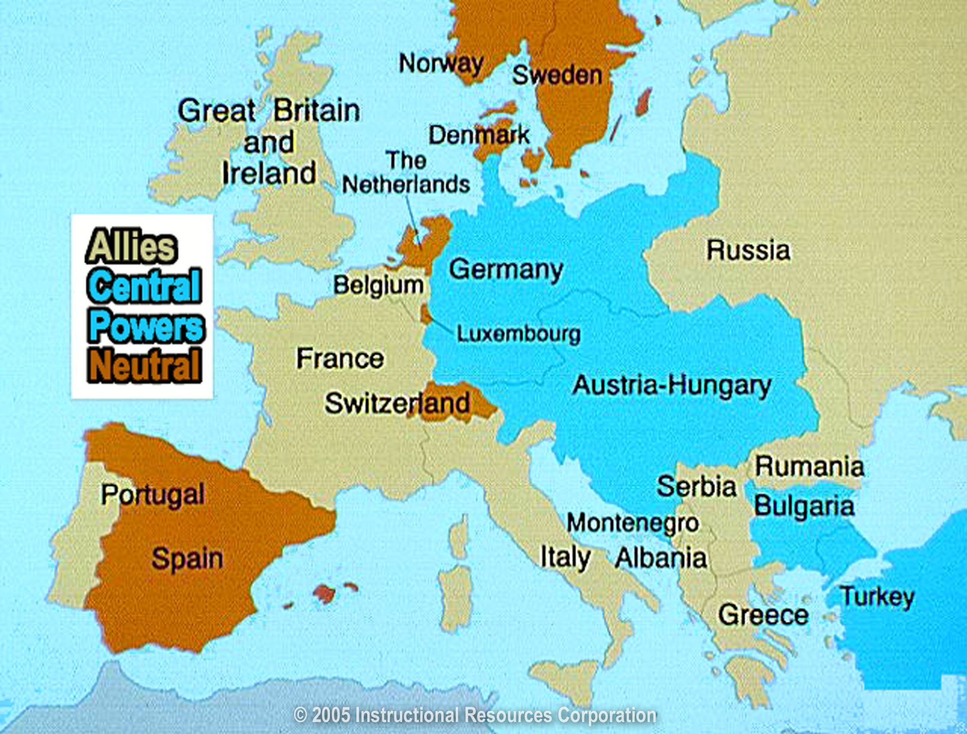

Slide 18
US declares neutrality(1914)
Reasons US enters war in 1917
1.) German submarine warfare
1915, sinking of the Lusitania, killing 1,200 civilian passengers.
2.) Zimmerman Telegram
German plan to keep the US out of the war by urging Mexico to declare war against America
3.) “Make the world safe for democracy” (Woodrow Wilson)
4.) Close relations with Britain – propaganda, investments & trade

Slide 19
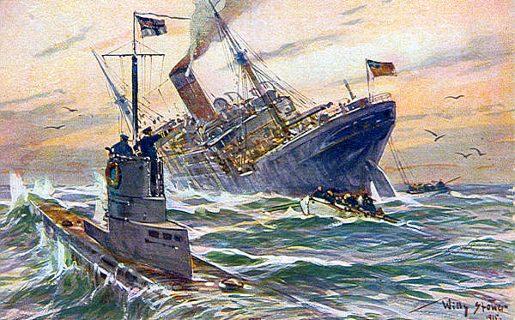
Sinking of the Lusitania

Slide 20
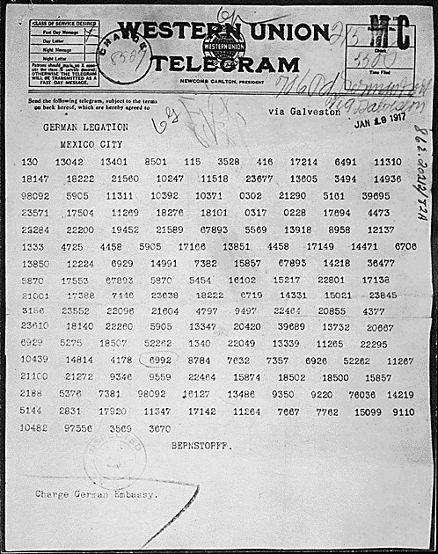
Original coded telegram

Slide 21
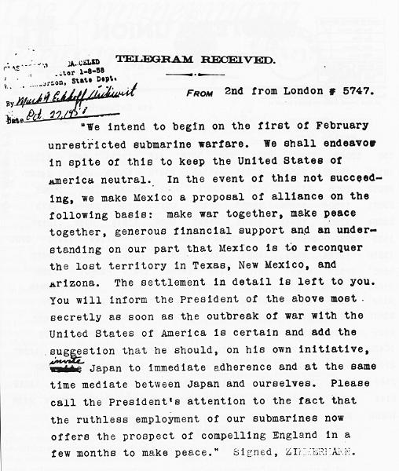
Decoded telegram

Slide 22
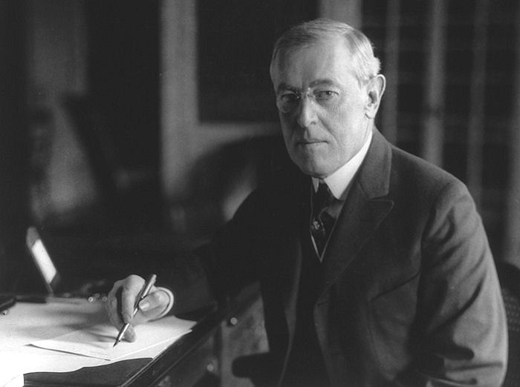
Wilson’s 14 Points
Wilson’s peace plan
Self-determination – people choose own government
Freedom of the seas
Freedom of trade
League of Nations (Wilson’s 14th Point) – way in which to prevent future wars

Slide 23
Treaty of Versailles
Ends WWI
French and English - harsh punishment of Germany
Taking of German territory
France receives Alsace- Lorraine
Germany loss of Asian colonies
Germany pays war reparations
Limits German military
Rhineland demilitarized
League of Nations formed

Slide 24
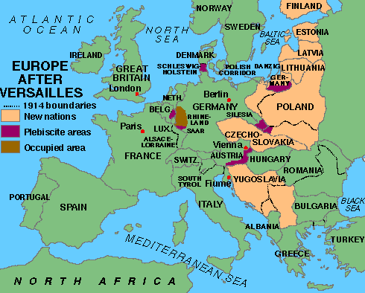
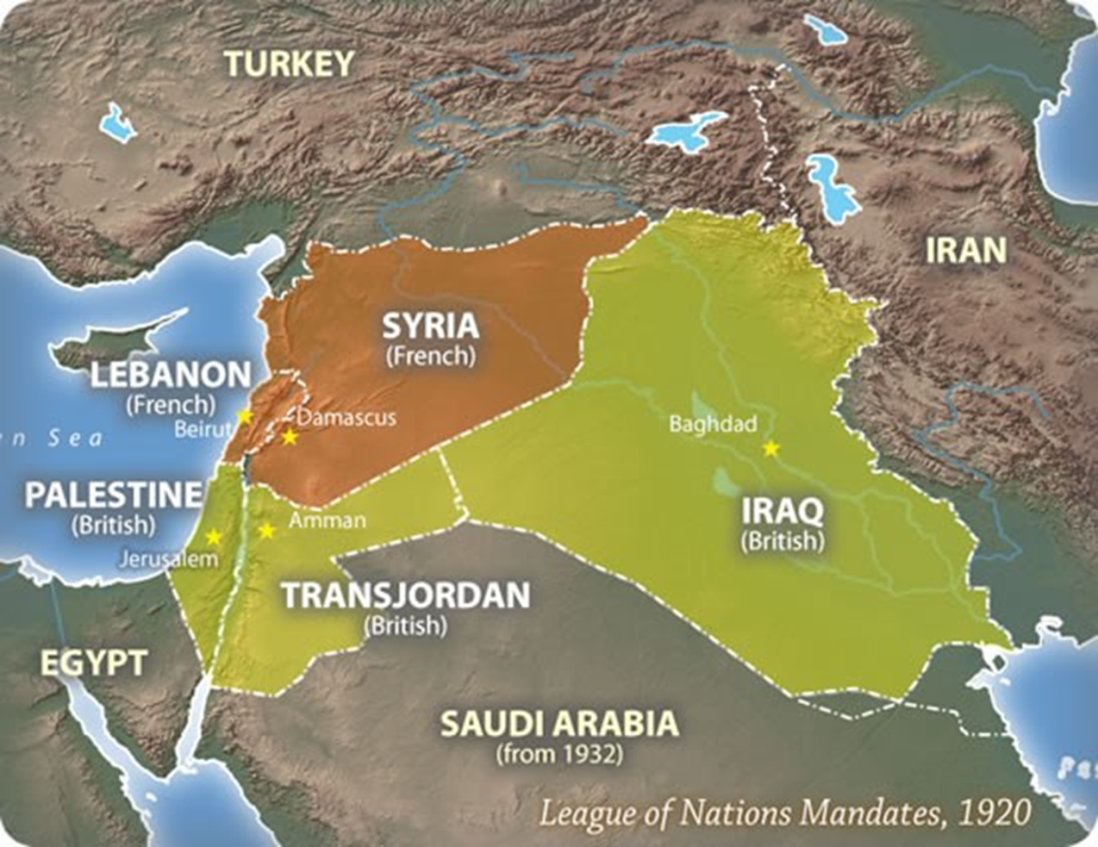
New nations in Europe - Ethnic
Finland
Estonia
Latvia
Lithuania
Poland
Czechoslovakia
Yugoslavia
Ottoman Empire - Mandates
Great Britain gained control of Palestine

Slide 25
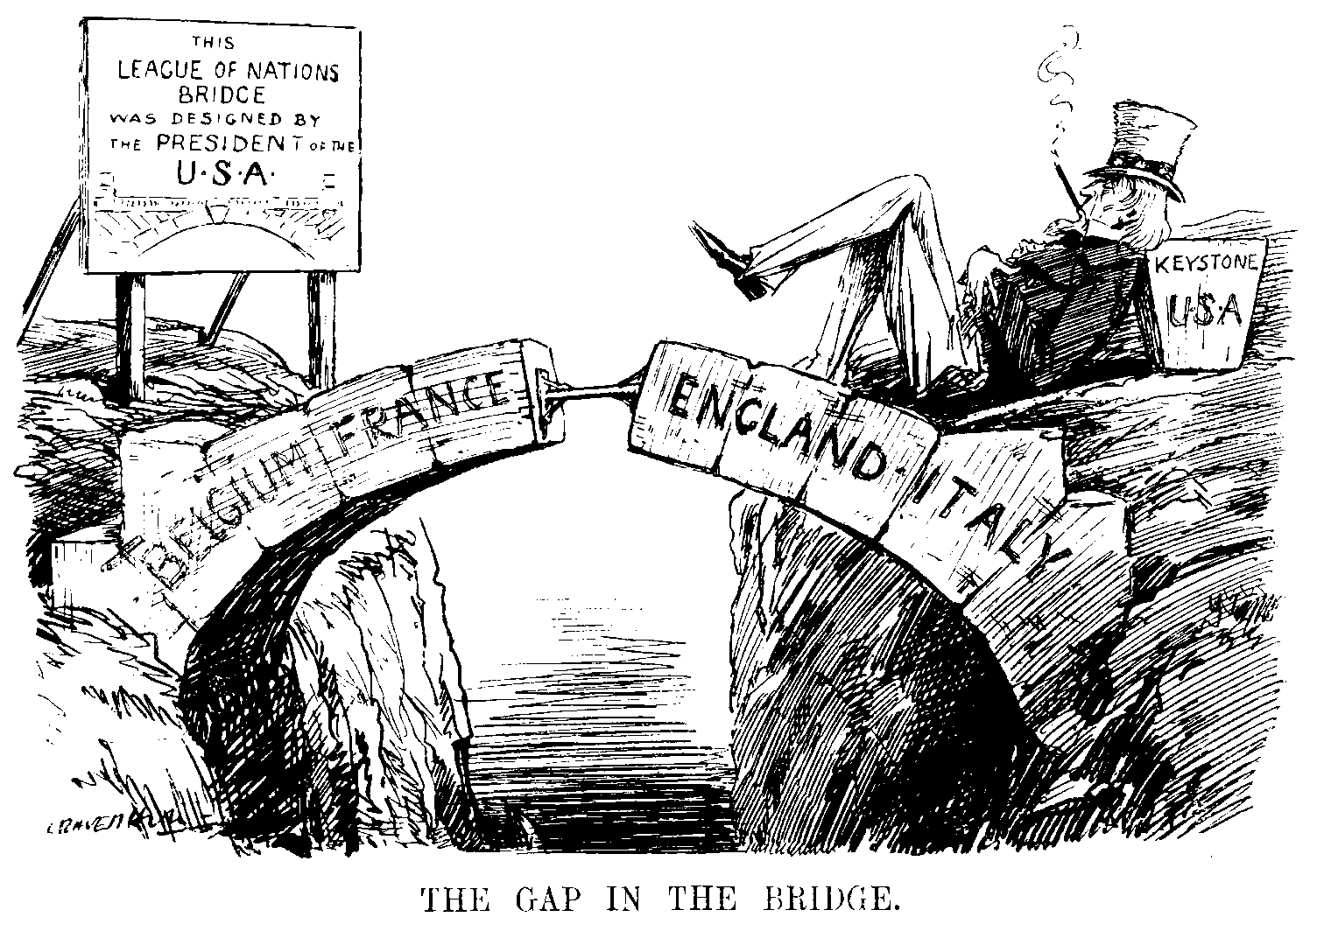
League of Nations Debate in the U. S.
US Senate refused to approve the Treaty of Versailles
US didn’t join the League of Nations
Return to isolationism

Slide 26
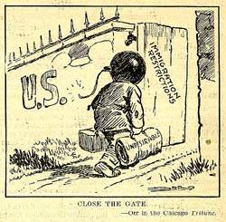
America in the 1920s & 1930s
1.) Red Scare:
Fear of communism
1917: Communist Revolution in Russia
U. S. sees any foreigners born as a threat to democracy
2.) Palmer Raids:
Mitchell Palmer- Attorney General.
US deports many immigrants – no legal counsel

Slide 27
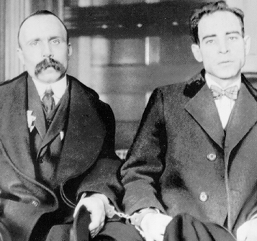
3.) Sacco & Vanzetti:
2 immigrants accused of robbing & killing a guard at the Massachusetts shoe factory – found guilty & executed
Judge makes remarks about them being immigrants & a threat
Sacco and Vanzetti

Slide 28
4.) Mass Media and Communications:
Radio: Broadcast jazz & Fireside Chats
Movies:
Silent films
1927, First talking picture: The Jazz Singer
During the Great Depression, movies offered people a chance to escape
Newspapers & magazines:
Shaped cultural norms & sparked fads

Slide 29
5.) Agricultural Overproduction:
US farmers overproduced due to advancements in technology (tractor) – led to surplus – prices drop – foreclosures
6.) Scopes Trial:
1927 – John Scopes – Tennessee biology teacher -evolution
Fundamentalist Christians attack idea of evolution
Trial - Clarence Darrow(Defense) and William Jennings Bryan(Prosecutor)
Scopes was found guilty - fined $100

Slide 30
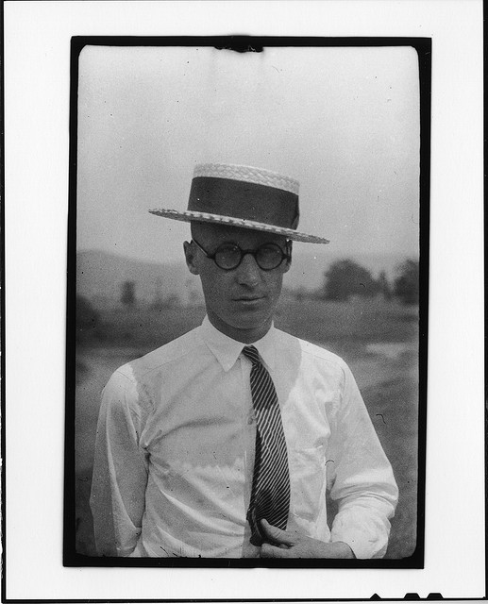
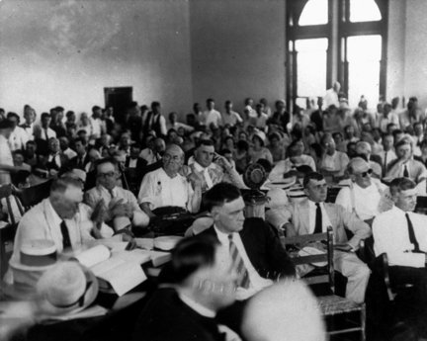
Scopes Monkey Trial

Slide 31
7.) Prohibition:
18th Amendment (Volstead Act)
National law prohibiting the manufacture, transport, and sale of liquor (alcohol) in the United States
Bootleg liquor
Speakeasies - illegal drinking establishments Organized crime
Al Capone - Chicago bootlegging gang

Slide 32
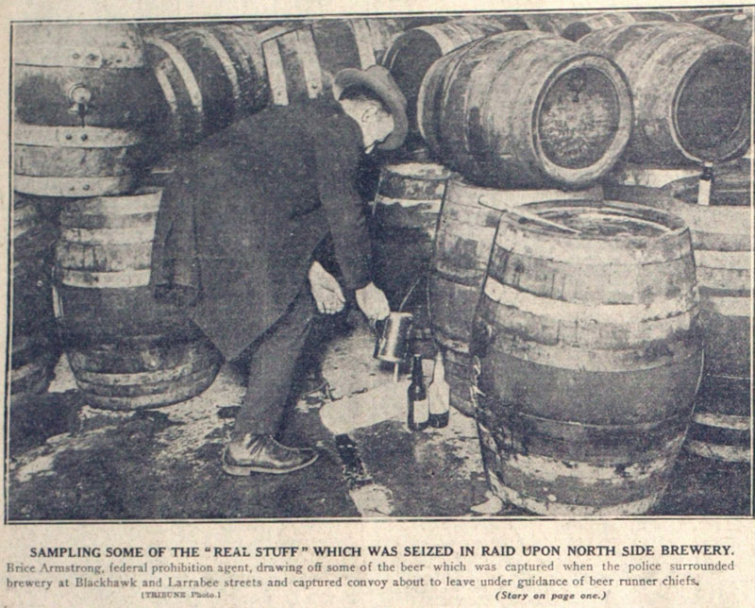
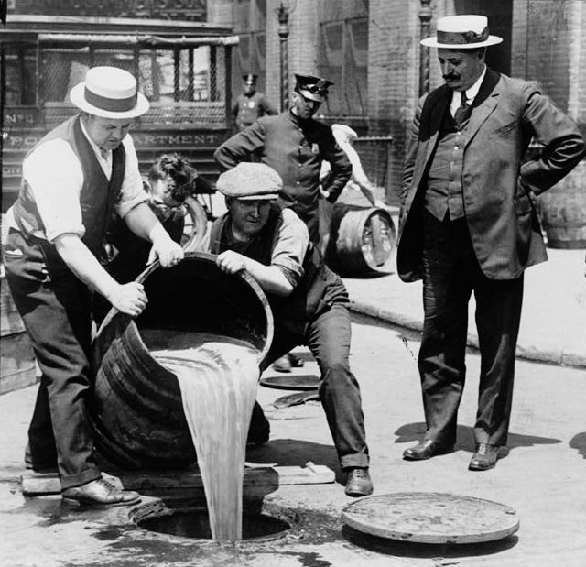

Slide 33
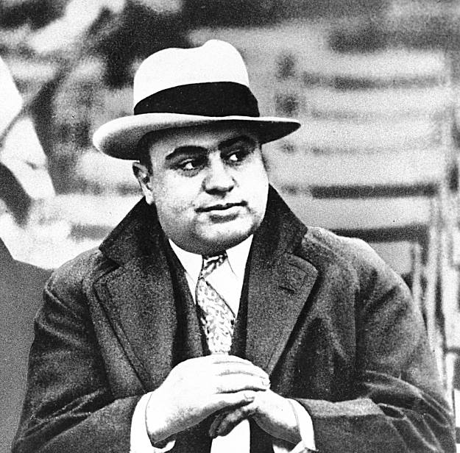
Al Capone

Slide 34
8.) Harlem Renaissance:
A Black cultural movement in New York City
Cotton Club - Harlem - Jazz clubs
Famous writer Langston Hughes

Slide 35
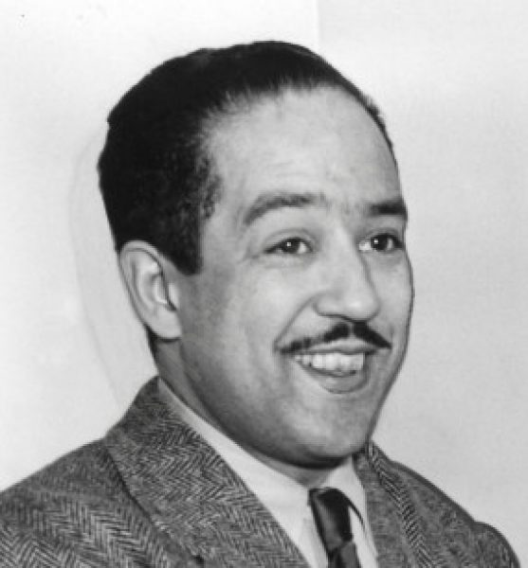
50-50
I’m all alone in this world, she said, Ain’t got nobody to share my bed, Ain’t got nobody to hold my hand— The truth of the matter’s I ain’t got no man. Big Boy opened his mouth and said, Trouble with you is You ain’t got no head! If you had a head and used your mind You could have me with you All the time. She answered, Babe, what must I do? He said, Share your bed— And your money, too.
Langston Hughes

Slide 36
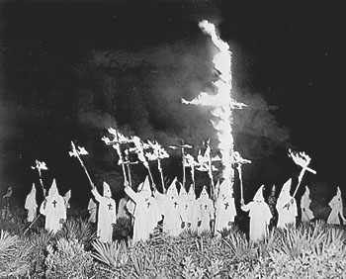
9.) KKK—the Second Klan:
KKK rebirth
Movie Birth of a Nation - glorified the original KKK
Membership grew rapidly in cities especially Midwest
Reflection of anti-immigrant feelings
Anti-Catholic
Anti-Communist
Anti-immigrants
Anti-semitism—dislike for Jews

Slide 37
10.) Women in the 1920s:
Fashion and social trends changed drastically in the 1920s –A Flapper
More make-up—especially rouge and lipstick
Dresses length above the knee
“Bobbed” their hair
Bind their chests

Slide 38
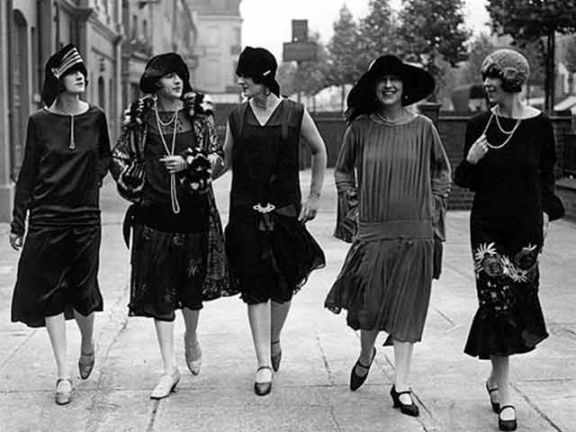

Slide 39
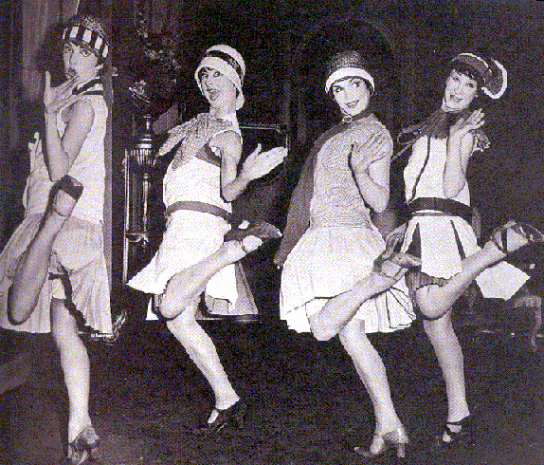

Slide 40
Business Cycle
Economic model showing growth and decline of Gross Domestic Profit (GDP) over time
GDP—total value of goods and services produced by a nation in a given year
The cycle consists of periods of expansion, a period of contraction, and a trough (bottoming out)
1.) Expansion (BOOM) – Economic growth
2.) Contraction (BUST) – Economic decline

Slide 41
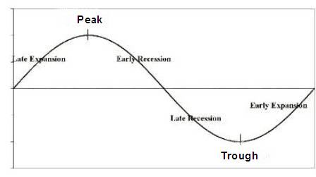
BOOM
BUST
depression

Slide 42
Causes of the U. S. Stock Market Crash
Crashed on Oct. 29, 1929
1.) Overspeculation:
Speculators buy cheap stocks, hoping price would increase
When price rose, speculator would sell stock for profit
Buying on margin—borrowed $ from broker
2.) Panic Selling:
Brokers call in their margins—people must pay off loans
Everyone selling stocks – price drops more
Fears led to a “run on the bank” – banks close – deposits are lost

Slide 43
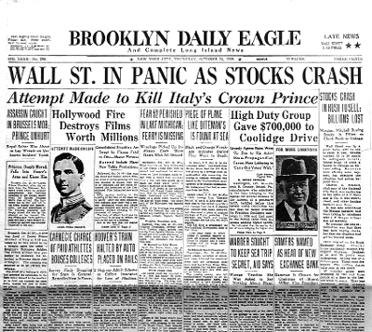
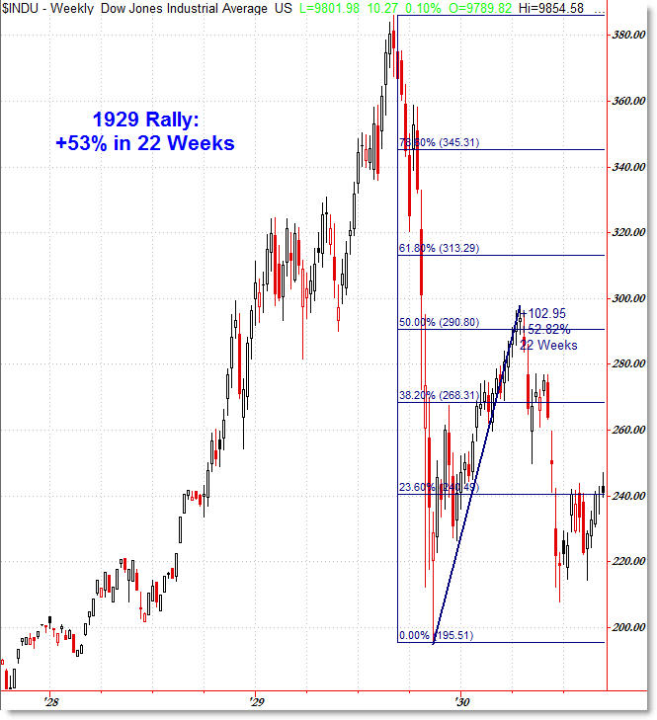
Stock Market Crash and Depression

Slide 44
Causes of the Great Depression
1.) U. S. stock market crash of 1929
2.) High Protective tariffs (Hawley-Smoot Tariff)
Retaliatory tariffs by other countries, strangles world trade
3.) FED Policy
Restricts supply of money—not enough money in circulation to allow economic recovery

Slide 45
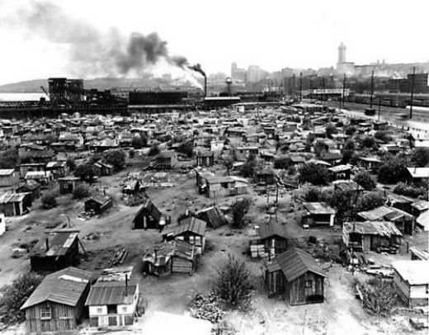
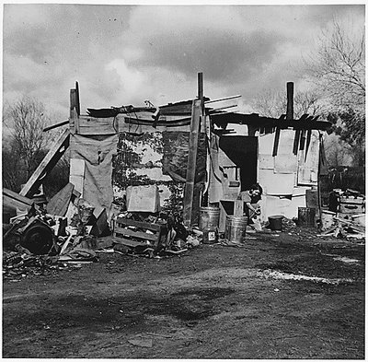
Impact of the Crash and Depression
President Herbert Hoover did little to ease the crisis
State and local governments - economic recovery
Hoovervilles: Shantytowns of the unemployed

Slide 46
Unemployment
-Demand decreased
-Greatest problem of the Great Depression
Dust Bowl:
1931: Great Plains region suffered a severe drought
Strong winds began to blow the topsoil up into big, black clouds of dust – black blizzards
Soil was being blown to the east to NYC
Okies - families packed up and moved to the west (California) looking for jobs

Slide 47
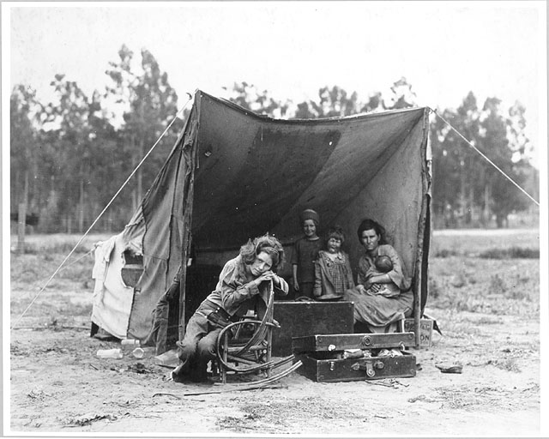

Slide 48
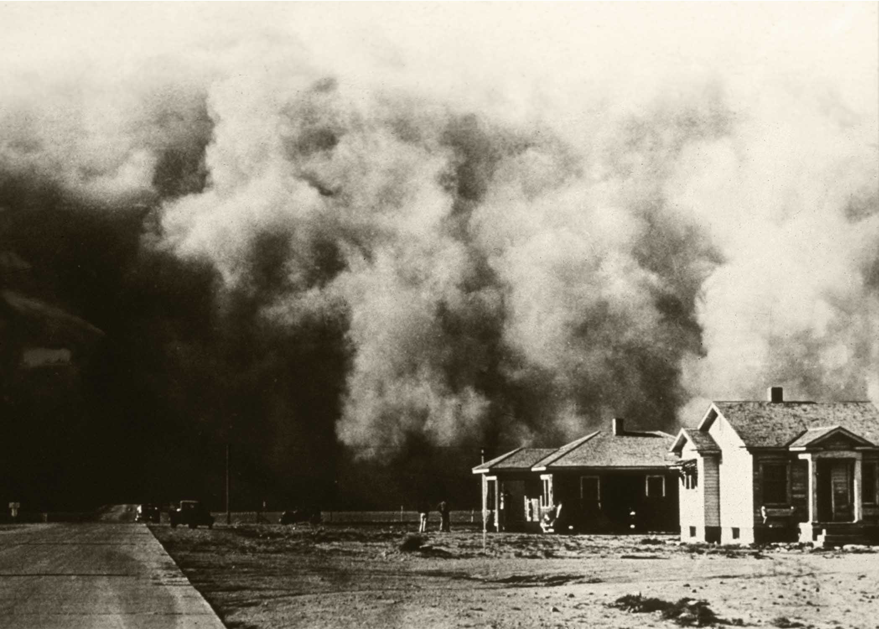

Slide 49
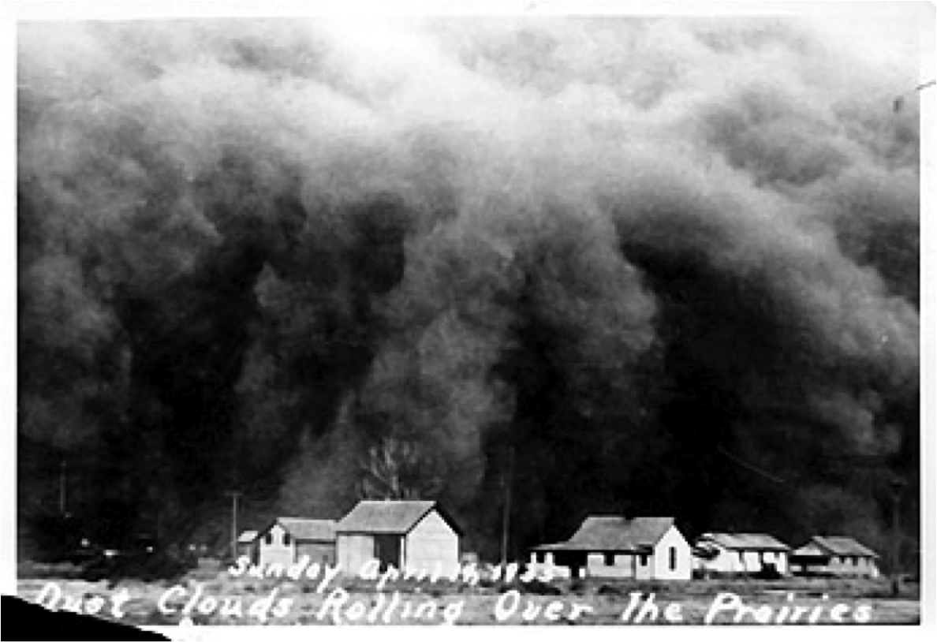

Slide 50
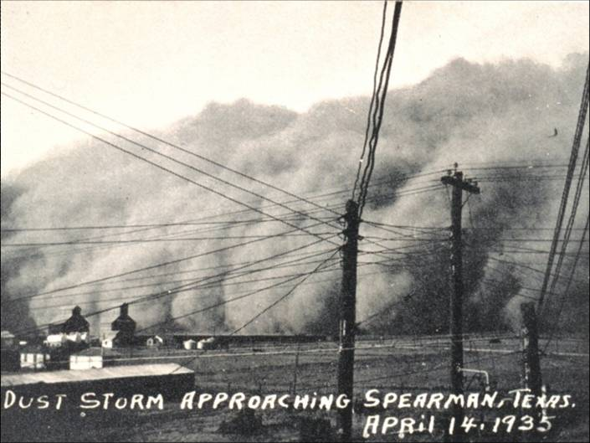
Video on the DustBowl

Slide 51
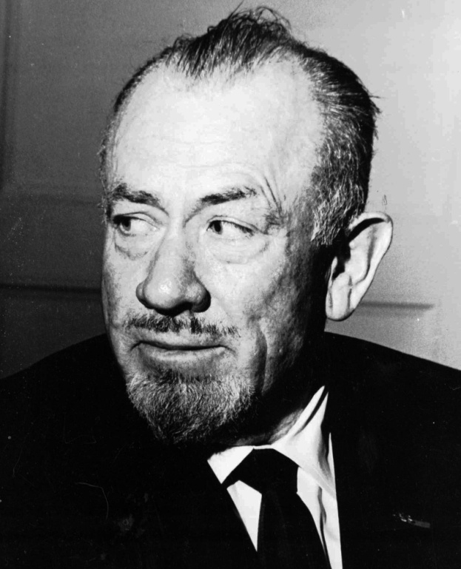
John Steinbeck:
Wrote Grapes of Wrath & Of Mice and Men
Books portray the hardships of the Depression, & the Dust Bowl

Slide 52
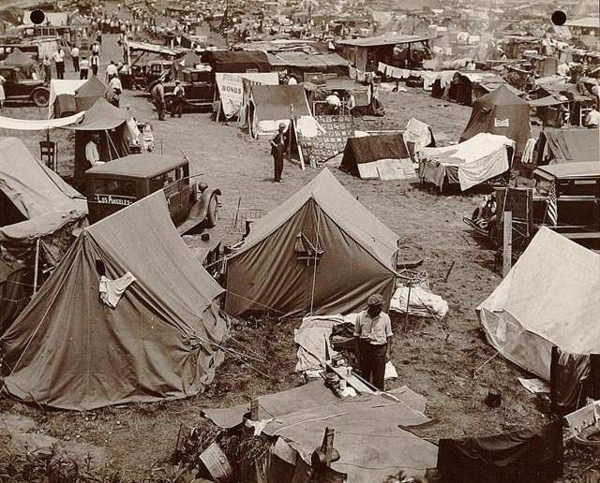
Bonus Army:
Veterans were promised a bonus for serving in WWI & wanted it in 1932 not 1945
Shantytown built outside DC of 17,000
Hoover sends troops - destroy camp, disperse protesters
Bonus Army Video

Slide 53
New Deal:
1932: Franklin D. Roosevelt (FDR) is elected President
Promised a “New Deal”
used the radio – “Fireside Chats”
Explained New Deal programs – “nothing to fear but fear itself”
Federal government stimulates economy - provide unemployment relief
GDP = C+I+G+F

Slide 54
New Deal Legislation:
1.) Agricultural Adjustment Act (AAA)
AAA paid farmers a subsidy
Paid farmers to CUT BACK their production – raise prices
2.) Civilian Conservation Corps (CCC)
Give unemployed young men (18-25) jobs on environmental projects
3.) Public Works Administration (PWA)
Put people to work to build dams, schools, government buildings, etc.
Randolph-Henry was a PWA project

Slide 55
4.) Tennessee Valley Authority (TVA)
Built dams - create electricity
Lakes for recreation
Create jobs
5.) Federal Deposit Insurance Corporation (FDIC)
Insures bank deposits
6.) Securities and Exchange Commission (SEC)
Regulated the Stock Market

Slide 56
7.) Works Progress Administration (WPA)
Put unemployed teachers, artists, and actors back to work
8.) Wagner Act and the National Labor Relations Board (NLRB)
Workers could join unions again
National Labor Relations Board
-Arbitrate disputes between Labor and Management
9.) Social Security Act
Government accepted direct responsibility for meeting the basic needs of the citizens
Gave pensions and survivors’ benefits for the elderly and orphaned

Slide 57
Effects of the New Deal
New Deal - “3 R’s”
Relief
Reform
Recovery
Changes in the American economy
Federal deficit increased
Deficit spending—borrowing $ to spend more than what was collected in taxes

