Slide 1
TEST #5 Lecture Notes Progressivism
VUS8

Slide 2
Working Conditions
Dangerous – few if any safety regulations
Child Labor
10 hour workday
No job security or benefits
No compensation if injured
This type of factory was a sweatshops

Slide 3
Company towns
Towns run by (factory) owners
paid in “script” (tokens) - purchase goods at company stores
labor supply increased due to immigration – wage rate low

Slide 4
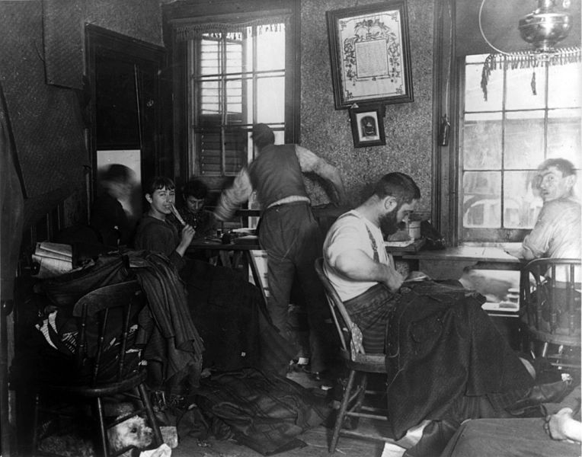

Slide 5
Unions
Labor unions – organizations of workers
Worked for higher pay
Reduction of hours
Safety regulations
Favor restricting immigration - would increase wages

Slide 6
Knights of Labor:
-1st national labor union
-Skilled and unskilled workers - Failed
American Federation of Labor (AFL):
-Led by Samuel Gompers
-Organized from skilled workers
- Used strikes and boycotts

Slide 7
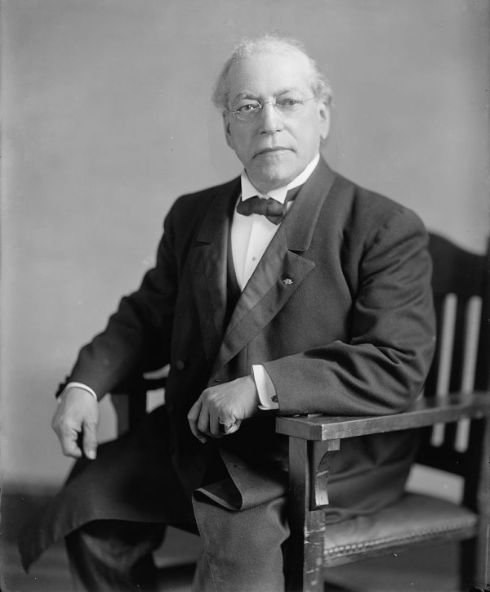
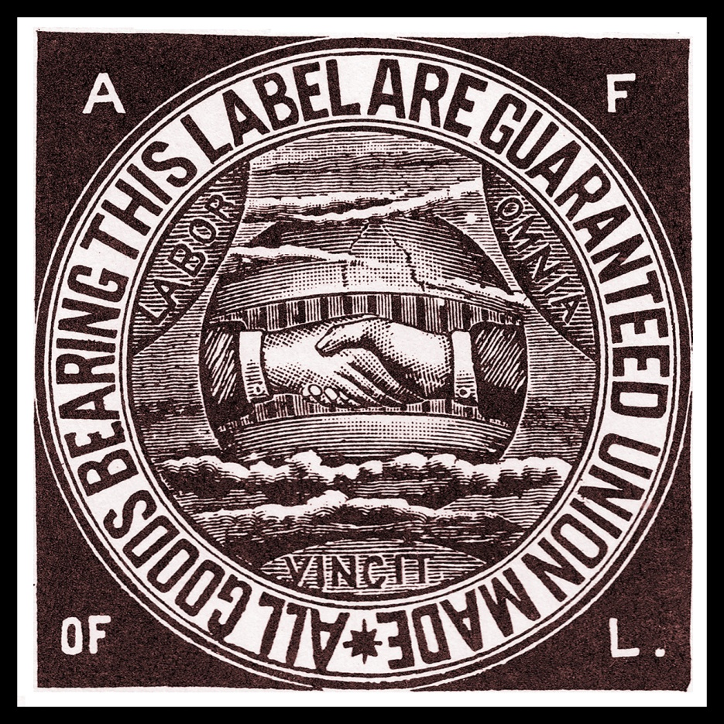
Samuel Gompers

Slide 8
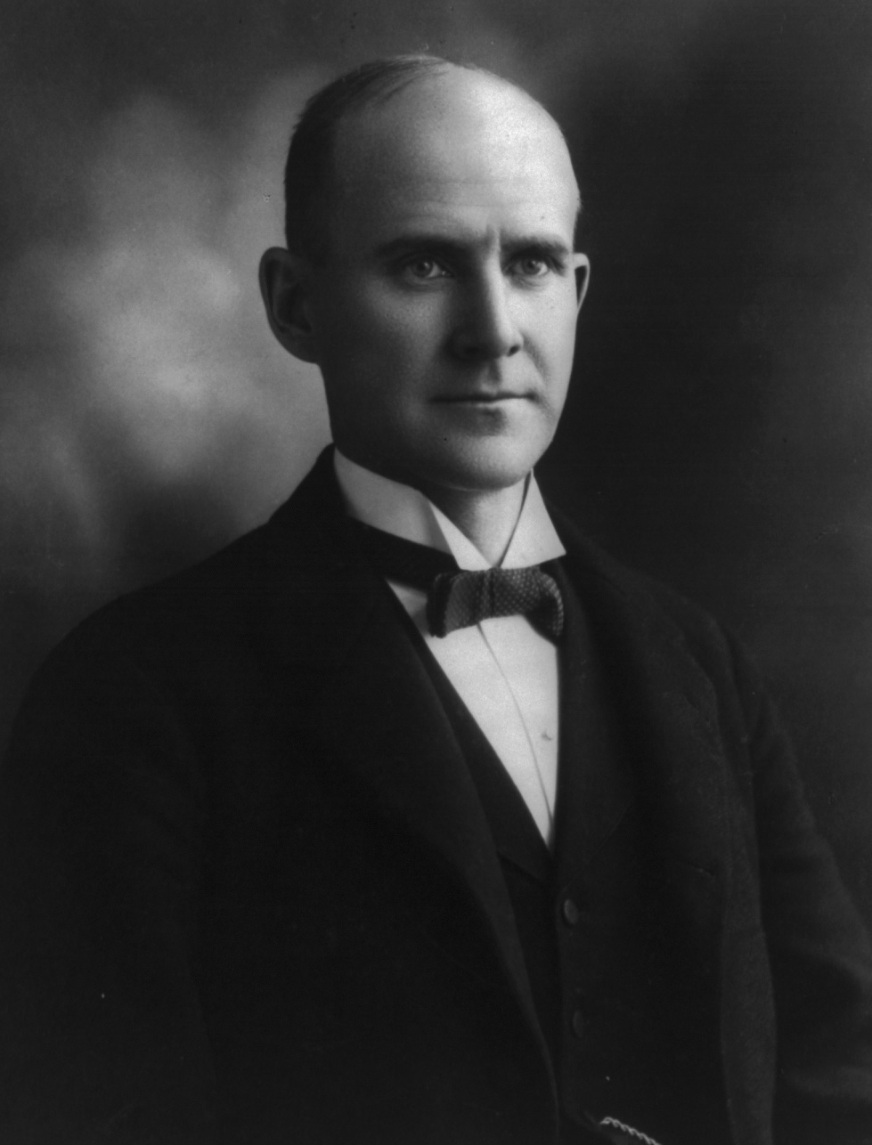
American Railway Union:
-Led by Eugene V. Debs
-United railway workers
Industrial Ladies Garments Workers Union:
-Union created for seamstresses
-Fought to get an 8-hour workday for the workers

Slide 9
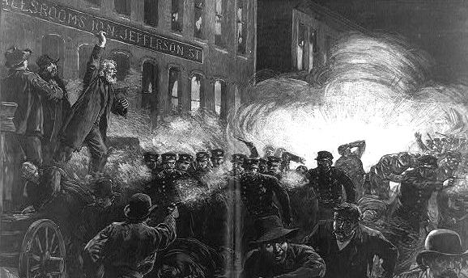
Labor Strikes
1.) Haymarket Square:
1886: Strike by McCormick Harvester workers
Violent, riot after a bomb exploded, 7 police killed, 4 labor leaders executed
Haymarket Square Video

Slide 10
2.) Homestead Strike:
1892: steelworkers - Homestead, PA
Wages cut by 1/3
A battle between the striking steel workers and “scabs” (strikebreakers)
13 people killed

Slide 11
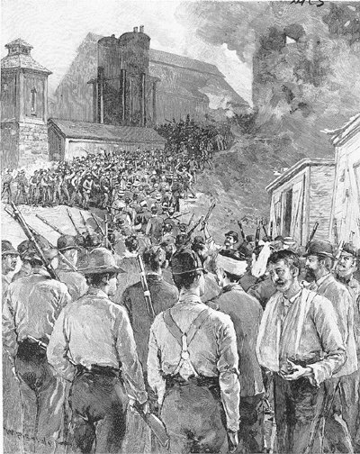
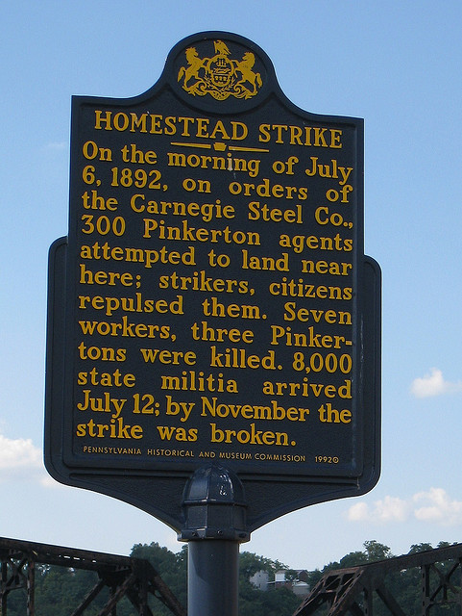
Homestead Strike Video

Slide 12
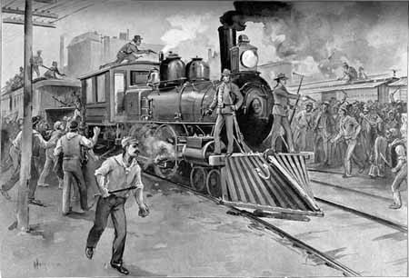
3.) Pullman Strike:
1894: Railway workers, led by Eugene V. Debs
Violence and riots erupt
Federal troops sent in

Slide 13
Progressivism
Progressivism - movement that attempted to fix problems associated with immigration, city growth, and the increasing power of giant corporations during the Industrial Period
“Gilded Age” (Glittered with wealth, but rotten to the core) – term coined by Mark Twain
Practices of the Robber Barons (powerful business men and bankers) - used whatever means necessary to make themselves richer
Addressed bad working conditions
Child labor
Long hours and low wages
Lack of safety
Lack of job security and benefits
Company towns

Slide 14
THE IDEALS
Reduce political corruption - reform town and state governments
Government regulation of big business
To get rid of social injustices
Pass laws protecting workers and the poor

Slide 15
ANALYSTS
Muckrakers - Writers who exposed the “ills of society”
Jacob Riis
Wrote articles about the conditions of the poor in urban areas
Upton Sinclair
Wrote The Jungle
Exposed the meat packing industry
Ida Tarbell
Wrote History of the Standard Oil Company
described how John Rockefeller amassed his power and wealth

Slide 16
ACTIVISTS
Florence Kelley
Exposed the hazards of child labor
Children working in most hazardous factories
Wanted to outlaw child labor
Organized boycotts against goods manufactured by children
Jane Adams
Created Hull House - a settlement house in Chicago
Immigrants and the poor could come and learn English, talk about politics

Slide 17
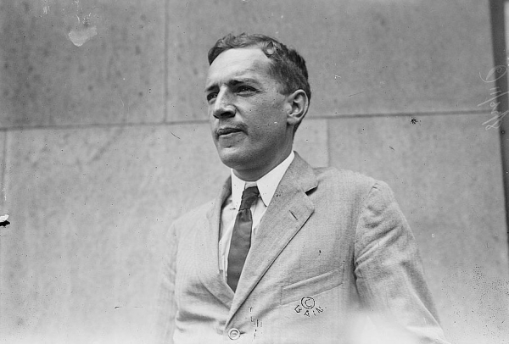
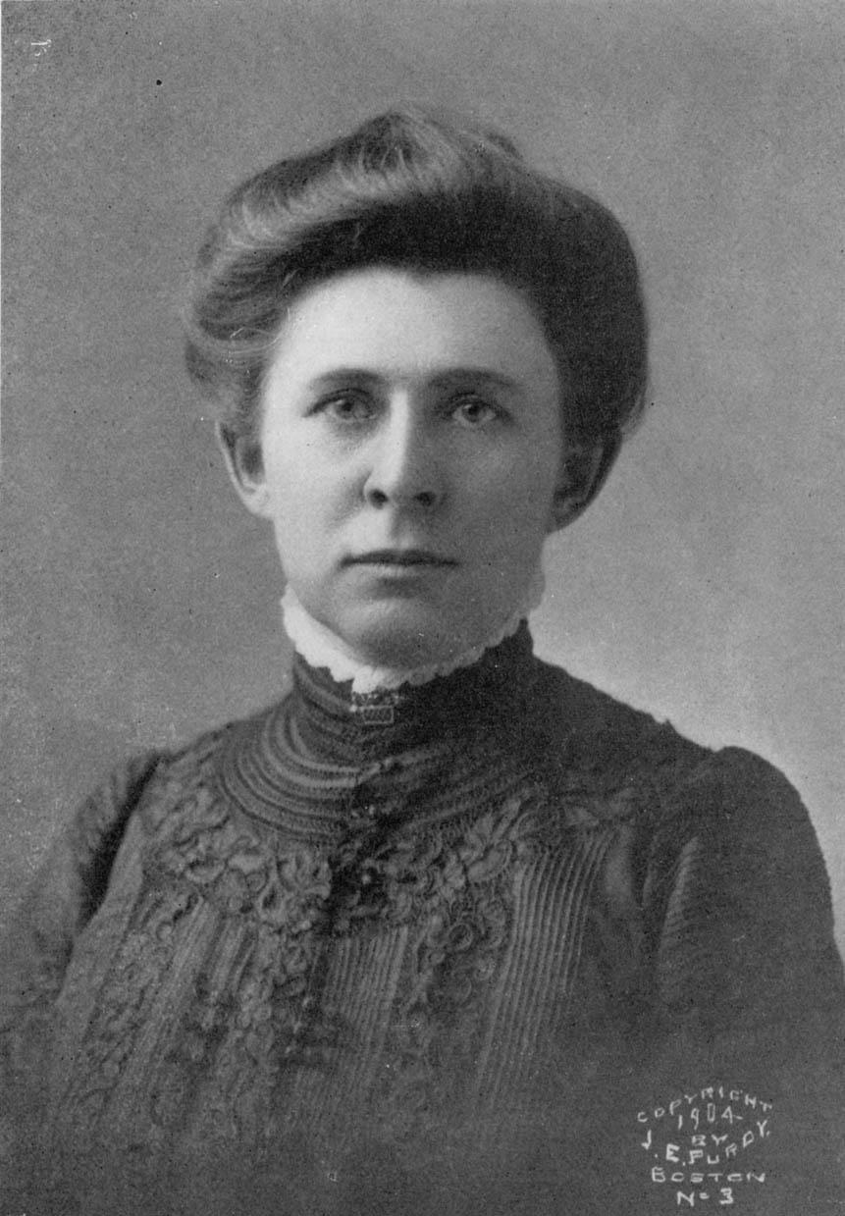
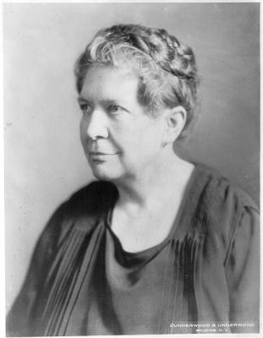
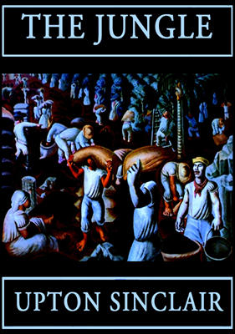
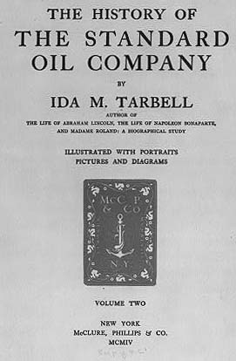
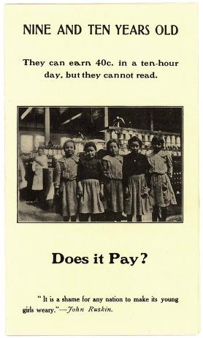

Slide 18
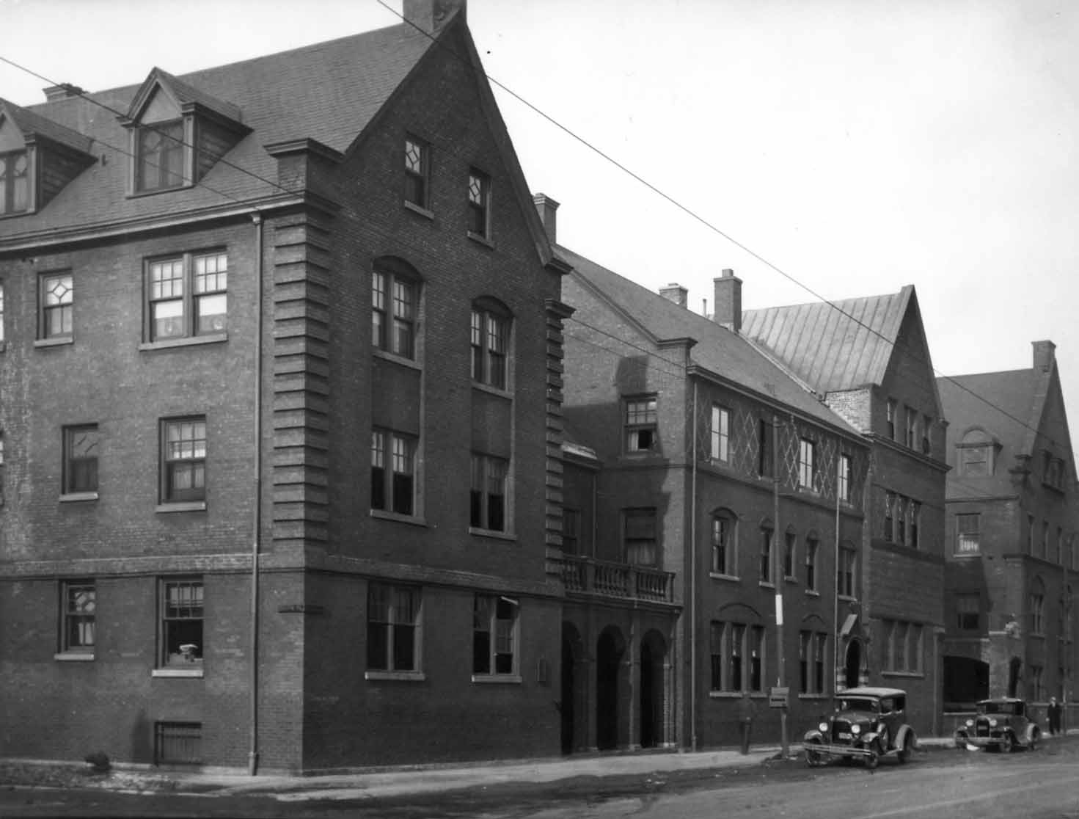
Jane Adams’ Hull House

Slide 19
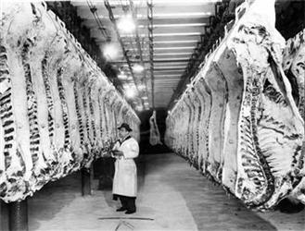
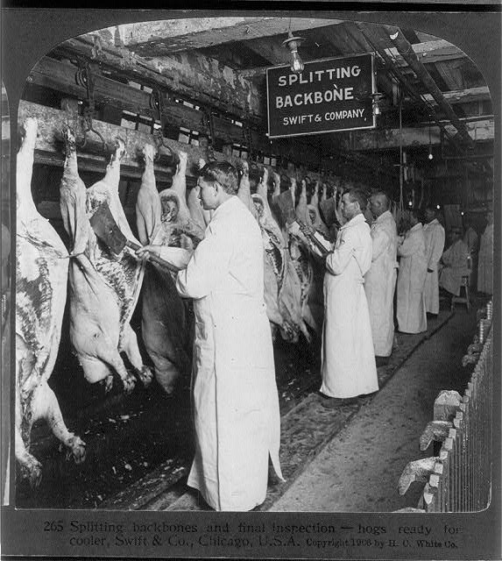
Meat Inspection Act:
T. Roosevelt read The Jungle
1906: Meat Inspection Act passed
Set standards for meat-packers - Federal meat inspection was created

Slide 20
Pure Food and Drug Act:
Prohibited the manufacture, sale, or shipment of impure or falsely labeled foods in interstate commerce
Contents had to be accurately labeled

Slide 21
National Parks:
Conservationists (Johan Muir) - Federal government creates 13 forest reserves with over 21 million acres of land
T. Roosevelt created 5 national parks

Slide 22
Progressive Changes in Government and Economics
1.) Interstate Commerce Commission (ICC):
Regulated Railroads
2.) Federal Trade Commission (FTC):
Stop unfair trading and business practices among companies
3.) Sherman Anti-Trust Act:
1890 - Banned business activities that reduced competition
4.) Clayton Act:
1914 - Broadens the Sherman Anti-Trust Act
Outlawed price fixing

Slide 23
5.) 16th Amendment:
federal income tax
6.) Federal Reserve Act:
Central bank to regulate the nation’s private banks
Controls the “Money Supply” – Monetary Policy
7.) 17th Amendment:
Direct election of U. S. senators by popular vote
Before this amendment, state legislatures elected U. S. Senators
8.) 19th Amendment:
Gave women the right to vote (allowed for women’s suffrage)

Slide 24
9.) Wisconsin Reforms: Rober LaFolette
Referendum—People directly vote on bills from State legislatures
Initiative—People start bill by petition, State legislatures vote on it
Recall—voters can remove an elected official from office through a direct vote
10.) Local Government—City Manager:
Hired (appointed) city managers - replace elected mayors
First in Staunton, VA

Slide 25
Leaders of the Progressive Changes
Theodore Roosevelt—”Square Deal”
Based on 3 principles: conservation of natural resources, control of corporations, and consumer protection
Woodrow Wilson—”New Freedom”
Clayton Antitrust Act
Business Reform –Federal Trade Act
Banking Reform –Federal Reserve Act

Slide 26
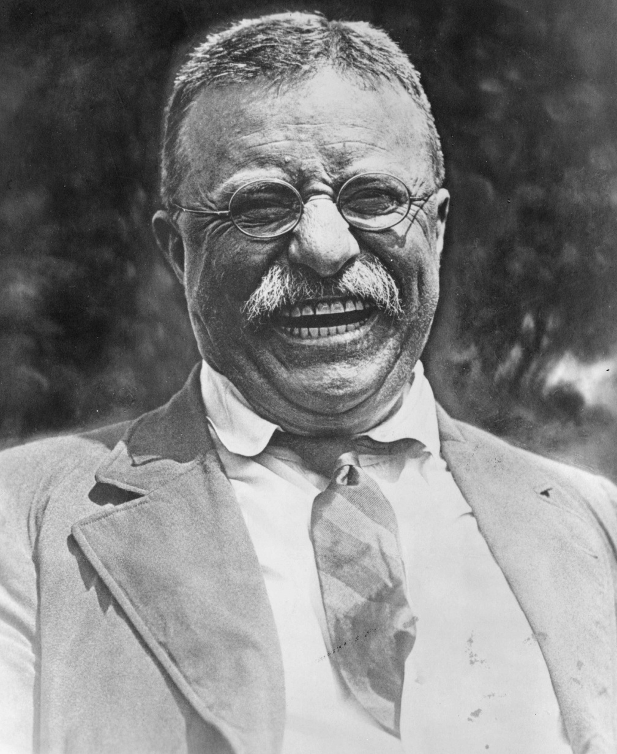
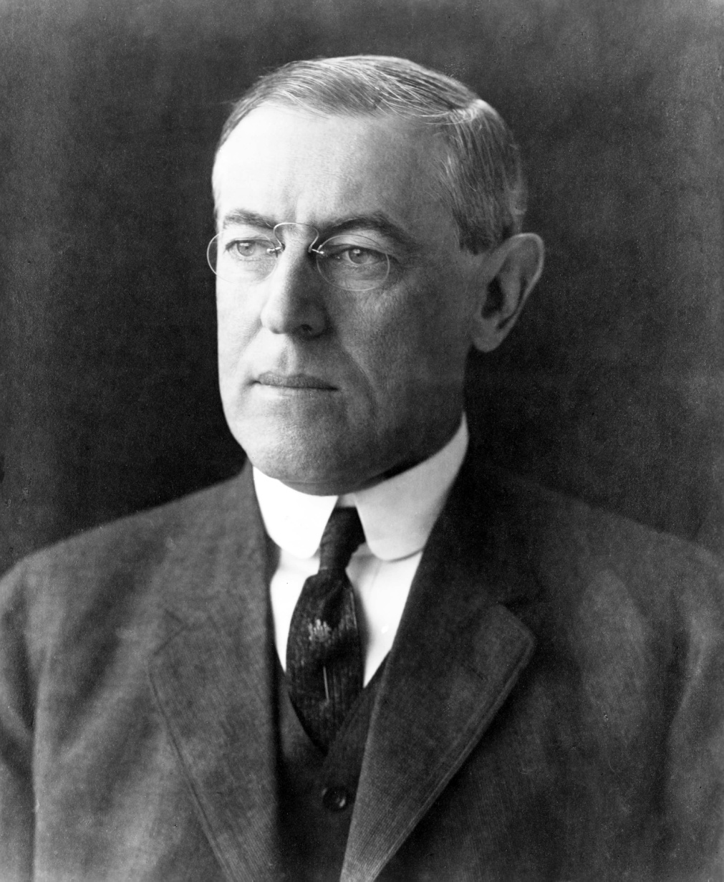
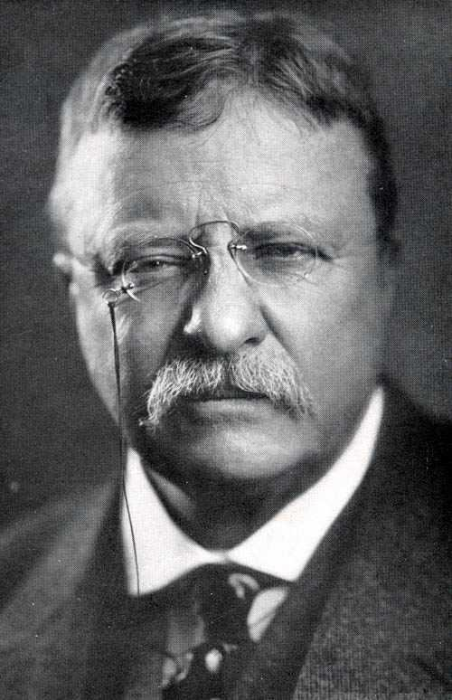
Woodrow Wilson
Theodore “Teddy” Roosevelt

Slide 27
African Americans
1.) Booker T. Washington:
Son of slave parents
Attended Hampton Institute, VA
Founded Tuskegee Institute in Alabama in 1881
Vocational education
African Americans could achieve economic prosperity, independence, and the respect of whites
Accepted by whites because he didn’t challenge existing social conditions such as segregation

Slide 28
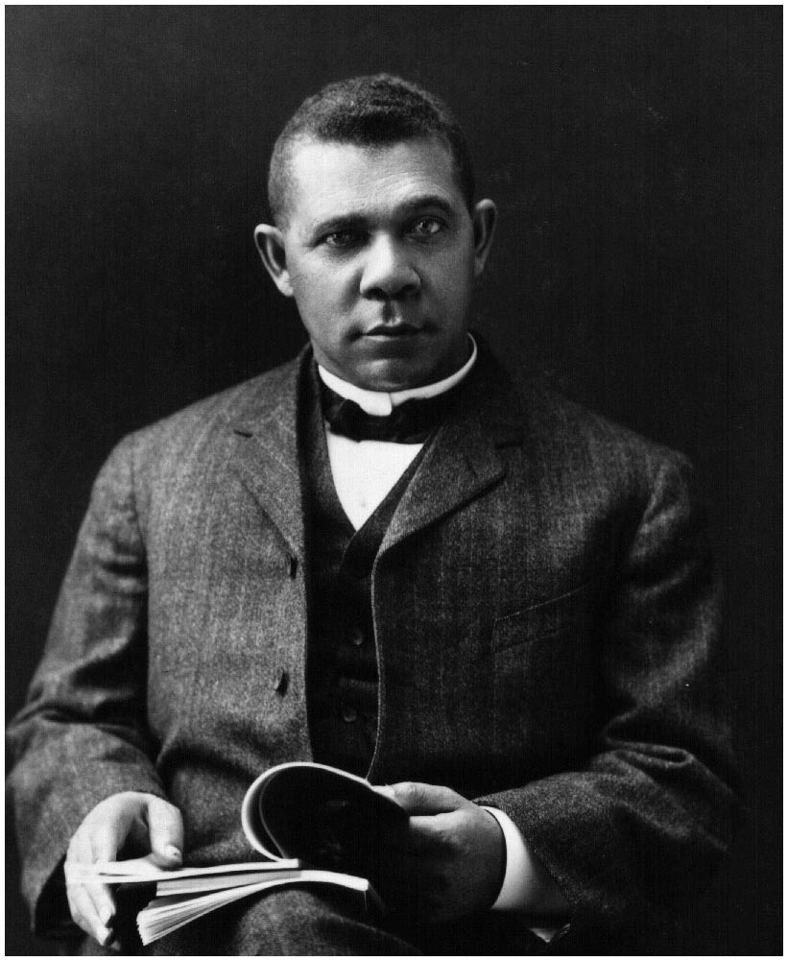
Booker T. Washington

Slide 29
2.) W. E. B. Dubois:
Degree from Harvard University
Believed education was meaningless without equality
Demanded equality at once
Helped created the NAACP (National Association for the Advancement of Colored People)
Wanted African American children to have equal opportunities in education

Slide 30
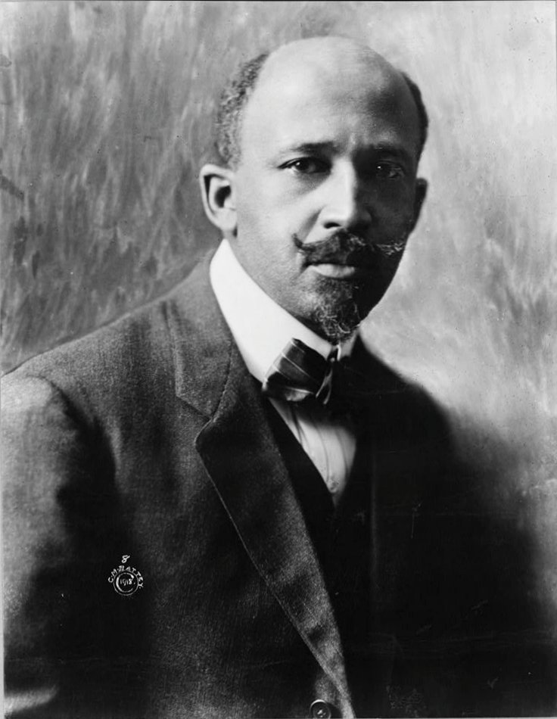
W. E. B. Dubois

Slide 31
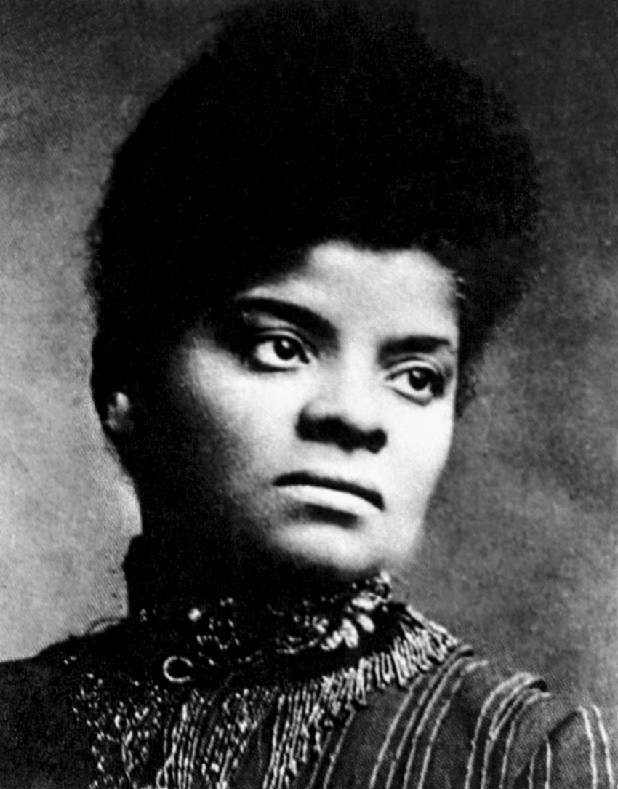
3.) Ida B. Wells:
Led an anti-lynching crusade

Slide 32
Jim Crow Laws
-made it legal to segregate blacks and whites
1896: Plessy v. Ferguson
-upheld “Jim Crow”
-established “Separate but Equal”

Slide 34
The “Great Migration”
African Americans moved to northern cities looking for jobs
escape the poverty in the South
escape discrimination in the South

