Slide 1
TEST #4 Lecture Notes
Industrialization and Immigration VUS.8

Slide 2
Settling the West
After Civil War, settlement - Mississippi River to Pacific Ocean
American cowboy, long cattle drives for hundreds of miles over unfenced open land
Homestead Act 1862
Gave 160 acres of free land if you lived and improved it over a 5 year period
Morrill Land Grant Act
Gave land foreducational institutions that taught agriculture and mechanic arts
Virginia Tech

Slide 3
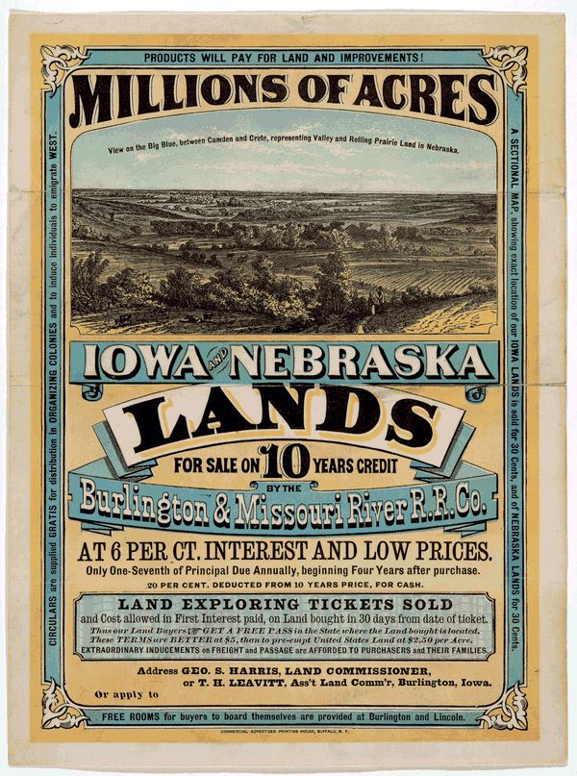
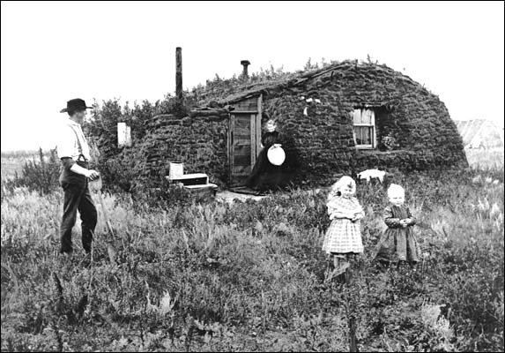

Slide 4
Settling the West
Transcontinental Railroad
opened up vast regions of the North American heartland for settlement
Linked the Union Pacific in the east to the Central Pacific in the west –Promontory Point, Utah
Chinese and Irish labor

Slide 5
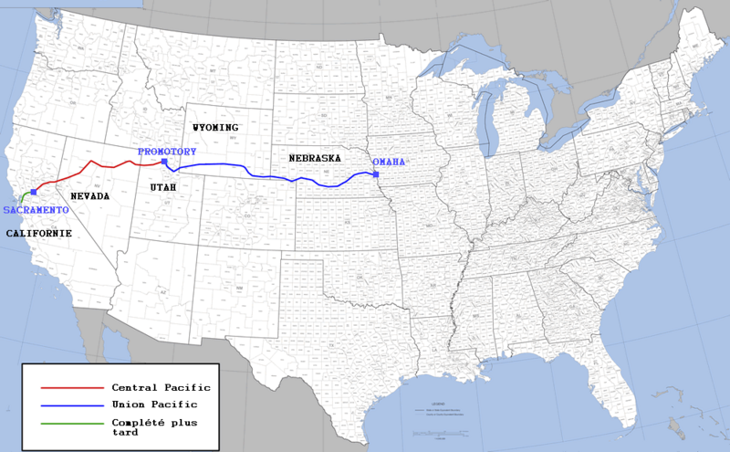
Transcontinental Railroad

Slide 6
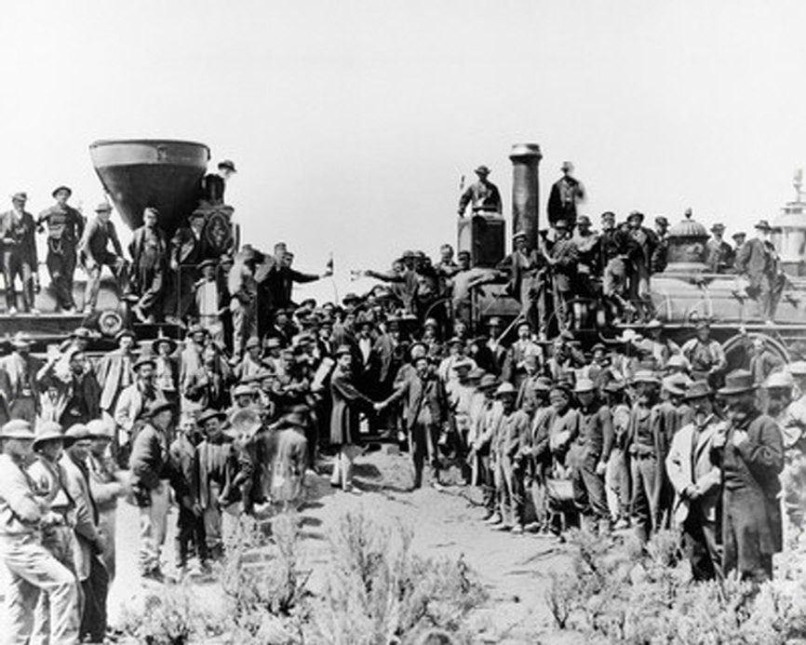
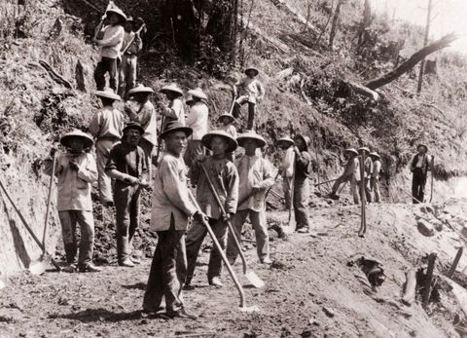

Slide 7
Settling the West
New technologies - farming profitable
Railroad
Land grants – private R.R.
Mechanical Reaper
Cyrus McCormick
A horse drawn machine – increases output

Slide 8
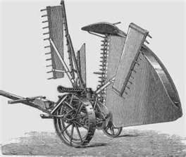
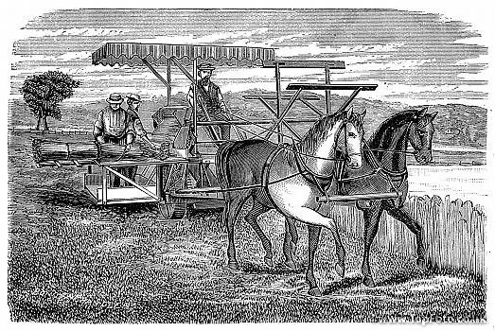

Slide 9
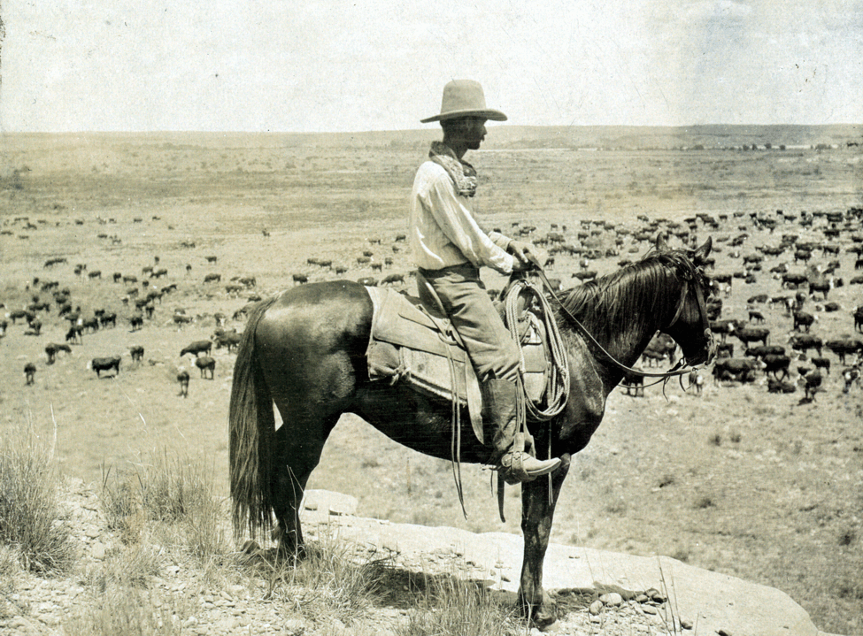

Slide 10
Immigration
Prior to 1871, most immigrants from northern and western Europe (Germany, Great Britain, Ireland, Norway, and Sweden)
1871 until 1921, most immigrants from southern and eastern Europe (Italy, Greece, Poland, Russia, present-day Hungary, and former Yugoslavia), also Asia (China and Japan)

Slide 11
Immigration
1.) Push Factors (Reasons why people left their native lands)
Religious and political persecution
Looking for a better opportunity
Relaxed immigration laws in their own nation

Slide 12
Immigration
2.) Pull Factors (reasons to come to the US)
Freedoms – religious and political
Family and friends that lived in the US
Land
Cheap labor for developing industry
Industrialists recruitment

Slide 13
Immigration and Industrialization
Jewish Immigrants
Clothing industry in New York City
Chinese Immigrants
Mines and Railroads
Irish Immigrants
Building and construction industries
Slavs, Poles, and Italians
Coal mines of West Virginia and Pennsylvania

Slide 14
Contributions of Immigrants
Food—Italian food, Chinese food, Irish Pubs
Language—Chinese, Yiddish, Italian, Slavic
Music
Dress

Slide 15
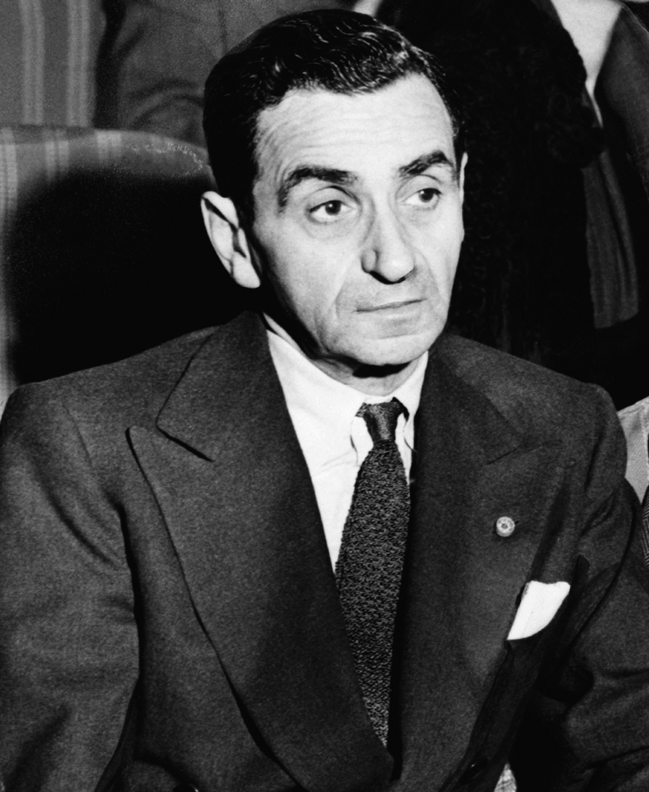
Contributions of Immigrants
Irving Berlin
Russian Composer
Wrote “God Bless America” and “White Christmas”

Slide 16
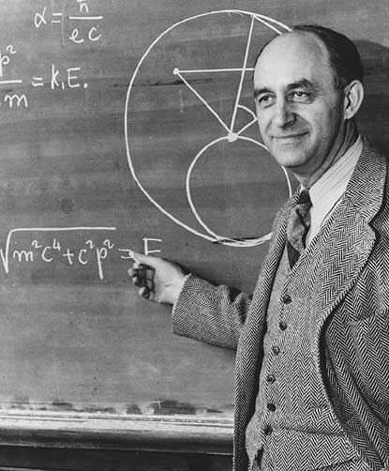
Contributions of Immigrants
Enrico Fermi
Italian
Physicist – split the atom creating nuclear power

Slide 17
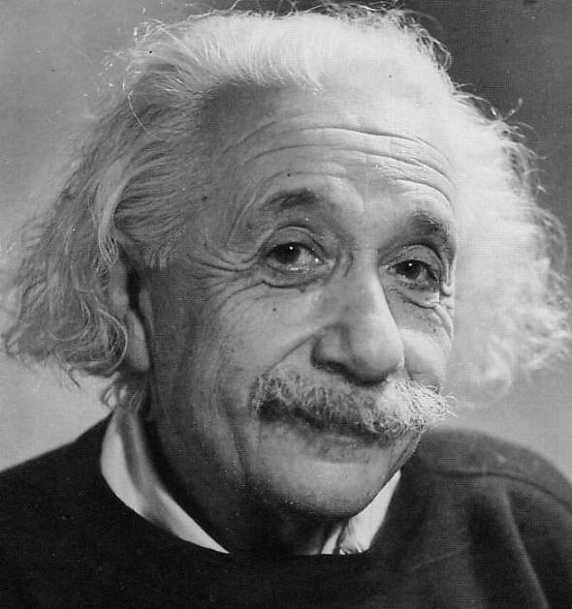
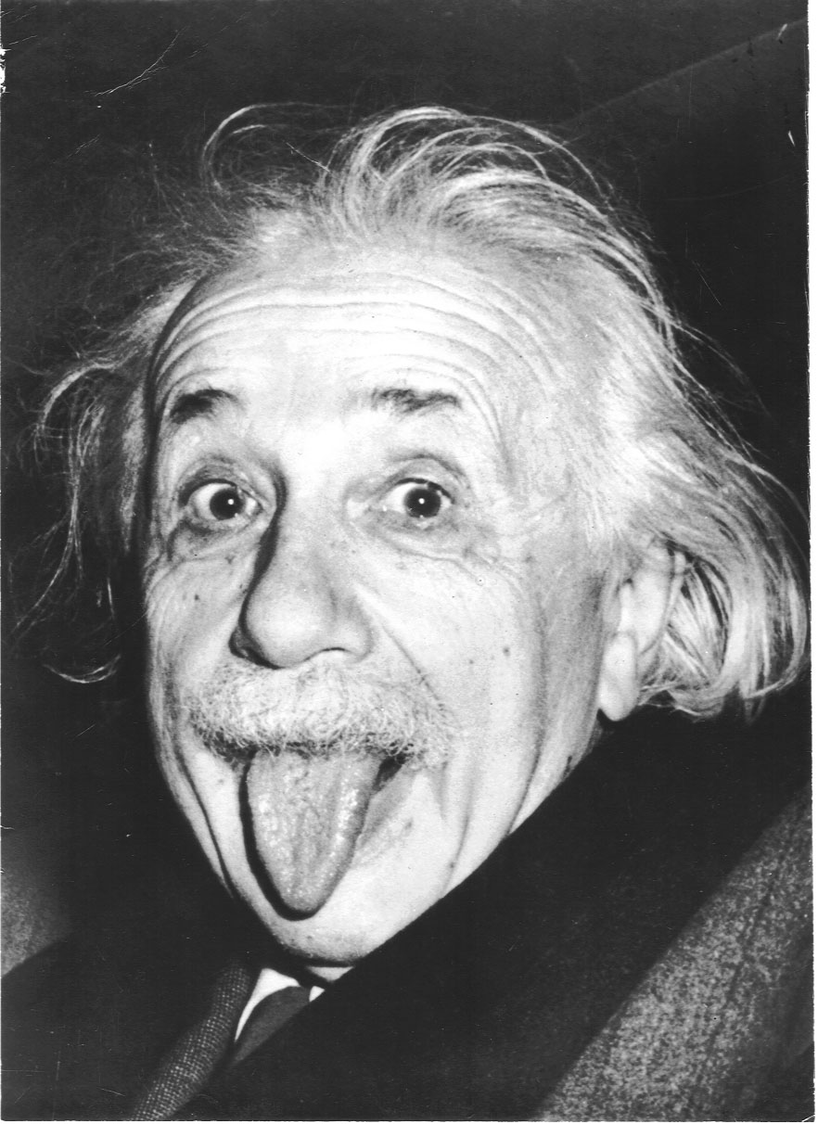
Contributions of Immigrants
Albert Einstein
German
Atomic theory
Theory of Relativity
Sent letters to FDR warning of Nazi work Atomic bomb

Slide 18
“Melting Pot”—Assimilation of Immigrants to the US
Problems facing immigrants
Prejudices - race, language, and religion
Lack of housing
The language barrier
Feared - take jobs for lower pay
Know Nothing Party
Opposed immigrants especially the Irish Catholics

Slide 19
Nativists--people against immigration—claimed that the immigrants’ language, customs, and ideas upset the American way of life
-took jobs – “we don’t hire Irish”
-threat to democracy
Ellis Island
New York Harbor
Statue of Liberty
immigrant receiving station

Slide 20
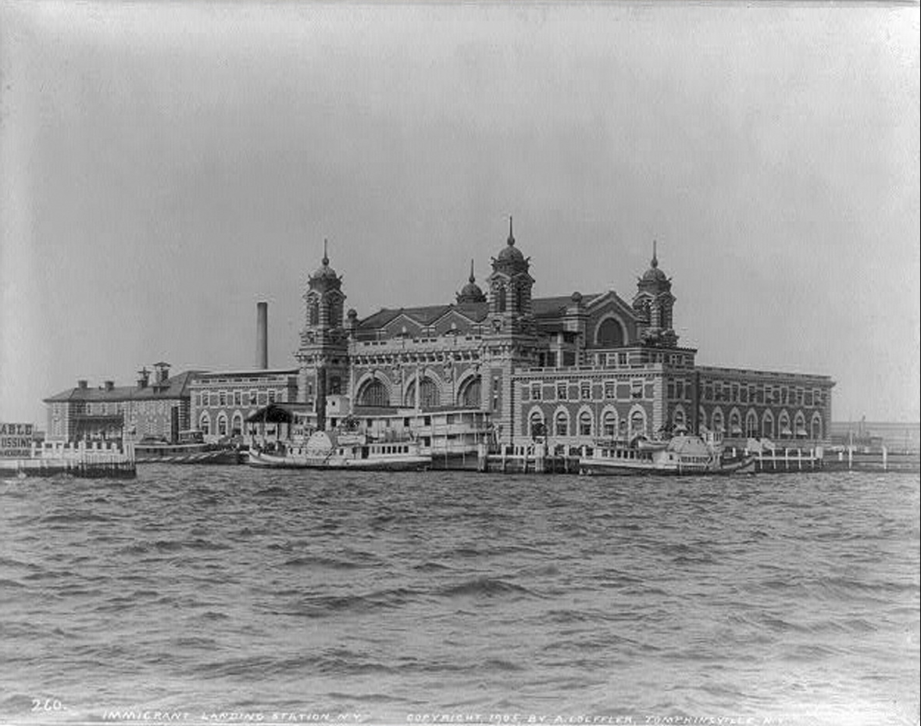
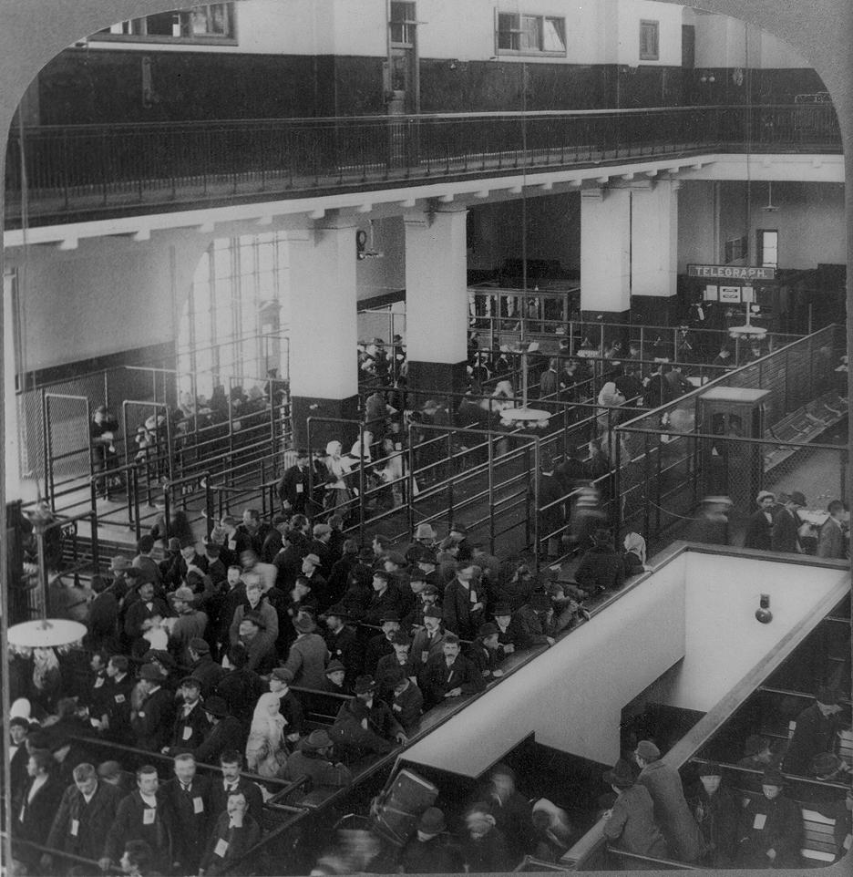
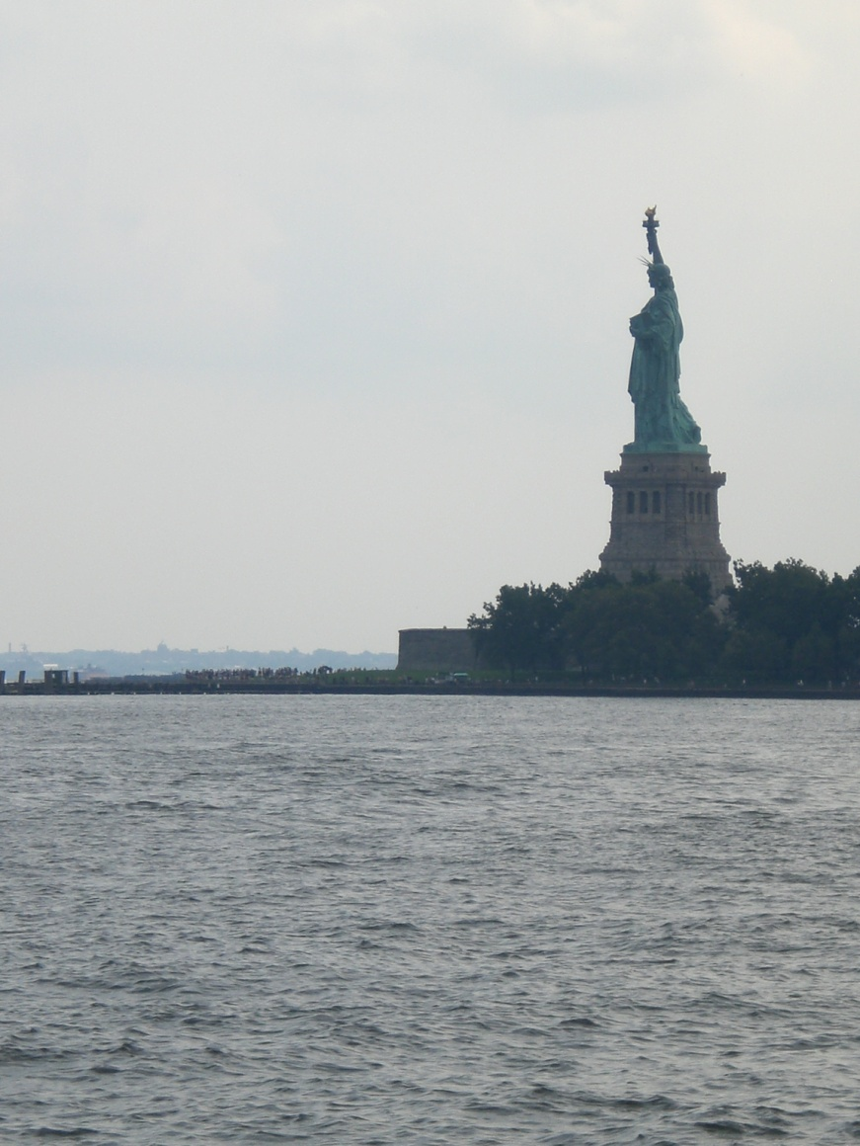

Slide 21
Legislation limiting immigration
Chinese Exclusion Act (1882)
Banned Chinese immigration to the US for 10 years
Immigration Restriction Act (1921)
Created a quota system - restricts immigration except Northwest Europe

Slide 22
Urbanization—the Growth of Cities
Chicago, Detroit, Cleveland, Pittsburgh, and New York grew from manufacturing and transportation centers
provided jobs
harsh conditions – tenements
Pollution
Waste thrown in streets
Lack of sewage – Disease
Violence – lack of police
New York City - Subway system
Trolley system - Richmond, VA

Slide 23
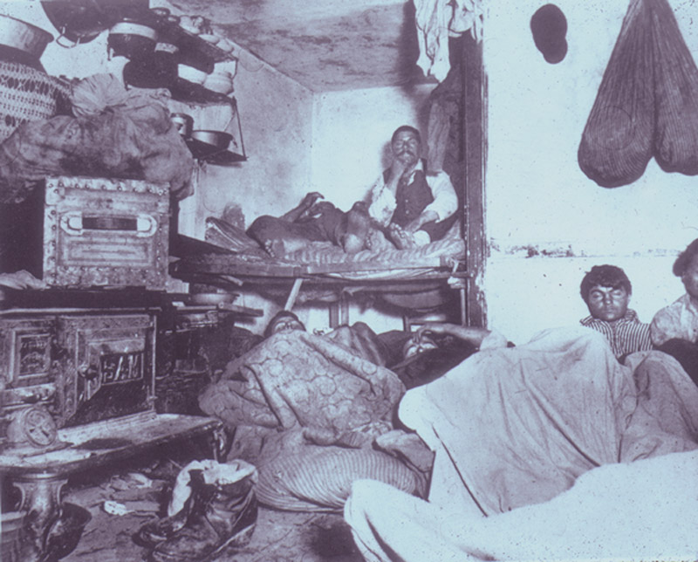

Slide 24
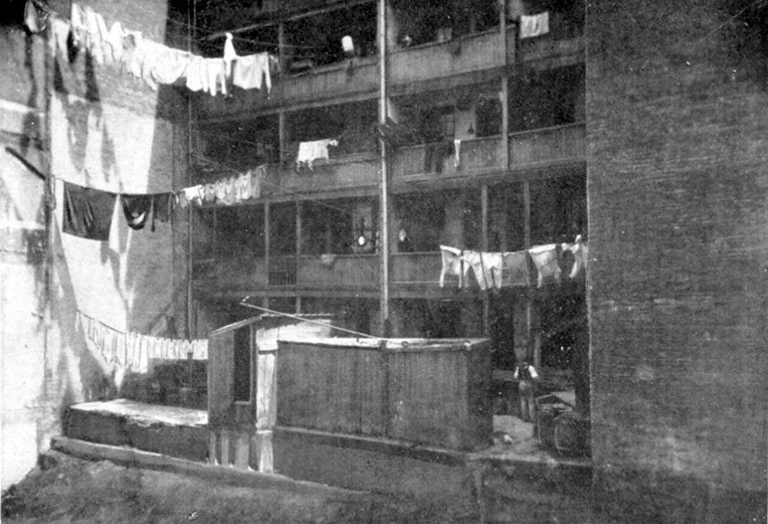

Slide 25
Political Machines
Political machines
Created to win votes – “did favors”
Did provide services especially for immigrants
Tammany Hall – New York City

Slide 26
Industrial Revolution
Electricity—Light Bulb—Thomas Edison
Bessemer Process—Henry Bessemer
Method of making cheaper steel
Assembly Line— Pioneered by Henry Ford -cars became more affordable
Airplane—Wright Brothers
First powered flight
Telephone—Alexander Graham Bell
Communication over long distances
Railroads—Cornelius Vanderbilt
transport raw materials and finished goods

Slide 27
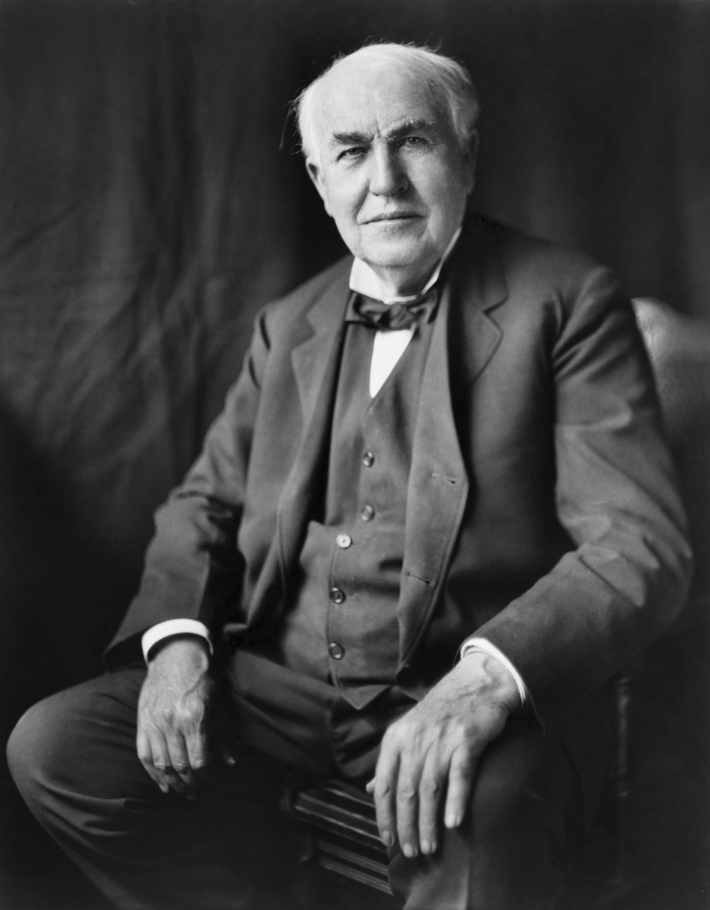
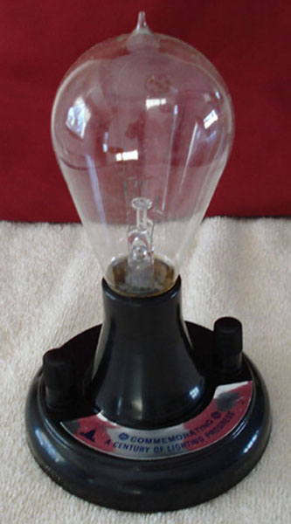
Thomas Edison

Slide 28
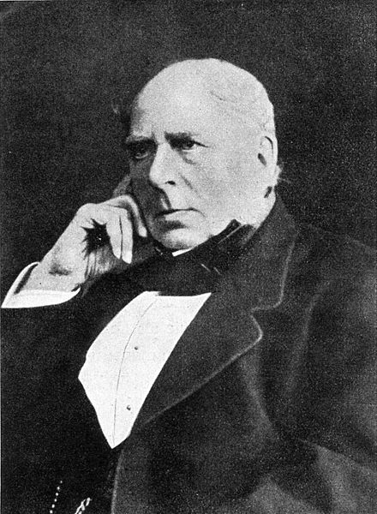
Henry Bessemer

Slide 29
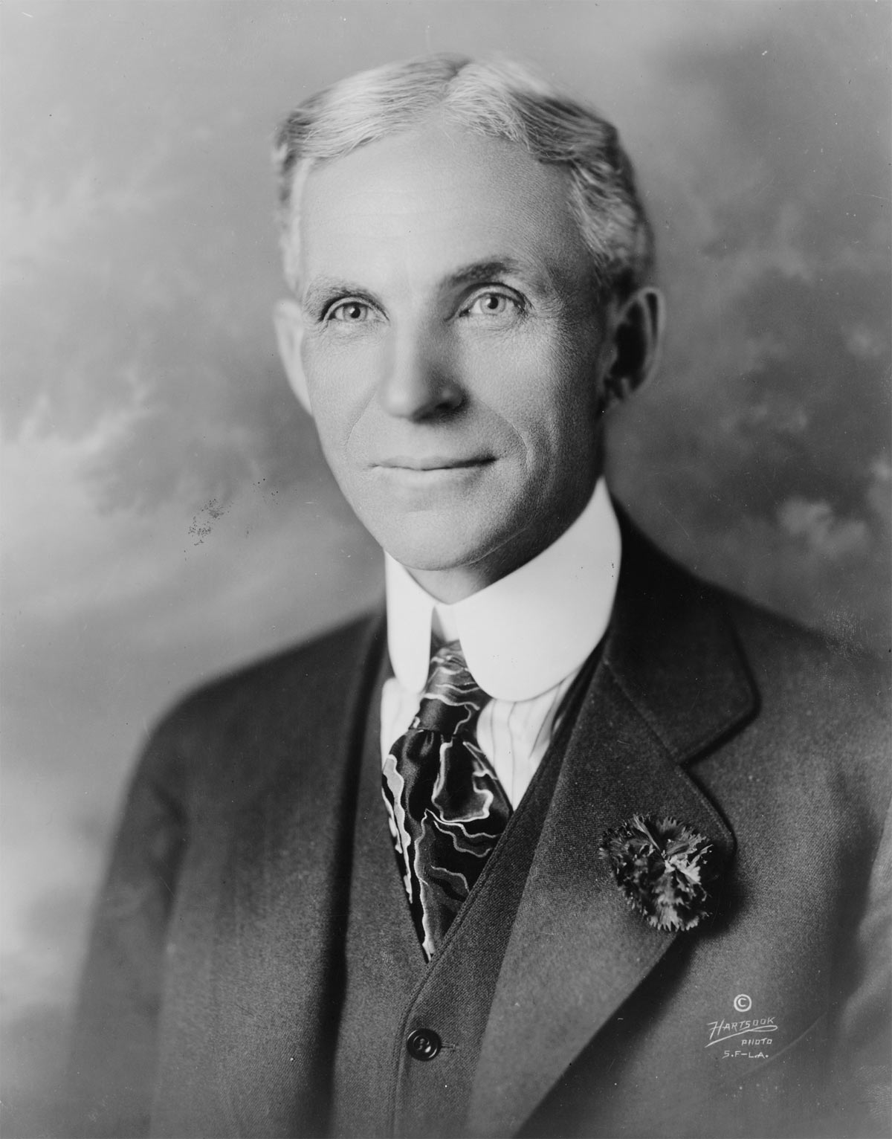
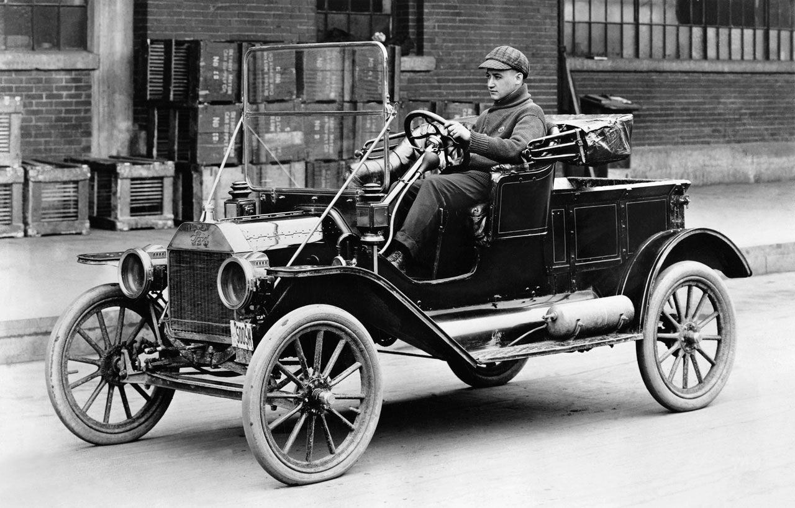
Henry Ford

Slide 30
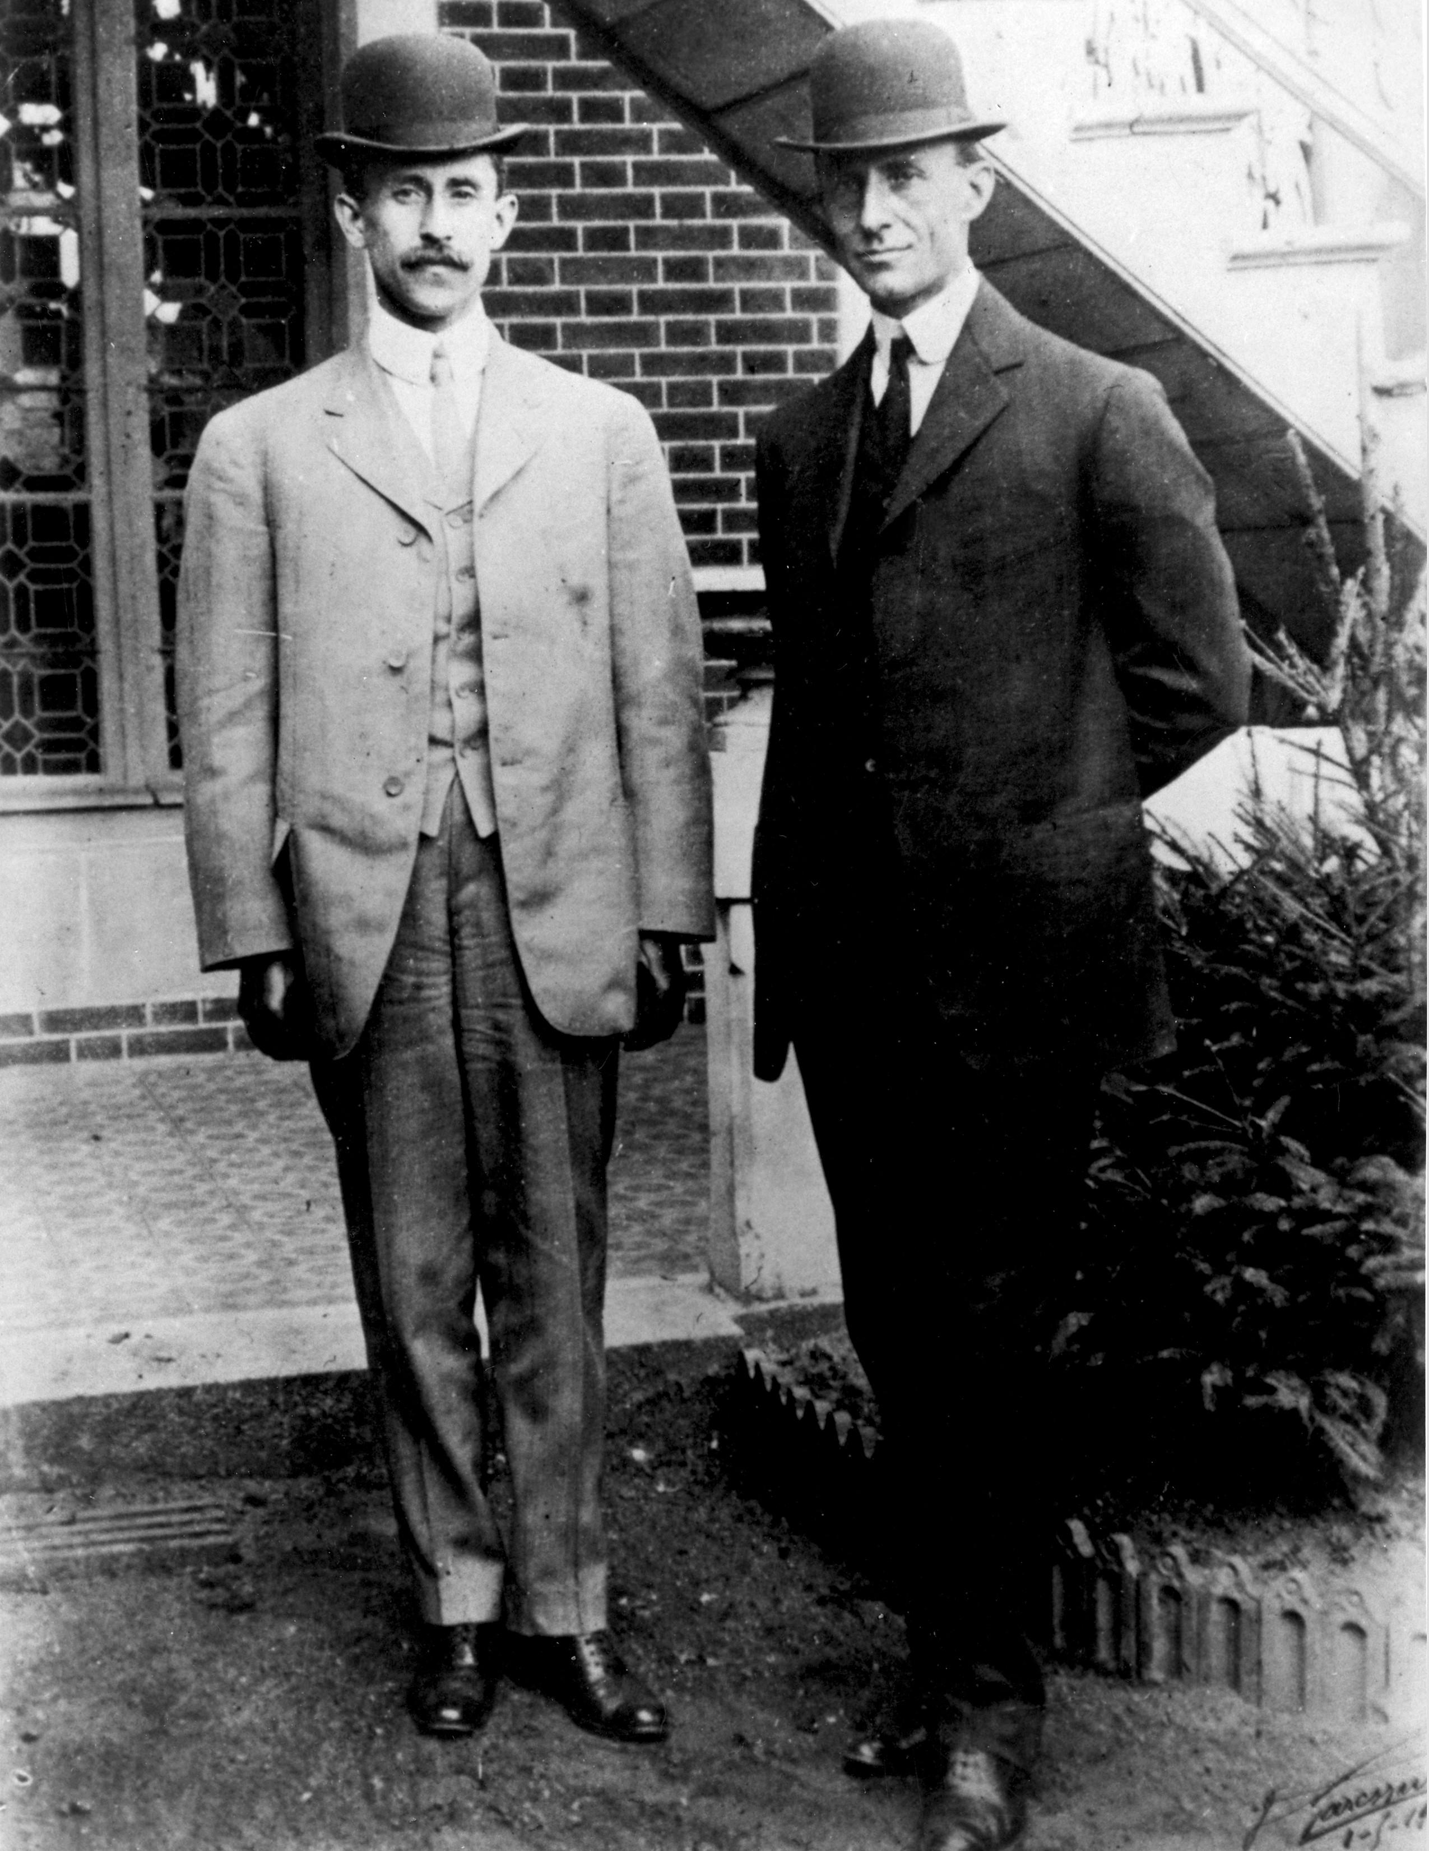
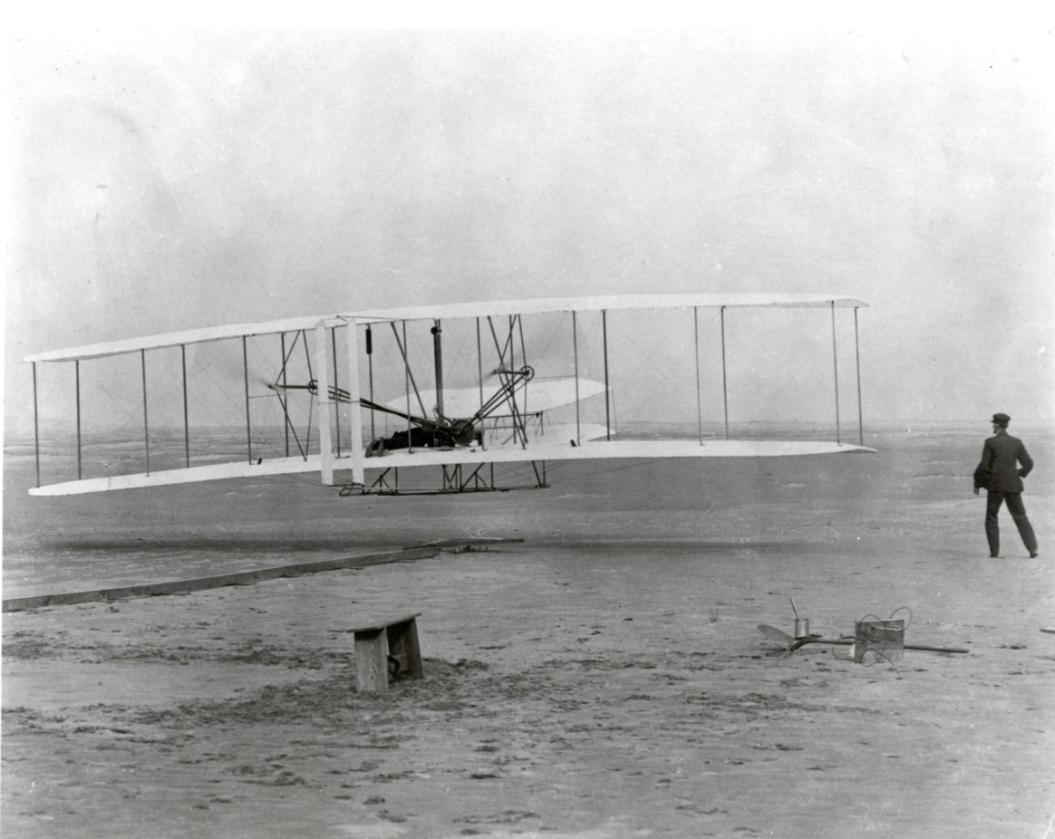
Wright Brothers
Video

Slide 31
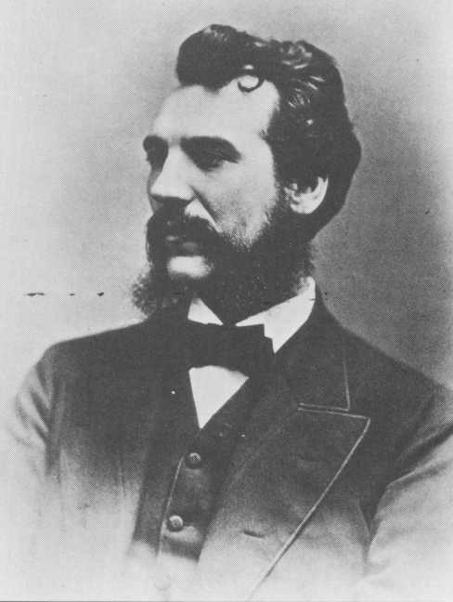
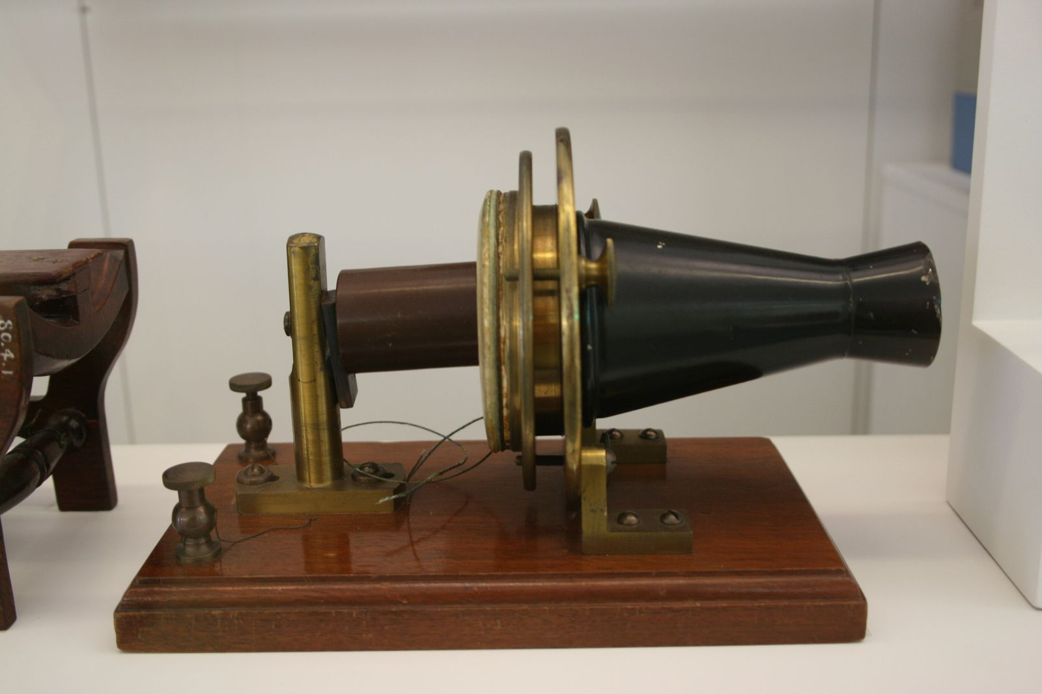
Alexander Graham Bell

Slide 32
Horizontal vs. Vertical Integration
Advantages of creating corporations
Limited Liability
If a corporation fails, shareholders normally only stand to lose their investments – Not liable otherwise
Raising Capital
Allows company to create more money by borrowing or selling more stock

Slide 33
Horizontal vs. Vertical Integration
1.) Horizontal Integration:
A company merges or buys all of the other competing companies
Used by Rockefeller
Single company controls one particular part of industry – A MONOPOLY
2.) Vertical Integration:
Company control all aspects of production—from the acquisition of raw materials to the final delivery of the product
Used by Carnegie

Slide 34
Trusts and Laissez-Faire Economics
A Trust - combination of companies that dominate an industry
Laissez-faire economics
Doing business without any government interference or regulation

Slide 35
1.) Andre Carnegie
Poor Scottish immigrant
Steel industry
Bought up coal mines and iron ore deposits
purchased railroads and ships to transport the raw materials and send the materials to market
Controlled every aspect of the steel production

Slide 36
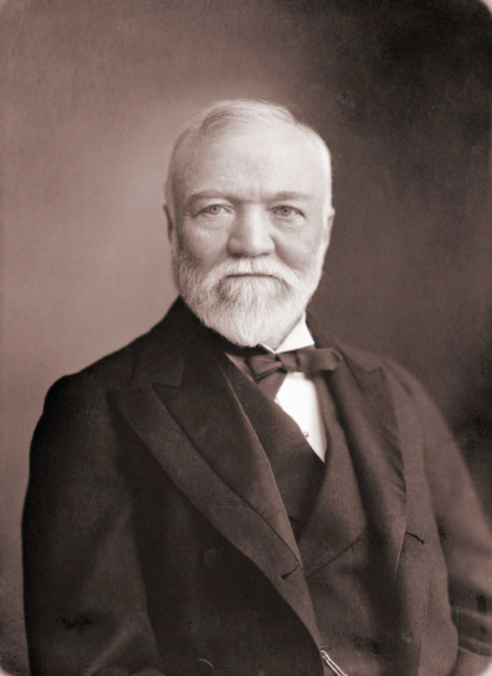
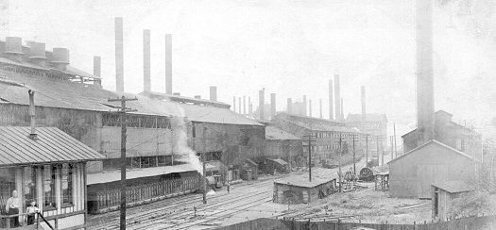
Andrew Carnegie

Slide 37
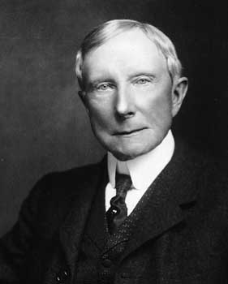
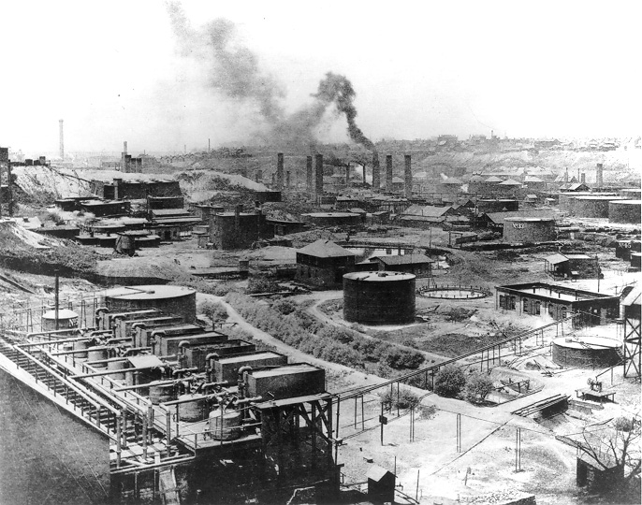
2.) John D. Rockefeller
refined kerosene from petroleum
Standard Oil Company
Tried to purchase all competing oil companies
Standard Oil controlled most of America’s oil industry

Slide 38
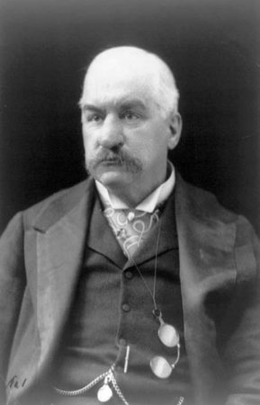
3.) J. P. Morgan
1901: Morgan purchased Carnegie’s steel company
Created U. S. Steel
Controlled banking
J. P. Morgan

Slide 39
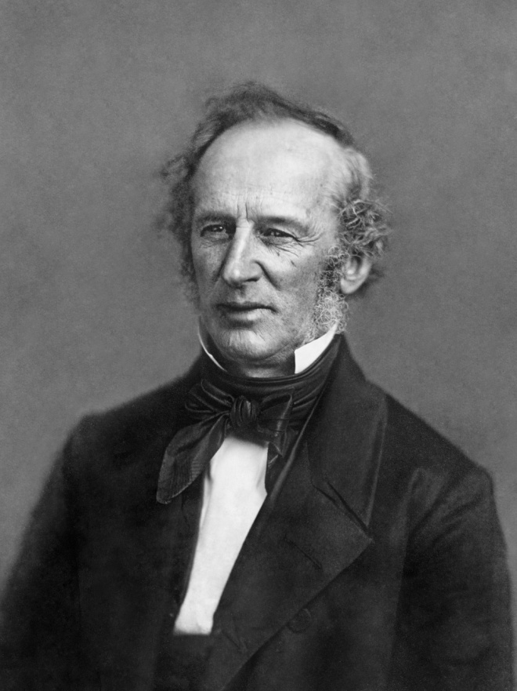
4.) Cornelius Vanderbilt
Controlled the railroad industry

