Slide 1
Colonization & Revolution
Test #1
US History

Slide 2
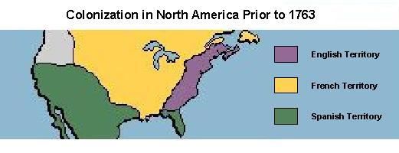
Strategies for Colonization
Spain - Government financed - Central & South America
England – Joint-stock companies – Atlantic coast of North America
France – More cooperative with Natives - Canada

Slide 3
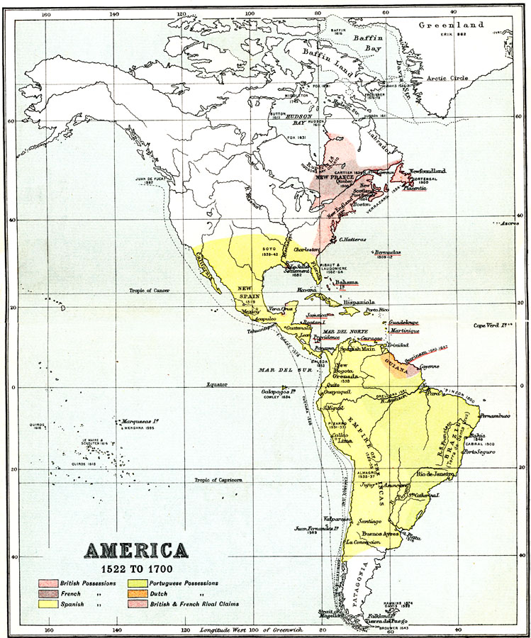

Slide 4
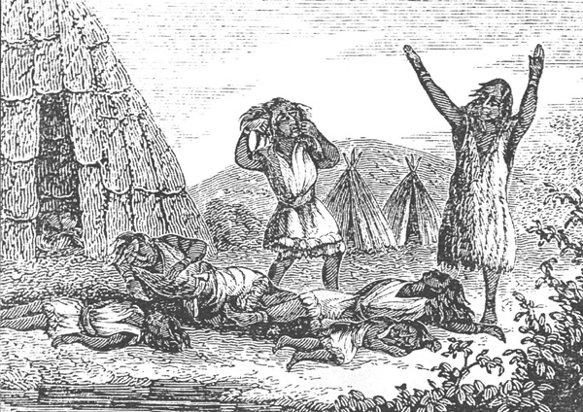
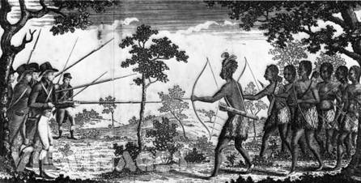
Effects of Europeans on Indians
Diseases – decline in populations
Loss of land to European whites
Resistance – King Philip’s War

Slide 5
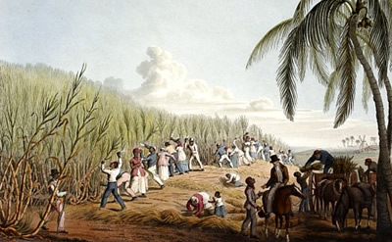
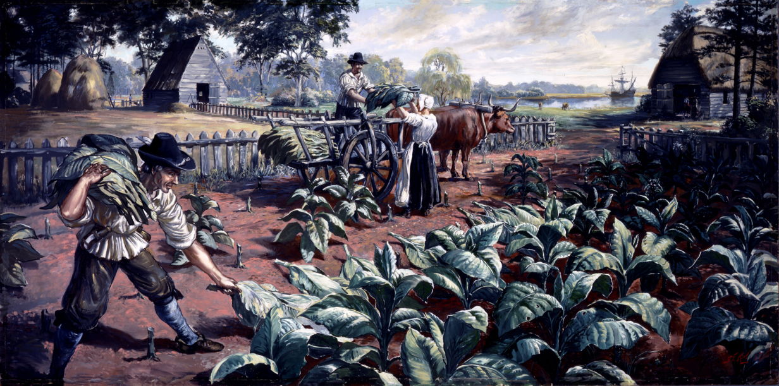
African Slaves
Introduced in Caribbean by Spain – agricultural economy – Sugar Cane
Plantations—large land holdings
1619 – Jamestown—tobacco
“Middle Passage”—slave passage to New World from Africa
Indentured servants until the 1660s in VA

Slide 6
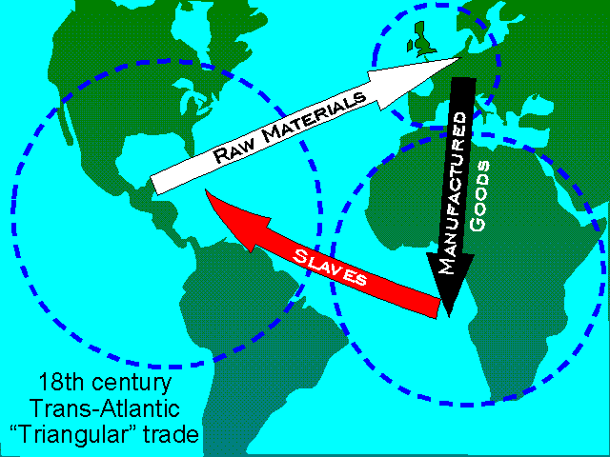
Triangular Trade

Slide 7
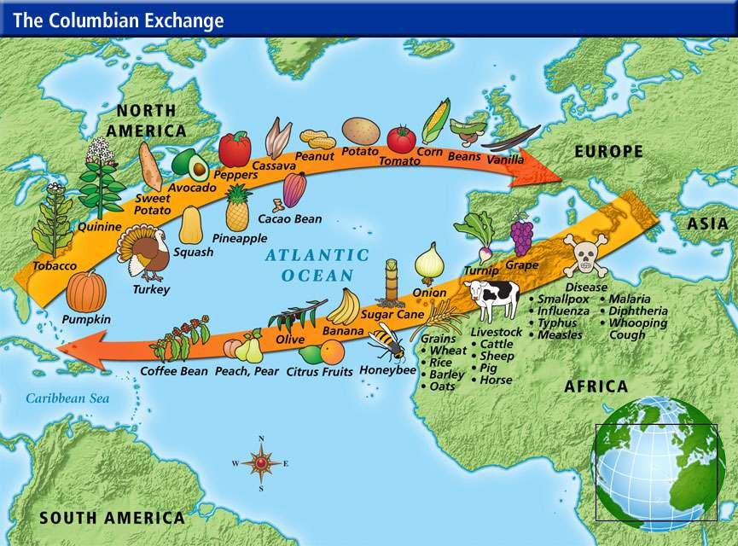

Slide 8
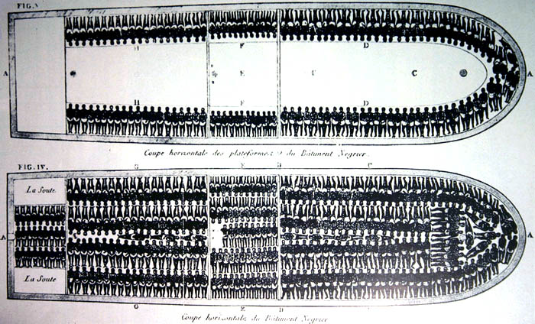

Slide 9
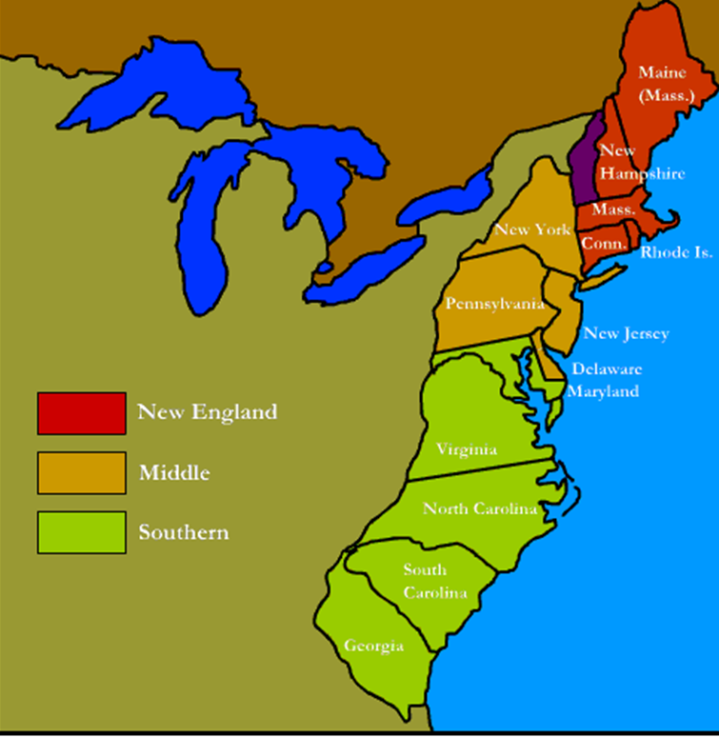
Colonial Region Settlement
Complete the 13 Colonies Map Activity to keep in your notebook to study.

Slide 10
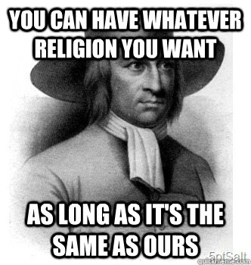
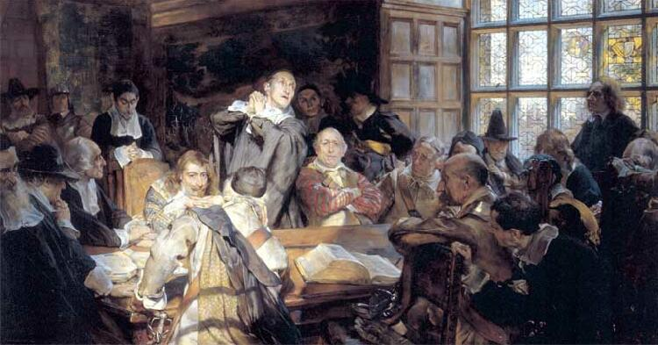
New England
Religious Freedom
Puritans – intolerant of others
Mayflower Compact – “Covenant Community”
Town meetings – “Athenian” direct democracy
Rhode Island – Puritan dissenters
Fishing, shipbuilding, small scale subsistence farming, & lumber
“Puritan Work Ethic” – hard work prevents sin

Slide 11
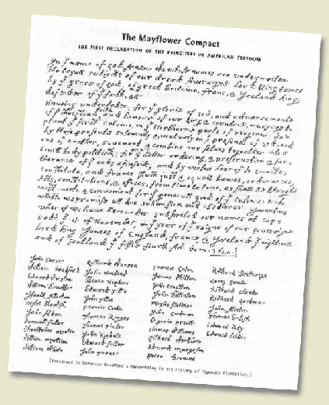
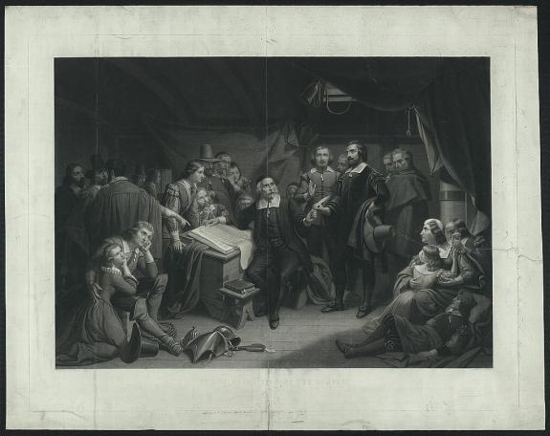
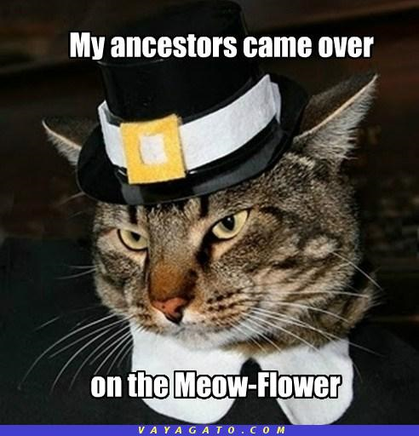
Mayflower Compact

Slide 12
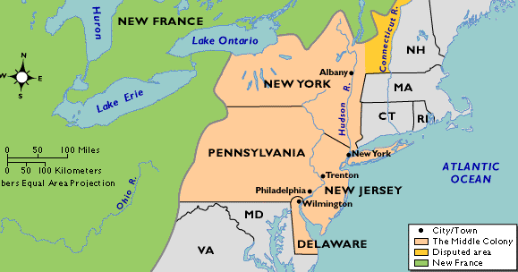
Middle Colonies
English, Dutch, & German
Religious Freedom & Economic Opportunity – tolerant of other religions
More flexible social structure
Incorporated democratic principles reflecting basic rights of Englishmen
Quakers – Pennsylvania (William Penn)
Huguenots & Jews –New York
Presbyterians – New Jersey
Shipbuilding, small scale farming, commerce & trade
Middle Class - skilled artisans, entrepreneurs (business owners), & small farmers
Seaports – New York City & Philadelphia

Slide 13
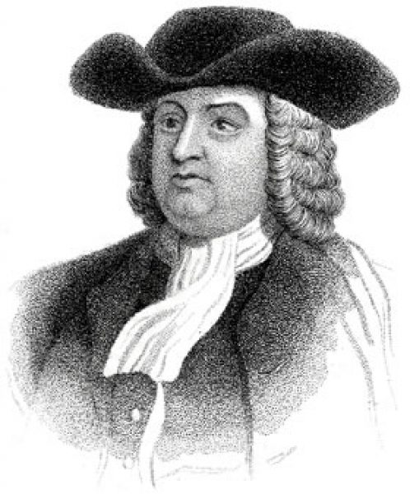
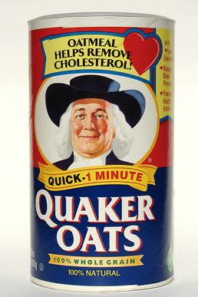
William Penn

Slide 14
VA & Southern Colonies
Economic Opportunity – “Free Enterprise”
Jamestown – London Company (1607)
House of Burgesses (General Assembly)— 1st representative legislatures
Indentured Servants—work plantations - pay New World passage
Plantations
Plantations – Eastern Coastal Lowlands (Tidewater)
Cash crops—tobacco, rice, and indigo grown for export
African slaves - labor/slave based economy
Poor – Scots-Irish
Shenandoah Valley and Appalachian foothills
Subsistence farming
“Cavaliers”
Nobility – large land grants (Headright system)
Dominated colonial government and society due to family status
Maryland – Catholics
Southern colonies – close ties - Church of England (Anglican Church)
Slavery based economy eventually leads to American Civil War

Slide 15
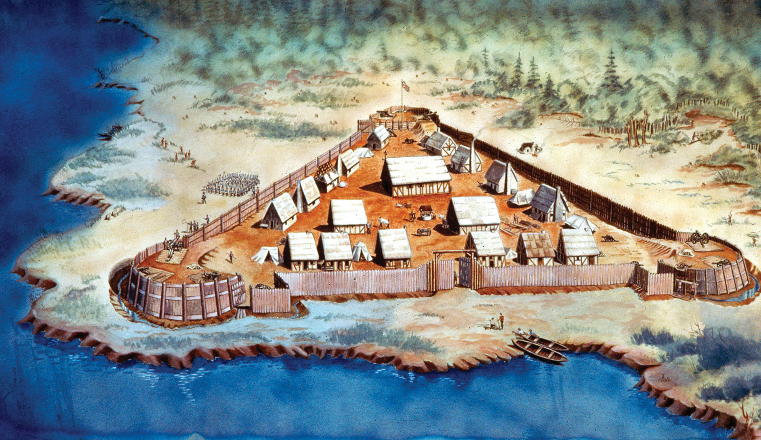
Jamestown

Slide 16
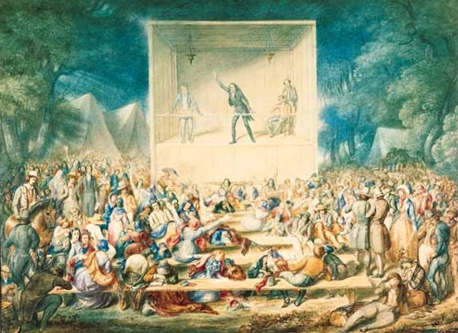
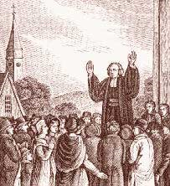
“Great Awakening”
Religious movement - Europe and the colonies – mid-1700s
Growth of evangelical religions
Baptists and Methodists
Challenged established government & religious order
Laid social foundations for American Revolution
Notes:
Sewed the seed of the Revolution

Slide 17
“Sinners in the Hands of an Angry God” – Jonathan Edwards
O sinner! Consider the fearful danger you are in: it is a great furnace of wrath, a wide and bottomless pit, full of the fire of wrath, that you are held over in the hand of that God, whose wrath is provoked and incensed as much against you, as against many of the damned in hell. You hang by a slender thread.”

Slide 18
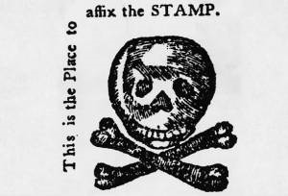
French & Indian War
War between England and France over land in New World
England wins – French removed from North America
England changes policy towards Colonists
Proclamation of 1763—prohibited colonial settlement west of the Appalachian Mts. – established Indian Territory
New Taxes—Stamp Act – revenue to pay for war
Quartering Act – housing and feeding troops
The Pennsylvania Journal ran this satirical ad on October 24, 1765. The skull and crossbones symbolized the death of the free press resulting from passage of the act.

Slide 19
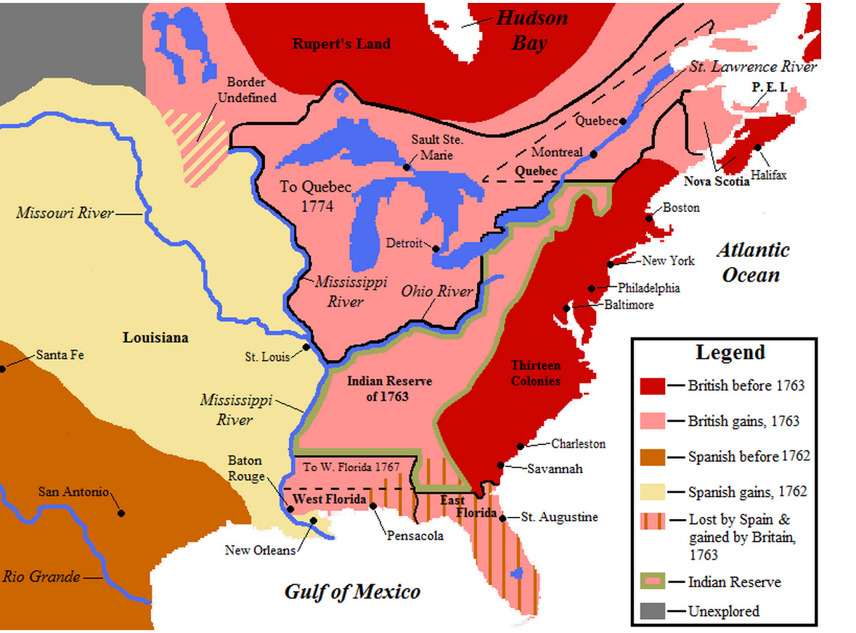
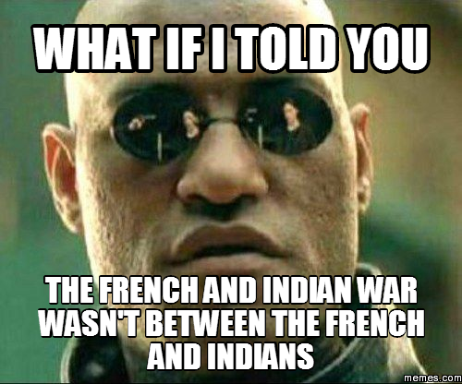

Slide 20
Comparing Primary Sources – p. 31
According to each speaker, what gives the land its value? How does each speaker characterize the actions and motives of the other? Do you think either or both are justified in their opinions? Explain your reasoning.

Slide 21
Join or Die Cartoon Analysis
We’ll read the background information together as a class. Once we have done so, you must analyze the political cartoon. Turn in your sheet to the tray when you’re done.

Slide 22
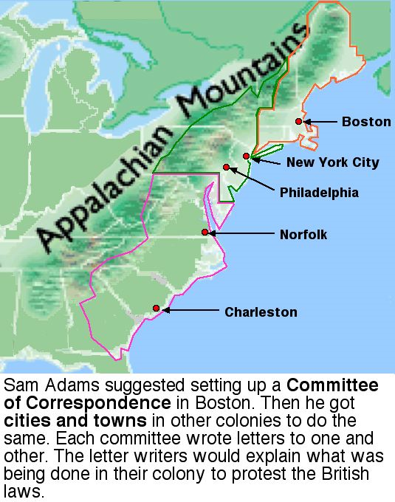
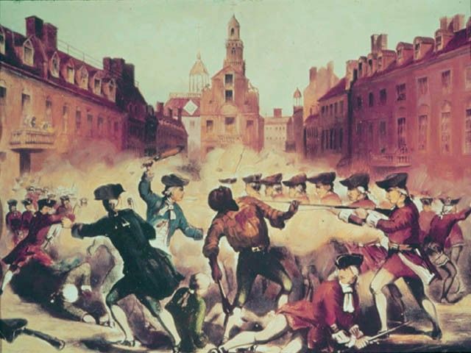
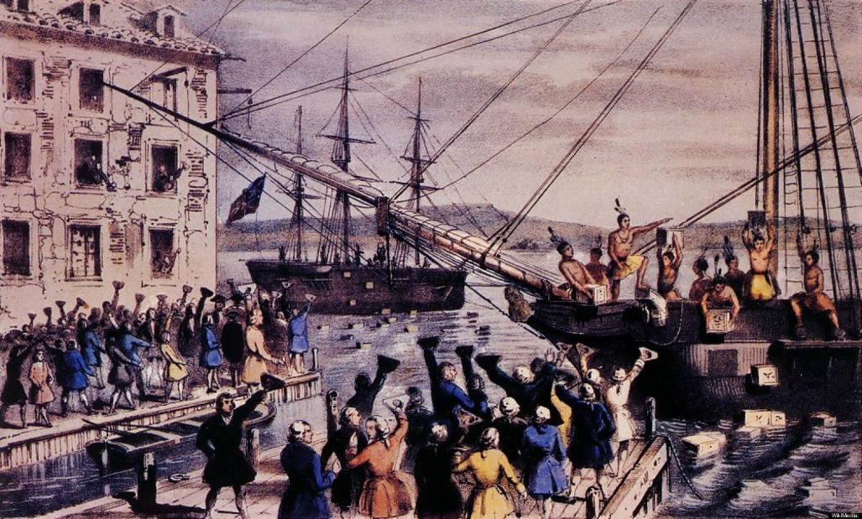
Events leading to separation
Boston Massacre
British troops fired on Anti-British demonstrators
Committees of Correspondence
Unify the colonies
Colonies corresponded to by letter
Boston Tea Party
Britain passes Intolerable Acts, closing Boston harbor
1st Continental Congress—representatives except Georgia

Slide 23
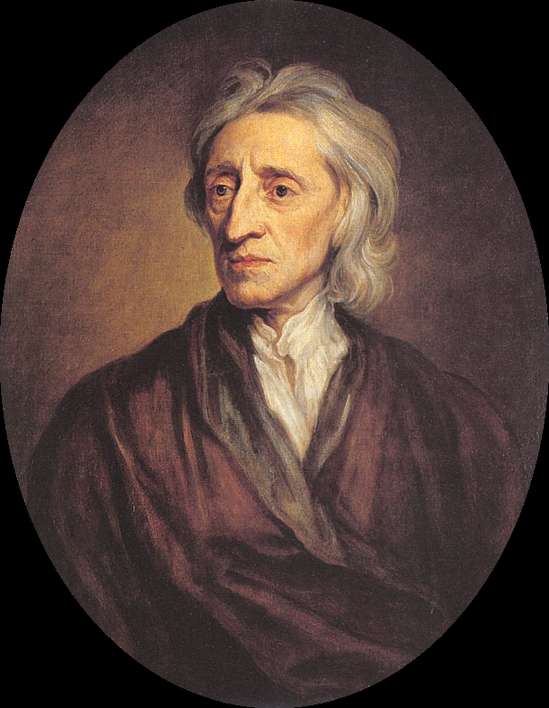
John Locke – Enlightenment Ideas
Natural Rights of Man
All men are free and equal
People have the rights to life, liberty, and property
Social Contract Theory
Power with people
Established a system of ordered liberty
Limited power of the government
People have the right to rebel if government breaks contract
Taxation without Representation
Ideas —challenged old world order (emperors, kings, etc.)

Slide 24
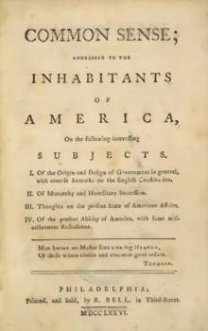
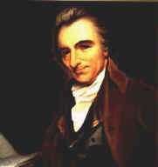
Common Sense—Thomas Paine
Thomas Paine—first to assert the right to form a new nation
Contributes independence sentiment

Slide 25
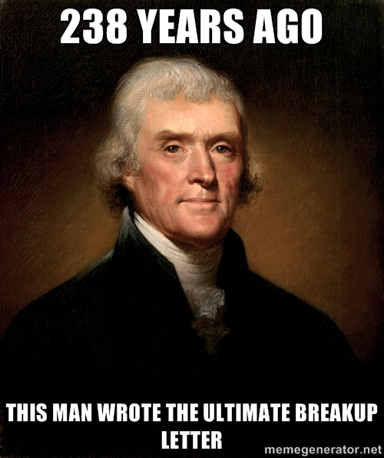
Declaration of Independence—Thomas Jefferson (from Virginia)
Reflects the views of Locke & Paine
People created equal
Natural rights of all men
Power by consent of governed (people)
Right to rebel
Detail of grievances as described in Common Sense

Slide 26
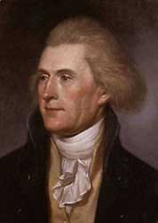
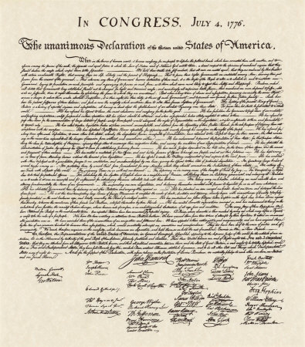
Thomas Jefferson

Slide 27
Analyzing the Declaration of Independence
On p. 50 of your textbook, we will read the Declaration of Independence. As we read this, please write down parts that are influenced by Enlightenment ideas.

Slide 28
Effect of the Declaration of Independence
Increased political, social, and economic participation
Political participation (equality)
Extending the franchise (right to vote)
Upholding due process
Free public education
Social participation (liberty)
Abolish slavery
Rights for women and minorities
Economic participation
Free enterprise system
Economic opportunity
Protecting property rights

Slide 29
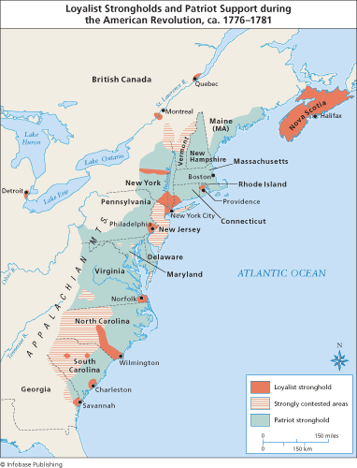
Difference among the colonists before revolution
Patriots
Complete independence from Great Britain
Paine, Patrick Henry, George Washington (leader)
Loyalists (Tories)
Loyal to Great Britain
Believed taxation of colonies by GB was justified
Neutrals
Tried to stay uninvolved

Slide 30
Loyalist & Patriot Propaganda Posters
You will create two propaganda posters. Be sure to include:
Picture that enhances poster
Catchy saying or slogan to attract people to your message
What your beliefs as a patriot or loyalist are
Reasons to support your cause
Notes:
http://www.learnnc.org/lp/editions/careerstart-grade8/6695
http://www.smithsoniansource.org/display/primarysource/results.aspx?hId=1004

Slide 31
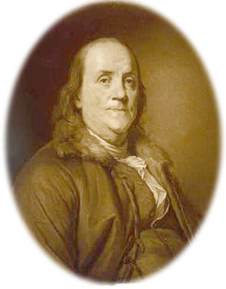
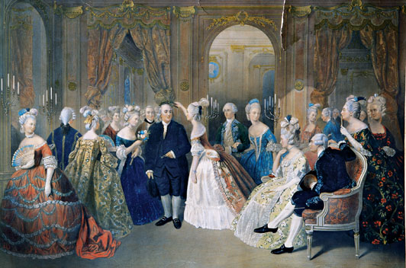
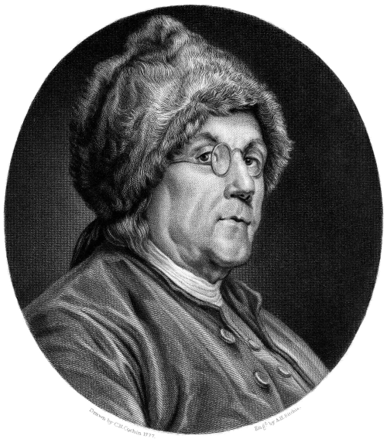
Factors Leading to Colonial Victory
Diplomatic – Ben Franklin
Ben Franklin negotiates Treaty of Alliance with France
War unpopular Britain

Slide 32
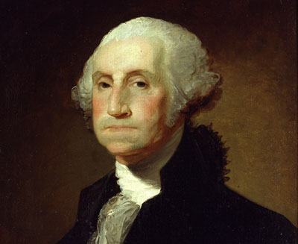
Military
George Washington—Commander of the Continental Army
Avoided open battles – war of attrition
Leadership held army together
Minutemen – farmers prepared to fight – short notice
George Washington

Slide 33
Major Battles
Lexington and Concord – Minutemen
First shots of the war
Ends chance for peaceful resolution
Saratoga—turning point of the war
Convinces France to join colonists
Yorktown (1781)— Due to French blockade Great Britain surrenders
Treaty of Paris – ends war - establishes western boundary of the US – Mississippi River

Slide 34
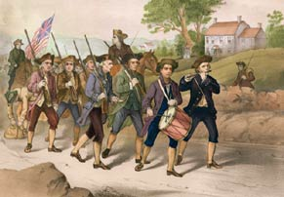
Minutemen

Slide 35
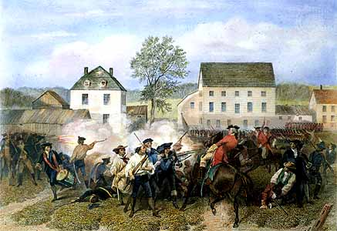
Battles of Lexington and Concord

Slide 36
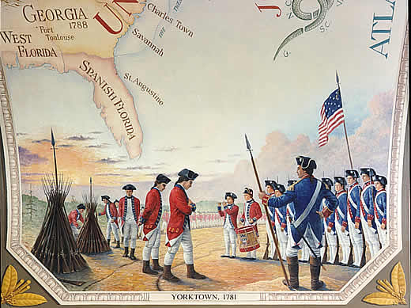
British surrender @ Yorktown

