Slide 1
Contemporary Issues
Test #10
VUS. 15

Slide 2
Women’s Movements
Women were paid less than men for same work
“Pink collar” jobs
jobs - stereotypically – “women's work”
Nurse, babysitter, waitress, etc.
1963: Betty Friedan wrote the Feminine Mystique
Challenged “traditional role” of women - wives and mothers

Slide 3
Feminism – the movement to bring equal rights for women
“Glass Ceiling”
Refer s to invisible barriers that impede the career advancement of women in the American workforce
1963: Equal Pay Act
Women should same pay as men for doing the same work
Women in the workforce
need for affordable day care

Slide 4
NOW (National Organization for Women) –
campaign for an Equal Rights Amendment (ERA) – end gender discrimination
ERA - passed by Congress, not ratified by states
Fear - lead to direct breakdown of the family

Slide 5
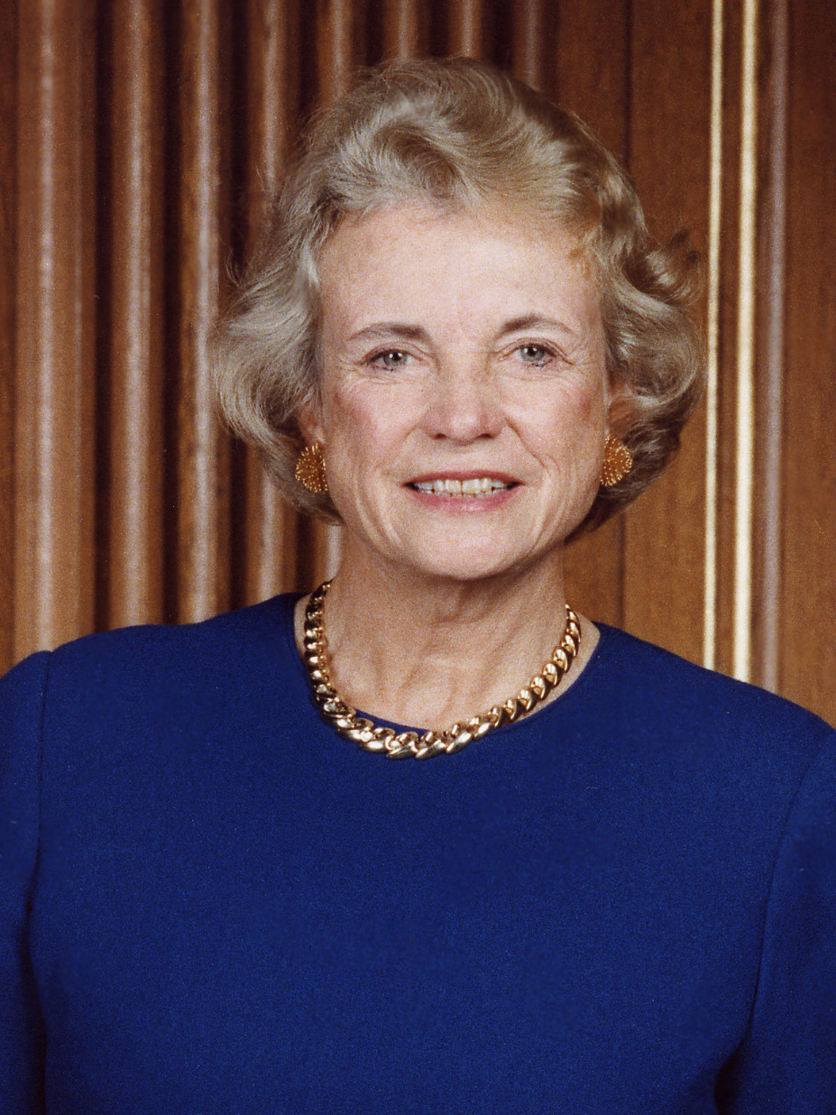
Notable women:
Sandra Day O’Connor - 1st woman to serve on Supreme Court
Sally Ride - 1st female astronaut
Sandra Day O’Connor

Slide 6
Roe v. Wade
Decided in 1973
Made it legal for women to get abortions
Roe v. Wade video

Slide 7
Technology
After Sputnik I in 1957 –
NASA (National Aeronautics and Space Administration)
National Defense Education Act – increased requirements for math and science in schools
Kennedy's Race to the Moon reference Video

Slide 8
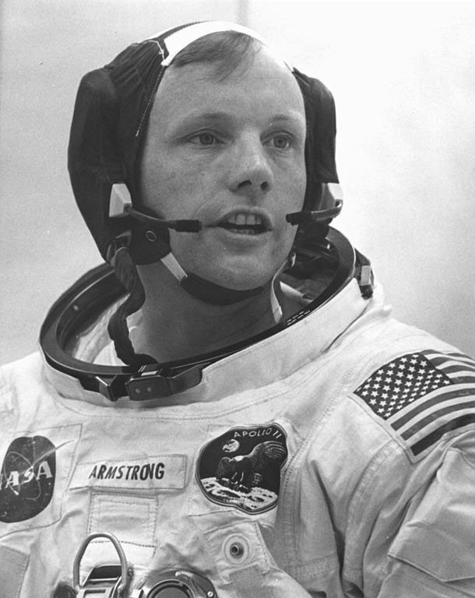
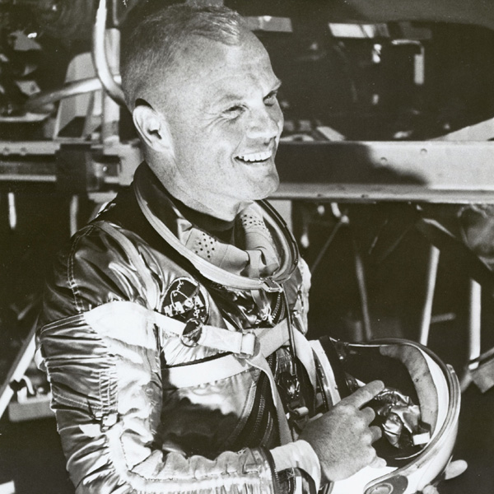
John Glenn - first American to orbit the Earth
1969 - Neil Armstrong - first person to step onto the moon’s surface
“That’s one small step for a man; one giant leap for mankind.”
One Small step video
Neil Armstrong
John Glenn

Slide 9
NASA space exploration
Space Shuttle (now retired) – reusable space craft
Voyager —2 satellites - study Jupiter and Saturn, and solar system
Hubble Space Telescope - allows scientists to look deeper into the universe
Mars Rover traveled on the surface of Mars collecting data

Slide 10
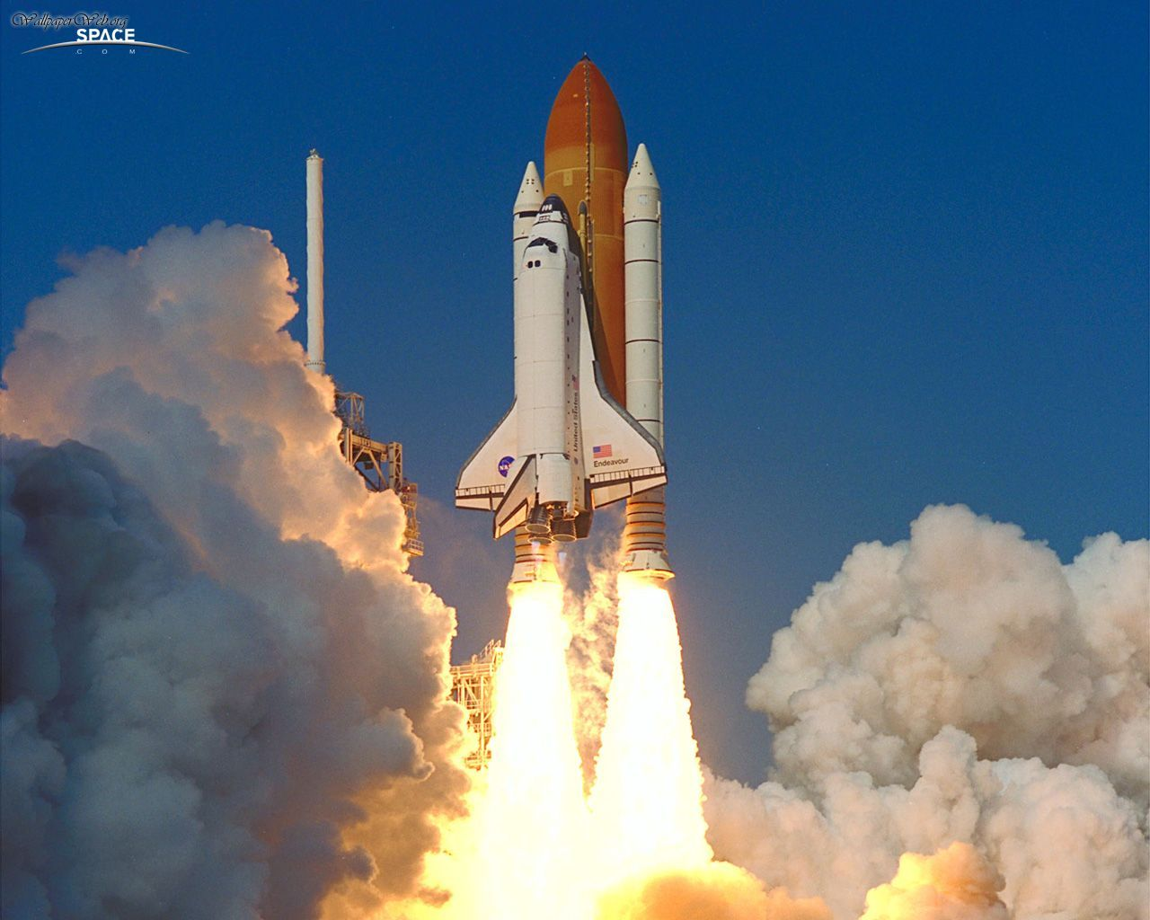

Slide 11
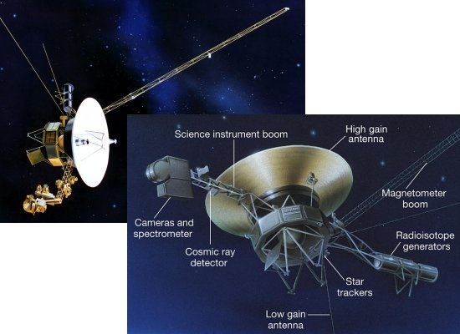
Voyager spacecraft

Slide 12
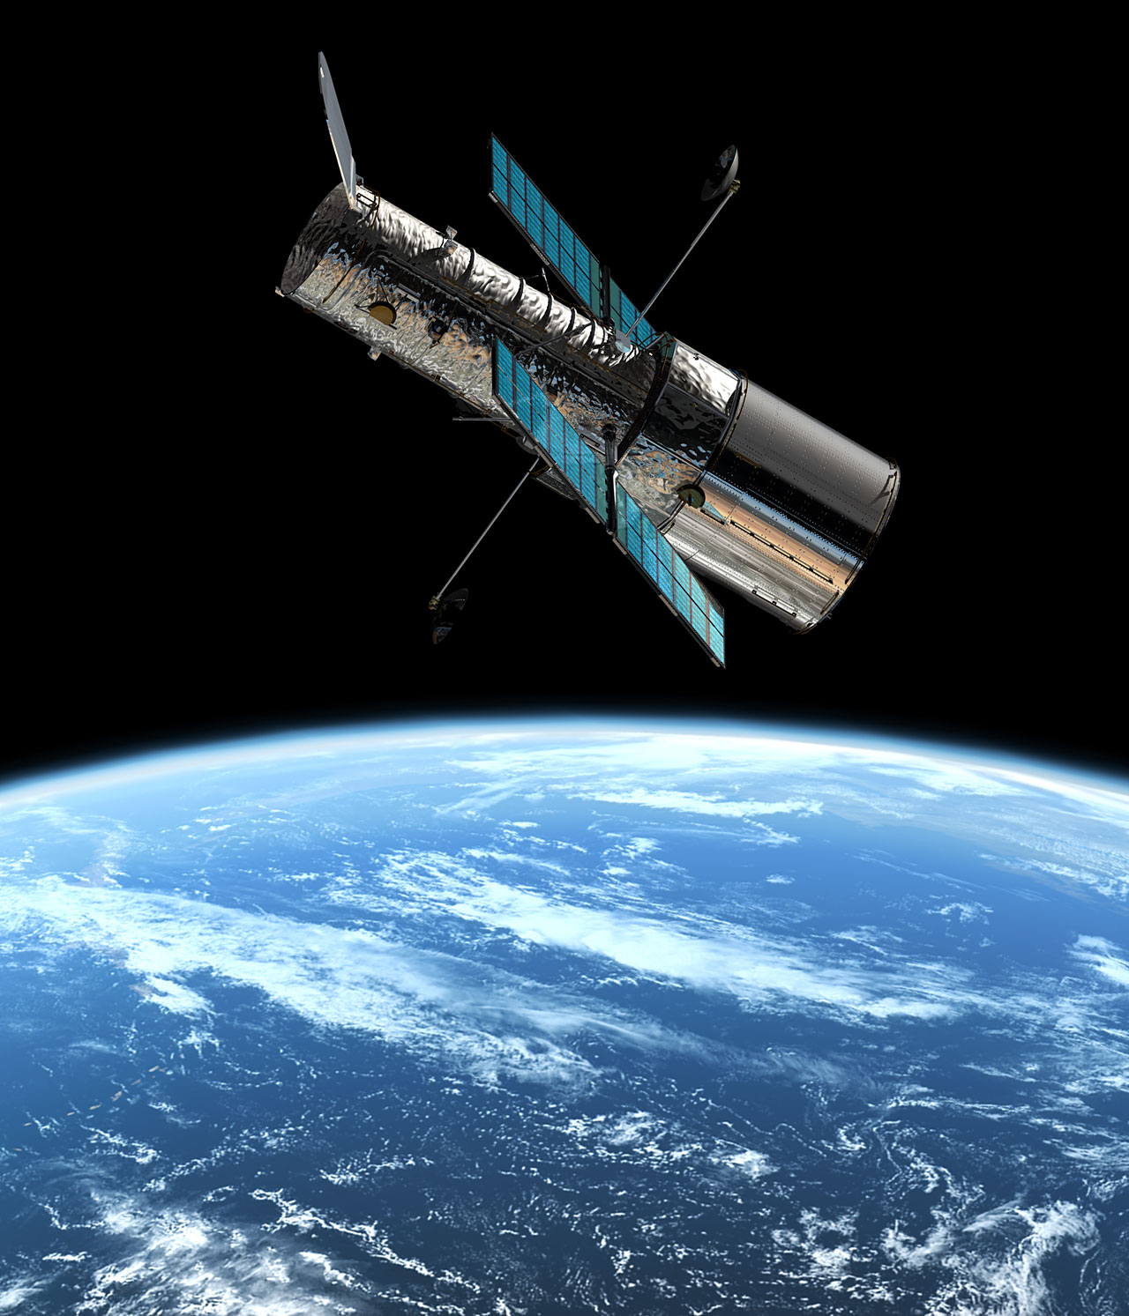
Hubble Telescope

Slide 13
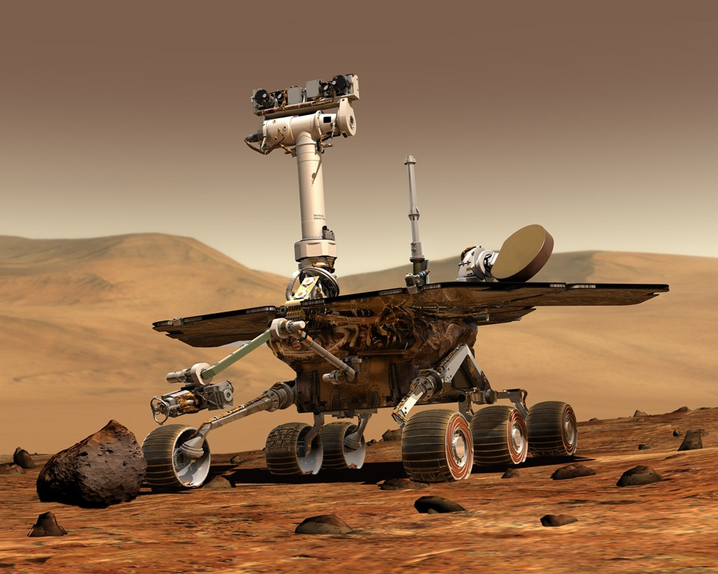
Mars Rover

Slide 14
IMPACT OF SPACE PROGRAM
Technology - access to global information, global viewpoints, and global products
Satellites—provide better communication, access to more television programming, etc.
Cable and Sat TV: More access to information
GPS (Global Position System)
Personal communication devices—PDA, Cell Phone, Smart Phone, etc.
Personal computers—widespread access
Internet (world wide web)

Slide 15
Work, Education and Health Care Telecommuting—work at home using a computer instead of going to office
Online coursework—college courses online
Service Industries—provide services rather than products
Outsourcing and Offshoring
Companies hire overseas
Help lines located in India
Company builds factory overseas
Cheaper labor

Slide 16
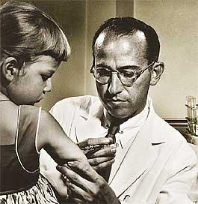
Medical research - Live healthier and longer
Vaccines and Antibiotics
1955: Dr. Jonas Salk created the polio vaccine
Dr. Jonas Salk

Slide 17
Détente and World Problems
Nuclear Test Ban Treaty
Banned nuclear testing above ground, under water, and in outer space
Nuclear Non-Proliferation Treaty :
Limit number of countries with nuclear bombs
SALT: Strategic Arms Limitation Treaty
limited the number of certain types of nuclear weapons

Slide 18
Détente: an attempt to make better relations with the Soviet Union and China
Nixon - visit to China in 1972
Carter – exported grain to Soviet Union
Opened up new markets for US goods

Slide 19
OPEC: Organization of Petroleum Exporting Countries)
Oil Cartel – mostly middle eastern nations
set prices and regulated the production of oil
Attempt to act as a monopoly
1973: October War (Yom Kippur War) – US supports Israel against Arab coalition
OPEC places an embargo on oil to the US
shortage of gasoline and oil products in US
Carter - conservation of oil and gas - rationing and lower speed limits
The embargo was lifted in 1974

Slide 20
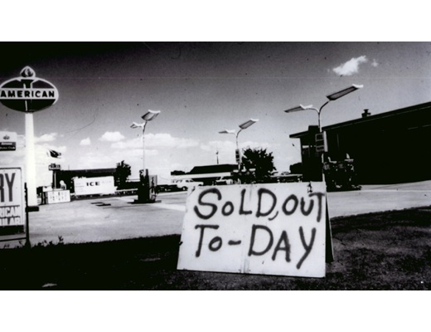

Slide 21
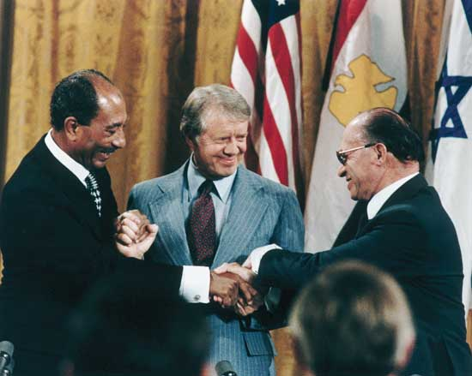
PLO: Palestine Liberation Organization (PLO) – opposed creation of Israel
Camp David Accords (Pres. Jimmy Carter):
1979: Camp David - Egyptian President (Sadat) and Israeli Prime Minister (Begin)
Established a peace between Israel and Egypt

Slide 22
Persian Gulf War :
1990: Iraq invaded Kuwait
George H.W. Bush
US - successful military operation to free Kuwait and protects oil interest in the region
2nd War with Iraq
George Bush
Overthrow Saddam Husain
War in Afghanistan –
Osama Bin Laden killed by US special forces

Slide 23
Politics and Economics
Conservatives (Republicans):
Cuts in government spending
Reduced government regulation of business
Tax cuts for the wealthy
Maintain strong defense
Reduction government programs and regulations
Opposed to social and moral changes – no gun control, gay marriage, legalization of marijuana

Slide 24
Liberals (Democrats):
More government spending
Reduction in military spending
Increased government regulation of business
Greater role for the government concerning moral and social issues – (favor gun control, gay marriage and legalization of marijuana)
Tax increases on wealthy to pay for programs and redistribute income

Slide 25
The economy:
Fiscal policy - use of government spending and taxation to influence the economy
Monetary policy - control of supply of money and credit to expand or contract economic growth—Federal Reserve

Slide 26
Reaganomics (“Regan Revolution”):
Economic policies of Reagan during the 1980s
Shrink size of Federal Government by reducing spending
Tax Cuts – Supply-side or “Trickle Down” Economics
Reduce Government regulation
Control the money supply to reduce inflation
Strengthening military - pressure Soviets - Cold War
Appointment of judges - “judicial restraint”—let the constitution speak for itself
More responsibility to the state governments

Slide 27
Important Supreme Court Decisions
Gideon v. Wainwright
Right to a lawyer, even if they cannot afford one
Escobedo v. Illinois (1964):
Right to a lawyer from the time of arrest or when one becomes the subject of a criminal investigation
Miranda v. Arizona
Informed of their right to a lawyer and their right not to testify against themselves
Engle v. Vitale
Said that school initiated prayer was unconstitutional

Slide 28
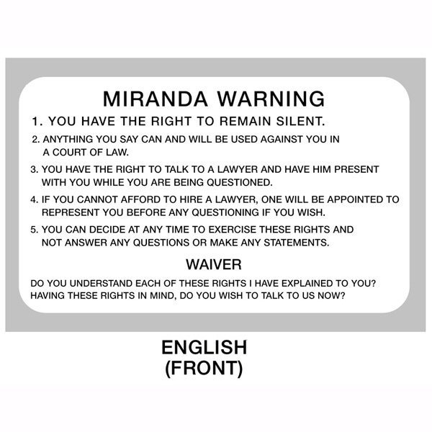

Slide 29
Watergate Scandal
CREEP:
1972 - Committee to Re-elect the President (CREEP) – Nixon - headed by John Mitchell
Used “dirty tricks” against Democrats
Used special investigation group - the Plumbers prevent security leaks
Broke into the Democratic National Committee headquarters at the Watergate Hotel in D.C.
Copy documents and wiretap phones to keep tabs on the Democrats election strategies

Slide 30
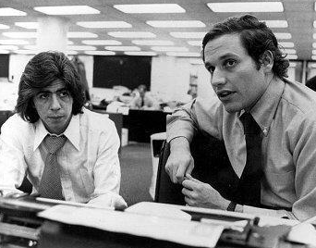
2 Washington Post reporters investigated break-in
Bob Woodward
Carl Bernstein
Investigation eventually leads to Nixon who denies it and orders subordinates to “cover it up”
House Judiciary Committee recommended to impeach Nixon
1974: Nixon resigns

Slide 31
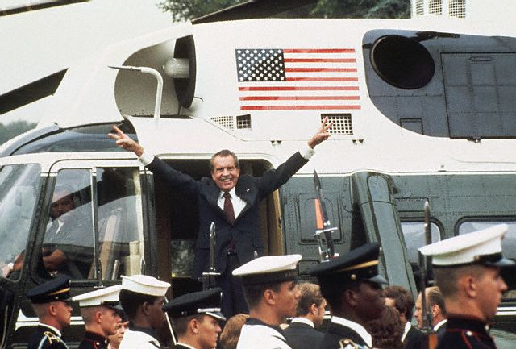
Nixon leaving the White House after resignation

Slide 32
Changing Patterns of Immigration
Immigration – increased, especially Asian and Latin American countries
Reasons for Immigration
Political freedom from oppressive governments
(Cambodians from the 1970’s and Modern Haitians)
Poverty
from devastating wars
(Southern Europe as well as Africa)
Economic opportunity through jobs

Slide 33
Effects of Immigration
Strain on government services
Filling low-paying jobs in the United States
take very low paying jobs other Americans will not
Border issues
Some immigrants enter US illegally
Terrorism threat
Bilingual education
Offering courses in school in 2 or more native languages
ESL—English as a second language courses
Increasing cultural diversity

Slide 34
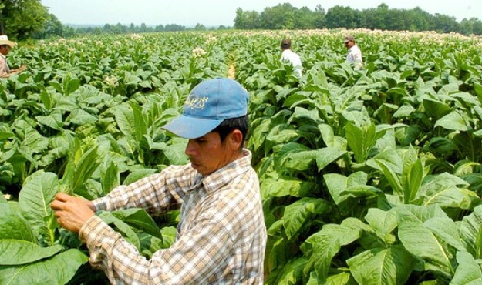
Contributions of Immigrants
Diversity in music, the visual arts, and literature
Labor force - jobs that others will not do
Achievements in science, engineering, and other fields made by immigrants
Immigrant worker in tobacco field

Slide 35
Current Global Issues
Terrorism
9/11 attacks - US government - confront and combat terrorism
Patriot Act
Reduced restrictions on law enforcement agencies' ability to search telephone, e-mail communications, medical, financial, and other records
Allows the government to use nearly any means necessary to track and search for terrorists

Slide 36
Office of Homeland Security
A cabinet department
Protects the United States from and responding to terrorist attacks, man-made accidents, and natural disasters

