Slide 1
Fertile Crescent

Slide 2
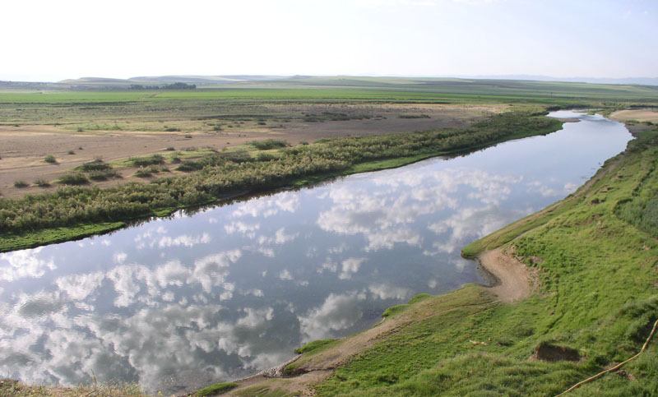
“Cradles of Civilization” river valleys=rich soil & irrigation

Slide 3
5,000 BC: Civilization in Fertile Crescent
Mesopotamia=“land between 2 rivers” Tigris & Euphrates Rivers
Notes:
3

Slide 4
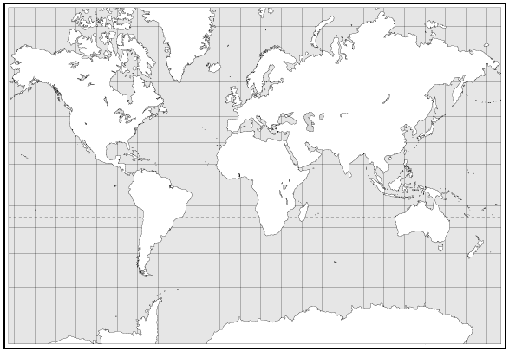
_{USA}
Mesopotamia was located in the Middle East.

Slide 5
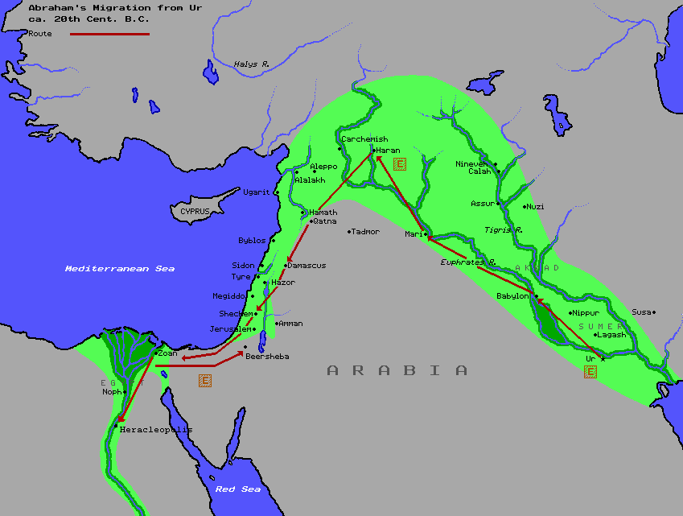
The Fertile Crescent
Notes:
5

Slide 6
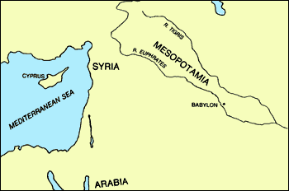
The Fertile Crescent
Notes:
6

Slide 7
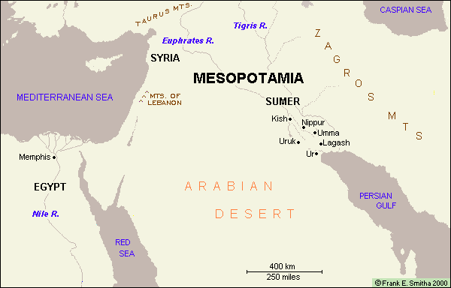

Slide 8
Sumer
3500 BC—1st cities
city-states—city & surrounding land with its own, independent government
Notes:
8

Slide 9
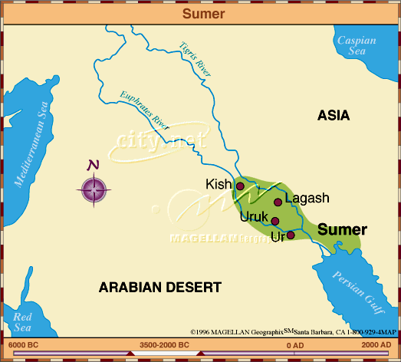
Sumer
Notes:
9

Slide 10
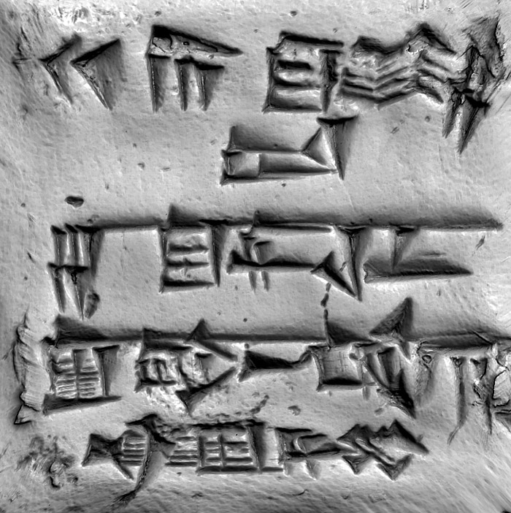
City-states shared culture:
Cuneiform (600 + symbols—writing on clay using wedge-tipped reed (stylus) – only scribes could read & write
Notes:
10

Slide 11
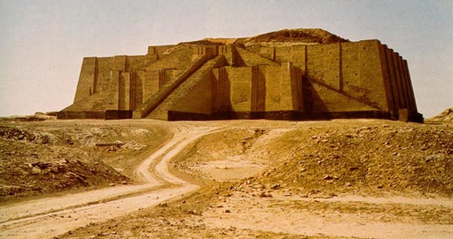
Polytheists
7 main gods, 1,000 lesser gods
Farmland owned by god/temple
Ziggurats—stone temples

Slide 12
An – god of heaven
Enlil – air/wind
Enki – water
Creation story
Flood story (like Noah)

Slide 13
City-states had kings (religious, military, & political leader)=Theocracy

Slide 14
Sumerians invented:
Potter’s wheel
Wagon wheel
Sundial
12 month calendar
Bronze
Metal plow
Math based on 60
Notes:
14

Slide 15
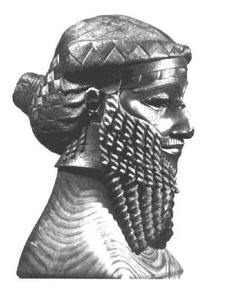
Akkadians
Took over Sumer 2000s BC
Sargon the Great (found in river like Moses)
Notes:
15

Slide 16
Babylonians
Hammurabi’s Code
1st set of written laws
“An eye for an eye”
Notes:
16

Slide 17
Stealing a slave = death
Slave striking freeman=60 blows w/ ox whip/hand cut off
Wife embarrasses husband = divorce
Unfaithful wife arranges murder of husband=her & her love impaled
Woman drinks in tavern = burned to death
Son strikes father = hand cut off
Wife disgraced by husband=she leaves w/ dowry
Man strikes a pregnant lady & child dies=pay 10 gold coins, if lady dies=man’s daughter put to death

Slide 18
Shoulder Partner Activity
Do you think Hammurabi’s Code would keep people from breaking the laws?
Do you think Hammurabi’s Code was fair?

Slide 19
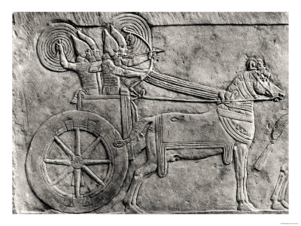
Assyrians
1st to use cavalry & chariots
Battering rams & siege towers
Cruel to the conquered – deported them
Notes:
19

Slide 20
“ I built a pillar over against his city gate, and I flayed all the chief men who had revolted, and I covered the pillar with their skins; some I walled up within the pillar, some I impaled upon the pillar on stakes, and others I bound to stakes round the about the pillar; many within the border of my own land I flayed, and I spread their skins upon the walls; and I cut off the limbs of the officers, of the royal officers who had rebelled.”

Slide 21
The Book of Nahum tells us that the merchants of Assyria were more numerous than "the stars of heaven" (3:16). Among the goods in which Assyrians traded were high-quality apparel, especially blue-colored clothing, exquisite embroidery, and fine furniture, expertly made of cedar "bound with cords" (Ezek.27:23-24). In its time of glory on earth Assyria "caused terror in the land of the living" (Ezek.32:21-23). Except for Babylon, God's people (the Hebrews) were harmed more by Assyria than any nation.

Slide 22
650 BC- Assyrian Empire from Persian Gulf to Egypt
Saved Epic of Gilgamesh
Notes:
22

Slide 23
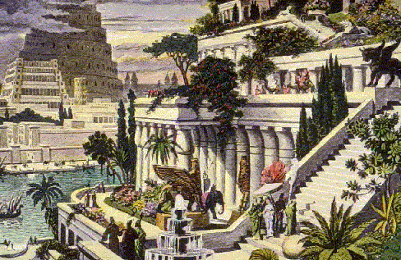
Chaldeans
King Nebuchadnezzar (605-562 BC)
Hanging Gardens of Babylon
Wall of Babylon
Notes:
23

Slide 24
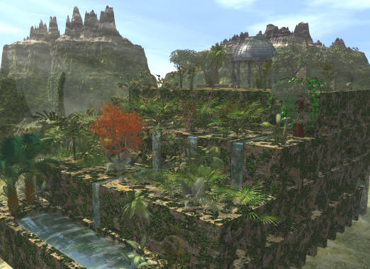

Slide 25
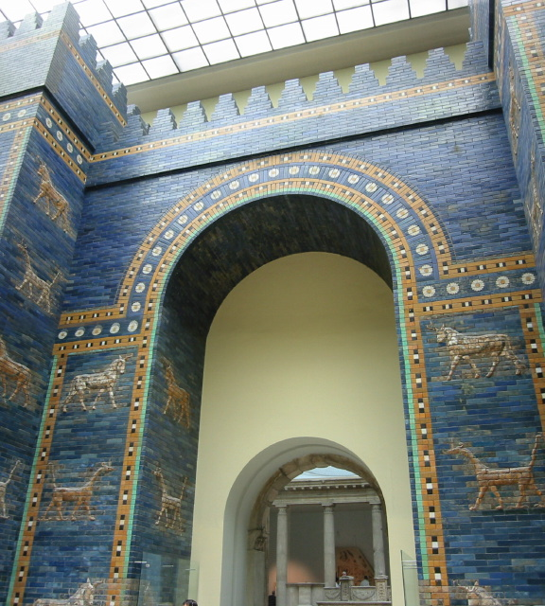

Slide 26
Persians
Persians–Iran
Darius I (521 BC)
Largest empire
Imperial Bureaucracy
23 governors
Imperial spies
Royal rds.
Tolerant
Notes:
26

Slide 27
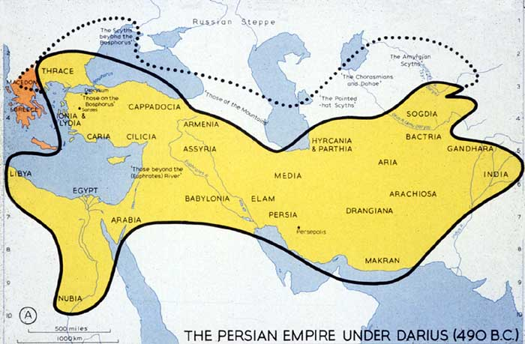
Persians
Notes:
27

Slide 28
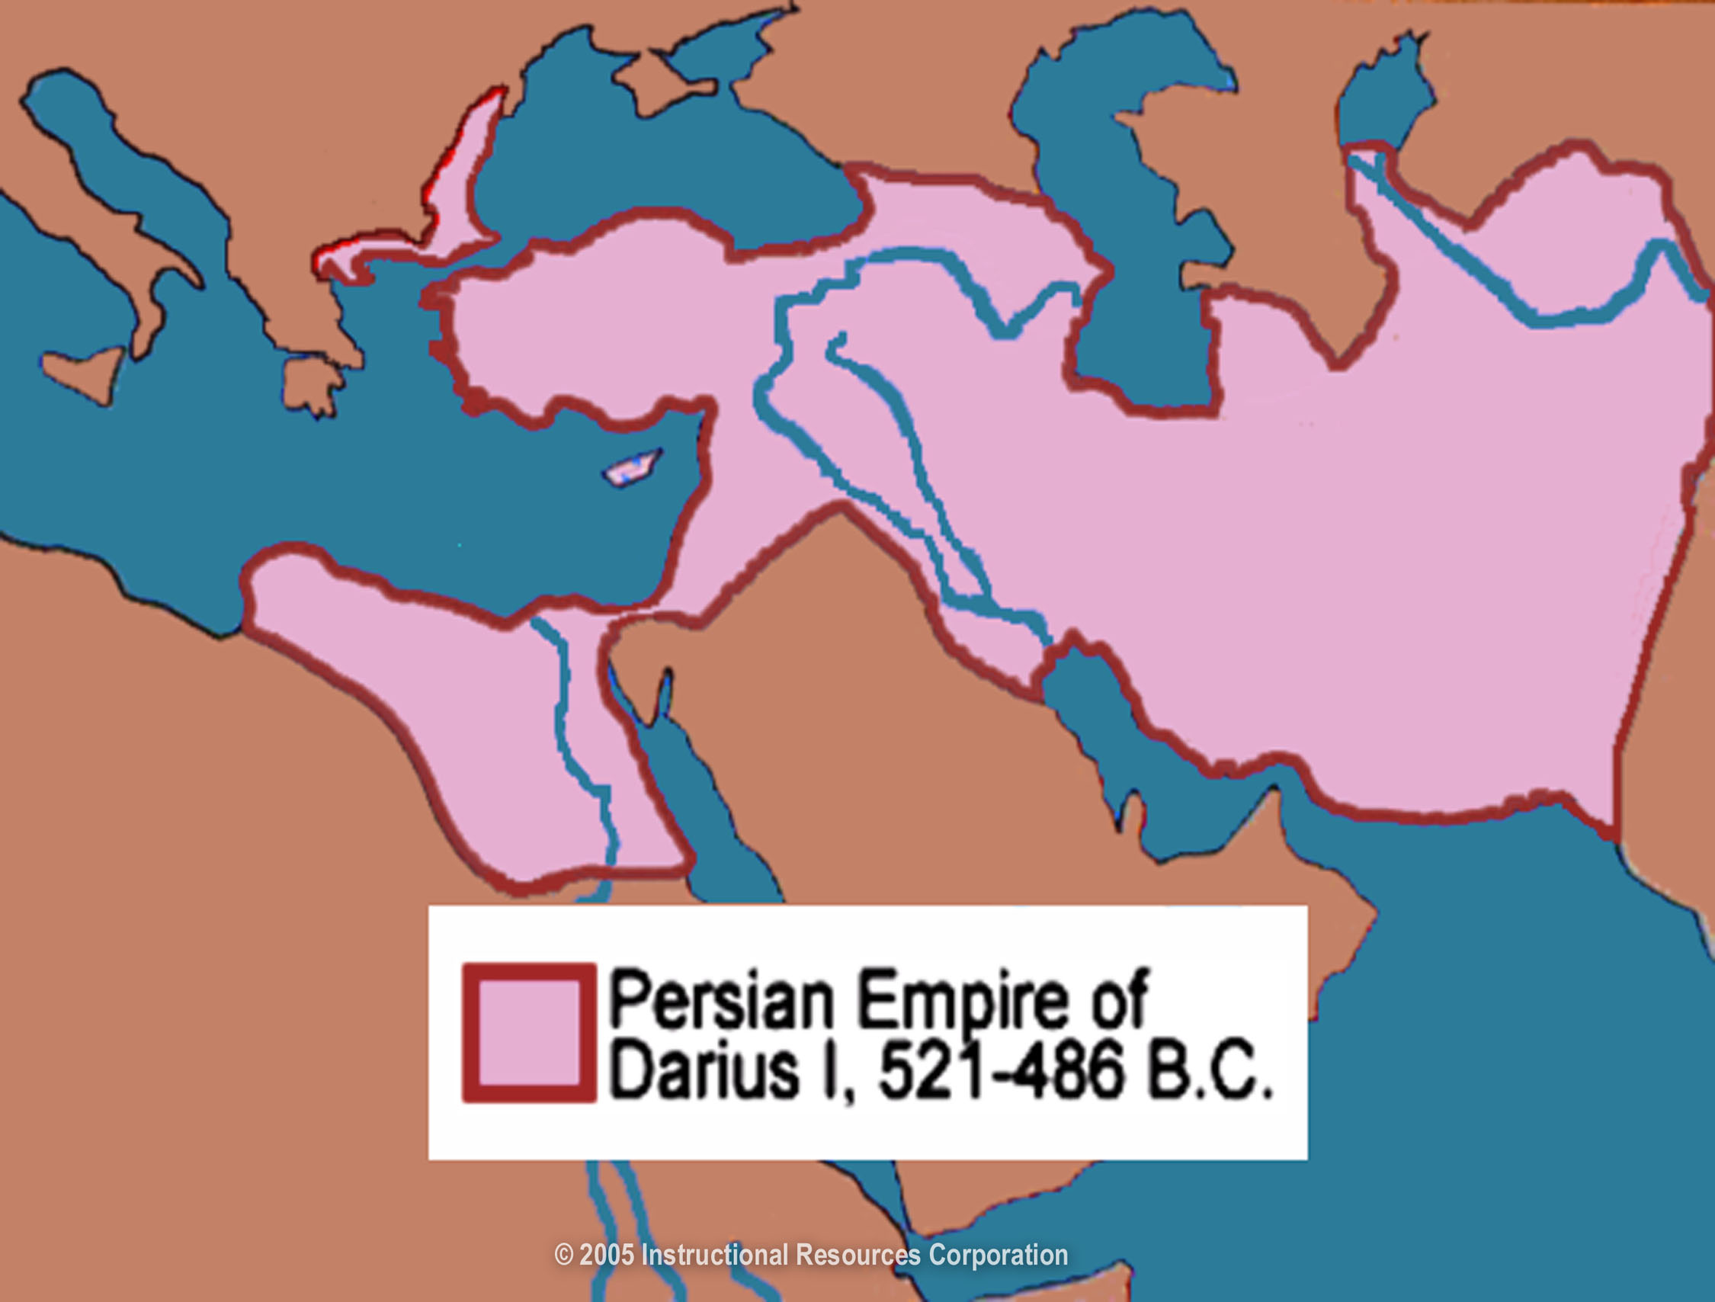

Slide 29
Persian Religion
Zoroastrianism – belief in two forces
Ahura Mazda (good)
Ahriman (evil)
Heaven & hell
Notes:
29

