Slide 1
Hebrews=Jews=Israelites
Notes:
1

Slide 2
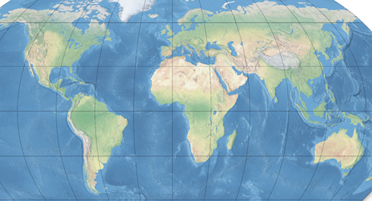

Slide 3
Hebrews introduced monotheism—1 God
Yahweh (Jewish God)
Notes:
3

Slide 4
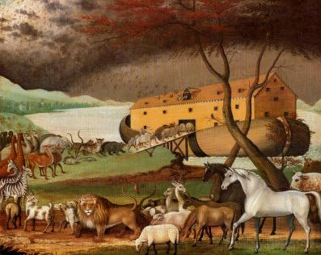
Notes:
4

Slide 5
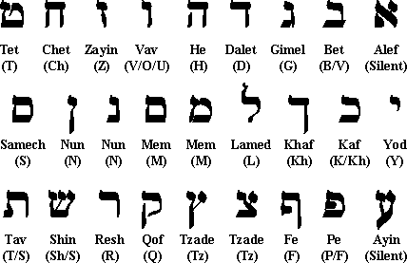
Noah’s son Shem’s great grandson Heber
Hebrew means “From across”
Notes:
5

Slide 6
Abraham—father of the Hebrews
1800 BC-moved from Sumer to Canaan
Covenant with God for “Promised Land”
Notes:
6

Slide 7
“Now the Lord had said to Abram:
Get out of your country, from your family and from your father’s house, to a land that I will show you. I will make you a great nation. I will bless you and make your name great, and you shall be a blessing. I will bless those who bless you, and I will curse him who curses you; and in you all the families of the earth shall be blessed.” - Genesis 12: 1-3

Slide 8
Abraham’s grandson—Jacob (Israel)—had 12 sons (12 Tribes of Israel)

Slide 9
Israel had twelve sons:
Reuben
Simeon
Levi (LEVITES)
Judah (JEWS)
Dan
Naphtali
Gad,
Asher
Issachar
Zebulun
Joseph
Benjamin
Notes:
9

Slide 10
1200s BC—Moses led the Hebrews out-- EXODUS
10 Commandments on Mt. Sinai
Joshua—Moses’ successor—led Hebrews to Canaan
Notes:
10

Slide 11
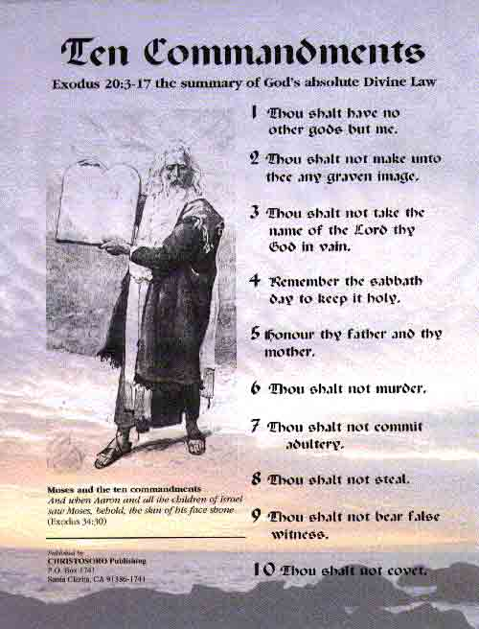

Slide 12
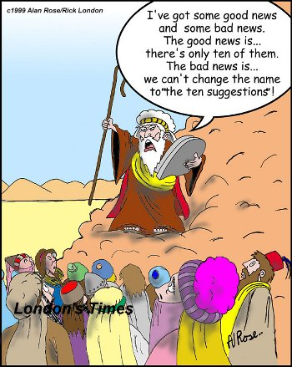

Slide 13
In Canaan
The 12 Tribes fought Canaanites & Philistines for land

Slide 14
King Saul (1020-1012 BC)
Unable to defeat Philistines
Plot against David
Suicide

Slide 15
King David (1012-973 BC)
Killed giant Goliath
Capital at Jerusalem

Slide 16
King Solomon (973-922 BC)
Temple in Jerusalem
700 wives (political allies)
After his death, Hebrews split
Israel—N
Judah—S

Slide 17
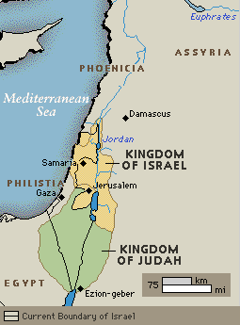
Judah and Israel

Slide 18
586 BC—Babylonians destroyed temple
Hebrews forced out of homeland by Nebuchadnezzar- “Babylonian Exile”
“Diaspora”= scattering of seeds

Slide 19
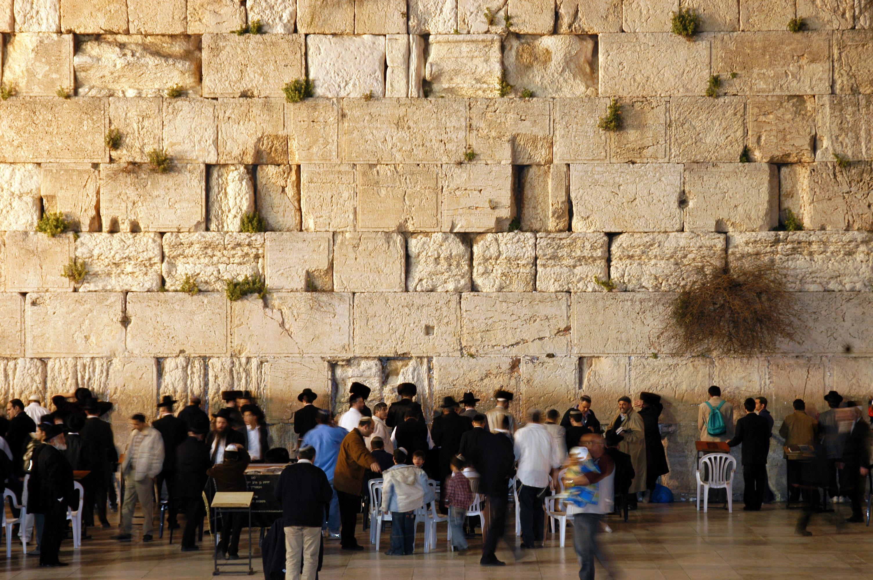

Slide 20
539 BC—Hebrews allowed back into homeland by Persians
400s BC—Ezra gathered holy writings Torah together again
Genesis
Exodus
Leviticus
Numbers
Deuteronomy

Slide 21
Judaism, Christianity, & Islam- based on Hebrew idea of monotheism

Slide 22
Phoenicians
Canaan
Sea Traders
Ships made of cedar from Lebanon Mtns.
Created 1st alphabet
1100 BC
Used for trade
22 characters
Easy to learn—no need for scribes
Notes:
22

Slide 23
Notes:
23

Slide 24
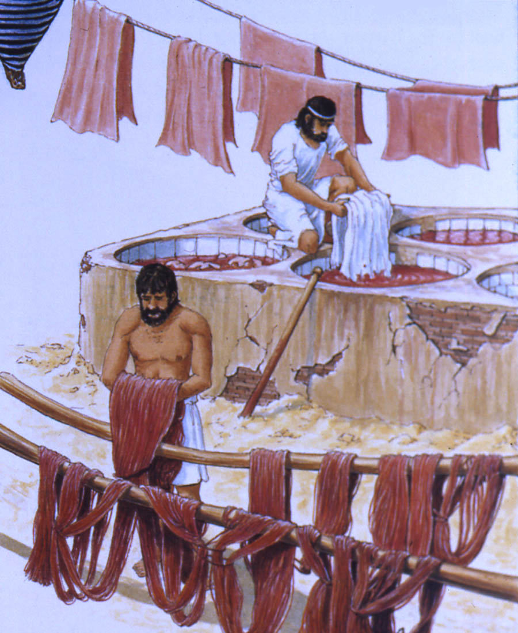
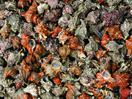
Phoenicia = Greek for “land of the purple”
Purple dye

Slide 25
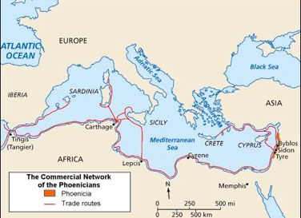

Slide 26
Phoenician Colonies
Good trade routes & a safe place to rest mid-voyage
See what customers like – to make profit
Resources

Slide 27
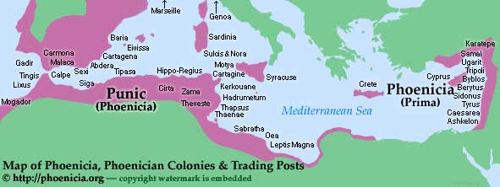
Carthage- colony in North Africa

Slide 28
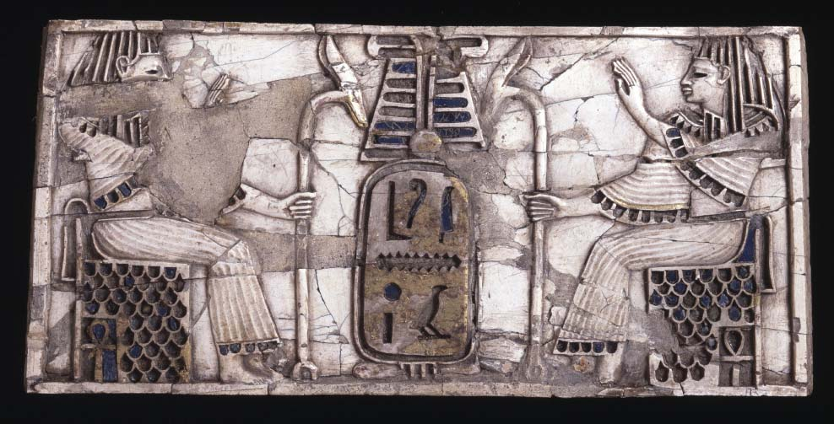
Some of the work looks very Egyptian
Can you point out the bits that look Egyptian?
Notes:
Dress, hieroglyphics, the ankh symbol, hair style and faces in profile. Why is this? Children to think about who the Phoenicians were making the materials for and for what purpose. Explain that the Phoenicians made their crafts to sell and had to think about the needs and wants of their buyers.

Slide 29
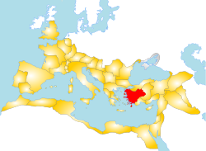
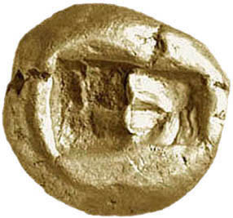
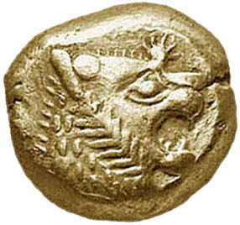
Lydians
Asia Minor—gold found here
600 BC: 1st to produce coins (gold & silver)
Notes:
29

