Slide 1
Principles of Economics
Test #9

Slide 2
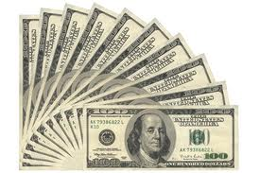
What is economics?
Study of how people choose to use their limited resources to satisfy their unlimited wants

Slide 3

Key Assumption of Economics
People are rationally self interested & strive to achieve their greatest satisfaction

Slide 4
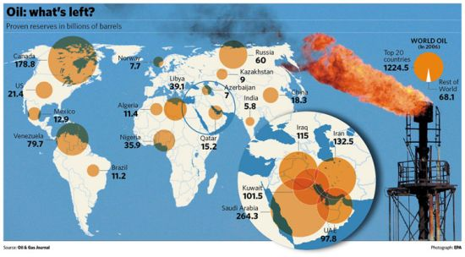
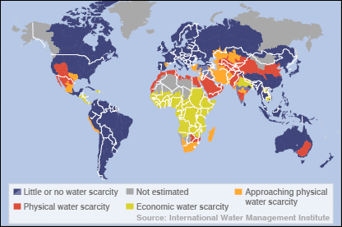
Scarcity
“The Economic Problem”
Issue that all societies face is…
  Wants > Resources
  Some people have to do without
Basic Economic Questions
What to produce?
How to produce?
For whom to produce?

Slide 5
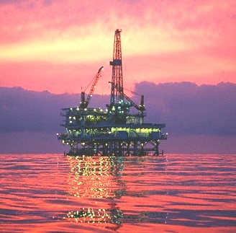
Factors of Production
Resources that go into producing goods & services
Land (natural resources)
  Air, soil, minerals, water, & plants

Slide 6

Factors of Production
Labor (human resources)
  All physical & mental activities that go into producing a good or service

Slide 7
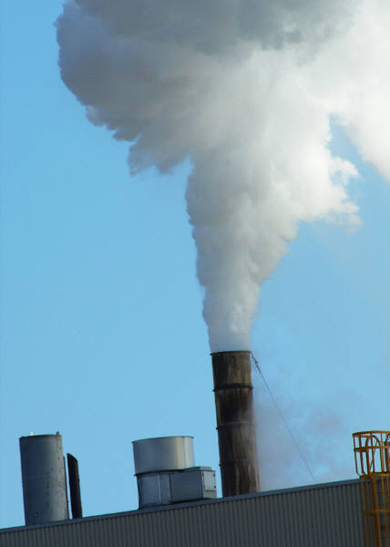

Factors of Production
Capital
  Includes tools, machines, buildings, & technologies

Slide 8
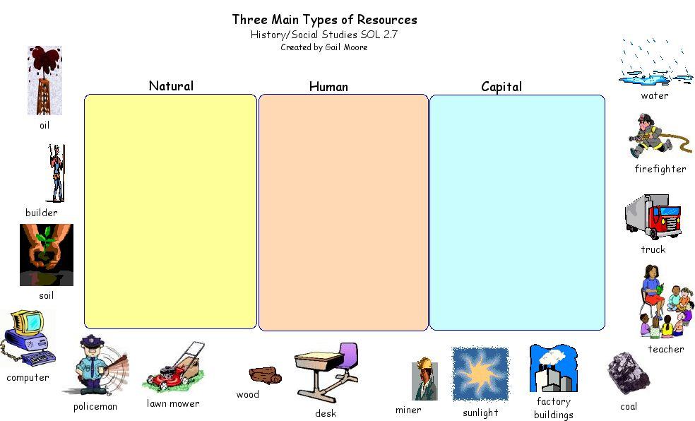

Slide 9
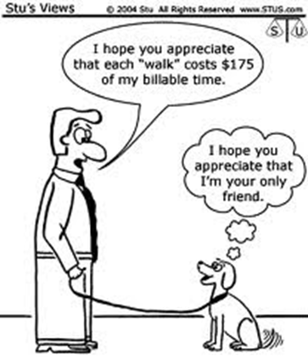
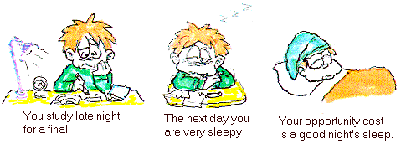
Making Choices to Deal with Scarcity
People seek to maximize utility (satisfaction or benefit of receiving good or service)
Tradeoffs- exchange of 1 benefit for another (i.e: Get out of bed & go to school or sleep in?)
Opportunity Cost- The best thing we give up to get what we want

Slide 10
The Lorax
The Lorax Questions:
List an example for each factor of production.
What tradeoffs were illustrated?
What can this teach us about economics and scarcity?

Slide 11
After reading about California’s drought, reflect on the issue of scarcity and how it relates to government.
California Drought Questions:
What sort of scarcity problems does the government have to deal with?
How do you think they should address these problems?
How much power do you think is necessary for government to address these problems?

Slide 12
After reading one economist’s view on scarcity, answer the following questions.
The Scarcity Shortage Questions:
According to the author, what was the number one problem economics attempted to solve in the past?
Summarize what has happened to this economic issue, presently.
Describe an example, other than those used in the article, that displays this change.

Slide 13
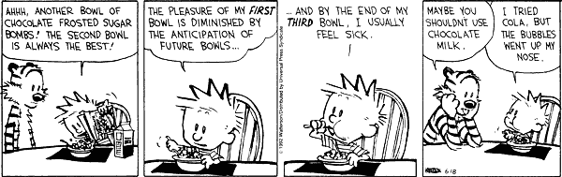
Law of Diminishing Marginal Utility
As we get more of something, the pleasure we derive from it tends to decrease

Slide 14
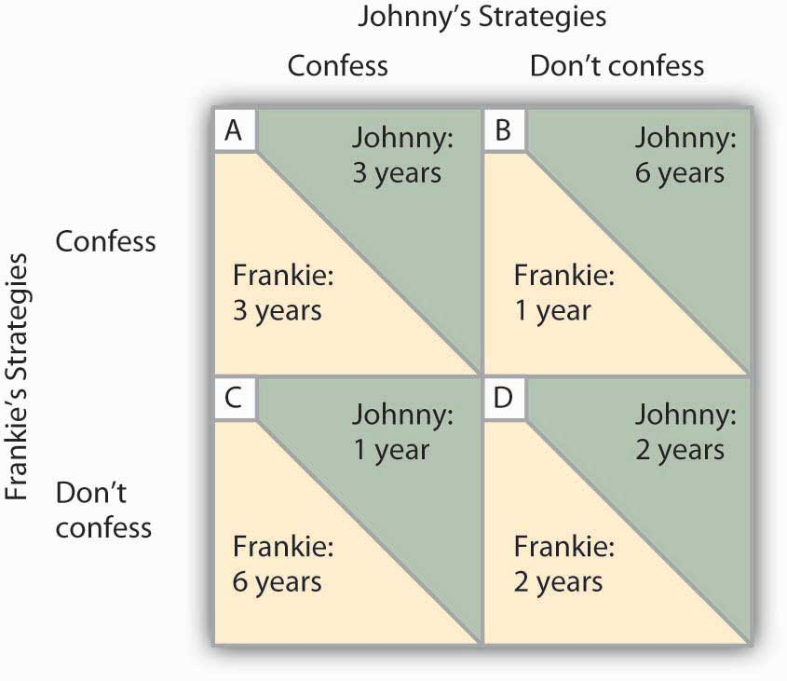
Game Theory
Developed to solve economic problems – the formal study of conflict & cooperation
i.e.: The Prisoner’s Dilemma

Slide 15
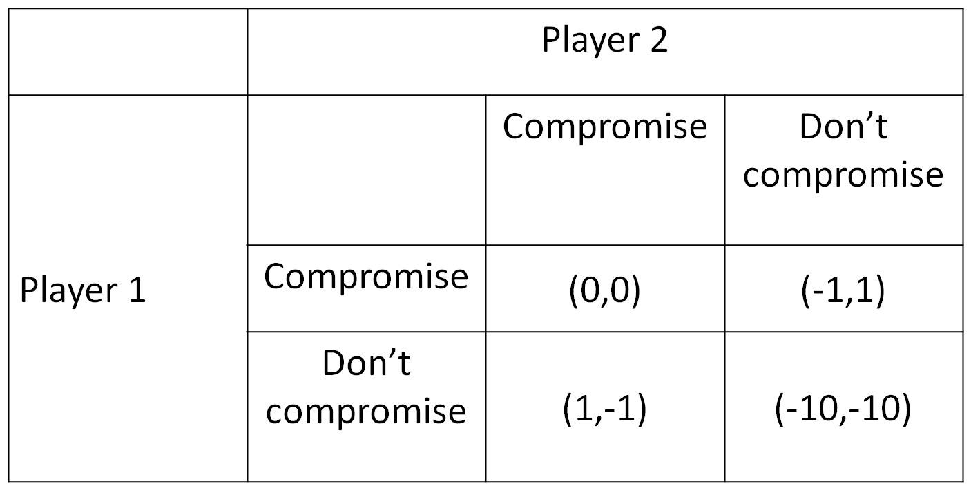
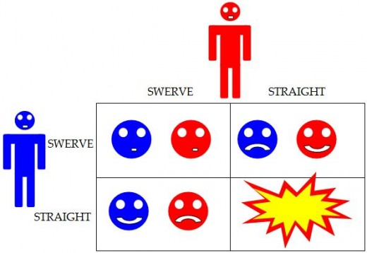
Now, you try it… (Player 1 gets the first number in the set, Player 2 gets the second number in the set). Highest number wins!
Why is this one called “The Game of Chicken?”

Slide 16
Now, you try it… (Player 1 gets the first number in the set, Player 2 gets the second number in the set). Highest number wins!
A
B
A
-4, -4
0, -10
-4, -4
B
-10, 0
-1, -1
What is the lesson of this game?

Slide 17
Now, you try it… (Player 1 gets the first number in the set, Player 2 gets the second number in the set). Highest number wins!
A
B
A
-4, -4
-7, +7
-5, +5
B
+8, -8
+1, -1
Play this game as if Player 1 always picks B

Slide 18
Now, you try it… (Player 1 gets the first number in the set, Player 2 gets the second number in the set). Highest number wins!
A
B
A
-4, -4
+50, -50
-3, -3
B
-50, +50
+3, +3
What game is this?

Slide 19

Why it matters…
Understanding opportunity costs/tradeoffs makes you a better decision maker
Individuals, businesses, & governments incur tradeoffs when making decisions
How is game theory present in the film we watched during the last unit, The Thirteen Days?
Notes:
Nash Equilibrium A Beautiful Mind

Slide 20

Chicken Game & the Cuban Missile Crisis
USSR
Main idea behind the chicken game: Brinkmanship - bring the situation to the edge of a disaster in order to achieve highest possible outcome.
 | Retreat | Deploy more missiles
Do nothing | 0, 0 | -1, +1
Blockade | +1, -1 | -10, -10
USA

Slide 21
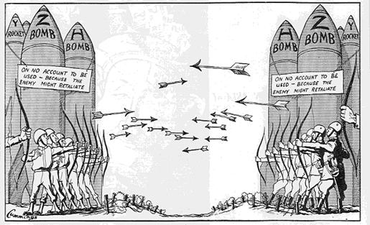

Slide 22
Lighthouse Joke
Radio conversation:
#1: Please divert your course 15 degrees to the North to avoid a collision.
#2: Recommend you divert YOUR course 15 degrees to South to avoid a collision.
#1: This is the Captain of a US Navy ship. I say again, divert YOUR course.
#2: No. I say again, you divert YOUR course.
#1: THIS IS THE AIRCRAFT CARRIER ENTERPRISE, WE ARE A LARGE WARSHIP OF THE US NAVY. DIVERT YOUR COURSE NOW!
#2: This is a lighthouse. Your call.

Slide 23
Can Game Theory Help a Presidential Candidate Win?
Could Game Theory Have Helped United Airlines?

Slide 24
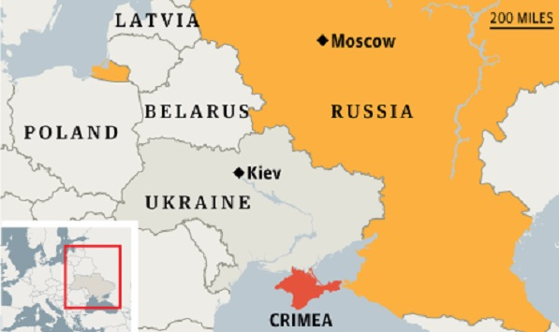
Crimea Through a Game Theory Lens
How can we apply game theory to current political situations like the one in the article?
Does looking at political situations through a game theory lens change how you look at the world?

Slide 25
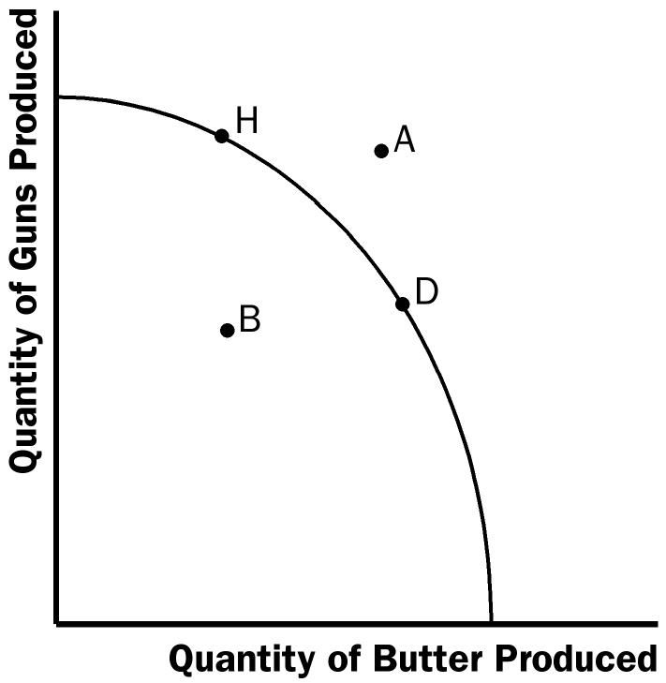
Production Possible Frontier (PPF)
Shows how an economy might use its resources to produce 2 goods
  Each point on the curve represents the use of all productive resources
  PPF is used to calculate the opportunity cost of moving production from one point to another

Slide 26
10 Hours a Day
Per Hour
Cars Lawns
1
1
1 2
A
Kevin
Mark
Stacy
40
D
25
Cars
C
20
B
20
25
40
Lawns

Slide 27
Locations on a PPF
Efficient Point- place where an economy is achieving as much output as possible from a given amount of resources- occurs at any point on the curve
Inefficient Point- place where the economy is not functioning as it could be- occurs at any point inside the curve
Unattainable Point- place where the economy cannot produce, given its current resources- occurs at any point outside the curve

Slide 28
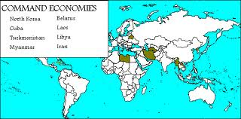
Command Economy
Economic decisions made by govt. leaders
Govt. owns factors of production
Prices set by govt.
Consumer choice is limited
Income distribution controlled by govt.

Slide 29

Traditional Economy
Decisions based on customs & beliefs
Change is discouraged & sometimes punished
Methods of production are often inefficient
Family & community ties are strong

Slide 30
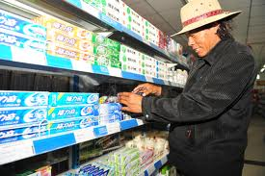
Market Economy
Decisions made by individuals
Individuals own factors of production & choose what to produce based on info. provided by market prices
Consumer choice is large
Little incentive to engage in unprofitable ventures

Slide 31
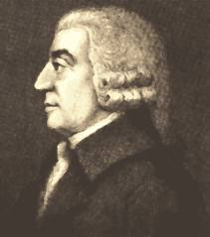
Influence of Adam Smith
The Wealth of Nations - credited with creating capitalism, a free-market economy

Slide 32

Economic freedom is essential for prosperity
  Invisible Hand Theory, an individual’s pursuit for selfish gain helps society as a whole
  Govt. shouldn’t interfere with economy based upon Laissez-Faire “let them do”

Slide 33
In the 1700s & 1800s Smith’s ideas were put into action:
  Capitalists grew wealthy by accumulating capital & devoting them to industrial production -> Industrial Revolution
  Positives- more jobs, urban growth, goods & services,& technology
  Negatives- harsh work conditions, long hours, low wages, unsanitary conditions

Slide 34
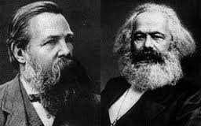
Rise of Command Economy
Workers blamed poverty on wealthy capitalists
  Rise of Socialism & Communism
  The Communist Manifesto in 1848
Engels
Marx

Slide 35
U.S. Mixed Economy
In a mixed economy…
  Individuals:
    Own the factors of production
    Freedom to produce or consume
    Must operate under confines of the law
  Government:
    Protects workers & consumers
    Regulates business & preserves competitions
    Provide public goods/benefits

Slide 36
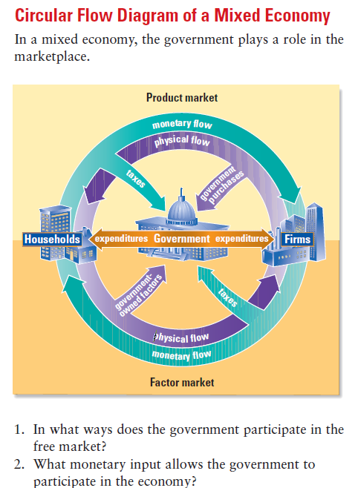

Slide 37
Micro & Macroeconomics
Test #10

Slide 38
Microeconomics
Part of economy that deals with behaviors & decision making of individuals

Slide 39
Law of Supply
If prices are high, suppliers offer greater quantities for sale
If prices are low, suppliers offer smaller quantities for sale

Slide 40
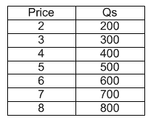
Supply Schedules
Shows Qs at all prices that might be seen in the market at a given time

Slide 41
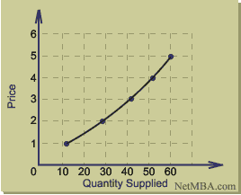
Supply Curve
Graph showing supply schedule
Illustrates quantity suppliers will supply at each price
Upward sloping

Slide 42
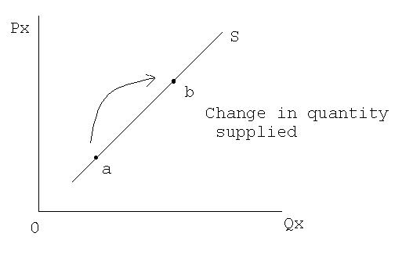
Change in Quantity-Supplied
Whole supply curve does not shift
Response to change in the price – movement along curvy

Slide 43
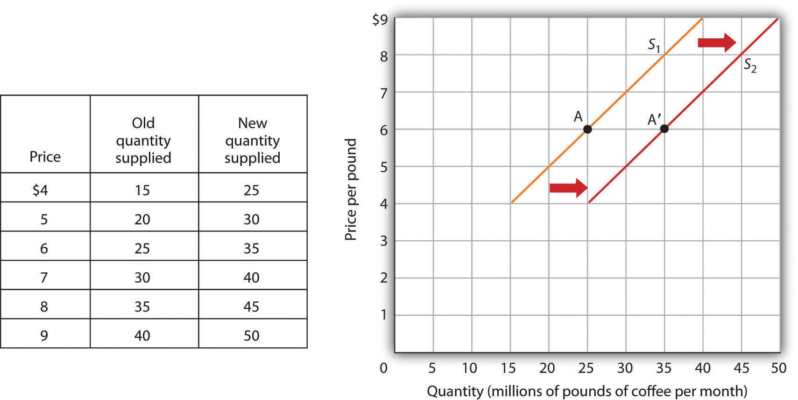
Change in Supply
Shift of entire supply curve
  Shift to right= increase in supply
  Shift to left= decrease in supply
Response to change in “non-price” determinants of supply

Slide 44
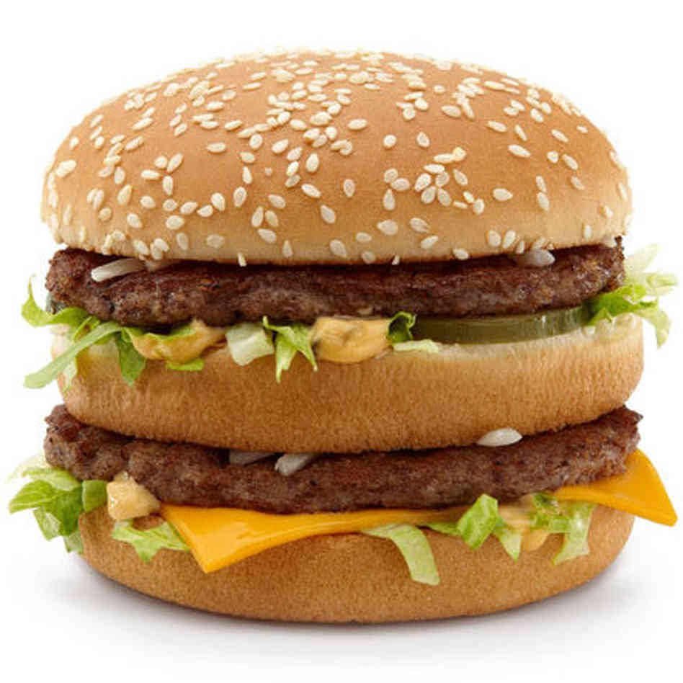
Change in Supply
Cost of Inputs
Productivity
Technology
  “We are on the cutting edge of technology, and we are bleeding.” – Mr. Graves
Taxes
What are the inputs in a Big Mac?

Slide 45
5. Subsidies
6. Future Expectations
7. Government Regulations
8. Number of Sellers

Slide 46
Farm Subsidies
On a sheet of notebook paper, answer the following questions. Keep this sheet because we may use it for one other activity in class today.
What is supposed to be the purpose of farm subsidies?
Do they work? Why or why not?
What is your opinion on this government subsidy?

Slide 47
Train Derailments in VA
What non-price determinant of supply is proposed in the situation above?
What consequences (seen and unseen) could this cause?

Slide 48
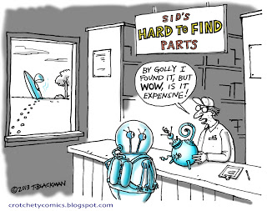

Demand
Desire, ability, & willingness to buy product

Slide 49
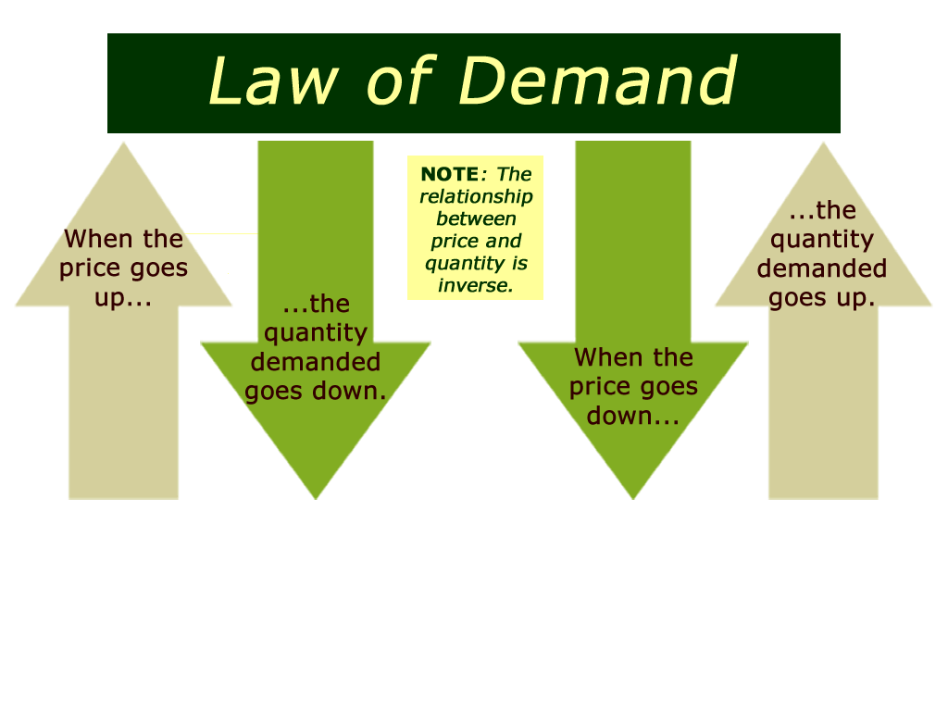
Law of Demand
High Prices= low Qd
Low prices= high Qd

Slide 50
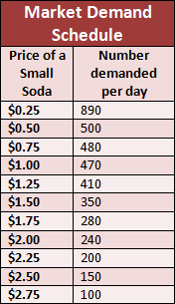
Demand Schedule
List showing quantity demanded (Qd) at all prices that might be seen in the market at a time given

Slide 51
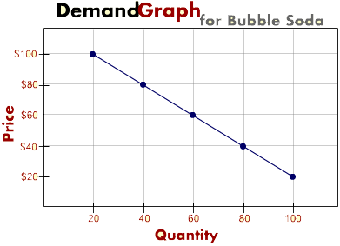
Demand Curve
Graph showing quantity consumers will demand at each price
Downward sloping

Slide 52
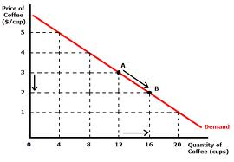
Change in Quantity-Demanded
Whole demand curves does not shift – just moves along curve
PRICE changes always cause changes in Qd

Slide 53
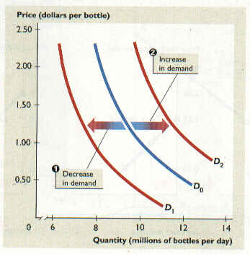
Change in Demand
Shift of entire demand curve left or right
Response to change in 1 of the 5 “non-price” determinants of demand

Slide 54
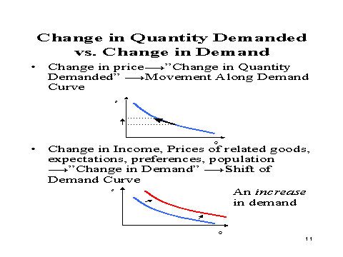
If demand increases, entire demand curve will shift right. This means that at each and every price, more will be demanded (Q-d).

Slide 55
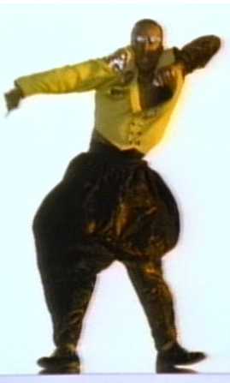
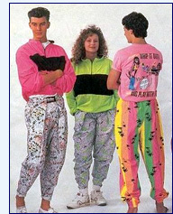
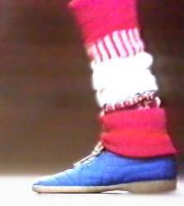

Non-Price Determinants of Demand
Consumer Income
  If you make more, you spend more
Consumer Tastes
  Advertising, celebrity endorsements, trends can all cause shifts

Slide 56
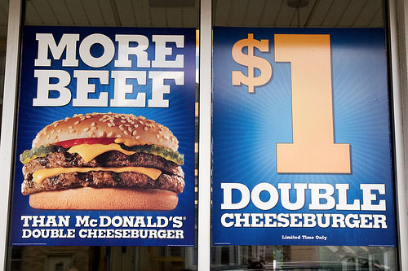
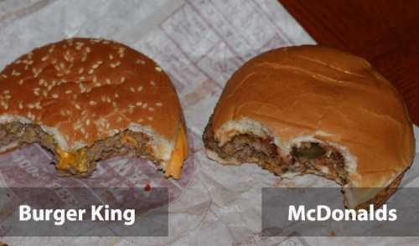
Advertising
  Celebrity Endorsements
Movie Trailers – can be misleading
Fast Food
Can be negative

Slide 57
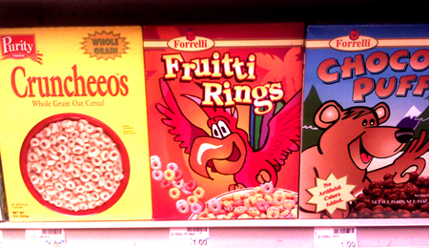
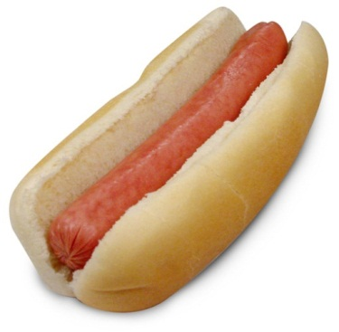
3. Price of Substitute Good
    Products that can be used in place of other products
4. Price of Compliment Goods
    Related good used together with another product
5. Increase in Consumers

Slide 58
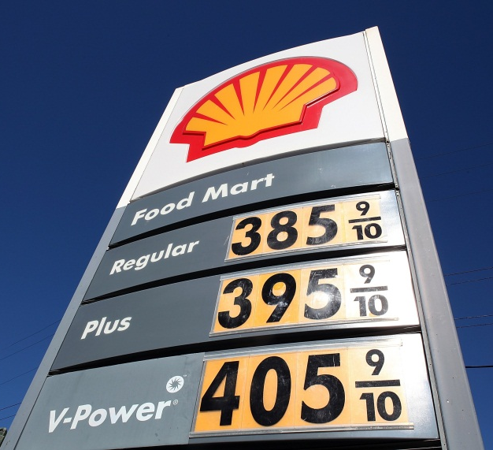
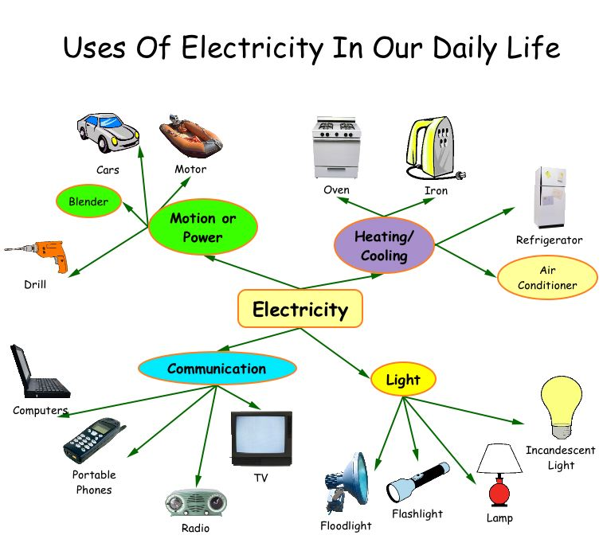

Elasticity of Demand
Measure consumers’ sensitivity to change in price
Elastic- small change in price causes large change in Qd
Inelastic- change in price causes only small change in Qd

Slide 59
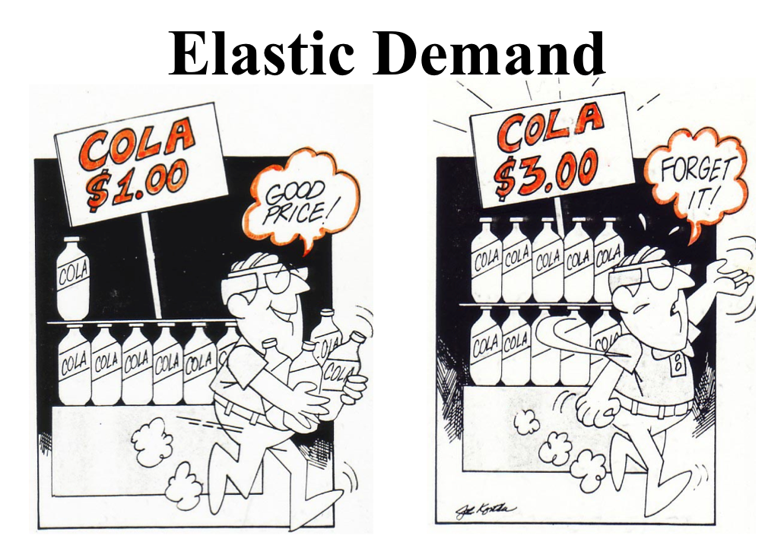
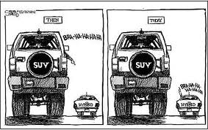
Determinants of Elasticity
Urgency of Need
Availability of Substitutes
Amount of Income required
      Products with high price are more elastic
      Products with lower price are more inelastic

Slide 60
Headliners Activity: Supply & Demand
Pretend you are a writer for the local newspaper.
Your task is to create a ‘catchy’ headline & write a brief news article detailing a scenario that would cause a change in supply or demand. Be sure to describe which determinant of supply or demand your article is discussing. Include a S&D graph to illustrate how the change in supply or demand would impact local consumers. Examples of “catchy” headlines from recent news…
  “J. Crew benefits as Mrs. Obama wears the brand”
  “Tickets! Tickets! Whose Got Tickets?”
  “Consumer demand for small cars is here to stay”

Slide 61
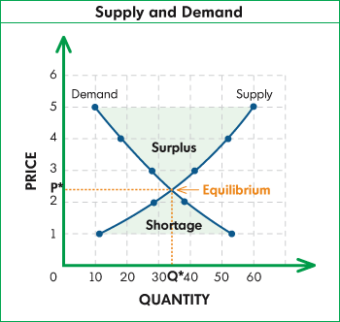

Slide 62
How do events affect the price of a product? Read each situation below. Will there be a change in the SUPPLY, DEMAND, and PRICE of the product (milk)?
 | SUPPLY | DEMAND | PRICE
1. The government runs a successful “3 a day” campaign encouraging people to drink more milk.
2. Fewer people want to be dairy farmers.
3. Ice cream becomes the favorite dessert during the month of June.
4. A milk scare took place due to finding some contaminated milk.
5. People started drinking more juice and water than milk.
6. A series of natural disasters kills 20% of the dairy cow population.

Slide 63
Elastic or inelastic? What are consumers willing to buy? For each of the following, decide if the good or service is elastic or inelastic. Briefly explain why.
Chevrolet automobiles
Restaurant meals
Plane ticket to visit a sick relative across the country that you must get last minute
Electricity
Insulin for a diabetic

Slide 64
How do events affect the price of a product? Read each situation below. Will there be a change in the SUPPLY, DEMAND, and PRICE of the product (oil)?
 | SUPPLY | DEMAND | PRICE
1. The government grants subsidies to oil companies to increase production.
2. The government increases safety regulations on oil companies requiring them to buy new oil tankers to transport the oil.
3. As natural gas production goes up and becomes more productive, this substitute is cheaper than oil.
4. Oil companies are forced to pay more taxes which leads to layoff of workers.
5. Natural gas lines are deemed unsafe, so many people have to switch to oil

Slide 65
For a grade, give me an example of each that would change supply & demand:
Non-price determinants of supply:
Cost of Inputs
Productivity
Technology
Taxes
Subsidies
Future Expectations
Government Regulations
Number of Sellers
Non-price determinants of demand:
Consumer Income
Consumer Tastes
Price of a Substitute Good
Price of a Compliment Good
Increase in Consumer

Slide 66
Understanding Market Equilibrium
During the 1920s & into the 1930s, the U.S. government experimented with Prohibition. The 18th Amendment, ratified in 1919, made the manufacture, sale, and transportation of alcoholic beverages illegal. For various social, political, and legal reasons, the experiment failed. Prohibition ended in 1933 with the ratification of the 21st Amendment.

Slide 67
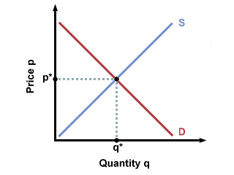
The diagram represents the market for alcoholic beverages in the U.S. in 1918. It is now 1921. What initial changes in the market for alcoholic beverages would the 18th Amendment have caused? Why?

Slide 68
Most of the alcohol produced in the U.S. historically has been made from grain (barley, rye, corn, etc.). The diagram below shows the market for U.S. grain in 1918. What initial changes in the market would the 18th Amendment have caused? Why?

Slide 69
Macroeconomics
Macroeconomics considers the performance of a country as a whole
  Rate of economic growth
  Inflation
  Unemployment
  Trade performance with other countries
Evaluate success or failure of govt economic policies

Slide 70
Measuring the Economy
Gross Domestic Product – $ value of all goods & services produced by a nation in a given yr.
GDP=C+I+G+F
  C – personal consumption expenditures
  I – private domestic investment
  G – government purchases and investments
  F – net exports

Slide 71
Consumption Expenditure
Factors affecting consumption:
  Tax Rates
  Income
  Credit
  Interest Rates
  Wealth (property, shares, savings, bonds)

Slide 72
Government Spending
Defense
Health
Social Welfare
Education
Foreign Aid
Industry
Law & Order

Slide 73
The People’s Pie Online Simulation
What are the 3 types of taxation?
What can be done to reduce Medicare & Social Security costs? What are the effects of this?
Explain budgeting.
What sort of things did you focus your spending on?
Is it easy to win re-election?

Slide 74
Import Spending
Goods & services bought from abroad- outflow of funds
Export Earnings
Goods and services sold abroad- influx of funds

Slide 75
Multiplier Effect
  Increase in demand leads to more people being employed
  People spend more
  More employment

Slide 76
Keynesian View on Inflation
Full employment leads to inflation
Rise in wages cause costs to increase

Slide 77
CONSUMER PRICE INDEX
Compares prices from different years
Indicators of the economy – rapid growth will cause inflation
  Leading – activities that tend to rise or fall before a change in economy– ex. New business, employment & construction
  Coincident – activities that change at the same time –industrial production, industrial sales, & payrolls
  Lagging – activities that change after the initial changes in economy ex. – interest rates

Slide 78
EMPLOYMENT
Underemployment –those who have a job for which they are over qualified
Unemployment –Unemployment rate -% of the labor force unemployed that are actively seeking employment

Slide 79
TYPES OF UNEMPLOYMENT
Frictional – “between jobs”
Cyclical – caused by the contraction of the business cycle.
Seasonal – annual changes in certain industries
Structural – changes in the economy that makes workers' skills obsolete or useless

Slide 80
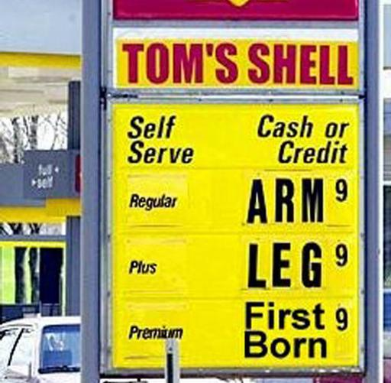
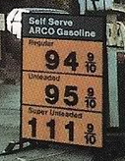
INFLATION
Demand-Pull – prices rise due to an increase in demand
Cost-Push – prices rise because of an increase in production costs
Stagflation – high inflation & high unemployment at the same time
What is a dollar worth?

Slide 81
BUSINESS CYCLES
Graph showing the growth and decline of GDP over time
Expansion - Period of economic growth – high employment & business activities
Peak - Highest point of economic activities
Contraction - Period of economic decline – increasing unemployment & weak business activity
Trough - Economy “bottoms out” with bank failures, major reduction in goods & services, high unemployment
Recession – a brief period of economic inactivity -2 consecutive quarters with a decline in GDP
Depression - an extended period of economic inactivity

Slide 82
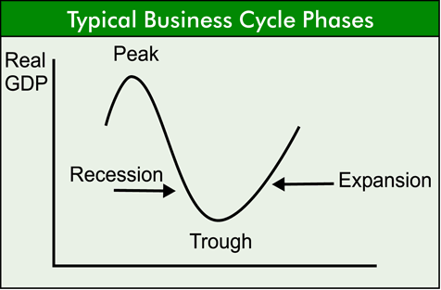

Slide 83
ROLE OF THE GOVERNMENT
Spends
Invests
Employs
Settles disputes – National Labor Relations Board
Regulates businesses to preserve competition
Protects the consumer

Slide 84
FISCAL POLICY
Taxes
  Progressive – income taxes
  Regressive – sales tax
  Proportional – takes in the same % of a person’s income
Expenditures
  Deficit – spend more than is taken in
  National debt – the amount that accumulates over time due to deficits
  Crowding out effect – as the government borrows to cover its deficit, it reduces the amount that private individuals could borrow

Slide 85
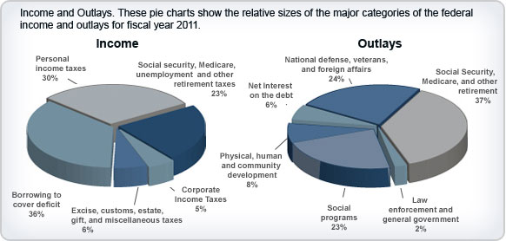

Slide 86
Open & Operating: The Federal Reserve Responds to 9/11
What is the purpose of a central bank?
How did an extraordinary event challenge the infrastructure of the financial system?
What role does the central bank play in responding to a crisis situation?

Slide 87
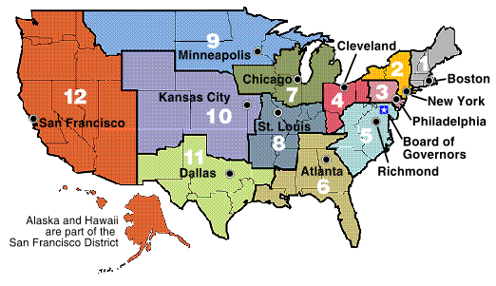
MONETARY POLICY
Controlling the money supply
Federal Reserve System
  12 regional banks
  7 member board appointed by President confirmed by Senate to 14 yr. terms
  Decisions aren’t subject to govt approval

Slide 88
TOOLS OF THE FEDERAL RESERVE
Reserve Requirement -% banks must keep in reserve & not loan out
Discount rate – interest rate banks must pay to borrow money from FED
Buying & selling govt bonds
Too rapid growth causes inflation
Slow growth causes unemployment

Slide 89
Easy money policy – more $$$ in supply
  Lower reserve requirement
  Reduce discount rate
  FED buys govt bonds
Tight money policy – restricts growth of $$$ supply
  Raise reserve requirement
  Raise discount rate
  FED sells govt bonds

Slide 90
Reality (pay)Check
Interpreting Your Pay Stub

Slide 91


REALITY (PAY)CHECK
Your paycheck comes with a pay stub. The pay stub gives details about how much you earn and the taxes you pay. Check out the parts of Wanda Worker’s pay stub.

Slide 92
REALITY (PAY)CHECK
How much does Wanda earn per hour?
$12.75

Slide 93
REALITY (PAY)CHECK
What are Wanda’s total earnings for the current pay period?
$1,020.00

Slide 94
REALITY (PAY)CHECK
Which tax had the least taken out? The most?
Least: Medicare tax
Most: Federal income tax

Slide 95
REALITY (PAY)CHECK
How much did Wanda pay in taxes this pay period?
$188.64

Slide 96
REALITY (PAY)CHECK
How much has Wanda paid in total taxes this year?
$2,263.68

Slide 97
REALITY (PAY)CHECK
How much federal tax has Wanda paid so far this year?
$1,112.40

Slide 98
REALITY (PAY)CHECK
What was Wanda’s gross pay during the current pay period?
$1,020.00

Slide 99
REALITY (PAY)CHECK
Was Wanda’s entire gross pay taxable?
❍ Yes
❍ No
✓

Slide 100
REALITY (PAY)CHECK
Wanda receives a check for which amount?
❍ Gross pay
Net pay
Taxable amount
✓

Slide 101
REALITY (PAY)CHECK
What are the two pre-tax deductions that are taken out of Wanda’s check?
Health insurance
401k Retirement

Slide 102
REALITY (PAY)CHECK
Wanda paid $93 toward health insurance and retirement. Did she pay taxes on that $93?
❍ Yes
❍ No
✓

Slide 103
REALITY (PAY)CHECK
If Wanda’s state did not have an income tax, how much extra money would she have kept so far this year?
$300.36

Slide 104
HOW MUCH WILL IT COST?
A Look at Sales Tax

Slide 105


HOW MUCH WILL IT COST?
If people in this county want to buy a car, they have 2 choices.
What are they?
City sales tax only applies inside a city’s boundaries. What is B-Town’s tax rate?
State sales tax applies everywhere in the state. What is the state tax rate?
County sales tax applies everywhere in the county. What is the county tax rate?
To find the total sales tax rate you will pay, add the tax rates of everywhere you are.
Here is an imaginary county in an imaginary state.
If you are in B-Town, what will be the total sales tax rate?
Now find the 3 biggest stores in the county.
There are 2 cities in this county.
Name them.
5% + 2% + 3% = 10%
Let’s learn how to calculate sales tax.
What is A-Town’s tax rate?

Slide 106
HOW MUCH WILL IT COST?
Example: How much will you pay for a $50 shirt at Bigmart in A-Town?
1) ADD to find the tax rate:
State tax 5 %
County tax 2 %
City tax + 2 %
Total Tax 9 %

Slide 107
HOW MUCH WILL IT COST?
Example: How much will you pay for a $50 shirt at Bigmart in A-Town?
2) MULTIPLY the tax by the price:
$ 50
x 9
← price
← tax rate
450

Slide 108
HOW MUCH WILL IT COST?
Example: How much will you pay for a $50 shirt at Bigmart in A-Town?
3) MOVE the decimal point 2 places to the left. This is the amount of tax you will pay:
$ 50
x 9
450
450
The tax on this shirt will be $4.50.

Slide 109
HOW MUCH WILL IT COST?
Example: How much will you pay for a $50 shirt at Bigmart in A-Town?
4) ADD the tax and the price to see the final cost:
$ 50.00
+ 4.50
54.50
The shirt will cost $54.50 at Bigmart in A-Town.

Slide 110
HOW MUCH WILL IT COST?
You try it:
1) A pair of headphones costs $10 at both Bigmart in A-Town and Hugemart in B-Town. What would you actually pay for the headphones at each store?
In A-Town:
In B-Town:
Tax rate = 9%
$10 x 9 = 90
Tax = $0.90
Tax rate = 10%
$10 x 10 = 100
Tax = $1.00
The headphones will cost $10.90 in A-Town and $11.00 in B-Town.
Notes:
To use this slide with an interactive white board, delete the answer calculations from the slide and have students solve the problems on the white board. Use the printed teacher guide to check students’ work.

Slide 111
HOW MUCH WILL IT COST?
You try it:
2) Lisa is going to buy a new car! It costs $15,000 at both A-Town Dealership and at Bob’s County Dealership. What would she actually pay for the car at each place?
In A-Town:
At Bob’s:
Tax rate = 9%
$15,000 x 9 = 135000
Tax = $1,350.00
Tax rate = 7%
$15,000 x 7 = 105000
Tax = $1,050.00
The new car will cost $16,350 in A-Town and $16,050 at Bob’s.
Notes:
To use this slide with an interactive white board, delete the answer calculations from the slide and have students solve the problems on the white board. Use the printed teacher guide to check students’ work.

Slide 112

HOW MUCH WILL IT COST?
You try it:
3) A stereo costs $257 at the County Store and $250 at Hugemart in B-Town. With taxes, what would you actually pay at each store?
In B-Town:
At the County Store:
Tax rate = 10%
$250 x 10 = 2500
Tax = $25.00
250 + 25 = 275
Tax rate = 7%
$257 x 7 = 1799
Tax = $17.99
257 + 17.99 = 274.99
The stereo will cost $275 in B-Town and $274.99 at the County Store.
If it costs you $10 in gas to drive to Hugemart, at which store will the stereo end up costing you the least?
The County Store.
Notes:
To use this slide with an interactive white board, delete the answer calculations from the slide and have students solve the problems on the white board. Use the printed teacher guide to check students’ work.

Slide 113
HOW MUCH WILL IT COST?
You try it:
4) The state is tired of people putting gum under tables and chairs. It just put a $1 excise tax on each pack of gum! Gum used to cost $0.75 at both Bigmart and Hugemart.
What will the new price tags say?
Bigmart
Hugemart
$0.75
$1.75
$1.75
$0.75
The price goes up $1 per pack everywhere, so the new price will be $1.75.

