Slide 1
US GOVERNMENT
TEST #8
COMPARATIVE POLITICAL & ECONOMIC SYSTEMS

Slide 2
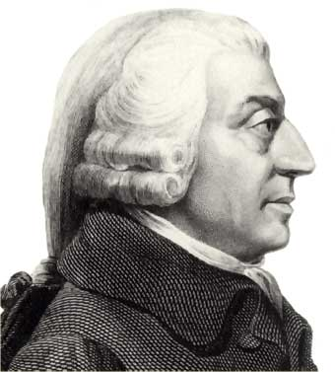
COMPARATIVE ECONOMIC SYSTEMS
Capitalism – economic system that rewards individuals through free enterprise & profit
Factors of Production
Land, Labor, capital & entrepreneurship
Market Economy
Free enterprise (factors are owned by private individuals)
Profit motive – gains from business dealings
Competition
Law of Supply & Demand – these forces set prices in the market
Monopoly – one seller of a good or service within an industry
Laissez-faire – business activity free of govt. regulations
Adam Smith – Wealth of Nations – the “invisible hand”

Slide 3
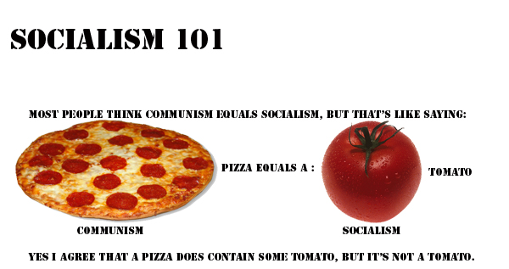
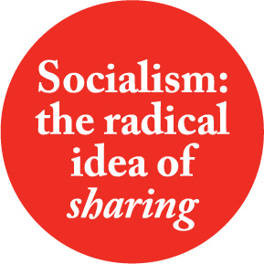
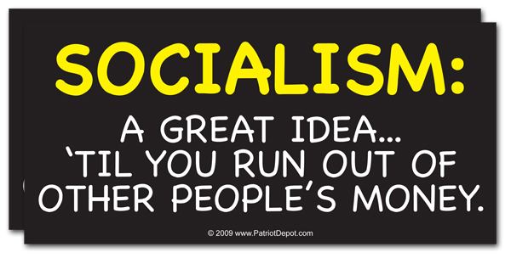
Socialism – economic & political philosophy based on the idea wealth should be equally distributed throughout society
Collective ownership of factors of production
Government can be democratic but must have centralized planning
Rejection of individualism & competition for profit
Created because of abuses by factory owners during the Industrial Revolution

Slide 4
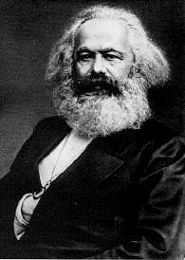
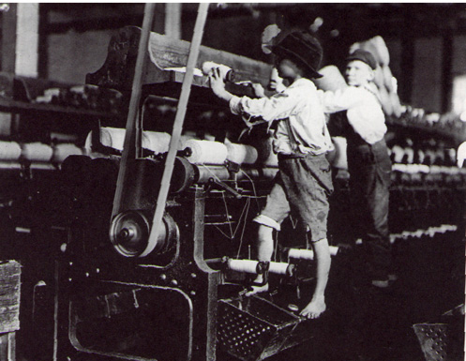
Karl Marx – Communist Manifesto
All of history is a class struggle
Condemned the misery of industrialism & capitalist enslavement
Proletariat - workers
Bourgeoisie – capitalists –owners of the factors of production
Socialist vs. Communist – socialists favor change through peaceful means while communist believe change will occur through a violent revolution

Slide 5
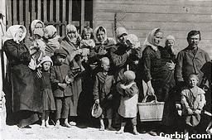
Nationalization – government take over of industries
Public Welfare –housing, food, & medical
Welfare state – countries that pay extensive social services
Taxation – high taxes to pay for govt. services (50-60%)
Central, Planned, or Command Economy – govt. chooses what to produce, how to produce, & how to distribute.

Slide 6
COMMUNISM
Collective or state ownership of land & other property.
Karl Marx
View of history – class struggle
Theory of Labor – product should be valued based on the labor put into making it. Workers should get the money from his labor
Nature of the State – Govt. was used by capitalists to keep power.
Religion used to make people tolerate the abuse in return for better life after death.
Dictatorship of the Proletariat – transition between capitalism & classless society - Authoritarian to do the will of the masses.

Slide 7
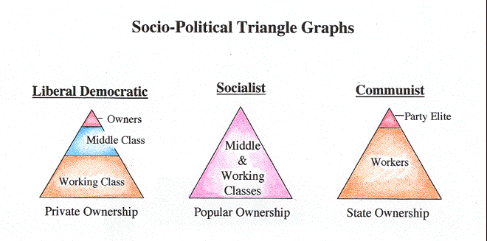
Communist economies
Role of the party
Central planning
Collectivization
State ownership
Cuba, China, Vietnam, Laos, & N. Korea – Still communist countries today

Slide 8
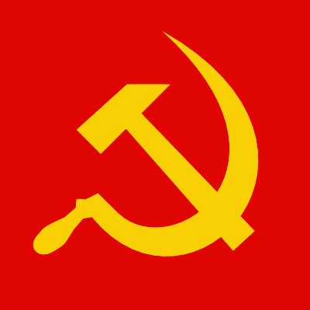
Communist symbol

Slide 9
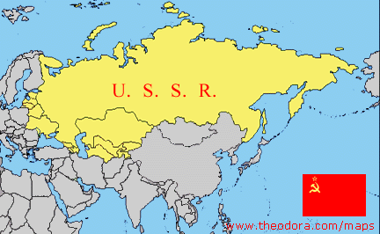
RUSSIA – SOVIET UNION

Slide 10
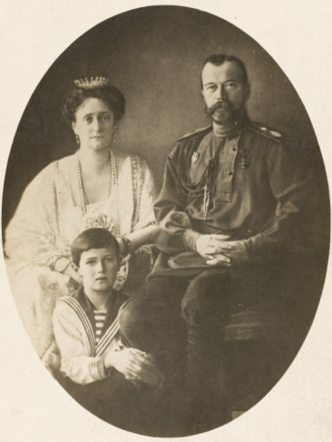
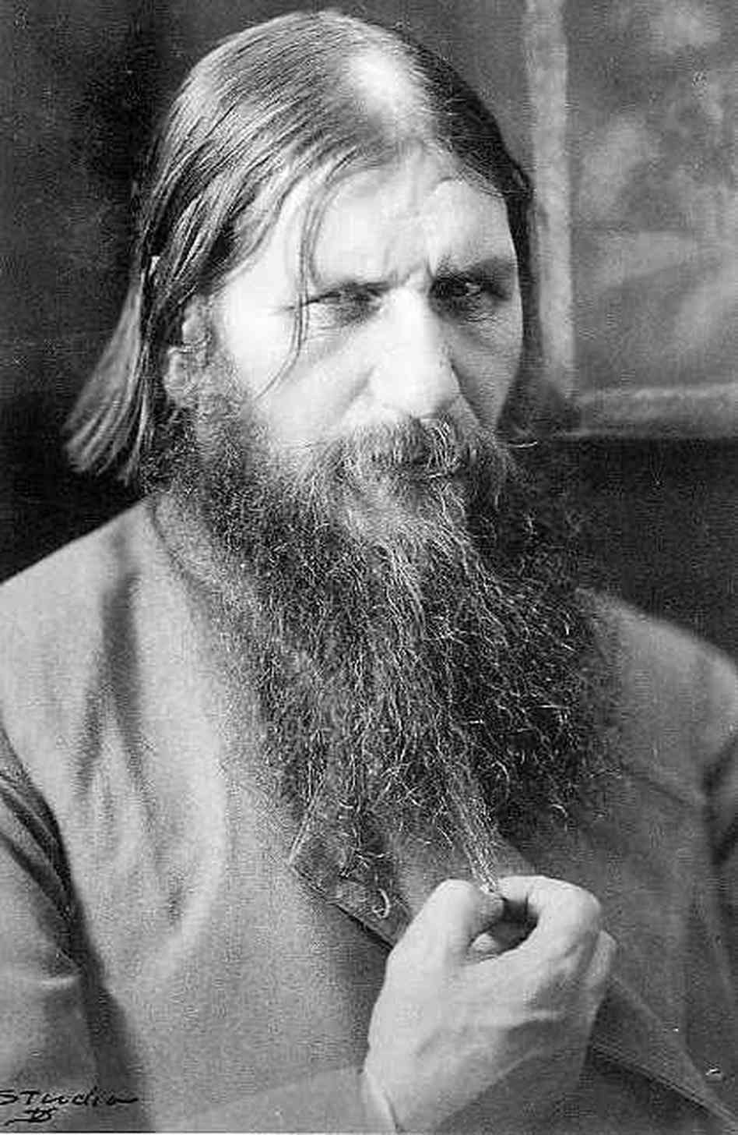
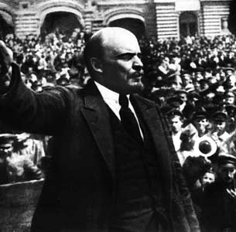
Monarchy until 1917
Began to decline after the Russo-Japanese War of 1905
Was unable to stay together during WWI
Czar Nicholas II – imprisoned, then killed
Communist promised “bread & peace”
Bolshevik Revolution
1917 Vladimir Lenin – transforms Russia into a communist nation

Slide 12
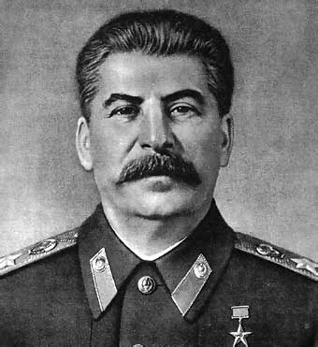
Stalin ruled from 1924 - 1953
“Great Purges” – purifies the party by executing his political & military threats
Forced collectivization of agriculture
Placed emphasis on industry & military growth
Rules during WWII & the beginning of the Cold War

Slide 13
Soviet Constitution
Established the structure and powers of the government
No limits to government power – doesn’t guarantee basic rights
Legislature
Supreme Soviet - Rubber stamps decrees of the Communist Party of the Soviet Union (CPSU) usually one candidate for each members seat

Slide 14
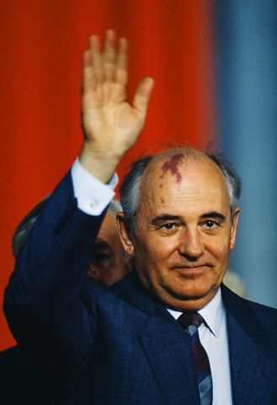
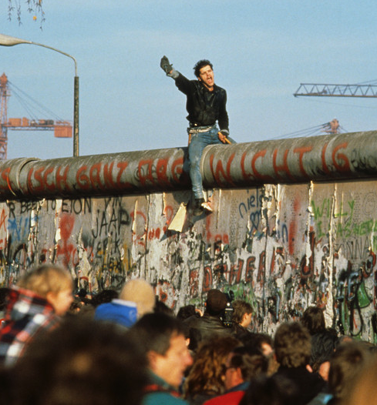
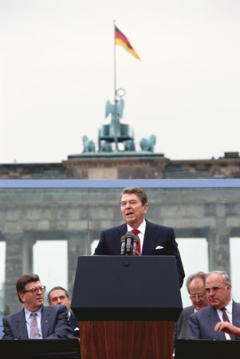
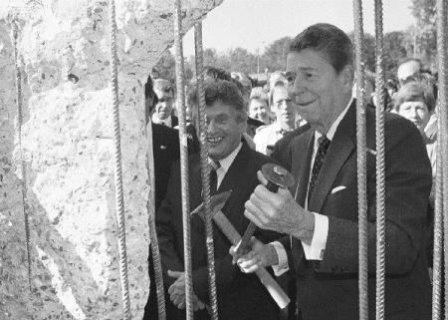
Communist Party
Top Committee – Central Committee or Politburo – head is the General Secretary
Gorbachev (1985-1991)
Perestroika – political & economic reforms
Glasnost – openness of the society reducing government censorship

Slide 15
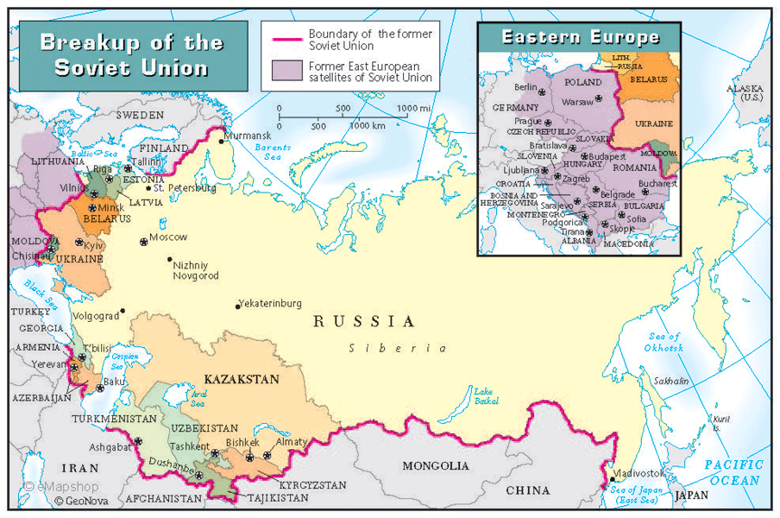
Fall of the Soviet Union
Baltic states declared independence
1991 – elections held & Boris Yeltsin (who withdrew from the communist party) became the President of Russia
Gorbachev & his wife arrested in a failed coup to gain back control
Gorbachev resigns – Soviet Union is dissolved

Slide 16
Russian Government Today
1993 Constitution – establishes a republic & guarantees individual freedoms
40 political parties including the Communist
Separation of Powers
President – most power – appoints Prime Minister (2nd in Command) & ministers of executive depts.
4 yr. term, 2 term limit, 35 yrs. old, citizens, 10 year resident
Legislative Branch – Federal Assembly
Bicameral – Council of Federation & State Duma (more powerful)
Override presidential veto by 2/3s vote
Constitutional Court – 19 members, 12 year terms
Power of “judicial review’

Slide 17
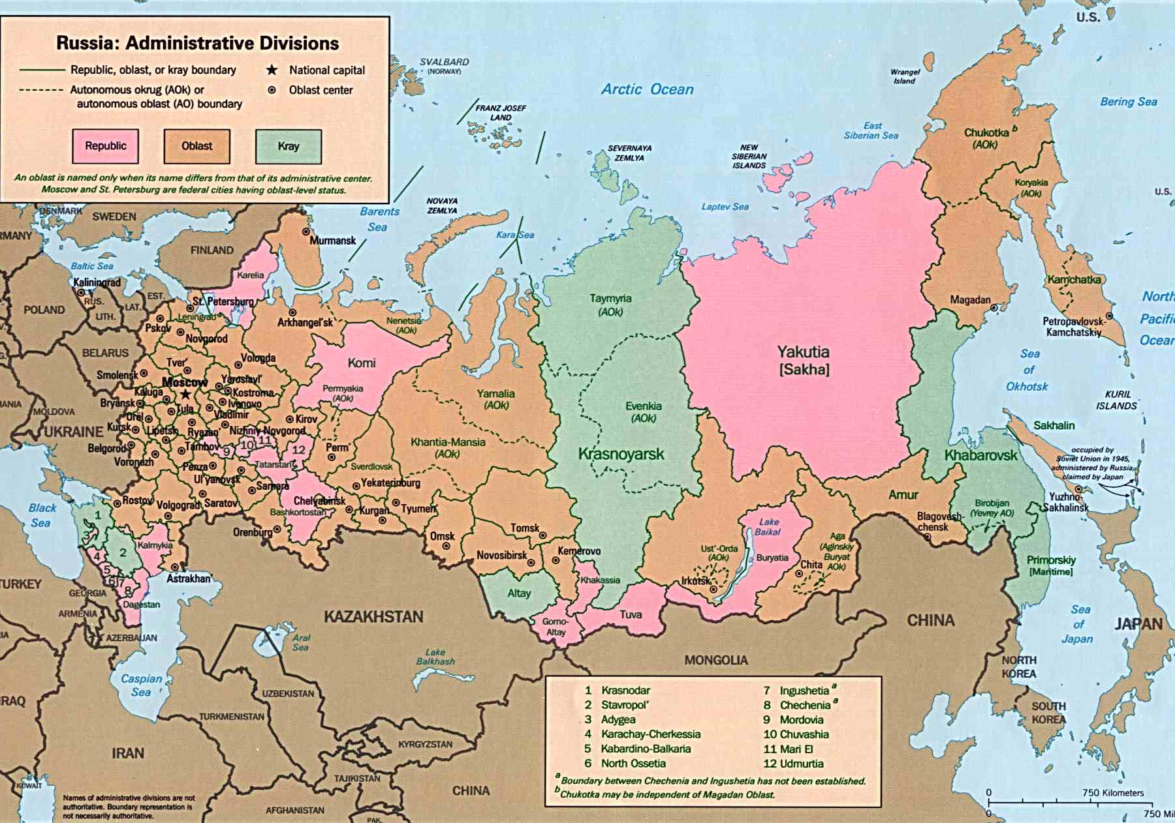
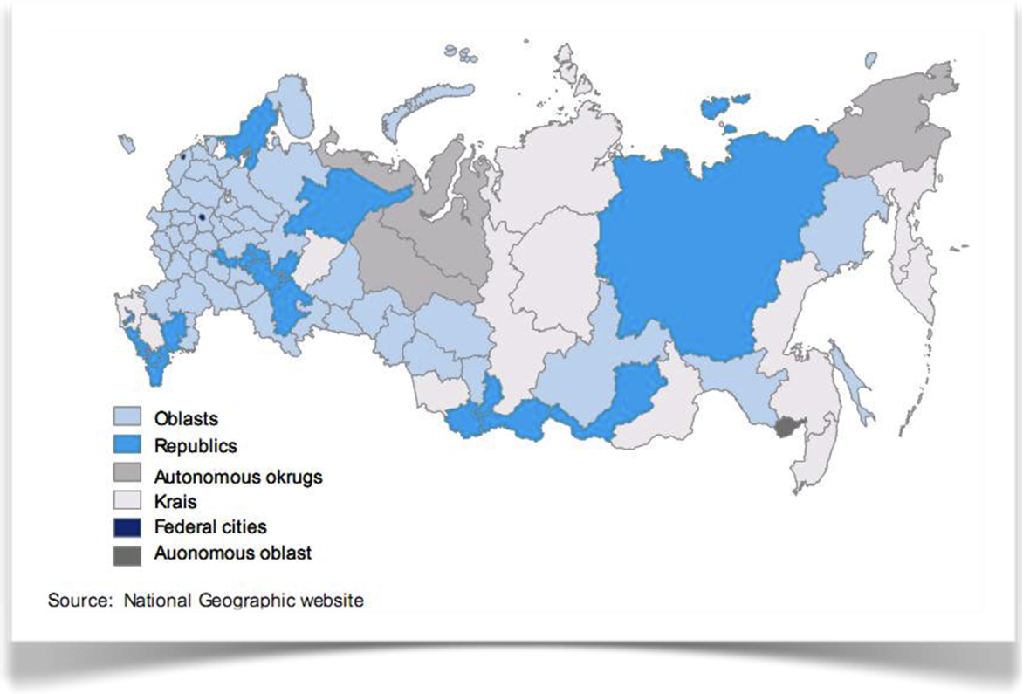
Regional & Local Governments
49 provinces with governors
The Federation contains 21 republics of which 10 are autonomous areas
Constant pressure by some republics to break away

Slide 18
Languages/Ethnic Groups of Russia
Abaza (Northwest Caucasian; in the Karachay–Cherkess Republic)^{[4]}
Adyghe (Northwest Caucasian; in the Republic of Adygea)
Altay (Turkic; in the Altai Republic)
Avar (Northeast Caucasian; in the Republic of Dagestan)
Azerbaijani (Turkic; in the Republic of Dagestan)
Bashkir (Turkic; in the Republic of Bashkortostan)
Buryat (Mongolic; in Agin-Buryat Okrug and the Buryat Republic)
Chechen (Northeast Caucasian; in the Chechen Republic)
Chuvash (Turkic; in the Chuvash Republic)
Erzya (Uralic; in the Republic of Mordovia)
Ingush (Northeast Caucasian; in the Republic of Ingushetia)
Kabardian (Northwest Caucasian; in the Kabardino-Balkar Republic and Karachay–Cherkess Republic^{[4]})
Kalmyk (Mongolic; in the Republic of Kalmykia)
Karachay-Balkar (Turkic; in the Kabardino-Balkar Republic and Karachay–Cherkess Republic^{[4]})
Khakas (Turkic; in the Republic of Khakassia)
Komi-Zyrian (Uralic; in the Komi Republic)
Lezgi (Northeast Caucasian; in the Republic of Dagestan)
Mansi (Uralic; in Khanty–Mansi Autonomous Okrug)
Mari (Uralic; in the Mari El Republic)
Moksha (Uralic; in the Republic of Mordovia)
Nogai (Turkic; in the Karachay–Cherkess Republic)^{[4]}
Ossetic (Iranian; in the Republic of North Ossetia–Alania)
Tatar (Turkic; in the Republic of Tatarstan)
Tuvаn (Turkic; in the Tuva Republic)
Udmurt (Uralic; in the Udmurt Republic)
Yakut (Turkic; in the Sakha Republic)

Slide 19
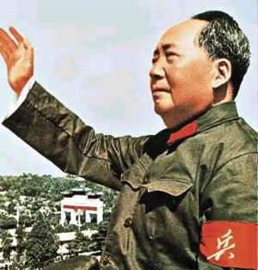
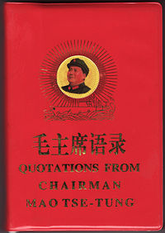
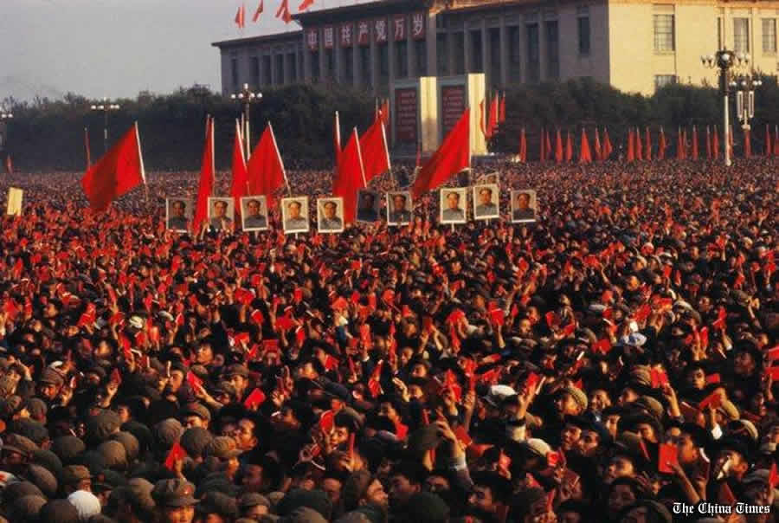
CHINA
1949 – becomes communist nation under Mao Ze-Dong
Support from the peasants
Great Leap Forward – plan to collectivize to increase agricultural production & to place emphasis on heavy industry
1960’s – Cultural Revolution (1966)
“Red Guard” – young patriots
“Little Red Book” – thoughts of Chairman Mao

Slide 20
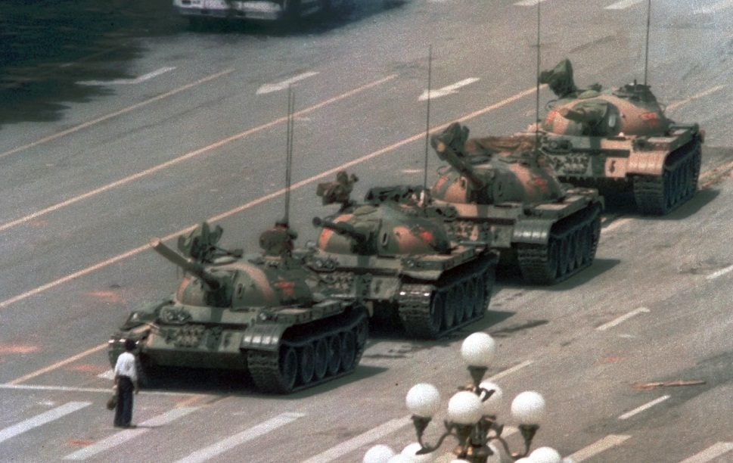
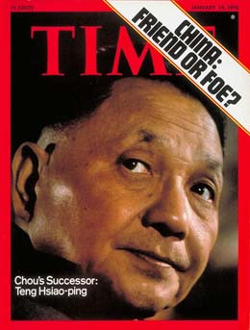
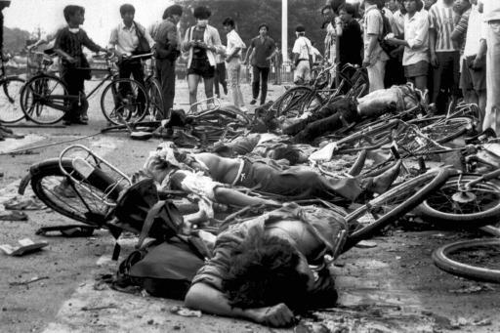
1976 – Deng Xia Ping
Reforms encouraging private enterprise
No right to political dissent
1989 – Tiananmen Square demonstration

Slide 21
Communist Party– hold all major positions; they control the government
Similar to Soviet Union with a Politburo & Premier
Punishment for most crimes is death – no guarantee of fair trial
Internet censorship – “50 cent party members” – posting positive message about China’s govt.

Slide 22
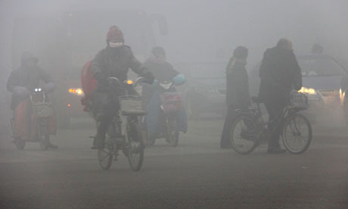
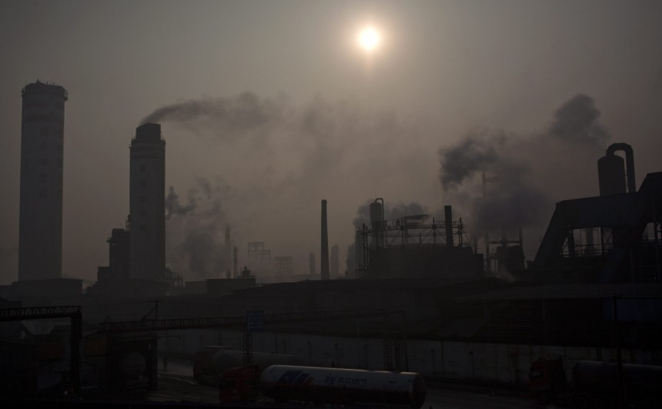
2010 – China became largest exporter
12th Five-Year Plan- in 2011 emphasizes continued economic reforms & the need to increase domestic consumption in order to make the economy less dependent on exports
Major environmental & population issues

Slide 23
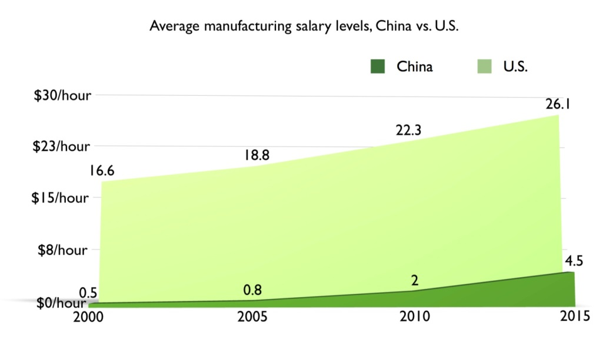
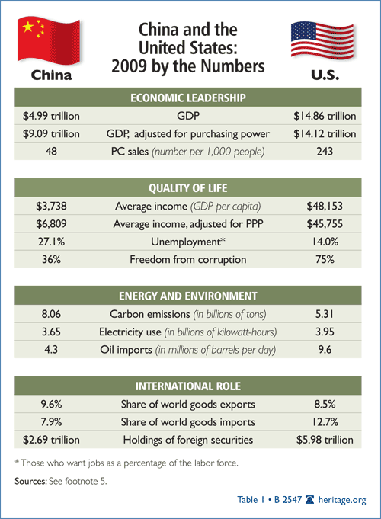
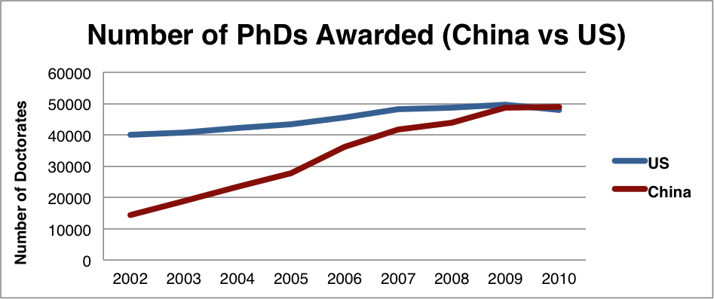
“Sweatshops” – Chinese factories assemble many products at very low cost – 77% of jobs lost to China are in manufacturing
College entrance exam determines admission

Slide 24
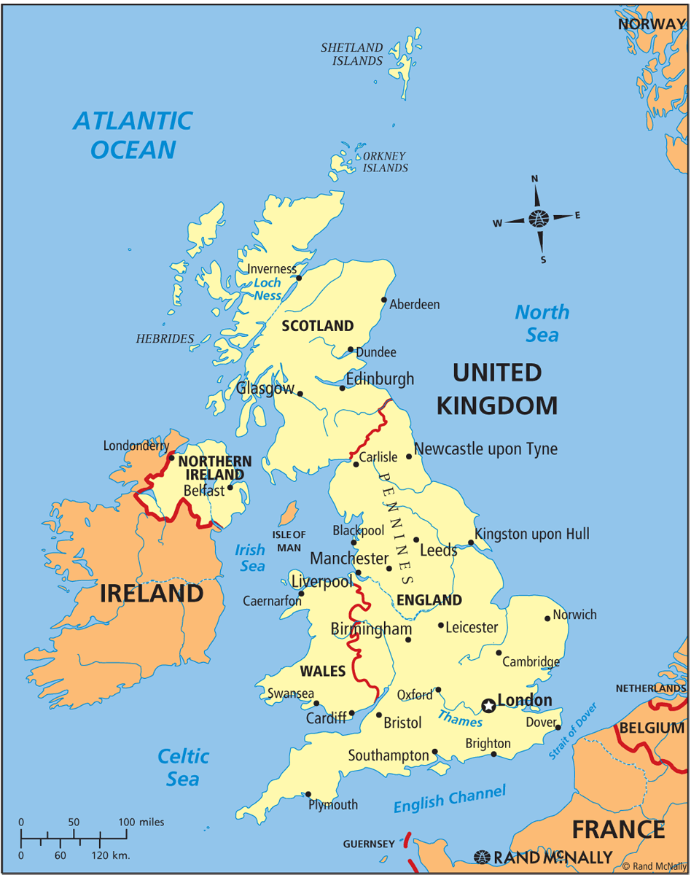
United Kingdom of Great Britain & Northern Ireland
Unwritten Constitution – no single document, based on historic documents, court rulings (English Common Law), & Parliament’s laws
Constitutional Monarchy

Slide 25
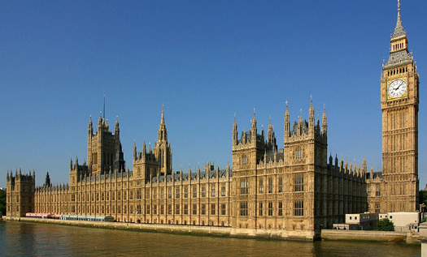
Parliament –holds legislative & executive powers
Legislative – lawmaking
Bi-cameral
House of Lords
House of Commons

Slide 26
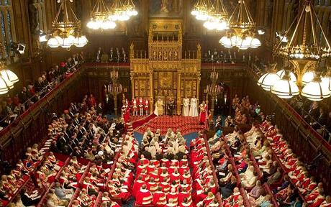
House of Lords – until 1999, members were appointed by queen or inherited noble titles *life peers (those honored for achievements in science, literature, politics or business.
682 members
Reviews bills made by the House of Commons
Can only delay a bill; can’t prevent it from passage
Serves as the final court of appeals in criminal & civil cases

Slide 27
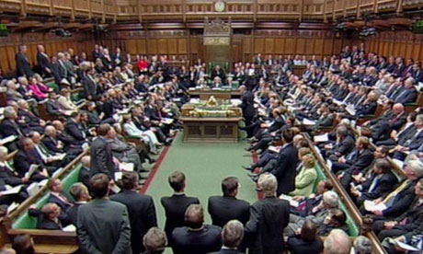
House of Commons – 659 members elected by single member districts of similar populations
Elections are held every 5 years
Opposing parties sit across from each other
Majority party does most of the work but any MP (member of Parliament) can introduce a bill

Slide 28
Executive – chooses administrative depts. & runs nation’s affairs
Prime Minister
Chosen by the majority party, approved by the queen
No majority, a coalition – temporary alliance of parties – will choose the Prime Minister
The Cabinet
Selected by the Prime Minister from the House of Commons or House of Lords
Carries out public policy

Slide 29
Calling elections
Held at least every 5 years
Sometimes the Prime Minister chooses to hold elections when he thinks his party will win
No checks & balances as in the US

Slide 30
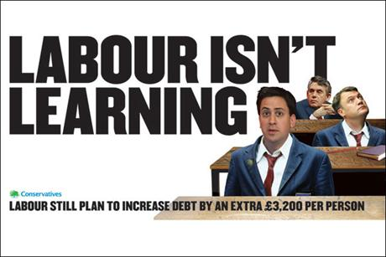
Political Parties
Conservative Party (Tories)
Middle & upper class – private economic initiatives over govt., less govt. involvement
Labour Party
Working class & poor – redistribution of wealth, nationalization of certain industries, public welfare programs
Parties have more loyalty from voters than in the US

Slide 31
Crown Court – Northern Ireland, England & Wales
Appellate courts – hears appeals – final appeal goes to the House of Lords
Decisions are based on parliamentary legislation, common law or judicial precedent
Not bound to uphold a constitution or bill of rights
No right of judicial review – cannot overrule Parliament

Slide 32
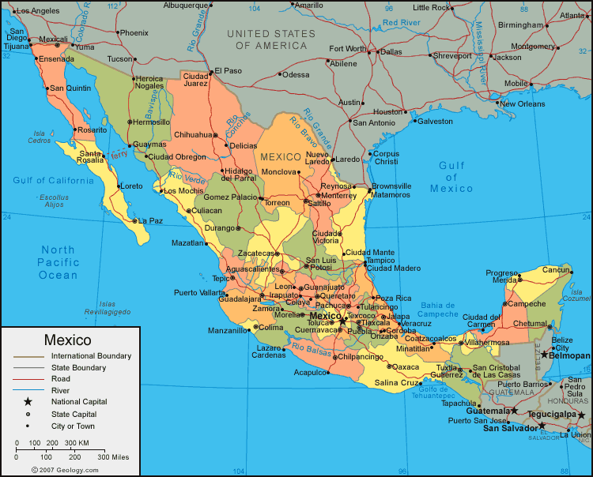
MEXICO
Declared independence from the Spanish in 1810
Federal republic
31 states & federal district of Mexico City
Mexico’s states have a great deal of freedom to govern, but must still obey the national constitution
President – elected to 6 yr. term – can only serve 1 term
Bicameral legislature – Senate & Chamber of Deputies

Slide 33
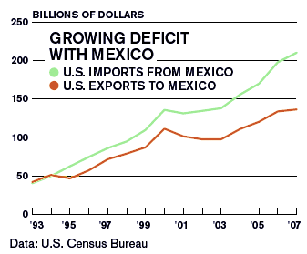
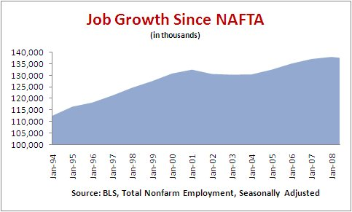
North American Free Trade Agreement (NAFTA): A free-trade zone of Canada, Mexico, & the United States intended to eliminate trade barriers, promote fair competition, & increase investment opportunities
“To export goods, not people.”

Slide 34
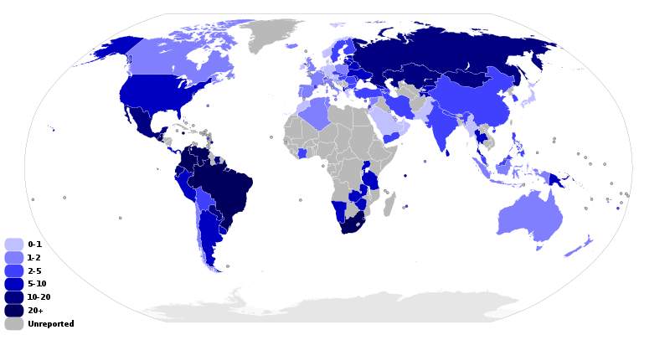
Immigration
Drugs & guns
Murder rates per 100,000 inhabitants – year 2012

