Slide 1
TEST # 5

Slide 2
POLITICAL PARTIES
Political Party – group who seek to control govt by winning elections & holding offices
Parties offer choices as a link to the public
Nominate candidates
2 Major Parties
Republicans & Democrats
Started with ratification debates – Federalists & Anti-federalists
1796 – Farewell Address – Washington warns against parties

Slide 3
One-Party System
Dictatorship
Communist

Slide 4
Minor parties
Tea Party
Communist Party
Libertarian Party
Green Party
1912 Presidential Election
Wilson – Democrat
Taft – Republican
T. Roosevelt – National Progressive Party or “Bull Moose Party”

Slide 5
Where do you fit?
http://www.people-press.org/political-party-quiz/

Slide 6
VOTERS
AND
VOTING

Slide 7
SUFFRAGE & FRANCHISE
Right to vote
Initial requirements
White
Male
21
Owned property
1789 – 1 in 15 white males could vote
Universal requirements
Citizenship
Residence
Age

Slide 8
EXTENDING SUFFRAGE
1826 - Eliminating property requirement
15th Amendment – race (1870)
19th Amendment – gender (1920)
23rd Amendment – added DC voters to Presidential elections (1961)
24th Amendment – prohibited the poll tax (1964)
26th Amendment – age (1971)
1965 Voting Rights Act – outlawed literacy tests

Slide 9
Would you be able to register to vote in 1964?
Louisiana Literacy Test 1964

Slide 10
SUFFRAGE AND CIVIL RIGHTS
Gerrymandering – dividing voting districts in a manner to give one group an advantage
Civil Rights Act of 1964
Outlawed discrimination
Courts could use an injunction to enforce voting rights
Voting Rights Act of 1965
Outlawed the literacy test
Preclearance

Slide 11
VOTER BEHAVIOR
Off year elections
Less turnout
Why vote?
Immigrant, sick, mental issues, criminals can’t
The “my vote doesn’t really count”

Slide 12
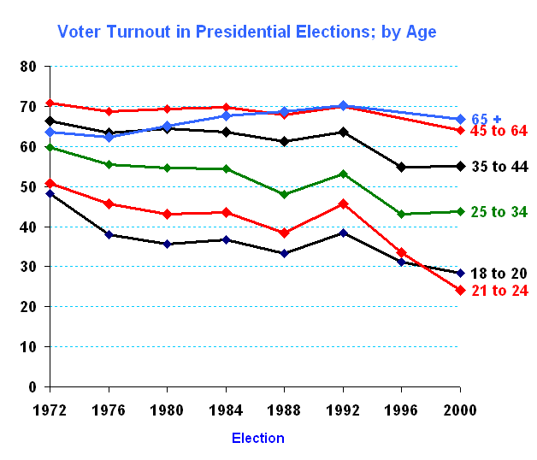

Slide 13
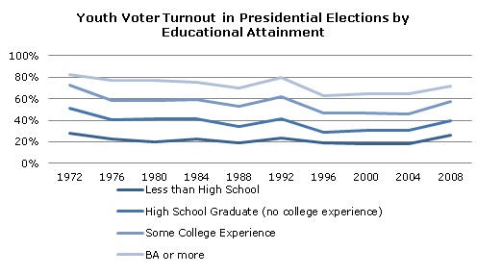

Slide 14
Voting factors
Income and occupation
Education
Gender and age
Religion
Ethnic background
Geography

Slide 15
ELECTORAL PROCESS
Nomination by party
Caucus
Open Primary
Allows any voter to participate
Closed Primary
Allows only voters from that party to vote

Slide 16
Money and Elections
Small contributors (about 10%)
“Fat Cats”
Candidates themselves
Ross Perot spent $65 million
Political Action Committees (PAC) – Super PACs
Arm of special interest groups
Temporary Organizations
Designed to fund raise by dinners, picnics and receptions

Slide 17
Loopholes in funding law
Soft money
Contributions by state & local party organizations for ads, mailings & get-out-the-vote-drives
Hard money
Regulated by Federal Elections Committee

Slide 18
MASS MEDIA & PUBLIC OPINION
Polling process
Universe – whole population to be measured
Constructing a sample
Valid questions
Interviewing
Analyze and report findings
Mass media – communication that reaches a large, widely dispersed audience
Ex. TV (The Living Room Campaign), Magazines, Newspapers, Radio, Internet

Slide 19
Propaganda – technique of persuasion
Create a particular belief
Advertisers, persuaders and brainwashers
Approaches
Bandwagon – everybody’s doing it
Plain folks – average person
Celebrity testimonials - endorsement
Multiple identities – “just like you”
Name calling – attacking and labeling opposition
Scare tactics – fear of the consequences

Slide 20
INTEREST GROUPS
Functions
To stimulate interest in public affairs – raise awareness
Represent interest on shared attitudes
Provide useful data to govt
Vehicle for political participation
Provide “checks and balances”

Slide 21
Criticisms
Influence beyond size or importance
Hard to tell just who or how many people the group represents
Doesn’t necessarily represent the views of all they represent
Tactics often challenge the political system

Slide 22
Types
Business
Labor
Agriculture
Professional groups
Promote causes
Promote welfare for particular groups
Religions

Slide 23
Lobbyists
Those who represent a group and place pressure on legislators and the legislative process
Examples – NRA, Civil Liberties Union, NOW, and NORMAL

