Slide 1
US GOVERNMENT The Executive Branch
TEST #4

Slide 2
Help Wanted! Poster
You will make a poster advertising the job of President of the United States. Your “help wanted” advertisement/job description must include the following:
Qualifications to be President
Roles of the President
Powers of the President
Qualities of a good President
Issues that a President should be knowledgeable about
Salary and benefits information
You poster must have color, pictures, and a works cited page.
You will be graded based on the following:
Accurate content 25 points
Poster attractiveness 25 points
Grammar/spelling 25 points
Works cited 25 points
Email final product to joynerkd@ccps.k12.va.us

Slide 3
Who is in the executive branch?
President
Vice President
Cabinet Departments & other executive agencies
White House Chief of Staff
Supervise key White House staff
Control access to the president
Manage communications
Negotiate with Congress, executive agencies, & political groups to implement the president’s agenda

Slide 4
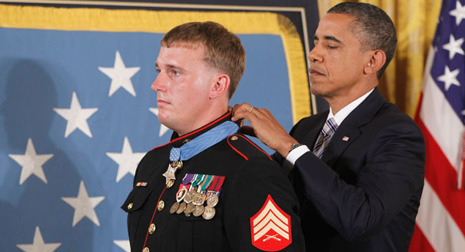
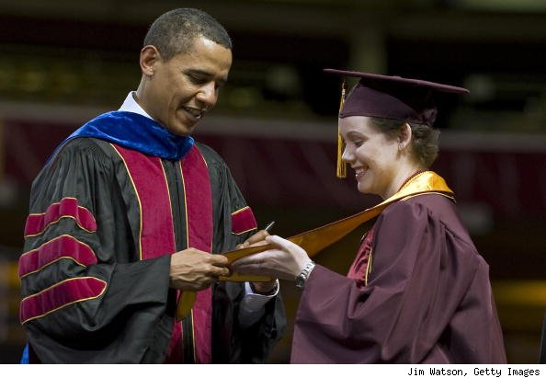
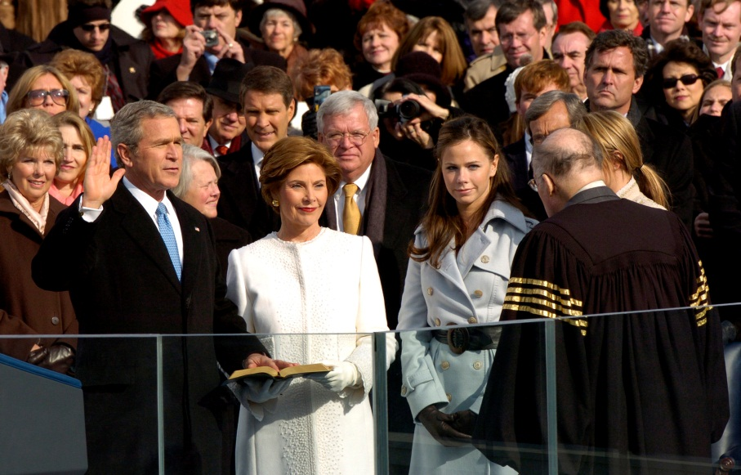
Constitutional Roles of the President
1. Chief of State – ceremonial duties

Slide 5
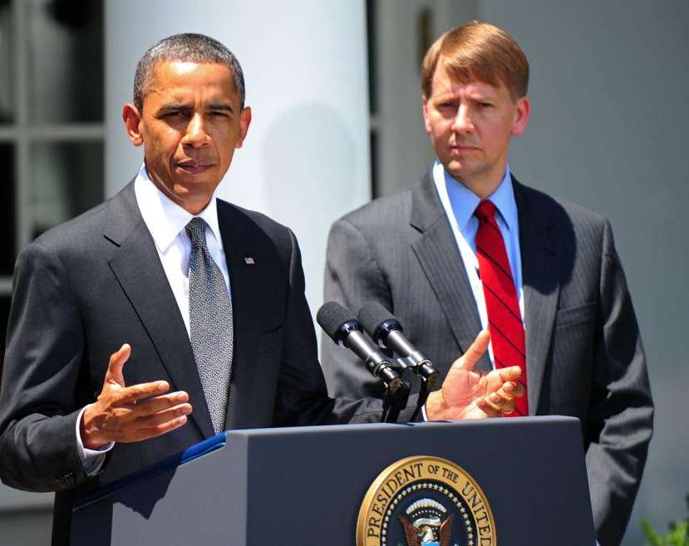
2. Chief Executive – makes sure laws are executed & oversees millions of federal employees
Appointment power
Ambassadors, diplomats, federal judges, US Marshals, cabinet members, military officers
Appointments approved by the Senate
President Obama appointed former Ohio attorney general Richard Cordray to serve as director of the Consumer Financial Protection Bureau (CFPB) Wednesday, drawing sharp criticism. (Manuel Balce Ceneta - Associated Press)

Slide 6
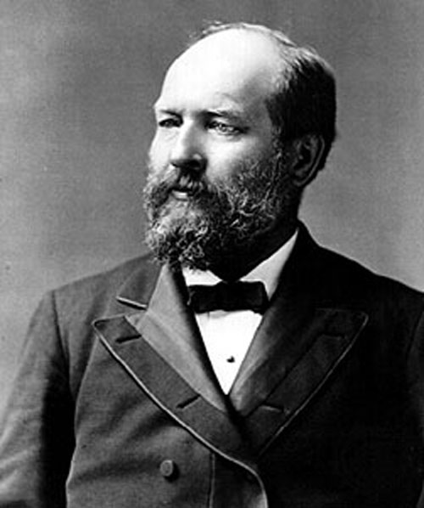
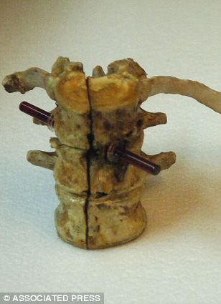
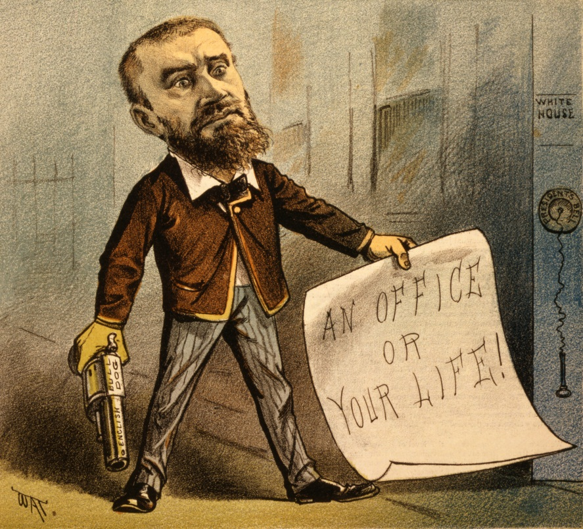
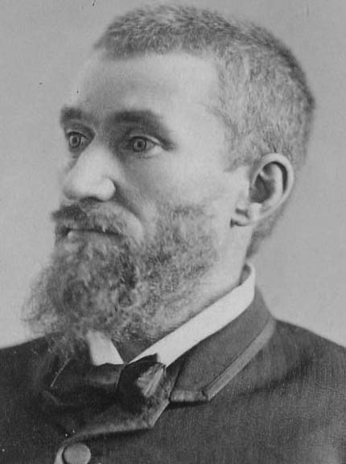
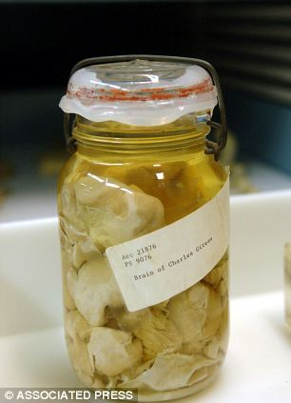
Civil Service Test for the bureaucracy
Replaced “Spoils System”
Created after President Garfield’s Assassination
Pendleton Act – most Federal jobs decided by test rather than appointment

Slide 7
Judicial powers
Reprieve – postponement of sentence
Pardon – legal forgiveness for crime (i.e.: Pres. Ford pardoned Nixon)
Amnesty – blanket pardon for group (i.e.: Pres. Carter gave amnesty to draft dodgers)
Commutation – reduce length of sentence
11 Notable Pardons

Slide 8
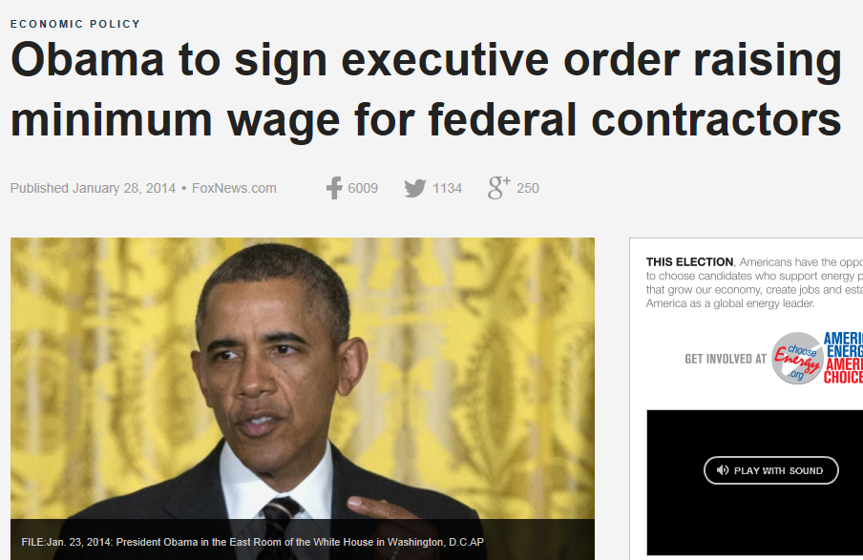
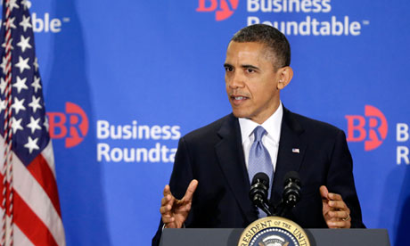
3. Chief Guardian of the Economy – can’t control the economy, but is expected to respond to unemployment, prices, etc.

Slide 9
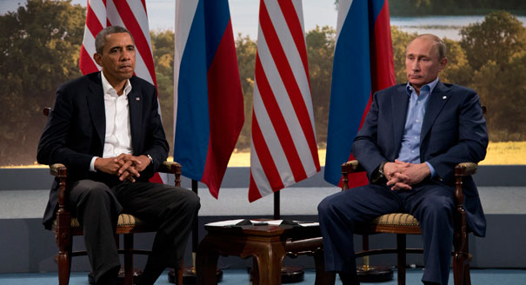
4. Chief Diplomat – sets foreign policy; decides what ambassadors will say

Slide 10
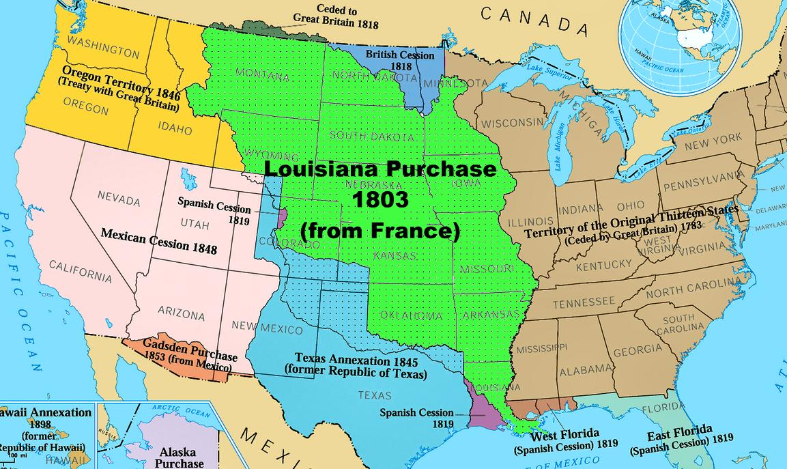
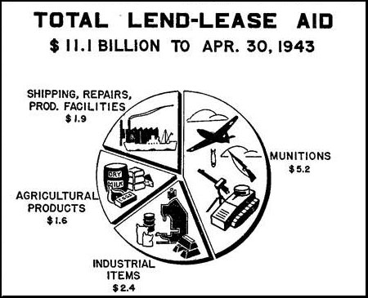
Executive Agreement – a pact between President & head of foreign state (can’t conflict with any U.S. law & usually don’t include future commitments)
Louisiana Purchase – Thomas Jefferson
Lend-Lease at the beginning of WWII

Slide 11
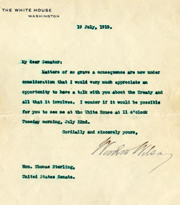
Treaty – formal agreement between 2 states (negotiated by Pres.) – BUT must be approved by 2/3s of Senate & can’t conflict with the Constitution (but can supersede U.S. law)
Versailles Treaty failed 49 to 35 vote

Slide 12
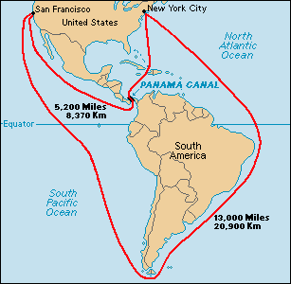
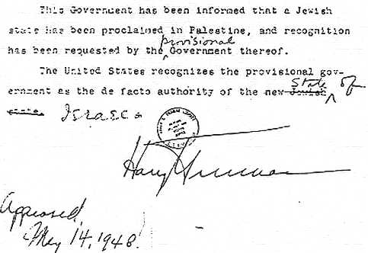
Recognition Power– acknowledge the legal existence of a country & its government
Panama - 1903
Israel -1948
Executive Privilege – right of the Pres. & exec. branch members to keep some info. secret from Congress & judicial branch
Notes:
Exec. Privilege, not mentioned in the Constitution but asserted by many Presidents (inherent in separation of powers which is throughout Constitution) – usually presidents will volunteer some information

Slide 13
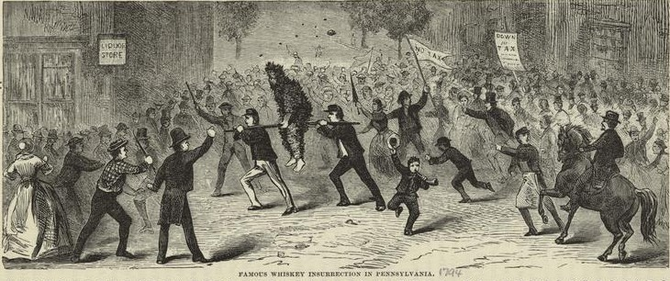
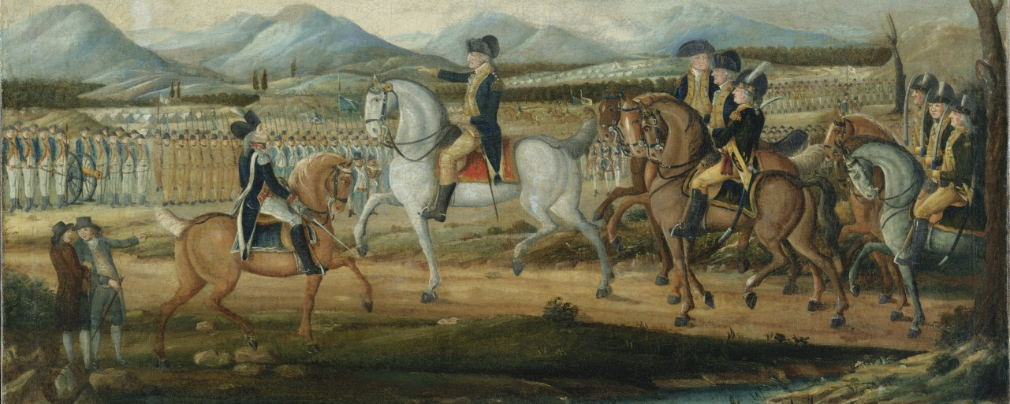
5. Commander-in-chief – head of the military – all military generals take orders from the Pres.
Starting with 1794 Whiskey Rebellion in western Pennsylvania
Washington organized a militia force of 12,950 men and led them. By the time the militia reached Pittsburgh, the rebels had dispersed and could not be found. When the militia reached Pittsburgh, the rebels had dispersed &couldn’t be found.
Notes:
Commander in Chief
Reflecting the clear consensus at the Constitutional Convention that the nation's highest civilian officer should have charge of the military, the Constitution states that the president “shall be Commander in Chief of the Army and Navy of the United States, and of the Militia of the several States, when called into the actual Service of the United States.” That is the only statement in the document about the president's war-making power. Because the precise authority of the office of commander in chief is left undefined, presidents have been able to argue that they possess any power needed to improve the nation's defenses in peacetime or to help it prevail over an enemy in wartime, without usurping the power of the other branches or violating the law.
The Constitution does not give the president complete domination over the war-making function. The power to declare war is reserved for Congress, as is the ability to raise and maintain an army. Nevertheless, presidential use of the power to order U.S. forces into combat without a congressional declaration of war increased greatly during the twentieth century. Particularly during the half-century of cold war conflict between the United States and the Soviet Union, presidents claimed the right to deploy military forces on their own initiative. Presidents also had the support of congressional resolutions authorizing them to use force, such as the Tonkin Gulf resolution which Lyndon Johnson claimed as his legal authority for carrying out the war in Vietnam.
In 1973 Congress responded to Richard Nixon's continuing prosecution of the Vietnam War by passing the War Powers Act over Nixon's veto. The most important and controversial provisions of the law outlined the situations under which presidents could commit troops, permitted Congress at any time to order the president to disengage troops involved in an undeclared war, and required the president to withdraw armed forces from a conflict within sixty to ninety days unless Congress specifically authorized its continuation. The law has failed to substantially change presidential war-making prerogatives, however. Presidents since Nixon have strongly refused to invoke the law, and only once—in speeding the removal of U.S. forces from Lebanon in 1982—has the law forced a compromise over the use of military power. In 1991 George Bush allowed a dramatic debate and vote in Congress over authorization of his use of force in the Persian Gulf without admitting that his actions were subject to the War Powers Act. In the fall of 2002, George W. Bush sought, and eventually received, congressional authorization to use military force against Saddam Hussein's regime.

Slide 14
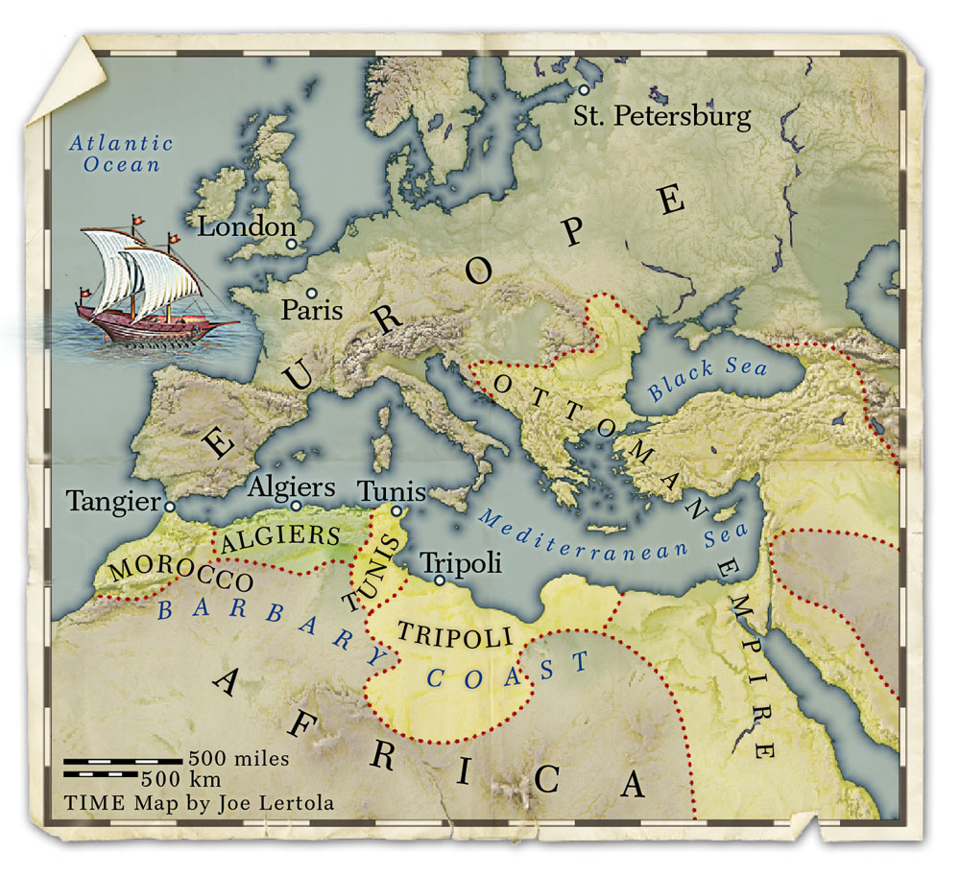
Thomas Jefferson waged war against Barbary Coast pirates in the Mediterranean
Congressional naval legislation had provided that, among other things, six frigates “shall be officered and manned as the President of the United States may direct.”

Slide 15
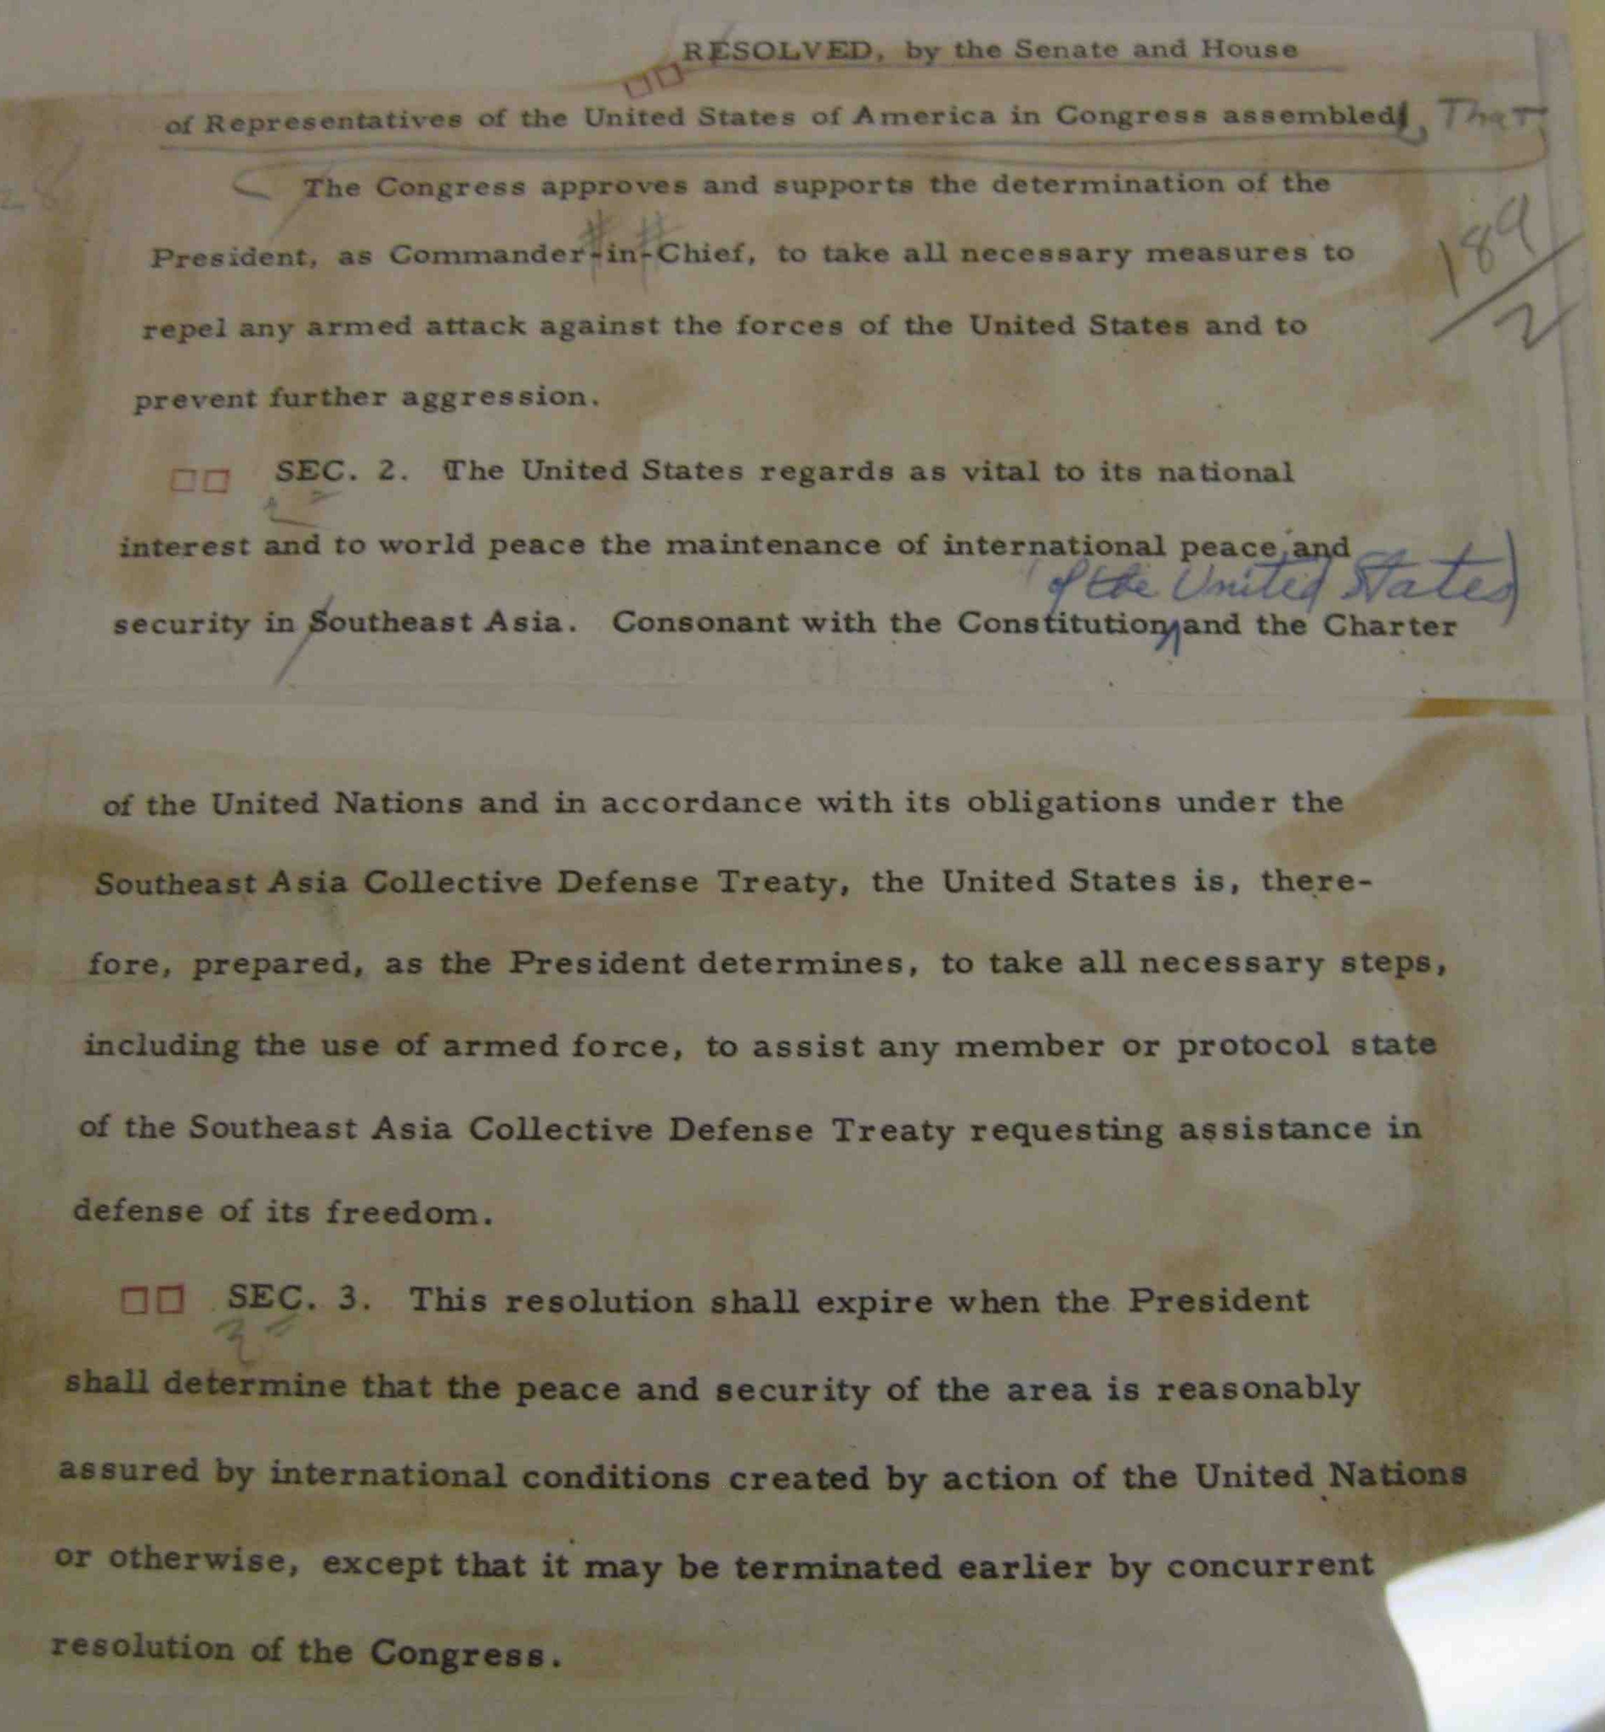
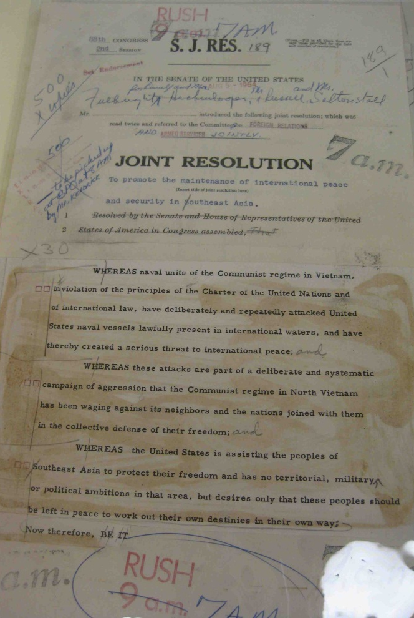
Hasn’t been a formal declaration of war since WWII
draft Gulf of Tonkin Resolution, as introduced by Senate Foreign Relations Committee Chairman William Fulbright, stored in the Archives’ Legislative Treasures Vault
Notes:
On August 4, 1964, in response to one confirmed and one alleged incident between North Vietnamese and U.S. Naval vessels in the Gulf of Tonkin, President Lyndon Johnson asked Congress for “a resolution expressing the unity and determination of the United States in supporting freedom and in protecting peace in southeast Asia.” To be sure, “the United States intends no rashness, and seeks no wider war.” (Regarding the second incident, Johnson privately remarked in 1965 that “for all I know, our Navy was shooting at whales out there.”)

Slide 16
War Powers Act – 1973
48 hrs. after committing troops, Congress must be notified
Combat commitment – 60 days – extended by Congress
Congress can end action by concurrent resolution

Slide 17
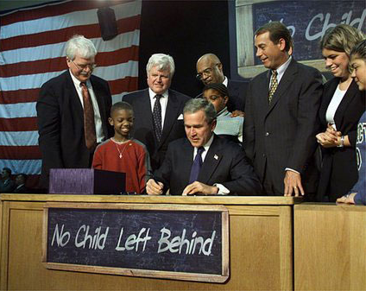
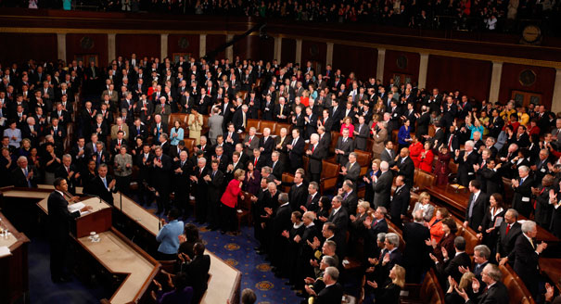
6. Chief Legislator- influences lawmaking agenda of Congress
Pres. signs No Child Left Behind Act
State of the Union Address to Congress

Slide 18
Sign bill
OR not act on bill within 10 days allowing bill to become law
Veto bill
OR pocket veto – doesn’t act on a bill within 10 days but the congressional session ends first
Line item veto
Congress passed law in 1996 allowing President to veto parts of a bill without vetoing the whole bill
1998 – Supreme Court ruled 6-3 against – this isn’t in the Constitution, so it must become an amendment

Slide 19
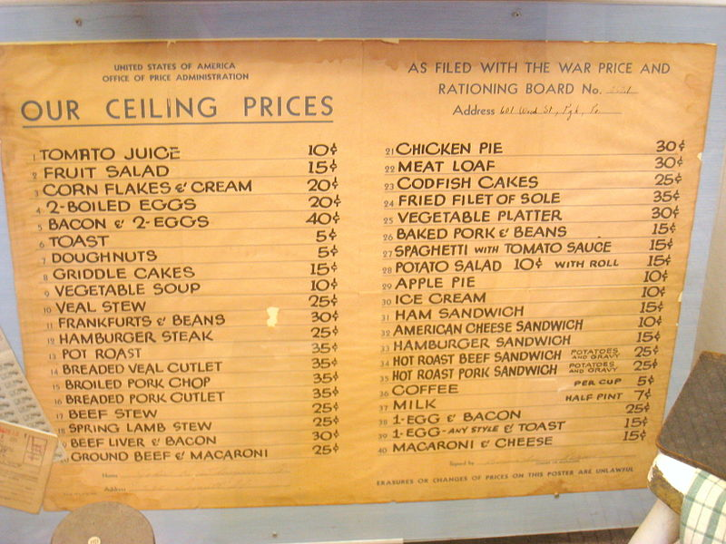
Executive Orders – directive to help manage exec. branch of federal govt. that has effect of law without needing approval of Congress
(FDR issued the most - WWII rationing & price controls, Japanese internment, etc.)

Slide 20
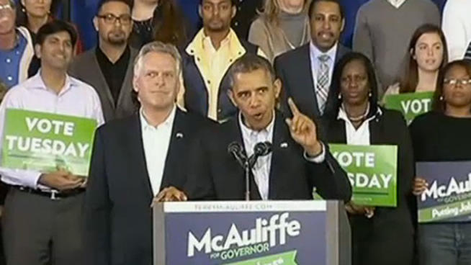
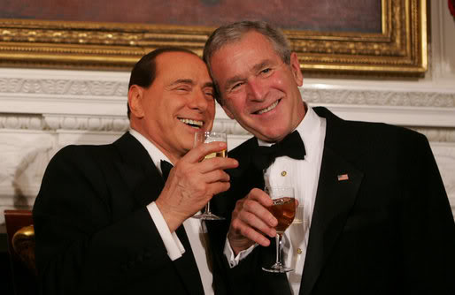
7. Chief of Party – leader of his political party
Campaigning and fundraising for fellow party members
Hosting dinners & parties

Slide 21
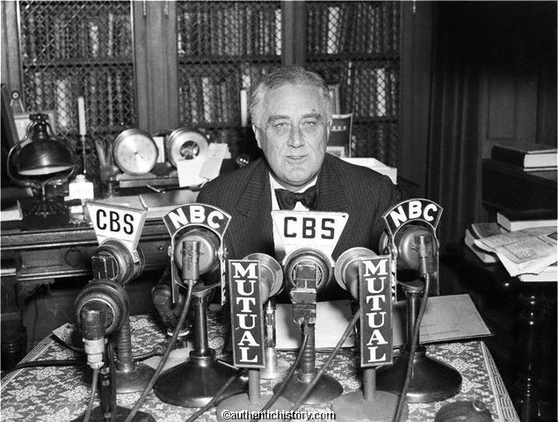
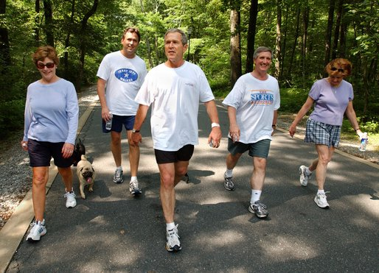
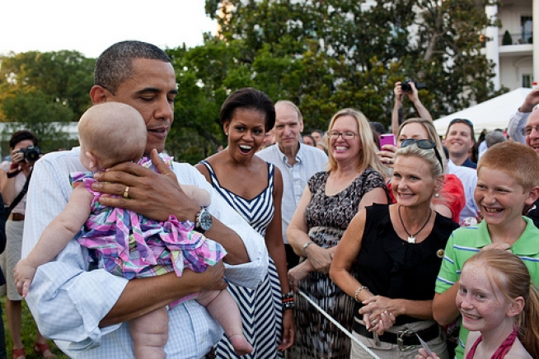
8. Chief Citizen – lead the people by example & make sure their interests are being met; educate the people on important issues
FDR’s “fireside chats” were the 1st direct communication between the Pres. & the people
The Pres. also likes to appear healthy, fit, and family oriented.

Slide 22
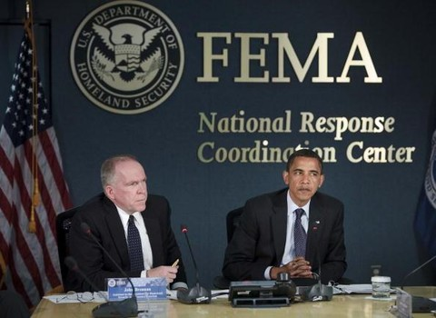
Looking at the picture below, what role is the President fulfilling?
Chief executive

Slide 23
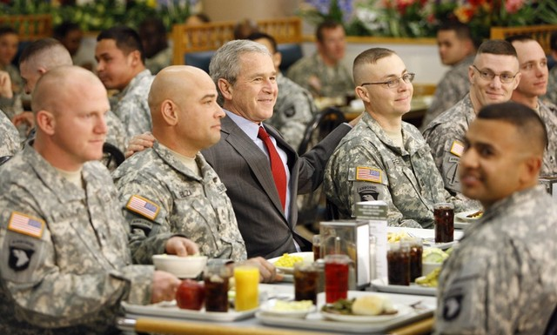
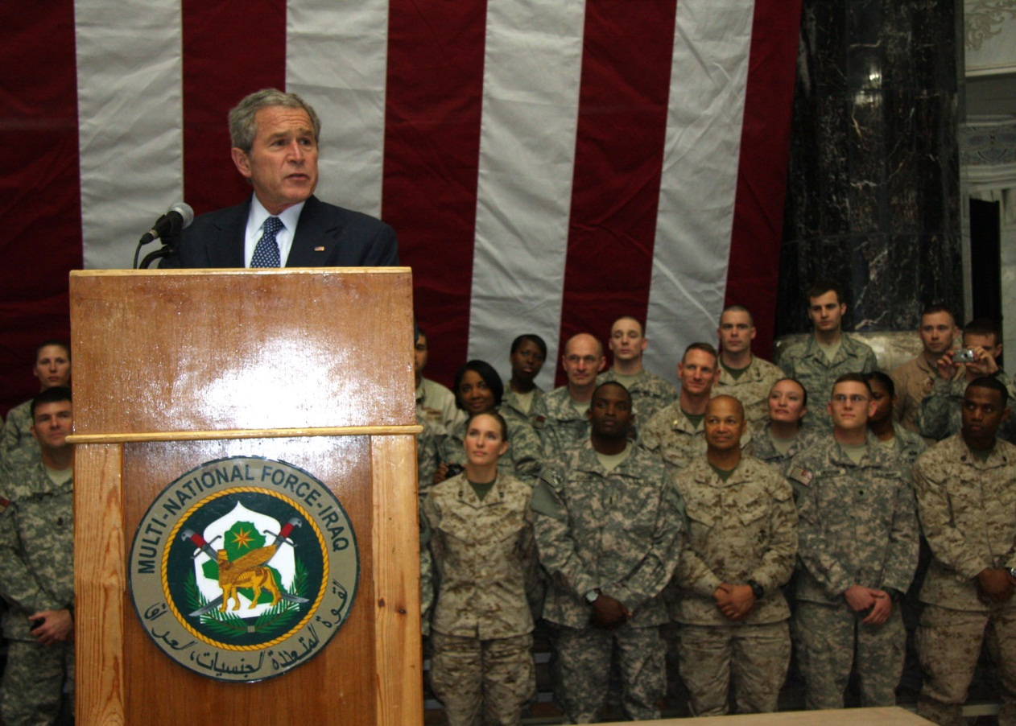
Looking at the pictures below, what role is the President fulfilling?
Commander in chief

Slide 24
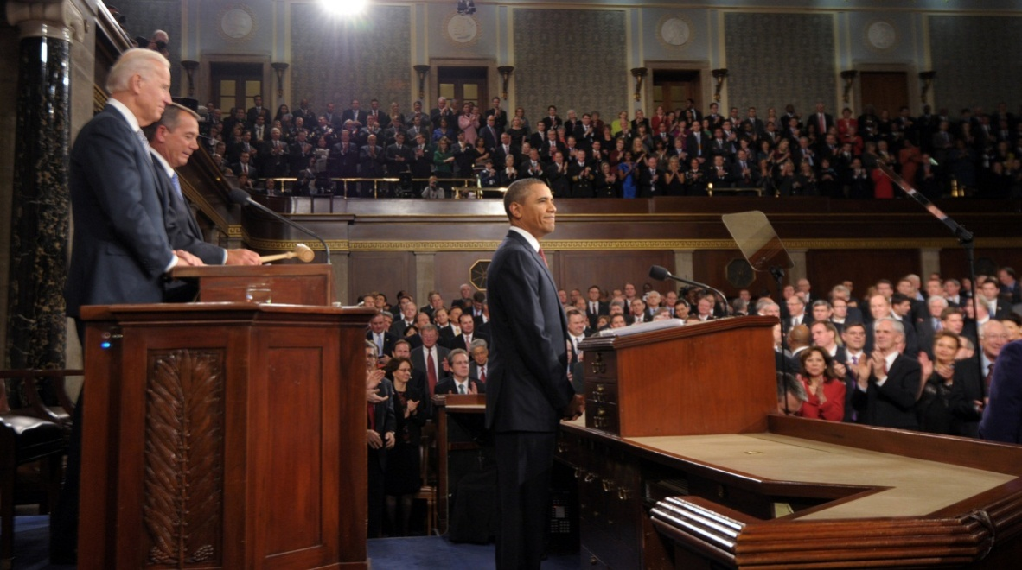
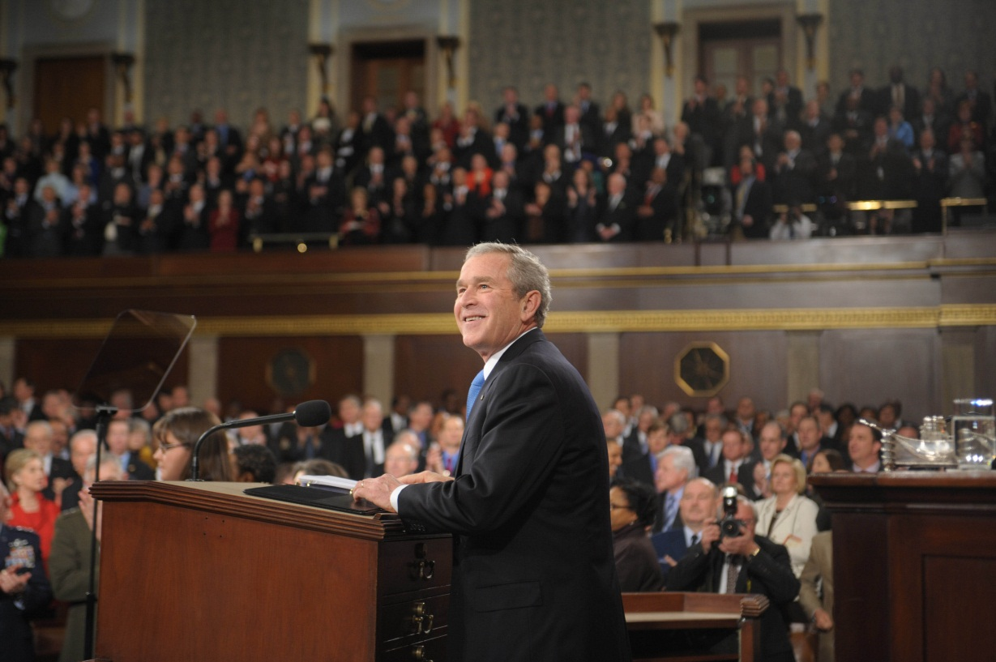
Looking at the pictures below, what role is the President fulfilling?
Chief legislator – State of the Union Address

Slide 25
During the 2012 government shutdown, when the President decided what federal employees were “essential” and had to report to work, what role was he acting in?
Chief executive

Slide 26
Pay - $400,000
Secret Service protection up to 10 yrs. after leaving presidency.
Term
4 years
22nd Amendment - limits to 2 terms (or total of 10 yrs.)
Qualifications
Natural born citizen
35 years old
Resident of the U.S. for 14 years

Slide 27
Presidential Succession
Vice President
Constitution only says he will take over the duties not the actual office – clarification made by the 25th Amendment (1967)
Speaker of the House
President pro tempore of the Senate
Secretary of State
Secretary of Treasury
The rest are the cabinet positions in the order of their creation

Slide 28
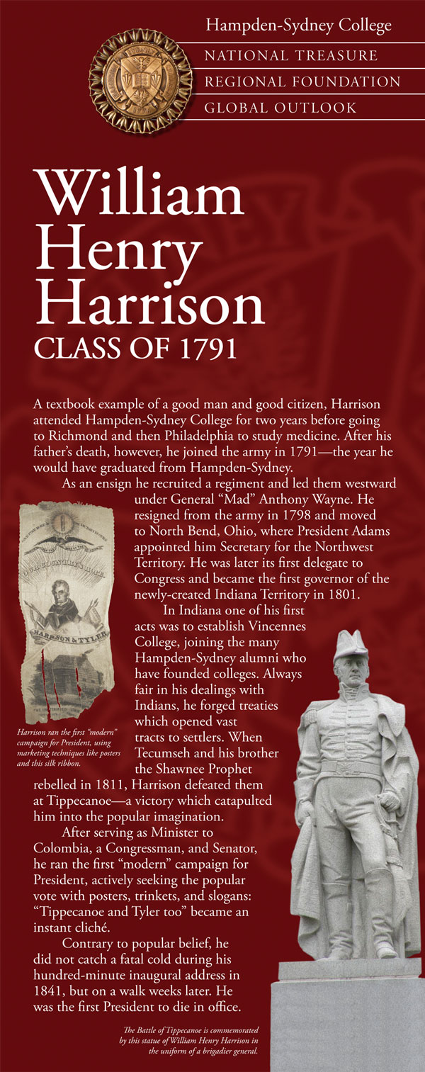
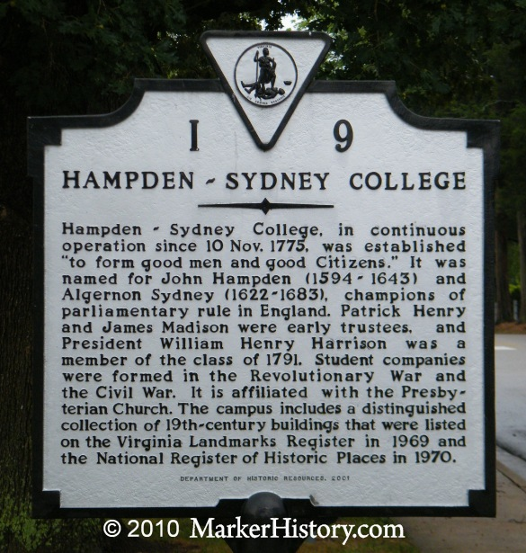
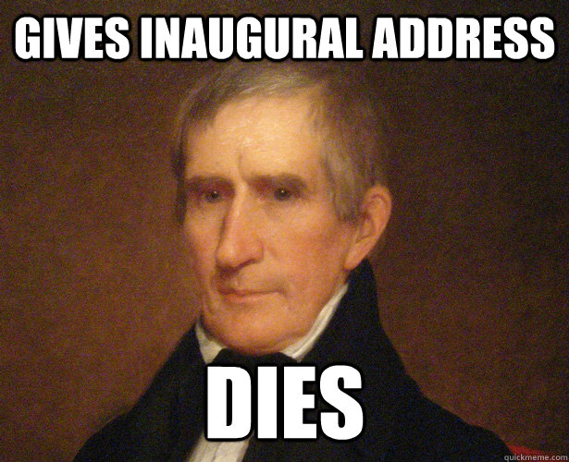
Presidents to die in office
1. William Henry Harrison (1841) – 9th Pres. –born in VA – died from pneumonia he caught while giving inaugural address

Slide 29
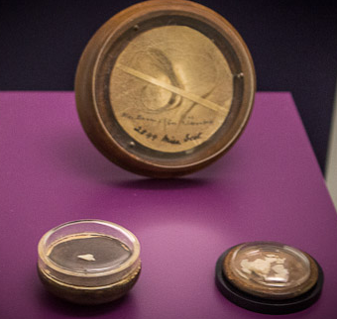
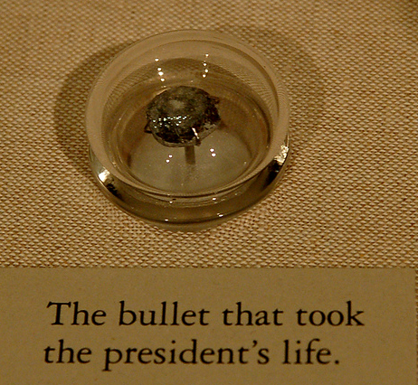
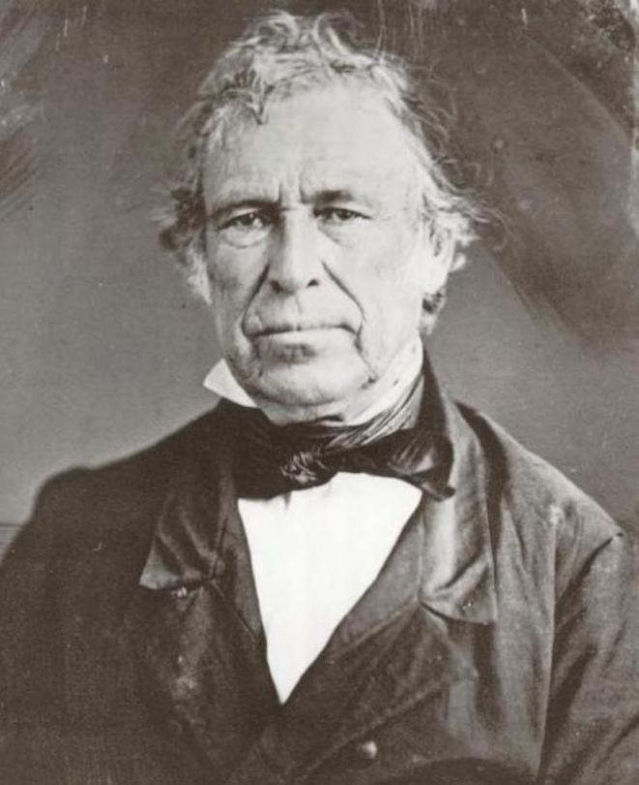
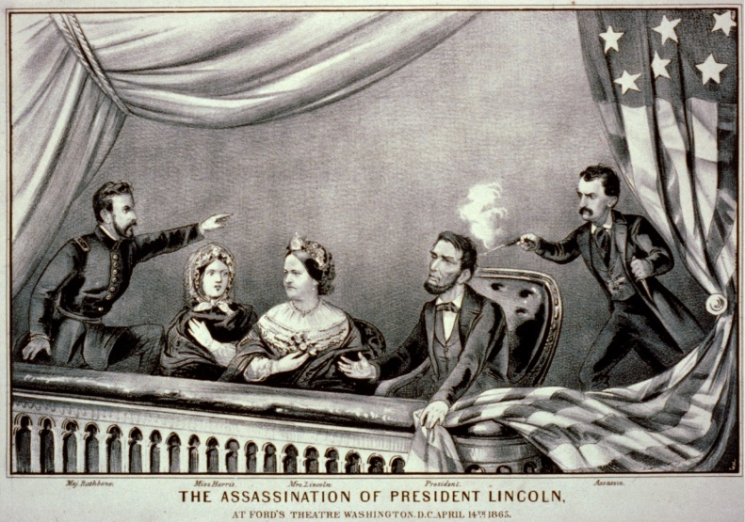
2. Zachary Taylor (1850) – 12th Pres. – died of gastrointestinal difficulties after eating a bunch of raw fruit (cherries) at July 4th celebration
3. Abraham Lincoln (1865) – 16th Pres. – assassinated by John Wilkes Booth at the end of the Civil War

Slide 30
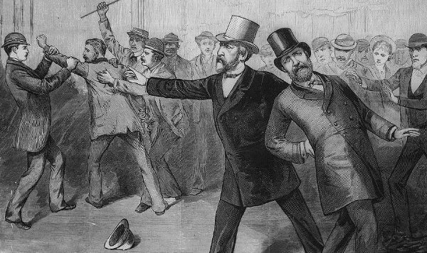
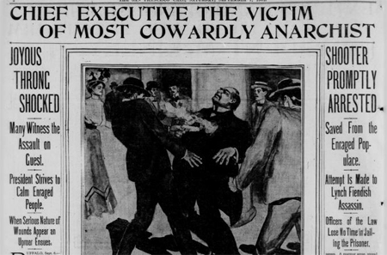
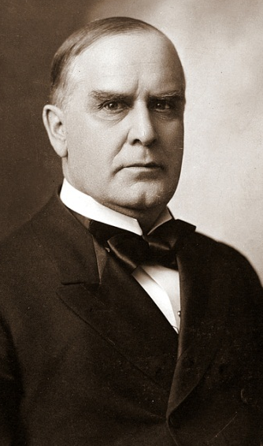
4. James Garfield (1881) – 20th Pres. – assassinated
5. William McKinley (1901) – 25th Pres. – assassinated by anarchist at World’s Fair in NY – after this Congress informally requested Secret Service Presidential protection

Slide 31
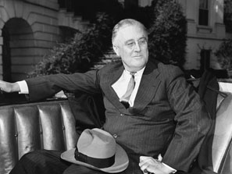
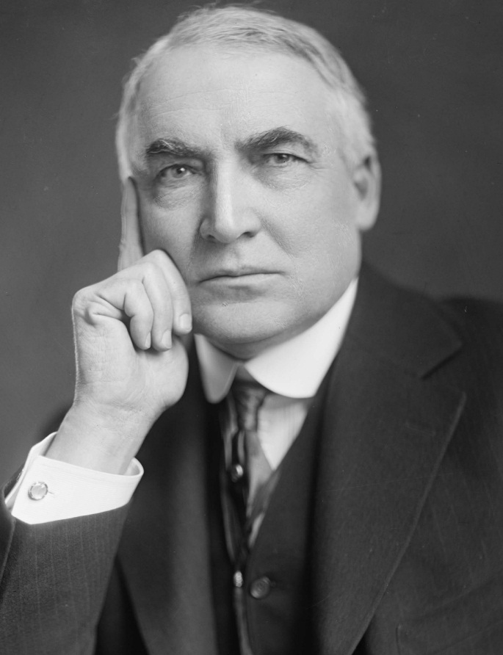
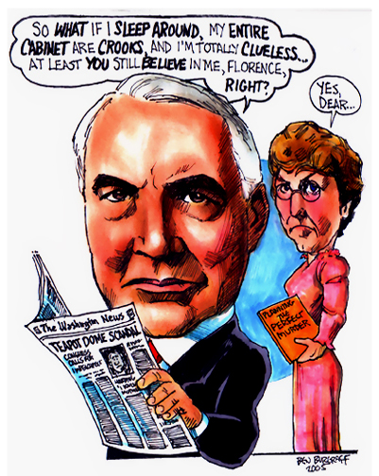
6. Warren G. Harding (1923) – 29th Pres. – heart attack?
7. Franklin D. Roosevelt (1945) – 32nd Pres. – massive stroke

Slide 32
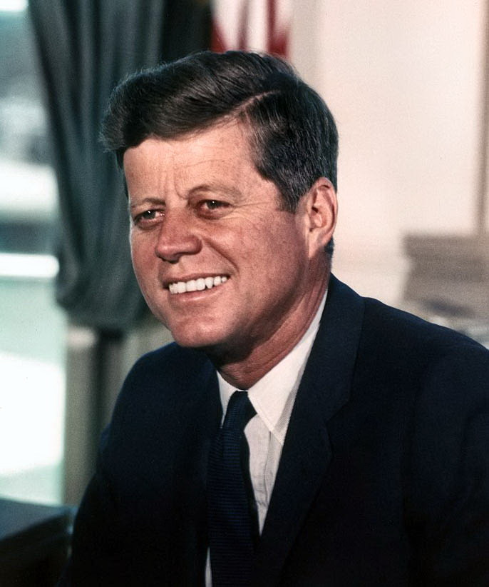
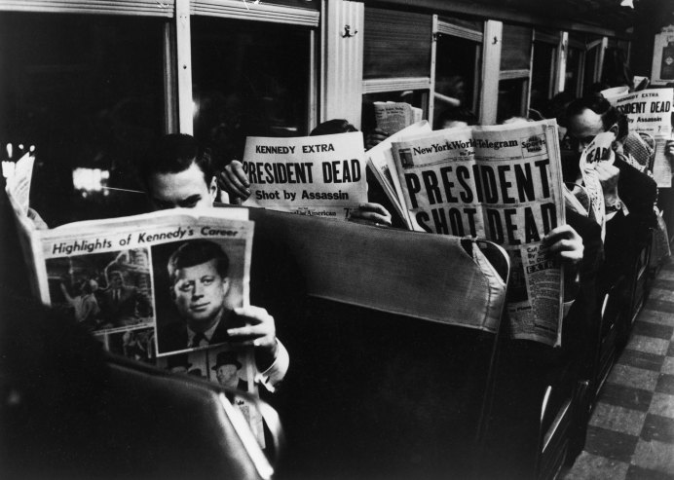
8. John F. Kennedy (1963) – 35th Pres. – assassinated

Slide 33
Vice-President
Presides over Senate
Only votes to break a tie
Helps decide the disability of a President
“Balances the ticket” for an election

Slide 34
Selection of the President
Presidential electors with 2 votes each for a different candidate – 1st place would be President, 2nd would be VP
President & VP could be from different parties – like in 1796 – John Adams wins by 3 votes & Jefferson becomes VP

Slide 35
Election of 1800 – tie between Jefferson & Burr
House of Representatives decided in favor of Jefferson
12th Amendment – separated electoral votes
3 new elements to elections -
Party nominations
Separate nominations for Pres. & VP
Automatic electoral votes in line with pledges

Slide 36
How do we choose Presidential candidates?
Presidential Primaries - An election by party voters to choose delegates to Democratic or Republican Convention & express presidential candidate preferences

Slide 37
Caucuses - Party voters meet at local level to choose delegates

Slide 38
National Convention
Candidate announced – lays out platform (principles & objectives)
Keynote Address – Best orator delivers speech to motivate & establish goals

Slide 39
The Election
Electoral College
Based on members of Congress – we have 13 (there are 538 total – 270 needed to win majority)
Framers wanted electors to use their own judgment
Today electors vote the way the majority of people in their state vote– “winner take all” except Maine & Nebraska
Election 1st Tuesday after 1st Monday in Nov.
Electoral vote – Mon. after 2nd Wed. in Dec. at State Capital, then sent to the Pres. Of the Senate

Slide 40
Which of the following is true?
When you vote, your ballot is cast for the Presidential candidate you want.
When you vote, your ballot is cast for the elector who has pledged to vote for that candidate.

Slide 41
Minnesota has10 electoral votes, if Candidate A wins 60% of the vote and Candidate B wins 40% of the vote, which of the following is true?
6 electoral votes go to A and 4 to B
It is based on how each Congressional district votes
All of the electoral votes go to Candidate A
None of the above.

Slide 42
Why did the Founding Fathers create the “Electoral College?”
It was part of a compromise to satisfy smaller states
They wanted to separate the presidency from
To prevent regional favoritism
All of the above.

Slide 43
Jan. 6 – President of the Senate reads the votes
No majority or a tie – House votes on top 3 like in 1800 & 1824

Slide 44
System Flaws
Popular vote winner not guaranteed Presidency
1824, 1876, 1888, 2000 (Supreme Court voted 5-4 to give Bush Florida’s votes making him the winner)
15 Presidents won plurality not majority
Electors not required to vote according to popular vote
9 times – faithless electors
Notes:
Year President Electoral percent Popular percent 1824 John Q. Adams 31.8% 29.8% 1844 James K. Polk (D) 61.8 49.3 1848 Zachary Taylor (W) 56.2 47.3 1856 James Buchanan (D) 58.7 45.3 1860 Abraham Lincoln (R) 59.4 39.9 1876 Rutherford B. Hayes (R) 50.1 47.9 1880 James A. Garfield (R) 57.9 48.3 1884 Grover Cleveland (D) 54.6 48.8 1888 Benjamin Harrison (R) 58.1 47.8 1892 Grover Cleveland (D) 62.4% 46.0% 1912 Woodrow Wilson (D) 81.9 41.8 1916 Woodrow Wilson (D) 52.1 49.3 1948 Harry S. Truman (D) 57.1 49.5 1960 John F. Kennedy (D) 56.4 49.7 1968 Richard M. Nixon (R) 56.1 43.4 1992 William J. Clinton (D) 68.8 43.0 1996 William J. Clinton (D) 70.4 49.0 2000 George W. Bush (R) 50.3 47.8 2004 George W. Bush (R) 53 50.7

Slide 45
Reforms
District Plan – Electors from each district of a state - vote based on popular vote of district – solves “winner take all” but not popular vote issue
Proportional Plan –win 40% of popular vote of a state with 20 electors, get 8 electors –eliminates “winner take all” but not popular vote issue

Slide 46
Direct Popular Vote
Needs amendment – House passed it in 1970 &1979 but killed by Senate.
Opposed by small states who are now overrepresented
As it stands, a candidate only needs to win 11 most populated states to get a majority of electoral votes

Slide 47
Growth of Presidential Power
One person in charge instead of many in legislature
Demands caused by industrialization
National emergencies
Congress passed laws to delegate authority to executive branch
Mass media

Slide 49
For the President’s Eyes Only
You will split into 6 groups.
Each group will receive a presidential crisis scenario (all scenarios are actual challenges encountered by past presidents.
You will come up with alternative solutions to your crisis. You may refer to the “Decision Making Spectrum” for ideas, but you are not limited to those actions.

Slide 50
The Presidential Decisions
CUBAN MISSILE CRISIS: Kennedy’s military advisors wanted to take hostile action against the bases in Cuba. The Air Force wanted to take out the sites with an air strike and many in the military called for an invasion of Cuba. Afraid that such actions might lead to a world war, Kennedy decided to set up a “quarantine” of the island instead – calling it a quarantine was a unique approach to avoid calling it a blockade, which is considered an act of war. He ordered that Soviet ships heading for Cuba carrying missile parts would not be allowed through the quarantine. In addition, he demanded that the Soviets remove their bases and all Soviet weaponry from Cuba. Just as tensions seemed to reach the breaking point, Khrushchev backed down. Soviet ships were recalled and he subsequently agreed to remove the missiles and their bases from Cuba, letting the United States inspect Soviet ships leaving the island to be sure this was being done. In return, the United States promised not to invade Cuba. No mention was made of the United States removing missiles from Turkey. Khrushchev handling of the situation may have contributed to losing his position as the Soviet premier.

Slide 51
DRUGS AND THE DICTATOR: Four days after the killing of the Marine, on December 20, 1989, President Bush ordered the invasion of Panama with more than 27,000 troops and over 300 aircraft. They were up against a Panamanian force of only around 3,000. A few hours after the invasion began, Guillermo Endara, who had been victorious in the election voided by Noriega, was sworn in as President of Panama and served from 1989 until 1994. Noriega escaped to the embassy of the Vatican in Panama. International law prohibits any personnel from entering any foreign embassy. Negotiations for his surrender ensued, and Marines set up enormous loud speakers across the street from the Embassy playing loud rock music around the clock in a residential area to increase the pressure. On January 3, 1990, Noriega agreed to surrender. Brought to the United States for trial, he was convicted on charges of drug smuggling, conspiracy, and racketeering and sentenced to 40 years without parole in a federal prison. He was extradited to France in 2010, where he was tried and found guilty of murder and money laundering. He is currently serving 20 years in jail in Panama.

Slide 52
SAVING POST-WAR EUROPE: President Truman resisted calls for use of military force against the Soviets. He instead implemented the Berlin Airlift in June of 1948. For the next eleven months, the United States flew supplies and food into the city, feeding close to two million people. At one point, a U.S. plane landed in Berlin every minute of the day. By May 1949, the Soviet Union gave in and lifted their blockade of West Berlin.

Slide 53
THE NULLIFICATION CRISIS: President Jackson reacted angrily. Pledged to uphold the Union, he threatened to hang the nullifiers: “…if a single drop of blood shall be shed there in opposition to the laws of the United States, I will hang the first man I can lay my hand on engaged in such treasonable conduct, upon the first tree I can reach.” At his request, Congress passed a Force Bill, authorizing the President to use the army and navy, if necessary, to collect federal tariff duties. The crisis was actually solved by the action of Jackson’s old foe, Henry Clay of Kentucky, who engineered a compromise tariff law, the Tariff of 1833. The compromise would gradually lower tariffs by about 10% over 8 years, to around 20 to 25% of the value of imported goods. Since no other Southern states had joined South Carolina’s nullification vote, they were forced to save face by calling a new convention to voice support for the new tariff and repeal the ordinance of nullification. As a last futile gesture of fist-shaking, they nullified the now unnecessary Force Act.

Slide 54
COMMUNIST PRESENCE IN CENTRAL AMERICA: On October 25, President Reagan launched an invasion of Grenada. Fighting continued for several days and the total number of U.S. troops reached some 7,000 along with 300 troops from the OAS (Organization of American States). The invading forces encountered about 1,500 Grenadian soldiers and about 700 Cubans. Nearly eight thousand soldiers, sailors, airmen, and marines had participated in OPERATION URGENT FURY along with 353 Caribbean allies of the Caribbean Peace Forces (CPF). U.S. Armed Forces sustained 19 killed and 116 wounded; Cuban forces sustained 25 killed, 59 wounded and 638 combatants captured. Grenadian forces casualties were 45 killed and 358 wounded; at least 24 civilians were killed, several of whom were killed in the accidental bombing of a Grenadian mental hospital. The invasion enjoyed popular support in the United States, but world reaction saw it as a violation of international law. An election in December of 1983 restored constitutional government, but U.S. military advisors remained on the island to assist efforts of the new government to keep the peace.

Slide 55
THE WHISKEY REBELLION: President Washington remembered the national government’s inaction when Shays’ Rebellion had occurred over collecting taxes in Massachusetts during the days of the Articles of Confederation. He was determined to show the strength of the new federal government. With Hamilton’s strong support, he summoned the militia of several states, and waited anxiously for states to answer the call to arms against a sister state. An army of about 13,000 men soon joined the President in marching to Pennsylvania. Washington himself donned his military uniform once more and accompanied the troops most of the way. Hamilton went the entire distance. The army Washington commanded outnumbered the size of his army during much of the Revolutionary War. When it reached the hills of western Pennsylvania, there was no rebellion to be found. The “Whiskey Boys” had been overawed by the show of force and had dispersed or been captured. Only some three rebels were killed. Washington wisely pardoned those convicted (Hamilton held out for severe punishment for the ringleaders). The power of the national government was substantially strengthened in this small rebellion. Washington had proven it could handle a crisis and enforce its laws. Some people disapproved of the huge show of force against such a small group. The less privileged farmers turned to the ballot box in support of Thomas Jefferson and his emerging Democratic-Republican party which championed a weaker central government.

Slide 56
Executive Branch in 20 min.
http://www.youtube.com/watch?v=Y5_ZNzjKkbU&list=PLD5CB52988D815420&index=14
http://www.youtube.com/watch?v=dcYz5c87agE&list=PLD5CB52988D815420&index=13
http://www.cqpress.com/incontext/constitution/docs/constitutional_powers.html

