Slide 1
Virginia State & Local Government

Slide 2
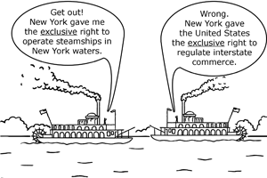
What is the Federal System?
Power to govern is shared by national & state govts.
Important note:
Federal government = usually refers to the central national government itself (ex: Federal Court system)
BUT, Federalism/Federal System = relationship of shared powers

Slide 3
Supremacy Clause
Article 6, Clause 2: US Constitution, federal statutes, & U.S. treaties are “supreme law of the land”
If conflicts arise between state & national legislation, national law rules

Slide 4
National Government v. State Governments
Responsibilities:
foreign policy, regulating commerce
Powers Denied:
marriage & divorce laws, conducting elections, many edu. regulations
Responsibilities:
public health, safety, & welfare
Powers Denied:
making treaties, declaring war, having an army, coining money

Slide 5
Cooperation Between National and State
Federal govt protects states from invasion & domestic violence
States hold national elections & handle voting for the federal govt.

Slide 6
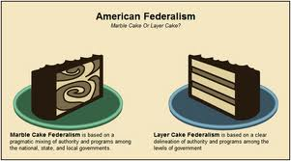
** The expansion of the national government’s powers into areas traditionally reserved to the states has altered the relationship between the two governments **

Slide 7
Cooperation between States
Full faith & credit clause – states must recognize documents & legal acts of other states as valid
Article IV, Section 1: Full faith and credit shall be given in each state to the public acts, records, and judicial proceedings of every other state. And the Congress may by general laws prescribe the manner in which such acts, records, and proceedings shall be proved, and the effect thereof.[5]
Extradition
Deporting a person accused or convicted of a crime, back to the state these charges are held

Slide 8
Virginia State Government

Slide 9
Virginia's capitol is located in Richmond. Richmond is the location for Virginia's state government.

Slide 10
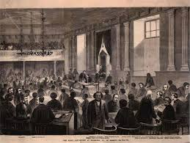
Virginia Constitution
1st state to adopt its own constitution in 1776 after the Declaration of Independence
Similar to U.S. Constitution:
Est. 3 branches
Executive, legislative, and judicial
Includes a Bill of Rights
Can be amended
Dillon’s Rule
Municipal govts have only powers expressly granted to them by state legislature

Slide 11
The Executive Branch
Governor – 4 yr term
Roles:
Chief of State
Chief Legislator
Chief Administrator
Party Chief
Commander in Chief
Can’t serve consecutive terms
Terry McAuliffe (Dem.)

Slide 12
(continued)
Cabinet Secretaries & departments, agencies, commissions, and regulatory boards
Administer & enforce laws
Regulate aspects of business and the economy
Provide services
Secretaries of Finance, Public Safety, Education, Finance, Agriculture and Forestry, etc.

Slide 13
Executive Branch
Lieutenant Governor
4 yr term
Elected separately from governor
President of Senate of VA
Ralph S. Northam (Dem.)

Slide 14
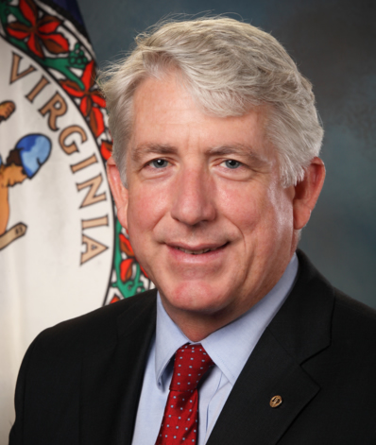
Executive Branch
Attorney General – 4 year term
His firm:
Provides legal advice & representation for the Governor & state govt
Defends the state in cases of criminal appeals & suits against the state
Defends the constitutionality of state laws
Mark R. Herring (Dem.)

Slide 15
Ways the Executive Branch influences Policy Making
Governor can propose legislation in annual State of the Commonwealth address
Appeal directly to the people
Approve or veto legislation
Appoint officials to carry out laws

Slide 16
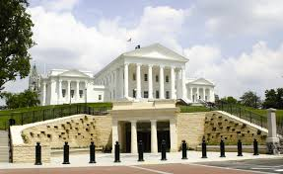
Legislative Branch
The General Assembly
Bicameral legislature
House of Delegates (100 members)
Senate (40 members)
Meet annually for a set number of days (30-60)
Not a full time job
Current Make-up:
Democratic Majority in House
50/50 split in Senate (where our Democratic Lt. Governor serves as tie breaker)

Slide 17
Roles of the Legislative Branch
Write law and take action in response to problems or issues
Individuals and interest groups help shape legislation
Lawmaking process
Introduce a bill
Work in committee
Debate on the floor of each house
Both houses vote on the bill
Governor signs or vetoes bill

Slide 18
Primary Issues of the State Legislature
Education
Promoting informed citizens
Public Health
Promoting and protecting health of state citizens
Environment
Protect natural resources
Budget
Approve a biennial (two year) budget
Revenue
Levy & collect taxes

Slide 19
Virginia Judicial System
Organization and jurisdiction derive from Virginia’s Constitution and state laws
Magistrate
Civil officer or local official
Set bail, issue search and arrest warrants, subpoenas (summons)

Slide 20
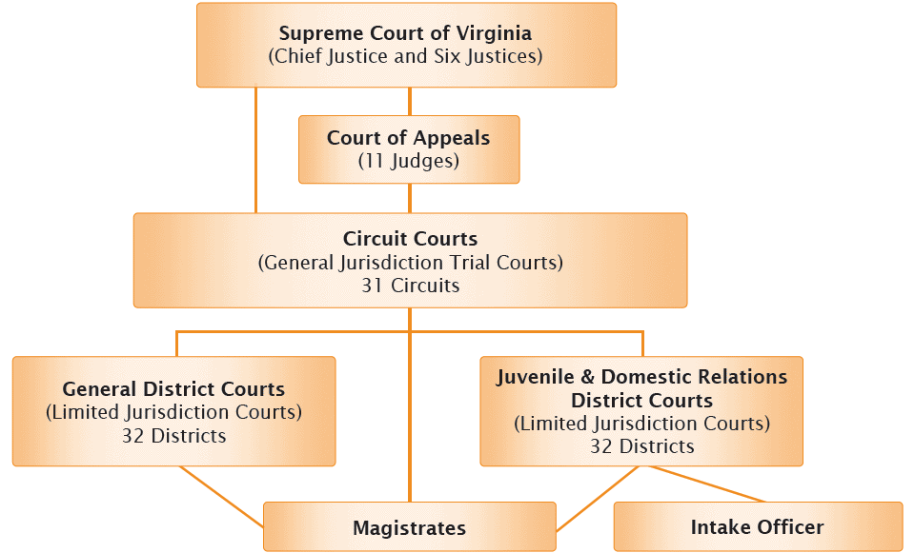
Virginia Court Ranking

Slide 21
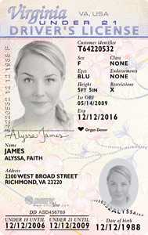
Virginia Juvenile and Domestic Relations District Court
Judge, no jury
Handles juvenile and family cases

Slide 22
General District Court
Judge, no jury
Original jurisdiction of misdemeanors
Handles civil cases less than $1,000
Also includes a small claims court

Slide 23
Circuit Court
Judge, sometimes jury
Both Original and Appellate jurisdiction
Original Jurisdiction of felony criminal cases and civil cases over $1,000
Appellate jurisdiction from district courts

Slide 24
Court of Appeals (of Virginia)
Judges, no jury
Appellate jurisdiction from circuit courts

Slide 25
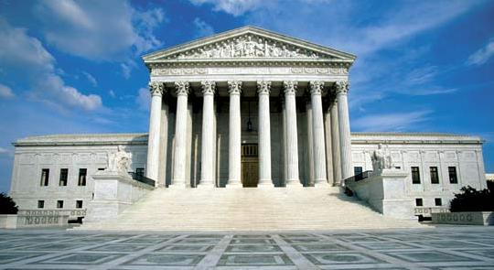
(Virginia) Supreme Court
7 justices, no jury
Court of final appeal
appellate jurisdiction & limited original jurisdiction

Slide 26
Which Court would each person start in?
Claire, a 13 year old, is caught stealing a pie from the local bakery. What court will she go to?
Kevin hit James’ truck while he was trying to park. When the drivers got out of their cars to discuss insurance, James punched Kevin in the nose; now Kevin is suing James for medical bills. What court will see their case if Kevin’s medical bills are under $1,000? What if they are over $1,000?
Quinton has just been convicted of robbing a gas station, but continues to claim that he is innocent. Where would he take his case in attempt to change the outcome?

Slide 27
Local Governments
Political subdivisions created by the General Assembly
Counties
Towns
Cities
Also exercise legislative, executive, and judicial powers, just on a smaller scale

Slide 28
Where do they get their power?
All authority of local governments is derived from the state
Given by Constitution of Virginia and other acts of the General Assembly
**Not all cities and towns have the same power.
- Cities have charters

Slide 29
Local Government Powers
Defined and limited
Enforce state and local laws
Promote public health and safety
Educate children
Protect environment
Regulate land use
Levy and collect taxes

Slide 30
Lawmaking Process
To enact an ordinance : to put forth a local law or piece of legislation
Charlotte County has several leash laws, curfew
Individuals can have the greatest influence on the decisions made by local government officials, because they are closest to them

Slide 31
Counties of Virginia
Largest by population: Fairfax County (1.1 million people)
Largest by area: Pittsylvania County (978 sq. miles)
Highest population by square mile: Arlington County (over 7,000)
Charlotte County!
Population: 12,505
Area: 477 sq. miles
Population by square mile: 26.5

Slide 32
Identify your Delegate and Senator after looking to see which district Charlotte County is in.

Slide 33
County-Level Organization
Board of Supervisors
Elected
Legislative Powers
Enacting ordinances
Adopting annual budget

Slide 34
County-Level Organization
School Board
Also part of city organization; each has an elected or appointed school board
Oversees operation of K-12 public schools

Slide 35
City or Town Level Organization
City/Town Council
Elected
Legislative powers
Enacts ordinances & adopts annual budget
Mayor
Elected by either voters or town council members
Manager
May be hired by the elected legislative branch to oversee the operations of the local government

Slide 36
Every Locality Must Have:
Sheriff
Responsible for keeping the peace
Clerk of Circuit Court
Maintain the records of a court
Commissioner of Revenue
Chief tax-assessing official; determines what is taxable
Treasurer
In charge of financial assets

Slide 37
Current Charlotte County Board of Supervisors

Slide 38
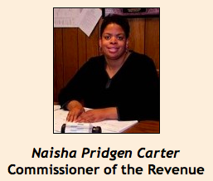
Charlotte County
Town Councils in
Keysville
Charlotte Court House
Drakes Branch
Phenix

Slide 39
National Level | Virginia State Level | Local Level
Executive Branch:
Legislative Branch:
Judicial Branch (levels of court):

