Slide 1
US GOVERNMENT
TEST #1
Principles of Government & Origins of American Government

Slide 2

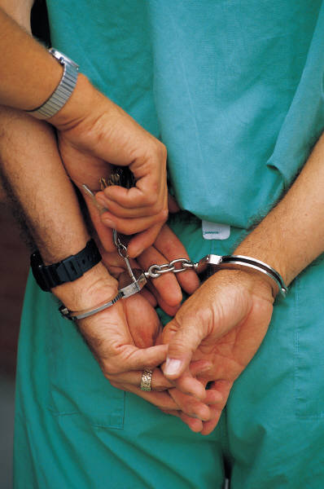

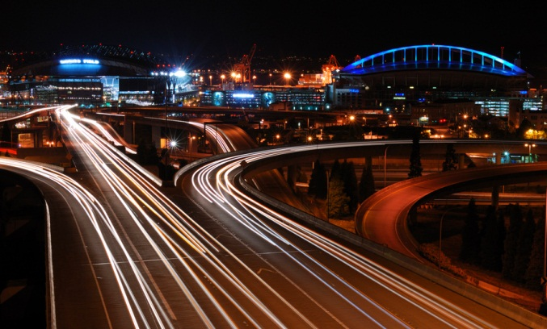
WHAT IS GOVERNMENT?
The institution through which a society makes and enforces its public policies.

Slide 3
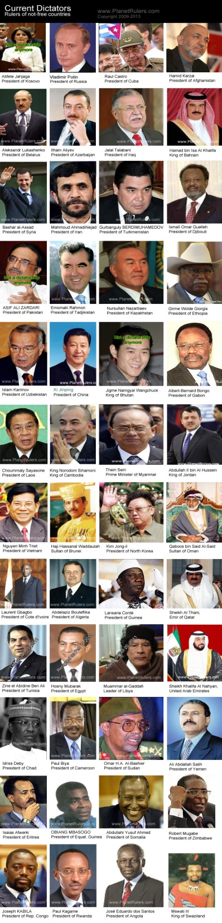
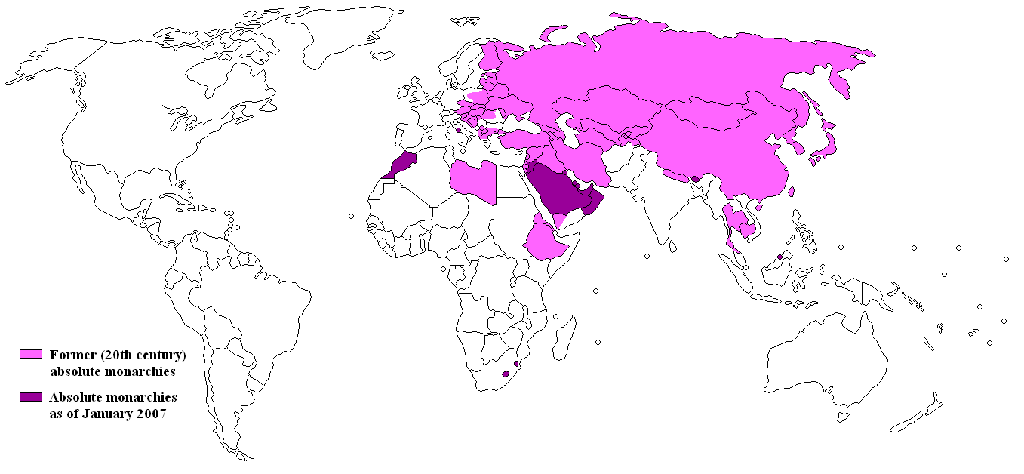
Autocracy
Single person with unlimited power
  Dictatorship
  Absolute Monarchy
Map of absolute monarchy by Nikodemos retrieved from http://commons.wikimedia.org/wiki/File:Map-of-absolute-monarchy.png
Picture retrieved from http://www.planetrulers.com/current-dictators/

Slide 4
Oligarchy
Rule by few
Usually self-appointed people from upper class

Slide 5
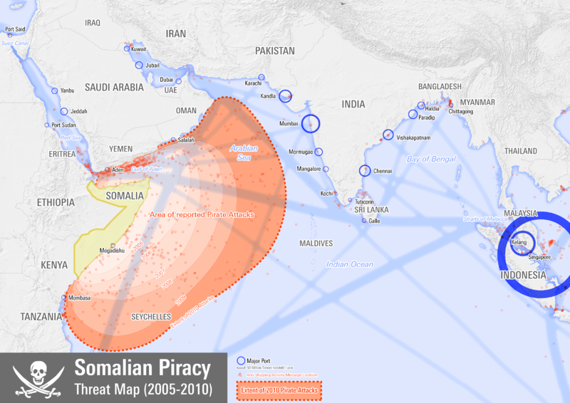
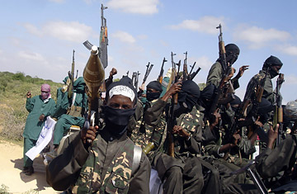
Anarchy
No formal government
i.e.: Somalia – run by militias, gangs, & pirates
Somalia piracy threat map by Planemad retrieved from http://en.wikipedia.org/wiki/File:Somalian_Piracy_Threat_Map_2010.png
Picture of Somalian war lords by Farah Abdi Warsameh / AP retrieved from http://content.time.com/time/world/article/0,8599,1866404,00.html

Slide 6
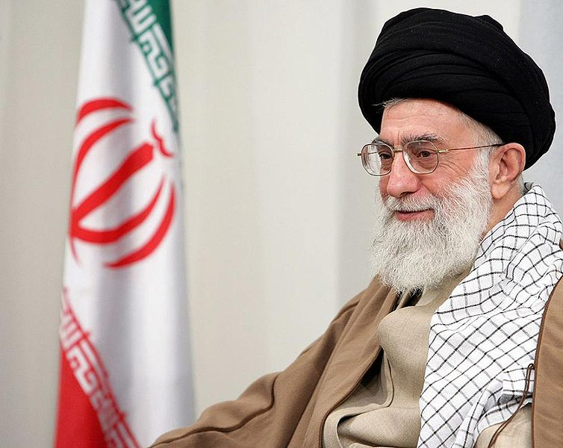
Theocracy
Government ruled by religious leaders
i.e.: Iran
"Foundation of Holy Defence Values, Archives and Publications", Website: www.sajed.ir accessed through http://en.wikipedia.org/wiki/File:Grand_Ayatollah_Ali_Khamenei,.jpg

Slide 7
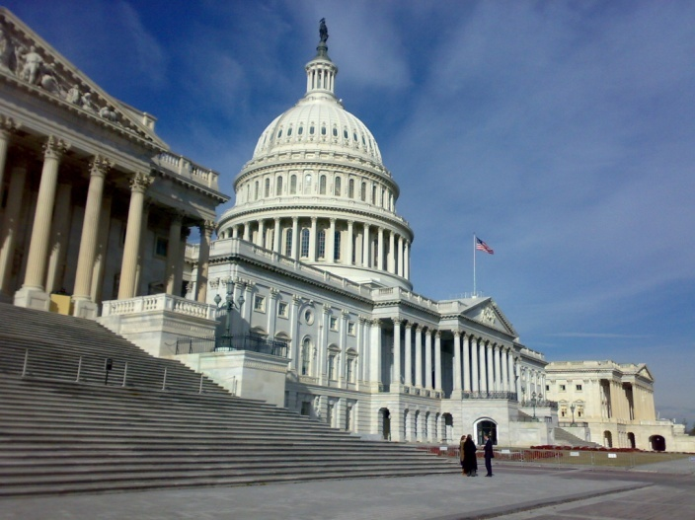
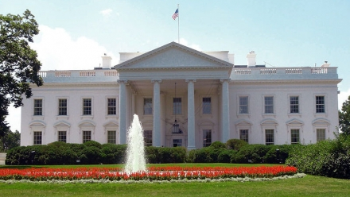
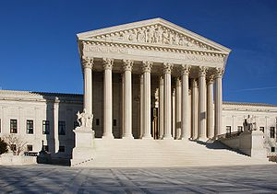
THREE KINDS OF POWER
Legislative – makes laws
Executive – executes & enforces laws
Judicial – interprets laws & settles disputes

Slide 8
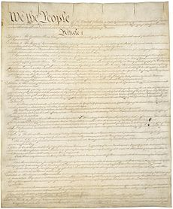
CONSTITUTION
Plan of government, body of fundamental laws setting out principles, structures & processes of government.

Slide 9
THE STATE
A body of people, living in a defined territory, organized politically with power to make & enforce law without the consent of any higher authority.

Slide 10

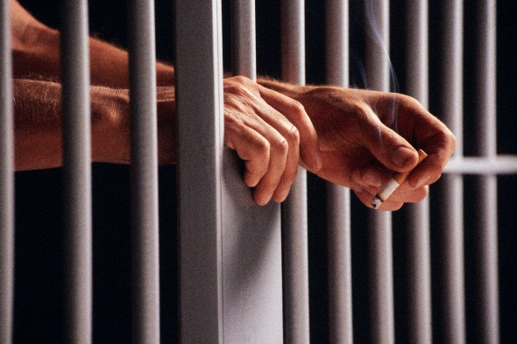
5 Functions of Government
Establish justice
  Ensure laws are carried out in a fair and reasonable manner

Slide 11
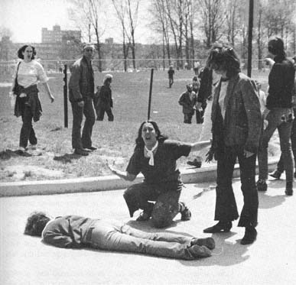
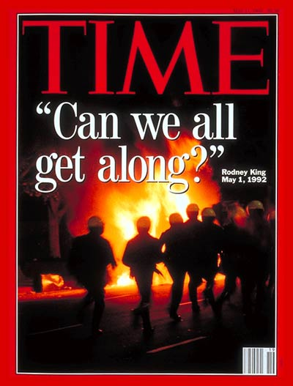
3. Ensure domestic tranquility
  Examples:
  1970: Kent State
  1992: LA Riots

Slide 12

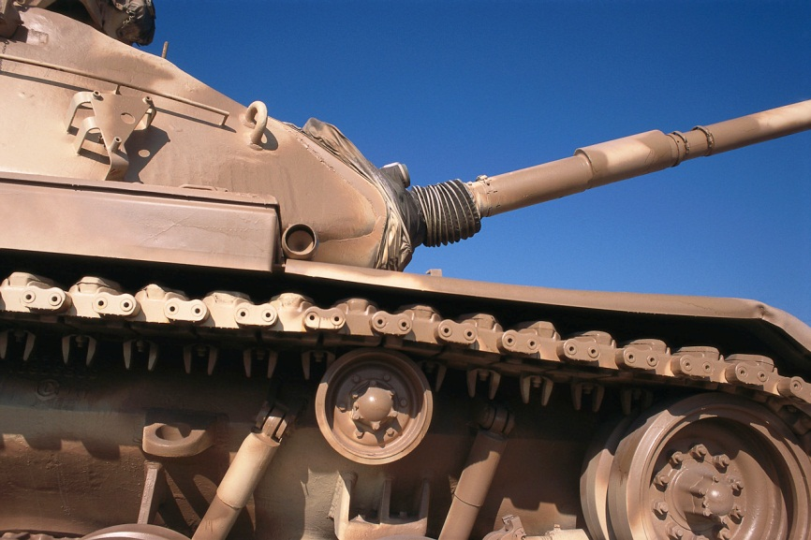
2. Provide for the common defense
  Over $500 billion/year

Slide 13




4. Promote the general welfare
5. Secure the blessings of liberty
Photo by Greg Knobloch, Centers for Disease Control and Prevention
Retrieved from http://orise.orau.gov/cdc/applicants/current-research-opportunities.aspx

Slide 14
Origins of the State
1. The Force Theory
1person or small group took control of an area & forced all within it to submit to their rule.
2. The Evolutionary Theory
The state evolved naturally out of the early family structure (i.e.: started with head of household, then led to a “clan”).
3. The Divine Right Theory
God created the state & gives those of royal birth a “divine right” to rule.
4. The Social Contract Theory
The state arose out of a voluntary act of free people.

Slide 15
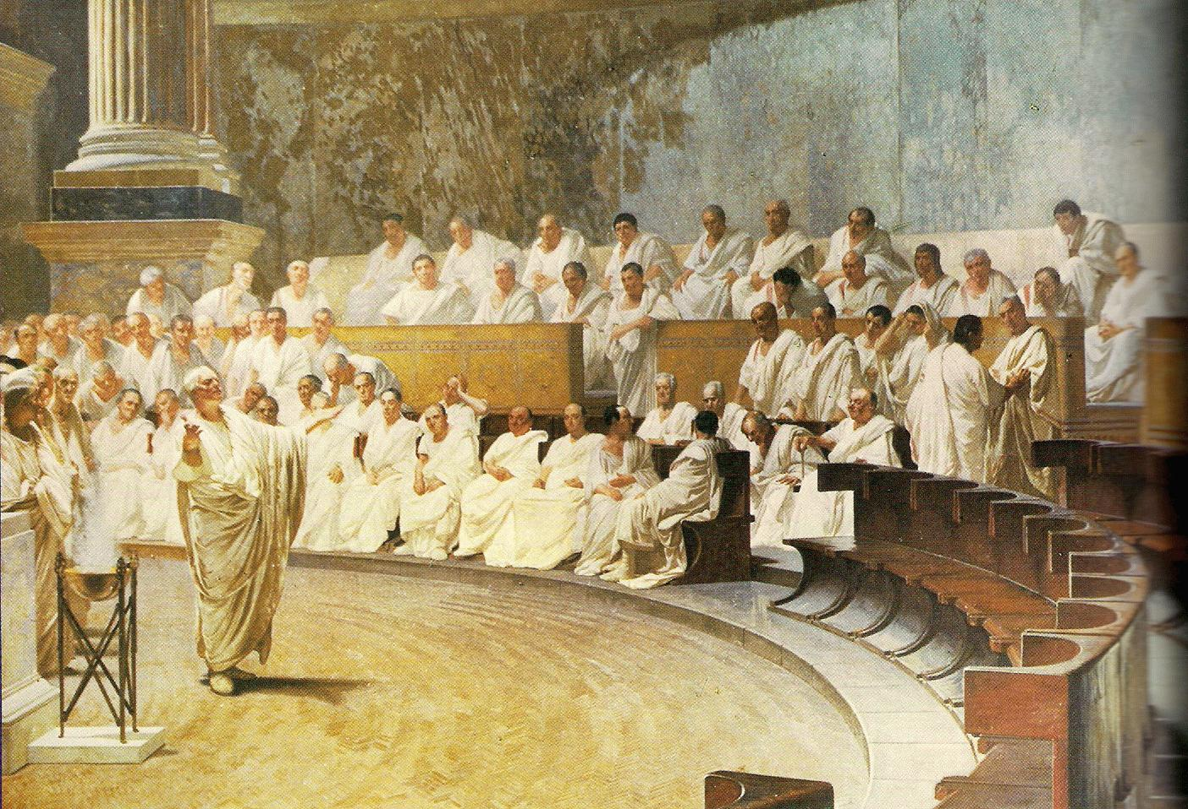
ORIGINS OF DEMOCRACY
Comes from 2 Greek words: demos (the people) & kratos (rule or power)
Greece – Athenian direct democracy
Rome – Republic (indirect or representative democracy) – what we have

Slide 16
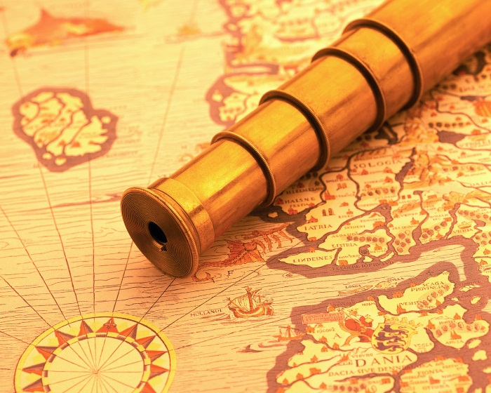

ENLIGHTENMENT Era
Mid 1600s – 1700s
Revolutions in science, philosophy, society & politics; swept away medieval world-view & ushered in the modern western world

Slide 17
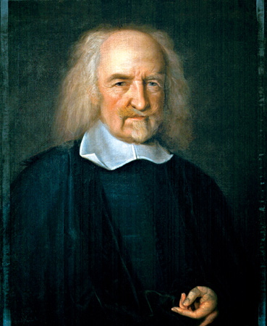
THOMAS HOBBES
Wrote Leviathan
Government exists to prevent chaos
“State of Nature” – i.e.: modern example Hurricane Katrina
Human life would be “solitary, poor, nasty, brutish, and short” without law & order
Prior to the creation of the state….
  People owned what they took by force
  No authority existed to protect anyone
  No one was subject to any superior power
(1588-1679)
Thomas Hobbes by John Michael Wright oil on canvas, circa 1669-1670 retrieved from http://faculty.cua.edu/pennington/frankfurtiuslex2007/SupremeCourt4.html

Slide 18
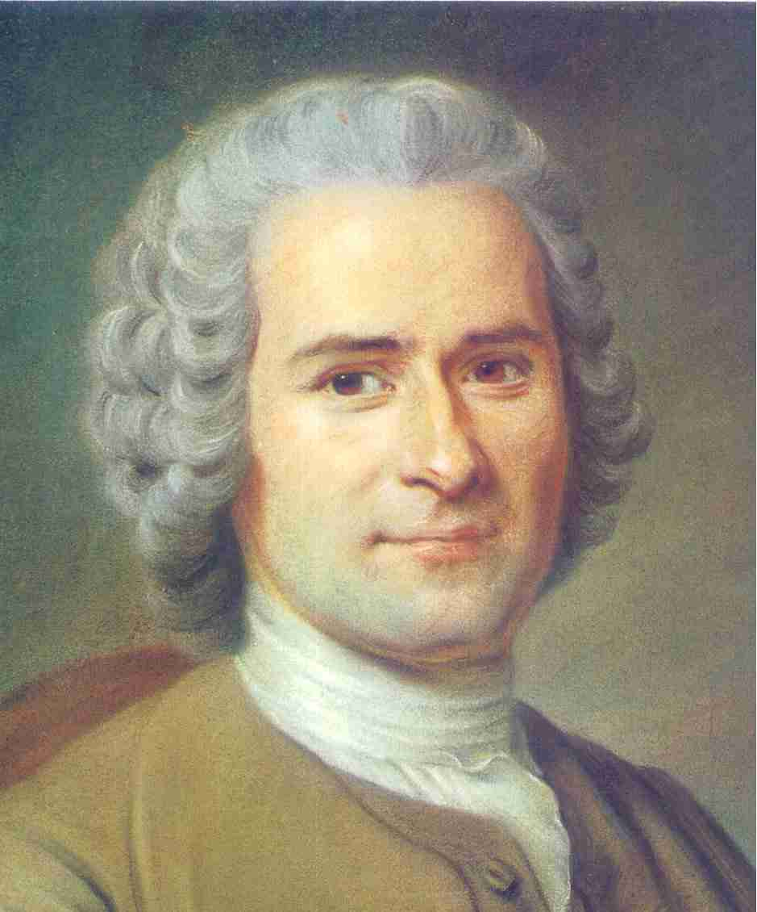
JEAN JACQUES Rousseau
The Social Contract
Man is basically good, society corrupts him
Education
Jean-Jacques Rousseau, by Maurice Quentin de la Tour, 1753. San Quentin: Musée Antoine Lécuyer retrieved from http://academic.shu.edu/honors/rousseau.jpg
(1712-1788)

Slide 19
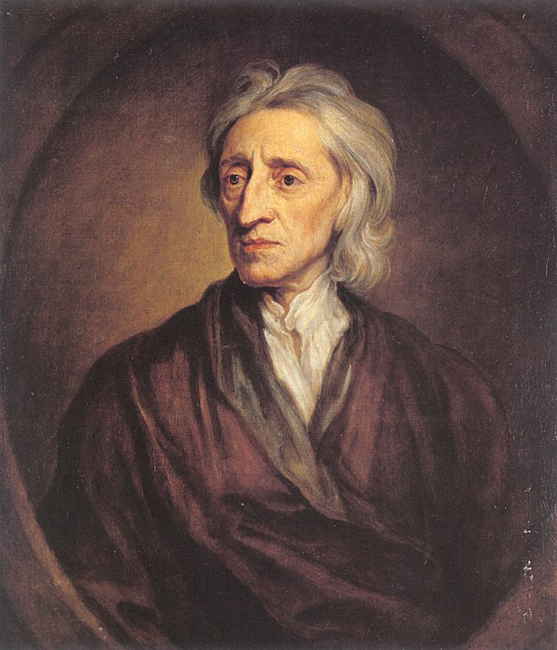
JOHN LOCKE
Two Treatises of Government
Natural Rights – Life, Liberty & Property
Right to govern comes from consent of the people who want their natural rights protected
Right to rebel against an unjust government
(1632-1704)
John Locke, by Sir Godfrey Kneller. St. Petersburg: State Hermitage Museum retrieved from http://academic.shu.edu/honors/John_Locke_Kneller.jpg

Slide 20
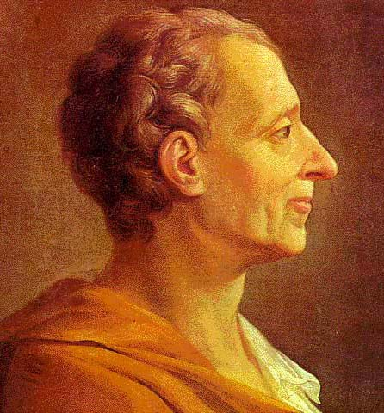
Charles-Louis De MONTESQUIEU
The Spirit of Laws
3 branches of government
Separation of powers
“checks & balances”
(1689-1755)
Picture retrieved from http://eweb.furman.edu/~pecoy/f411/authors/images/montesquieu/portrait1.jpg

Slide 21
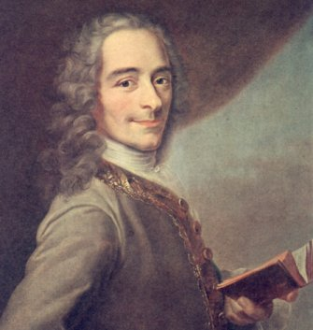
François Marie VOLTAIRE
Dictionnaire philosophique
Religious tolerance
Thought faith leads to fanaticism & savagery
Deist – saw God as a “divine clockmaker”
(1694-1778)
Picture retrieved from http://nzr.mvnu.edu/faculty/trearick/english/rearick/readings/authors/specific/voltaire.htm

Slide 22
Previous Religious Conflicts that probably influenced Voltaire
Crusades – Christians v. Muslims over Holy Land
Inquisition – Church court punished heretics
Thirty Years’ War – Protestants v. Catholics

Slide 23
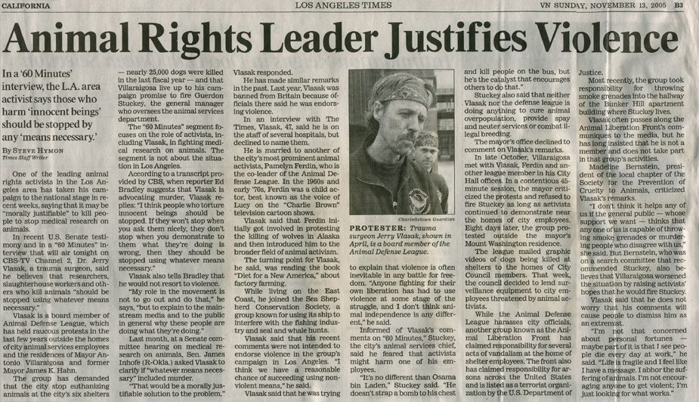
Examples of Religious Fanaticism in modern times

Slide 24
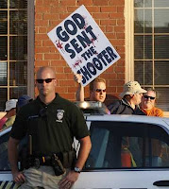
Attacks on Abortion Clinics & Doctors

Slide 25
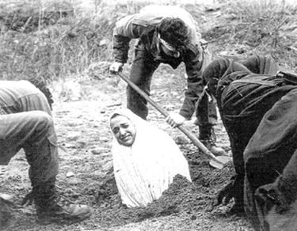
Iran – Stoning girls to death for “adultery”
Picture retrieved from http://www.dailymail.co.uk/news/article-467588/Iranian-wife-faces-death-stoning-adultery.html

Slide 26
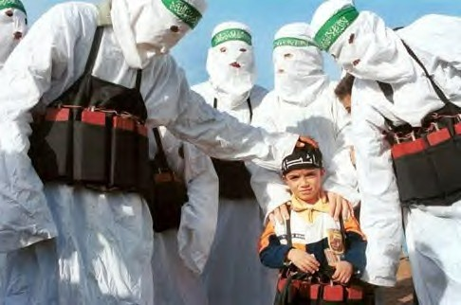
Hamas in Palestine
Picture retrieved from http://www.examiner.com/article/hamas-children-s-summer-camps-teach-palestinian-kids-terror-tactics

Slide 27
Voltaire supported idea of “Enlightened Despots”
Distrusts democracy – the masses are stupid
Frederick the Great – said he was 1st servant of the state instead of saying “I am the state”

Slide 28
FEDERAL GOVERNMENT
Division of power
  Local – city, county, town
  State
  Central

Slide 29
CONFEDERATION
European Union – best example today
  Central government has limited power most of the power lies with the state governments
  Historical examples: U.S. under the Articles of Confederation & South during the Civil War

Slide 30
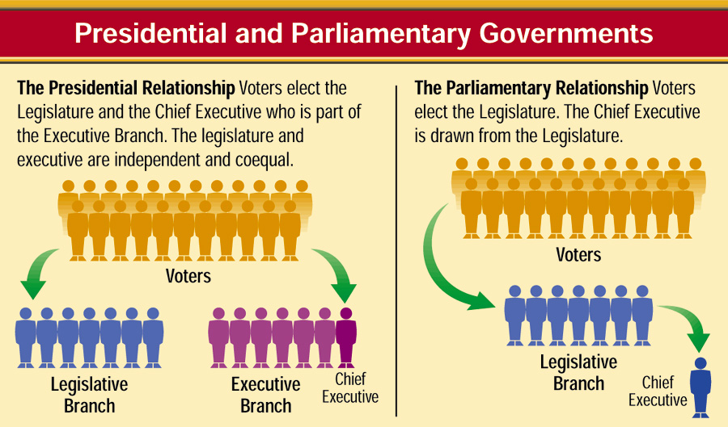
PRESIDENTIAL VS. PARLIAMENTARY
Elected President
Prime Minister (executive) chosen by the legislature or the party in power in the legislature & can be removed by them at any time
Chart retrieved from http://www.dsusd.k12.ca.us/users/kevin.husen/AmericanGov/Book/iText/products/0-13-251359-5/ch1/ch1_s2_4.html

Slide 31
FOUNDATIONS OF DEMOCRACY
Worth & dignity of the individual
Equality for all
Majority rule but minority rights
Compromise
Personal/individual freedom

Slide 32
FREE ENTERPRISE
Capitalism – supply & demand
Mixed economy – private &public

Slide 33
ORIGINS OF U.S. GOVERNMENT
The Magna Carta – King John
  Trial by jury
  Due process
  Limited the power of the Monarch – not absolute
  Can’t be imprisoned unless found guilty by trial of peers
Petition of Rights – Charles I
  Imprisonment based on laws
  No quartering
  No martial law
  King must obey the law
English Bill of Rights – William & Mary
  Fair trial
  No excessive bail
  No cruel & unusual punishment
  Right to petition king

Slide 34
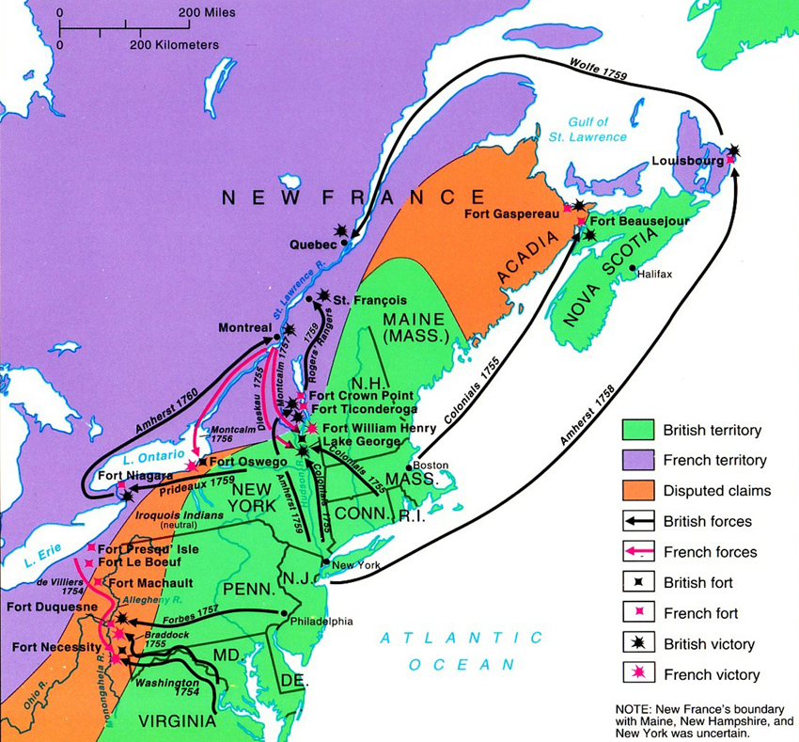
The Albany Plan of Union
7 Northern Colonies
  Discussion of trade problems & Indian attacks
  Ben Franklin proposes an annual congress of delegates from all colonies – power to raise troops, regulate trade, tax, etc.
Map retrieved from http://faculty.umf.maine.edu/walter.sargent/public.www/web%20103/7-YR-War-map.jpg

Slide 35
FRENCH AND INDIAN WAR
Salutary neglect – Britain’s unofficial & long-lasting policy of not enforcing all laws in the colonies & allowing the colonists to fend for themselves
  This changed after the war
Increased taxation on colonists to pay for war effort

Slide 36
FIRST CONTINENTAL CONGRESS
Sept. 5 – Oct. 26, 1774
Met in response to the Coercive Acts or “Intolerable Acts”
  These acts closed Boston Harbor & required colonists to quarter British troops
1774 – All colonies have representatives except GA
Sent a “declaration of rights” to King George
Embargo against Britain

Slide 37
SECOND CONTINENTAL CONGRESS
May 10, 1775 – March 1, 1781
After the battles of Lexington & Concord
Continental Army is created – George Washington chosen as commander
Thomas Jefferson – Declaration of Independence
Served as our 1st national govt.

Slide 38
STATE CONSTITUTIONS
Each state had one
Common features
  Popular sovereignty
  Limited government
  Separation of powers – “checks & balances”
  Civil rights & liberties

Slide 39
American Revolution Interactive Timeline

Slide 40
Additional References
Magruder, Frank Abbott. Magruder's American Government. Needham, MA: Prentice Hall, 2002. Print.

