Slide 1
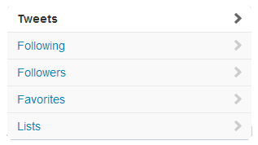
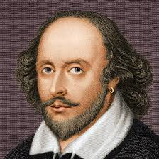
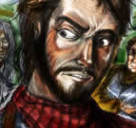
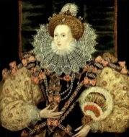
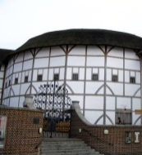
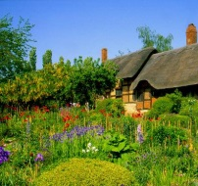
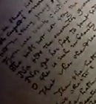
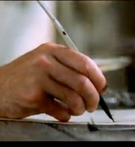
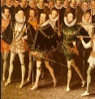
William Shakespeare
@willyshakes
Writes the occasional story and poem
London, UK – http://www.thebard.com
William Shakespeare
@willyshakes
14,234
5,321
3,445,234
William Shakespeare @willyshakes 3m
@QueenLizOne I hope you’ll like my latest work
William Shakespeare @willyshakes 2d
Oh the darling buds of May! #teaser
Expand
Lord Chamberlain’s Men @lordCmen 2d
Come down to #theglobe tonight for our final performance of Titus Andronicus
Retweeted by William Shakespeare
#theplague
William Shakespeare @willyshakes 1w
@MrsShakespeare I miss you too…not!
William Shakespeare @willyshakes 1w
@ChrisMarlowe What would you know!?!?!? #idiot

